Slide 1
CE-431
Irrigation Engineering
Lecture #1: Introduction

Slide 2
Course Outline
Introduction: Definition and types of irrigation. Merits and demerits of irrigation, Indus basin irrigation system.
Water Resources: Planning and development of water resources projects. Water resources in Pakistan.
Canal Irrigation: Elementary concept about canal head works, selection of their site and layout, weirs and barrages, various components and functions. Measures adopted to control silt entry into canals, silt ejectors and silt excluders. Design of weirs on permeable foundations, sheet piles and well foundations, cut off walls. Design of irrigation channels, Kennedy’s and Lacey’s theories. Rational methods for design of irrigation channels. Comparison of various methods. Computer Aided design of irrigation channels.
Irrigation Works: Canal head regulators, falls, meter flumes, canal outlets. Cross drainage works: types and functions. Canal lining: advantages and types. Maintenance of irrigation canals.
Irrigated Agriculture: Water requirements of crops, duty of irrigation water. Delta of crops, consumptive use, estimation of consumptive use, methods used for assessment of irrigation water. Irrigation methods and practices. Management of irrigation systems, various approaches, participatory irrigation management.
Water logging and salinity: Definition, field capacity, wilting point, hygroscopic moisture etc. Causes and effects of water logging, reclamation of water logged soils. Drains and tube wells. Causes and effects of salinity and alkalinity of lands in Pakistan. Reclamation methods. Drainage network in irrigated areas.

Slide 3
Reference Books
Irrigation and Hydraulic Structures: Theory, Design and Practice, 4th ed, 2010.
  By Dr. Iqbal Ali
Hydraulic Structures, 4th ed.
  By Novak, P., Moffat, I.B. and Nalluri
Irrigation Water management: Principles and Practice
  By Majumdar, Dilip Kumar
Irrigation Engineering and Hydraulic Structures, 14th ed.
  By S.K. Garg

Slide 4
Evaluation Methodology
Theory:
  Mid Semester Exam: (Close Book), Weightage: 30 %
  Quiz I: Weightage: 10 %
  Quiz II Weightage: 10 %
  Class Participation + Attendance: 10%
  End Semester Exam: (Close Book), Weightage: 40 %
Part-II:
  Lab Report & Viva Voce: 60 %
  Lab Quizes: 30 %
  Lab Attendance: 10 %

Slide 5
Lecture Delivery Plan
Week 1 | Definition and types of irrigation. Merits and demerits of irrigation, Indus basin irrigation system. Planning and development of water resources projects. Water resources in Pakistan.
Week 2 | Design of irrigation channels, Kennedy’s and Lacey’s theories. Rational methods for design of irrigation channels. Comparison of various methods.
Week 3 | Design of irrigation channels, Kennedy’s and Lacey’s theories. Rational methods for design of irrigation channels. Comparison of various methods.
Week 4 | Design of irrigation channels, Kennedy’s and Lacey’s theories. Rational methods for design of irrigation channels. Comparison of various methods.
Week 5 | Water requirements of crops, duty of irrigation water. Delta of crops, consumptive use, estimation of consumptive use, methods used for assessment of irrigation water field capacity, wilting point, hygroscopic moisture etc
Week 6 | Water requirements of crops, duty of irrigation water. Delta of crops, consumptive use, estimation of consumptive use, methods used for assessment of irrigation water field capacity, wilting point, hygroscopic moisture etc
Week 7 | weirs and barrages, various components and functions, Design of weirs on permeable foundations, sheet piles and well foundations, cut off walls
Week 8 | weirs and barrages, various components and functions, Design of weirs on permeable foundations, sheet piles and well foundations, cut off walls
Week 9 | Quiz 1 + Mid Semester Exam

Slide 6
Lecture Delivery Plan
Week 10 | Canal lining: advantages and types. Maintenance of irrigation canals. Irrigation methods and practices
Week 11 | Measures adopted to control silt entry into canals, silt ejectors and silt excluders
Week 12 | Canal head regulators, falls, meter flumes, canal outlets. Cross drainage works: types and functions
Week 13 | Canal head regulators, falls, meter flumes, canal outlets. Cross drainage works: types and functions
Week 14 | Canal head regulators, falls, meter flumes, canal outlets. Cross drainage works: types and functions
Week 15 | Causes and effects of water logging, reclamation of water logged soils. Drains and tube wells.
Week 16 | Causes and effects of salinity and alkalinity of lands in Pakistan. Reclamation methods. Drainage network in irrigated areas.
Week 17 | Drains and tube wells. participatory irrigation management
Week 18 | Quiz 2 + End Semester Exam

Slide 7
Course Learning Outcomes (CLOs)
After completion of this course, the students will be able to:
CLO | Description | PLO
1 | Describe current and historical development of Pakistan’s Water Resources, major treaties, and accords related to water resources. Problems and the possible solutions faced by agricultural sector of Pakistan (water logging, silt control in canal, canal maintenance etc.). | Knowledge
2 | Plan and design gravity irrigation system, Lined/unlined canals and allied small structures (falls, outlets) considering water availability and cropwater requirements. | Design
3 | Analyze and Design irrigation structures including Barrage/Head works, Head regulators, and Cross-Drainage works (Aqueduct, etc.). | Analysis

Slide 8
Introduction
Definition of Irrigation:
“Artificial application of water on an agricultural land for the assured growth of plant life” (Priyani 1979).
“Science of Artificial Application of Water to the land, in accordance to the ‘crop requirements’, through out the ‘crop period’ for full fledge nourishment of crop” (SK GARG, 1999)
“Irrigation is the art of applying water to the land by artificial means to fulfill the water requirement of crops in the areas where rainfall is insufficient.” (Iqbal Ali, 2010)
Rainfed Agriculture vs. Irrigated Agriculture?

Slide 9
Why Irrigation is Required/ advantages
Non-Uniform Rainfall
  Sometimes rainfall is sufficient but non-uniform with time and place. Like Monsoon season etc.
Augmentation of crop yield
  New high yielding varieties have higher water requirement. e.g sugarcane and rice need more water.
Exacting water requirement
  High yielding varieties need exact amount of water. Excessive water lead to lesser yield
Cash Crop Cultivation
  Cash crops require higher and assured supply of water with frequent water for maturity
Assured Water Supply
  Right amount of water at right time is a key to For successful farming.
Orchards and Gardens
  Fruit trees in orchards and gardens have higher requirement of water.

Slide 10
Disadvantages
Over irrigation may lead to waterlogging(Waterlogging refers to the saturation of soil with water. Soil may be regarded as waterlogged when the water table of the ground wateris too high to conveniently permit an anticipated activity, like agriculture.)
Poor maintenance and malfunctioning may lead to breaching and flooding
Number of X-drainage works required

Slide 11
HISTORY

Slide 12
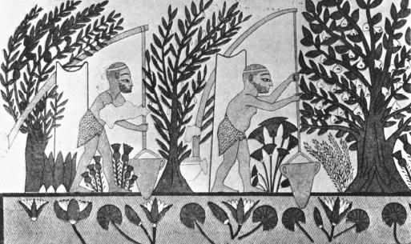
History of irrigation
It was only during the Holocene epoch (10,000 years ago) that the development of agriculture occurred, keeping in mind that the Earth and solar system are 4.6 billion years old
Only in the past 9,000 to 10,000 years have humans discovered how to raise crops and tame animals
The first successful efforts to control the flow of water were made in Mesopotamia and Egypt, where the remains of the prehistoric irrigation works still exist
In ancient Egypt, the construction of canals was a major endeavor of the pharaohs and their servants
This frieze (c. 2000 B.C.E. ) depicts Egyptians using water from the Nile River for irrigation.
Notes:
Holocene = recent
Epoch = beginning of an era in history
Frieze = picture

Slide 13
History of irrigation
The Sumerians (~2500 BC) in southern Mesopotamia built city walls and temples and dug canals that were the world's first engineering works.
It is also of interest that these people, from the beginning of recorded history, fought over water rights
The Assyrians (~1000 BC) also developed extensive public works. Sargon II, invading Armenia in 714 B.C.E. , discovered the qanat (Arabic name) or karaiz (Persian name), which is a tunnel used to bring water from an underground source in the hills down to the foothills. Sargon destroyed the area in Armenia but brought the concept back to Assyria for irrigation
Sophisticated irrigation and storage systems were also developed by the Indus Valley Civilization in present-day Pakistan and North India, including the reservoirs at Girnar in 3000 BCE(before common era) and an early canal irrigation system from Circa 2600 BCE
Mesopotamia, is Greek word which means for "the land between the rivers."

Slide 14
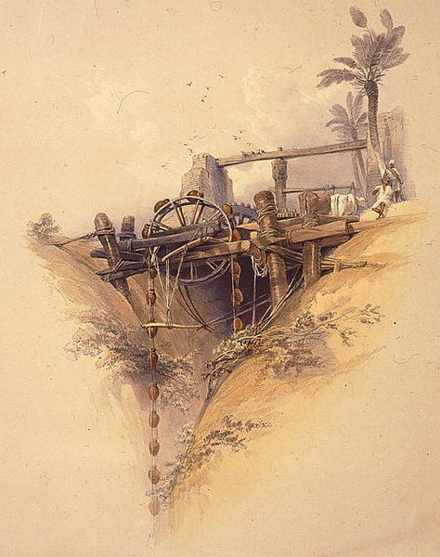
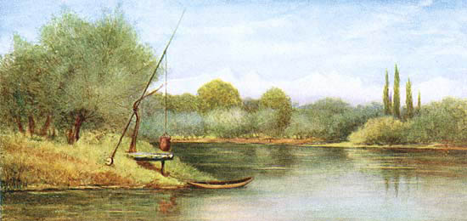
History of irrigation
An example of irrigation system common in Indian subcontinent. Artistic impression on the banks of Dal Lake, Kashmir, India.
Animal-powered irrigation, Upper Egypt, ca. 1840

Slide 15
Components of Irrigation System

Slide 16
Components of Irrigation system
Irrigation system consists of
  1.Storage or diversion
  2.Conveyance of irrigation water
  3.Distribution and application of irrigation water
  4.Drainage of excess water

Slide 17
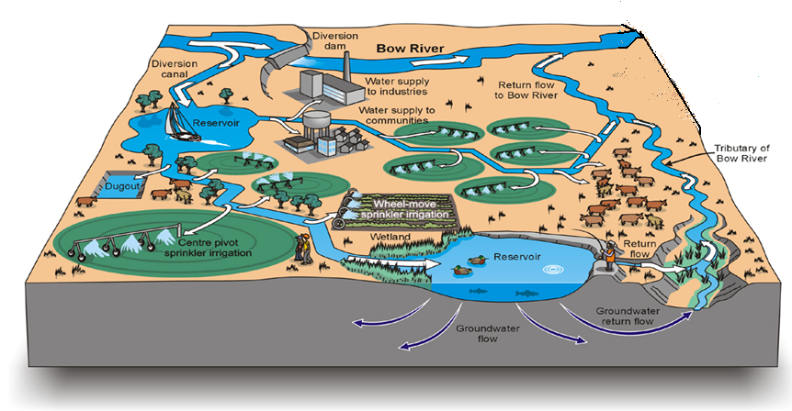
Components of Irrigation system

Slide 18
Components of Irrigation system
1.Storage or diversion
  Dams
  Headworks/Barrages/Weirs
Headwork: Headwork is a combination of weir or barrage and canal head regulator. Barrage is a part of Headwork.
Headworks is a civil engineering term for any structure at the head or diversion point of a waterway. It is smaller than a barrage and is used to divert water from a river into a canal or from a large canal into a smaller canal.

Slide 19
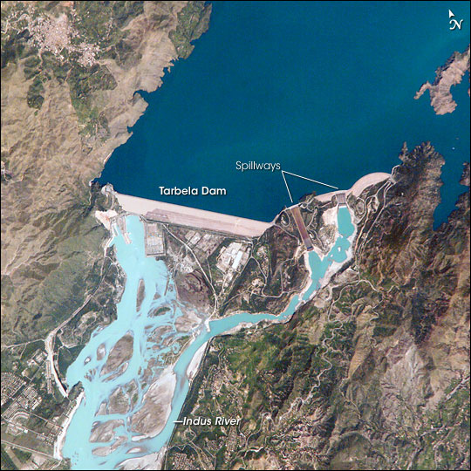
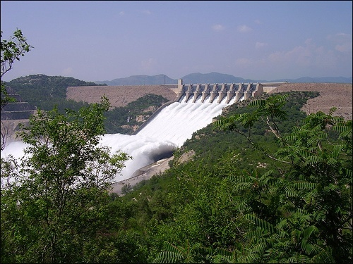
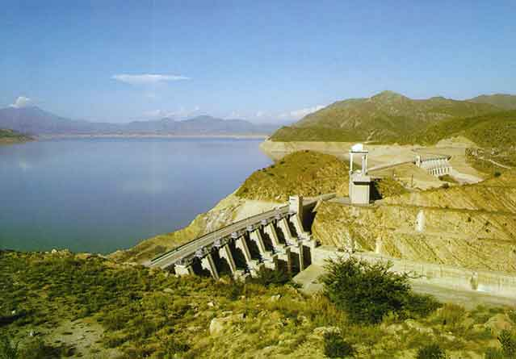
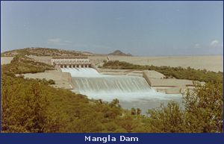
Components of Irrigation system
Storage or diversion
Tarbela Dam: Earth and Rockfill Dam
Mangla Dam: Earthfill

Slide 20
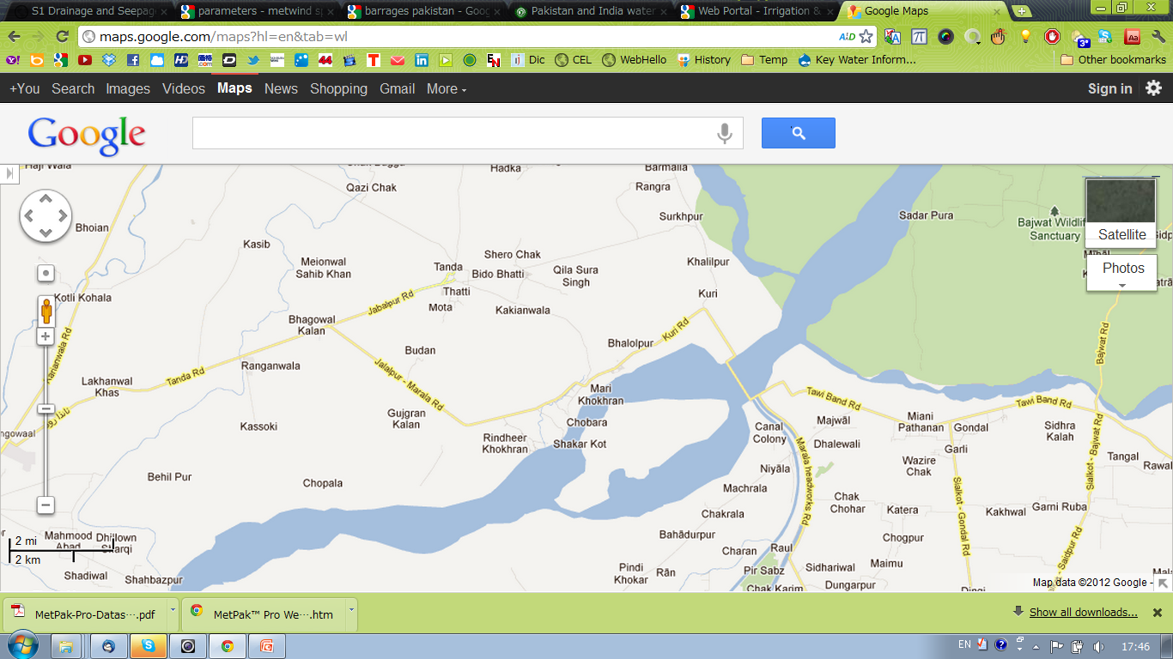
Components of Irrigation system
Storage or diversion
Munawar tawi
Jammu tawi
MR Link Canal
UCC
Maralla headworks

Slide 21
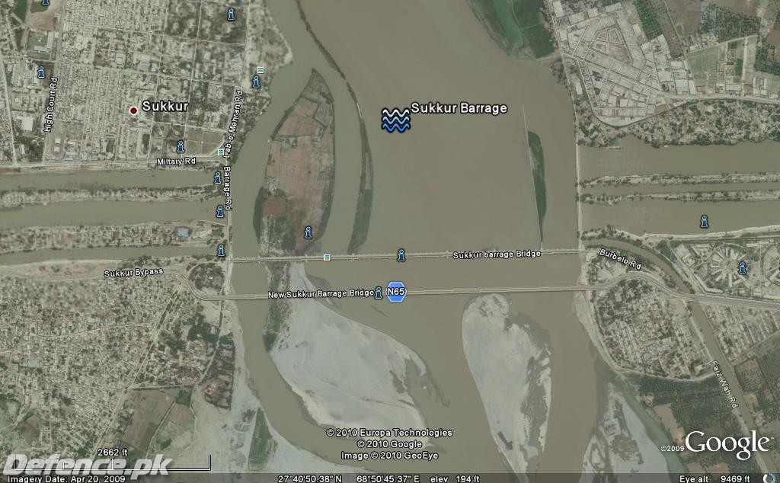
Components of Irrigation system
Storage or diversion
North West Canal
Rice Canal
Dadu Canal
Nara Canal
Khairpur East Canal
Rohi Canal
Khairpur West Canal

Slide 22
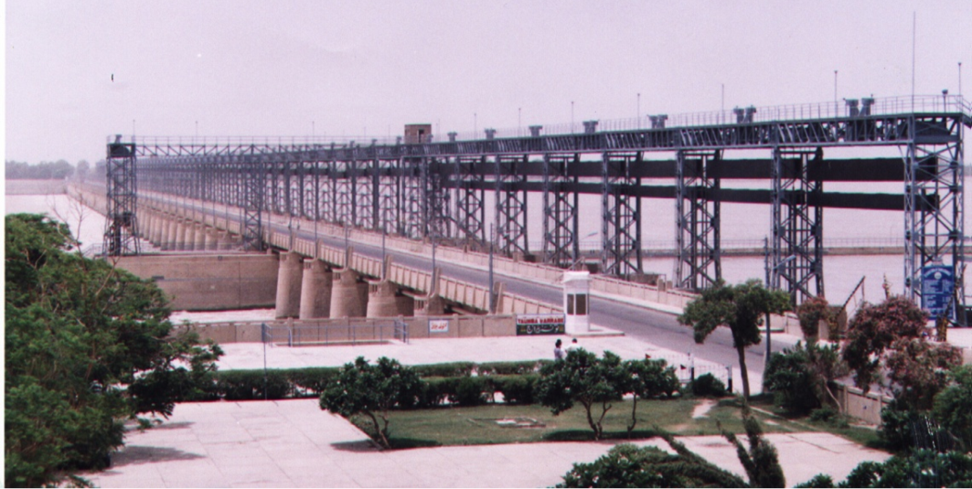
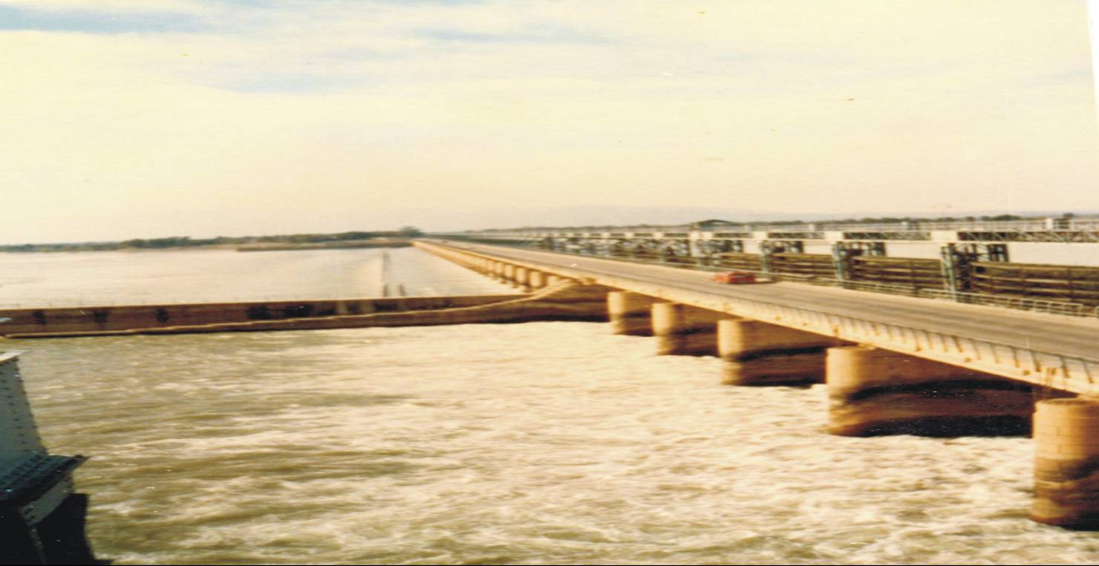
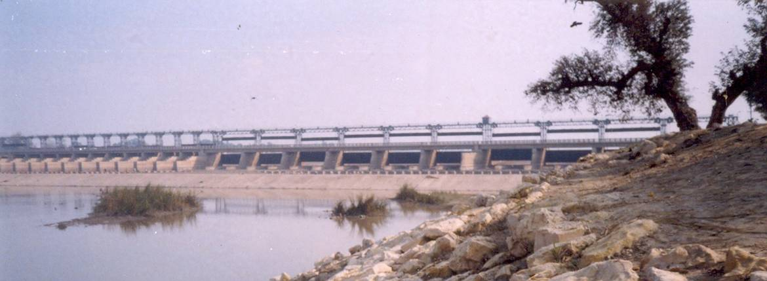
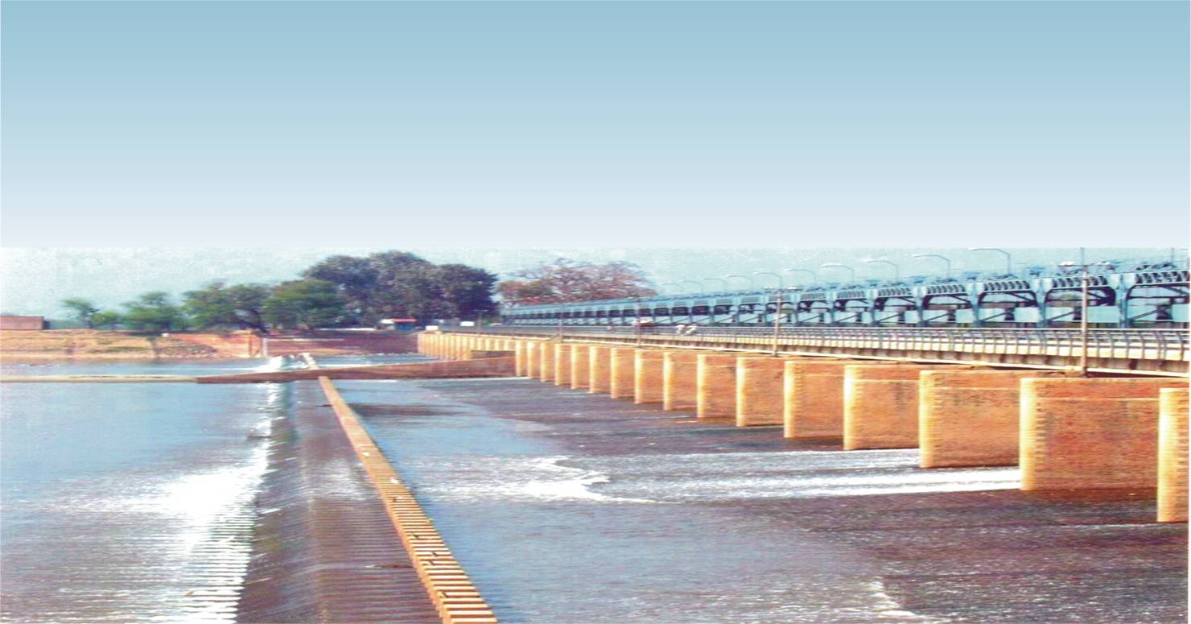
Components of Irrigation system
Storage or diversion
TAUNSA BARRAGE
JINNAH BARRAGE
ISLAM BARRAGE
BALLOKI BARRAGE

Slide 23
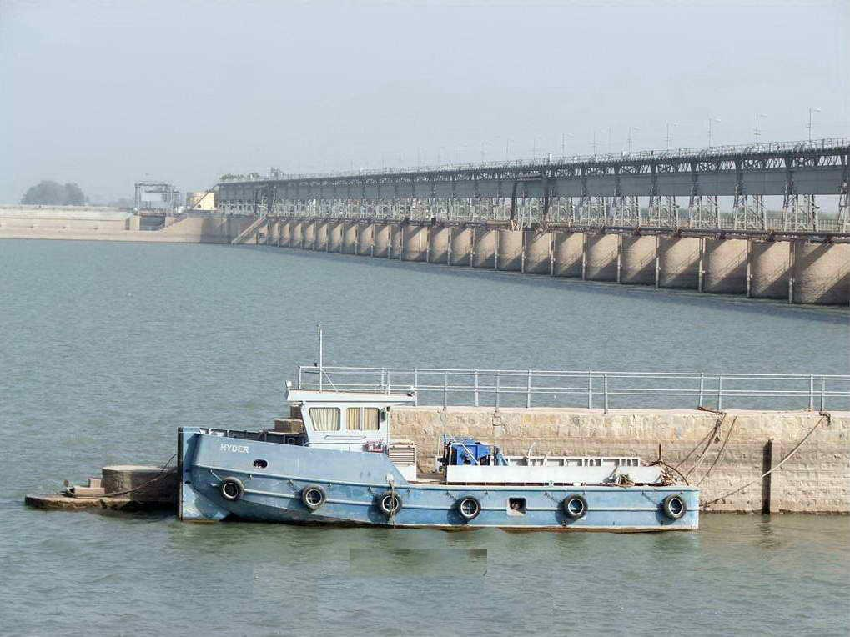
Kotri Barrage

Slide 24
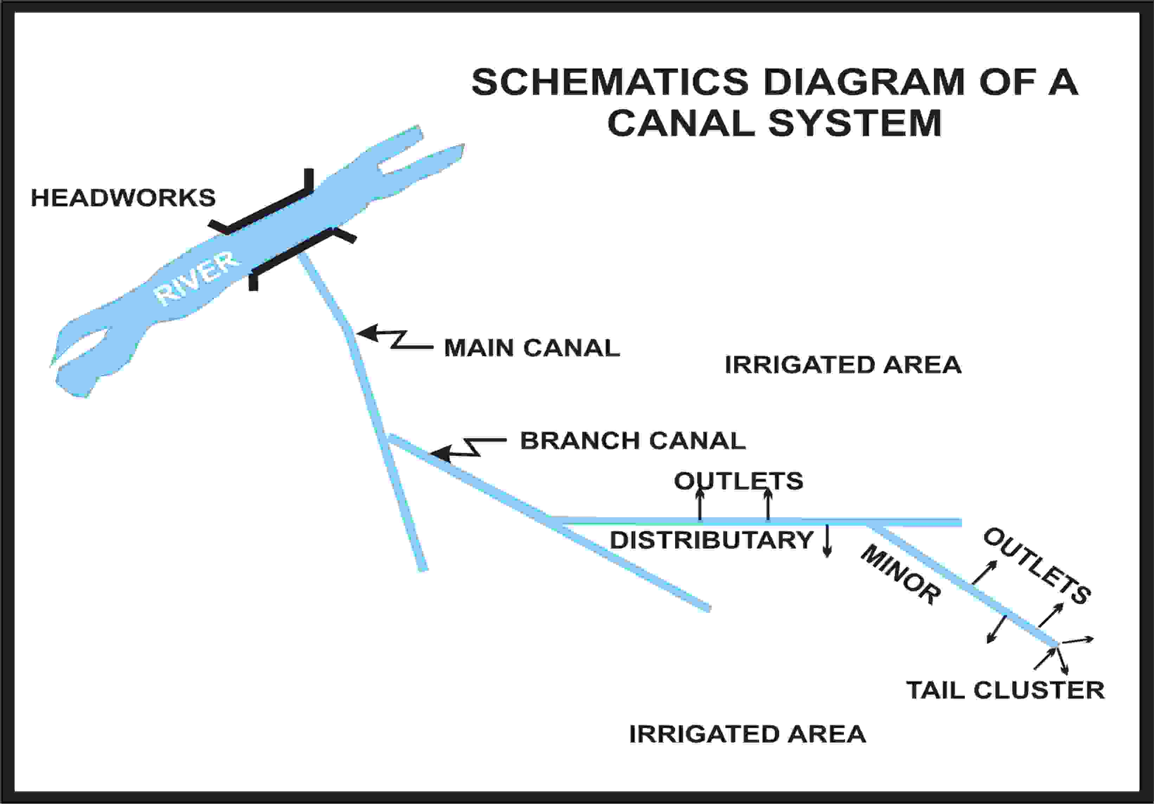
Components of Irrigation system
2.Conveyance of irrigation water

Slide 25
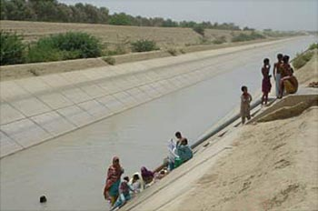
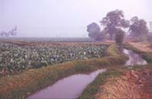
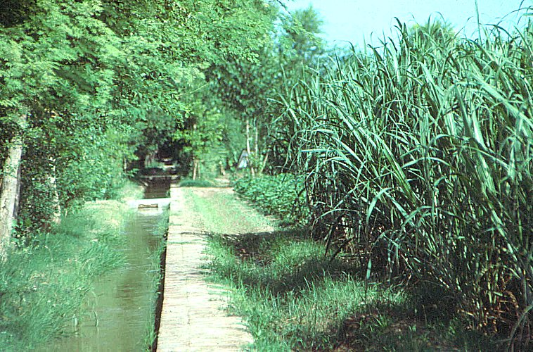
Components of Irrigation system
Conveyance of irrigation water
Chashma Right Bank Canal
Watercourses

Slide 26
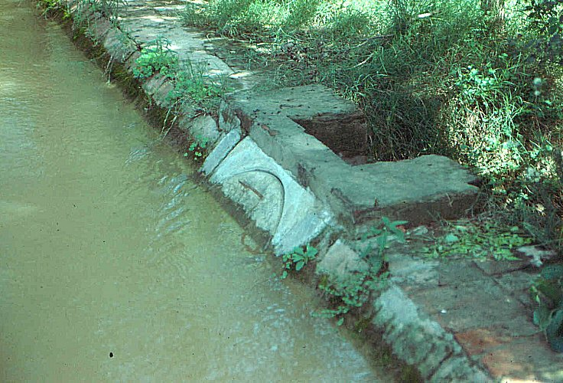
Components of Irrigation system
3.Distribution and application of irrigation water
  Warabandi is a rotational method for equitable distribution of the available water in an irrigation system by turns fixed according to predetermined schedule specifying the day, time and duration of supply to each irrigator in proportion to size of his land holding in the outlet command.(Singh 1981, Malhotra 1982)
  The term WARABANDI means turns (Wahr) which are fixed (bandi)
Pakka Watercourse
Pakka Nakka

Slide 27
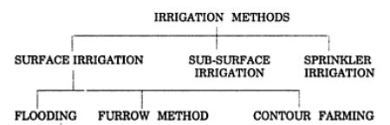
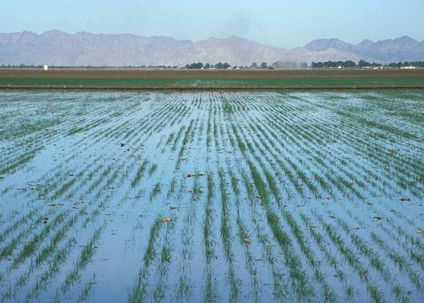
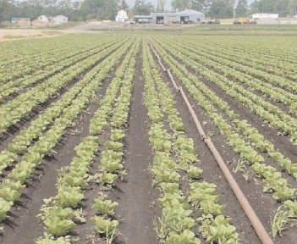
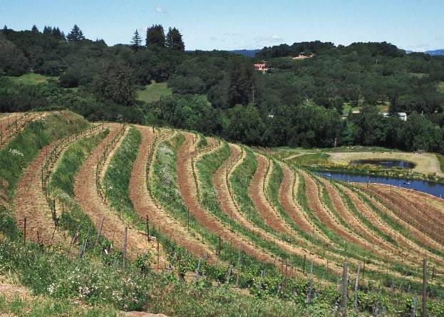
Components of Irrigation system
Distribution and application of irrigation water
Surface Irrigation system: Flooding
Furrow Irrigation system
Contour farming

Slide 28
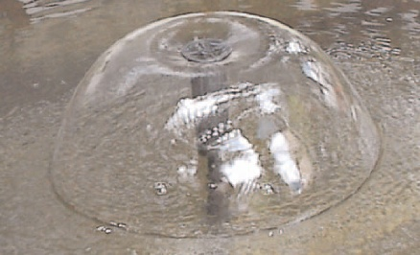
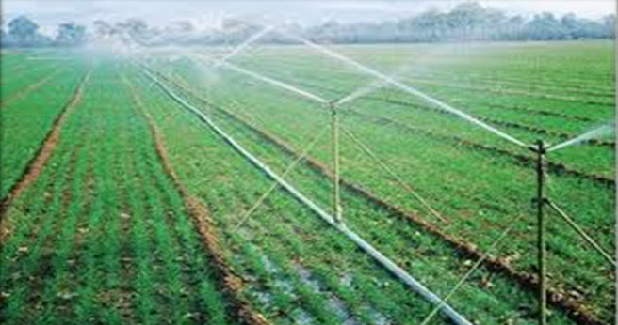
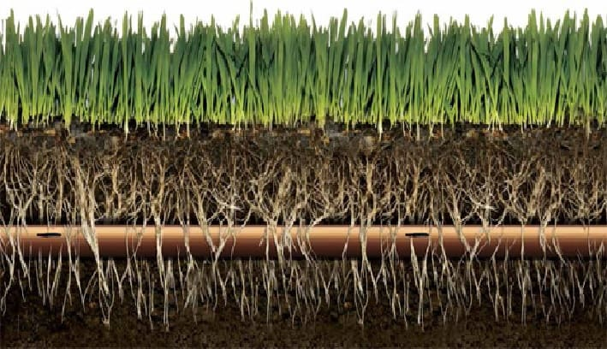
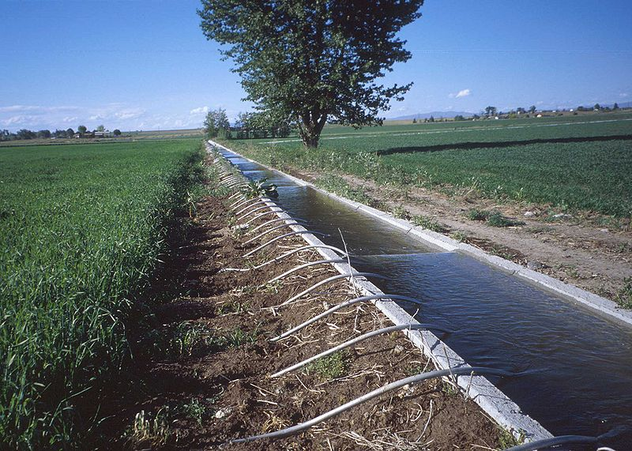
Components of Irrigation system
Distribution and application of irrigation water
Bubble Irrigation System
Sprinkler irrigation system
Subsurface irrigation system
Furrow irrigation system using siphon tubes

Slide 29
IRRIGATION METHODS
Surface irrigation is defined as the group of application techniques where water is applied and distributed over the soil surface by gravity. It is by far the most common form of irrigation throughout the world and has been practiced in many areas virtually unchanged for thousands of years.
  Flood irrigation is an ancient method of irrigating crops. It was likely the first form of irrigation used by humans as they began cultivating crops and is still one of the most commonly used methods of irrigationused today.
  Furrow irrigation is conducted by creating small parallel channels along the field length in the direction of predominant slope. Water is applied to the top end of each furrow and flows down the field under the influence of gravity.
  Contour farming is growing crops "on the level" across or perpendicular to a slope rather than up and down the slope. The rows running across the slope are designed to be as level as possible to facilitate tillage and planting operations on the contour.
  Subsurface irrigation is a highly-efficient watering technique that reduces outdoor water use by 30 to 40 percent. The system consists of drip irrigation tubing planted about five inches below the surface. The water goes straight to your lawn's roots, and it doesn't blow away or run down the sidewalk.
Subsurface drip irrigation is a low-pressure, high efficiency irrigation system that uses buried drip tubes or drip tape to meet crop water needs. Subsurface irrigation saves water and improves yields by eliminating surface water evaporation and reducing the incidence of weeds and disease.
Sprinkler irrigation is a method of applying irrigation water which is similar to natural rainfall. Water is distributed through a system of pipes usually by pumping. It is then sprayed into the air throughsprinklers so that it breaks up into small water drops which fall to the ground.

Slide 30
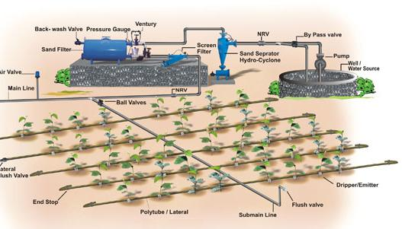
Components of Irrigation system
Drip irrigation is a type of micro-irrigation that has the potential to save water and nutrients by allowing water to drip slowly to the roots of plants, either from above the soil surface or buried below the surface
Drip Irrigation system

Slide 31
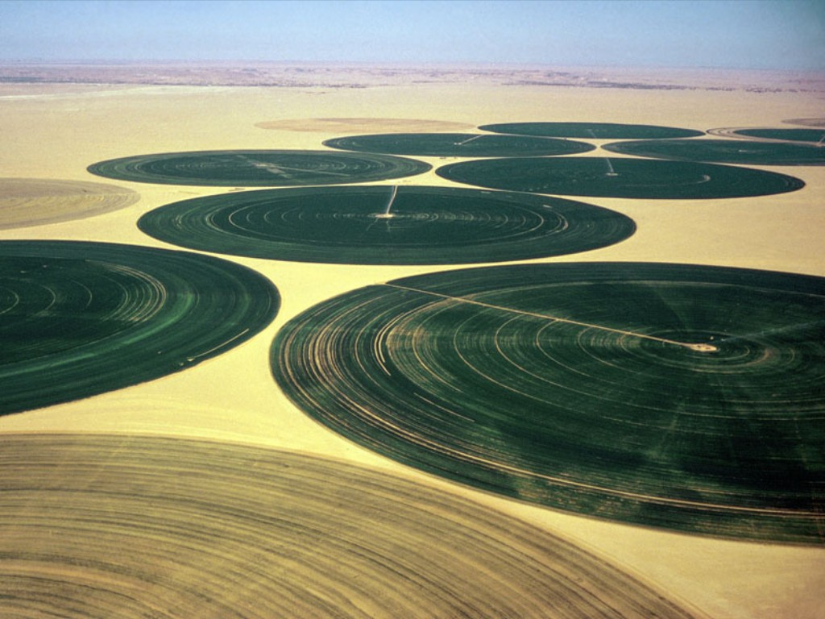
Components of Irrigation system
Center-pivot irrigation (sometimes called central pivot irrigation), also called waterwheel and circle irrigation, is a method of crop irrigation in which equipment rotates around a pivot and crops are watered with sprinklers.
Central Pivotal Irrigation system

Slide 32
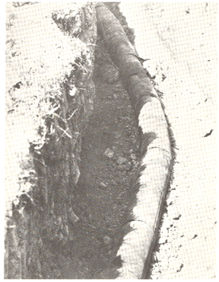
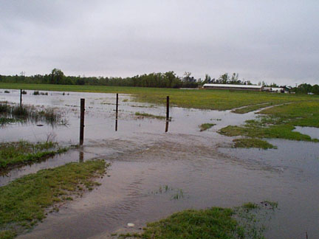
Components of Irrigation system
4.Drainage of excess water
Tile Drain
Ditching
Flooded crop land

Slide 33
Irrigation Water Quality

Slide 34
Constituents of irrigation water
Major Nutrients:
  Primary: Nitrogen, phosphorous, potassium,
  Secondary: Calcium, magnesium and sulphar
Micronutrients:
  Carbon, hydrogen, oxygen, iron, zinc, manganese, boron, copper
Sodium & excess Potassium are injurious to plant and reduces soil permeability`
Excess Calcium and Magnesium are not hazardous rather improve soil permeability.
Excess Nitrogen improves Fruit size
Chloride and Sulphats are injurious to plant
Water with nitrates and bicarbonate of calcium and magnesium is good for irrigation
Tables 2.5, 2.6 in Irrigation and Hydraulic Structures by Iqbal Ali, provide classification of irrigation water from excellent to hazardous, with respect of salts in water
Groundwater with total salt content upto 1000 ppm is
considered fit for crops, 1000 ppm to 3000 ppm to be used
after mixing with canal water, and more than 3000 ppm is hazardous.

Slide 35
IBIS

Slide 36
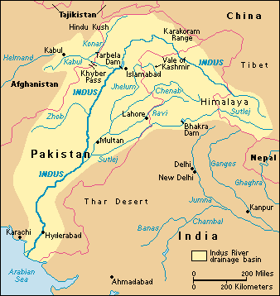
Indus Basin Irrigation System
Irrigated agriculture in Pakistan is confined primarily to the Indus Plains.
As a result of extensive developments, Pakistan now possesses the world’s largest contiguous(connected) irrigation system commonly called the Indus Basin Irrigation System (IBIS).
Indus basin

Slide 37
History of Irrigation in Pakistan
19th Century
Controlled year round irrigation began in 1859 with the completion of the Upper Bari Doab Canal (UBDC) from Madhopur Headworks on Ravi River (now in India) .
UBDC was followed by Sirhind Canal from Rupar Headworks on Sutlej in 1872 (also in India).
Sidhnai Canal from Sidhnai Barrage on Ravi in 1886.
The Lower Chenab from Khanki on Chenab in 1892, and Lower Jhelum from Rasul on Jhelum in 1901 was constructed
Lower and Upper Swat, Kabul River and Paharpur Canals in KPK (NWFP) were completed between 1885 to 1914.

Slide 38
History of Irrigation in Pakistan
20th Century
TRIPLE CANAL PROJECT (1907-15)
Ravi River, serving a large area of Bari Doab, was deficient in supply while Jhelum had a surplus.
An innovative solution was developed in the form of the Triple Canal Project, constructed during 1907 -1915.
The project linked the Jhelum, Chenab, and Ravi rivers, allowing a transfer of surplus Jhelum and Chenab water to the Ravi.
The Triple Canal Project as a land-mark in integrated inter basin water resources management and also provided the key concept for the resolution of the Indus Waters Dispute between India and Pakistan in 1960.

Slide 39
History of Irrigation in Pakistan
20th Century
The Sutlej Valley Project, comprising of 4 barrages and 2 canals, was completed in 1933, resulting in the development of the unregulated flow resources of the Sutlej River and motivated planning for the Bhakra reservoir (now in India).
During the same period, the Sukkur Barrage and its system of 7 canals serving 2.95 million hectares of land in Lower Indus were completed.
Haveli and Rangpur from Trimmu Headworks on Chenab in 1939 and Thal Canal from Kalabagh Headworks on Indus were completed in 1947.
This comprised the system inherited by Pakistan at the time of its creation in 1947.
During 1900-1962, the headworks / barrages constructed in Indus Plains comprised:
  Rasul on Jhelum (1901); Marala on Chenab (1912); Balloki on Ravi (1913); Ferozpur on Sutlej (1928); Suleimanki on Sutlej (1926); Islam on Sutlej (1927); Panjnad on Chenab (1932); Sukkur on Indus (1932); Trimmu on Chenab (1939); Kalabagh on Indus (1943/1946); Kotri on Indus (1955); Taunsa on Indus (1958); and Guddu on Indus (1962) (Ref: Izhar ul Haq’s Paper no 709, Pak Engg Congress.).

Slide 40
Indus Basin Treaty (1960)
At independence (1947) the irrigation system, conceived originally as a whole, was divided between India and Pakistan without regard to irrigated boundaries
This resulted in the creation of an international water dispute in 1948, which was finally resolved by the enforcement of Indus Waters Treaty in 1960 with the help of the World Bank
The treaty assigned three eastern rivers (Ravi, Beas, Sutlej) to India, and the three western rivers (Indus, Jhelum, Chenab) to Pakistan

Slide 41
INDUS BASIN PROJECTS
DAMS
i) Tarbela on River Indus
ii) Mangla on River Jhehlum
NEW BARRAGES
i) Chashma Barrage on River Indus
ii) New Rasul Barrage on River Jhehlum
iii) New Marala Barrage on River Chenab
iv) Qadirabad Barrage on River Chenab
v) New Sidhnai Barrage on River Ravi
vi) Mailsi Syphon on River Sutlej

Slide 42
INDUS BASIN PROJECTS
NEW LINK CANALS
i) Chashma Jhelum Link (C-J Link)
ii) Taunsa Panjnad Link (T-P Link)
iii) Rasul Qadirabad Link (R-Q Link)
iv) Qadirabad Balloki Link (Q-B Link)
v) Balloki Sulemanki Link II (B-S Link II)
vi) Trimmu Sidhnai Link (T-S Link)
vii) Sidhnai – Mailsi – Bahawal Link (S-M-B Link)
OLD BARRAGES REMODELLED
i) Trimmu Barrage
ii) Balloki Barrage

Slide 43
WATER APPORTIONMENT ACCORD (1991)
An agreement to share waters of the Indus River was reached among the four provinces of Pakistan in the form of the Water Apportionment Accord (WAA).
This accord is based on both, the existing and future water needs of the four provinces.
It has the following Purposes:
  It protected the existing uses of canal water in each province.
  It apportions the balance of river supplies, including flood surpluses and future storages among the provinces

Slide 44
WATER APPORTIONMENT ACCORD (1991)
Key features:
Province | Kharif (MAF) | Rabi (MAF) | Total (MAF)
Punjab | 37.07 | 18.87 | 55.94
Sindh * | 33.94 | 14.82 | 48.76
NWFP (a) | 3.48 | 2.3 | 5.78
(b) Civil Canals ** | 1.80 | 1.2 | 3.00
Balochistan | 2.85 | 1.02 | 3.87
Total | 77.34 | 37.01 | 114.35
** | 1.8 | 1.2 | 3
* Including already sanctioned Urban and Industrial uses for Metropolitan Karachi.
** Ungauged Civil Canals above the rim stations

Slide 45
WATER APPORTIONMENT ACCORD (1991)
The KPK (NWFP)/ Balochistan projects, under execution, were provided their authorized quota of water as existing uses.
Balance river supplies (including flood supplies and future storages) was to be distributed as below:
The need for storages, wherever feasible on the Indus and other rivers was admitted and recognized by the participants for planned future agricultural development.
Punjab | Sindh | Balochistan | NWFP | Total
37 | 37 | 12 | 14 | 100 %

Slide 46
Indus Basin Irrigation System
S.No | Item | Quantity
1. | Storage Reservoirs: Number Live Capacity (Designed) | 3 19.3 BCM (15.7 MAF)
2. | Barrages/Headworks/Syphons | 23
3. | Main Irrigation Canals: Numbers Commands Areas Length Including Distribution system | 45 14.2 Million hactre (35Million Acre) 60,800 km (38,000 miles)
4. | Watercourses: Number (Approximate) Length (Approximate) | 107,000 1.6 million km (1 million miles)

Slide 47
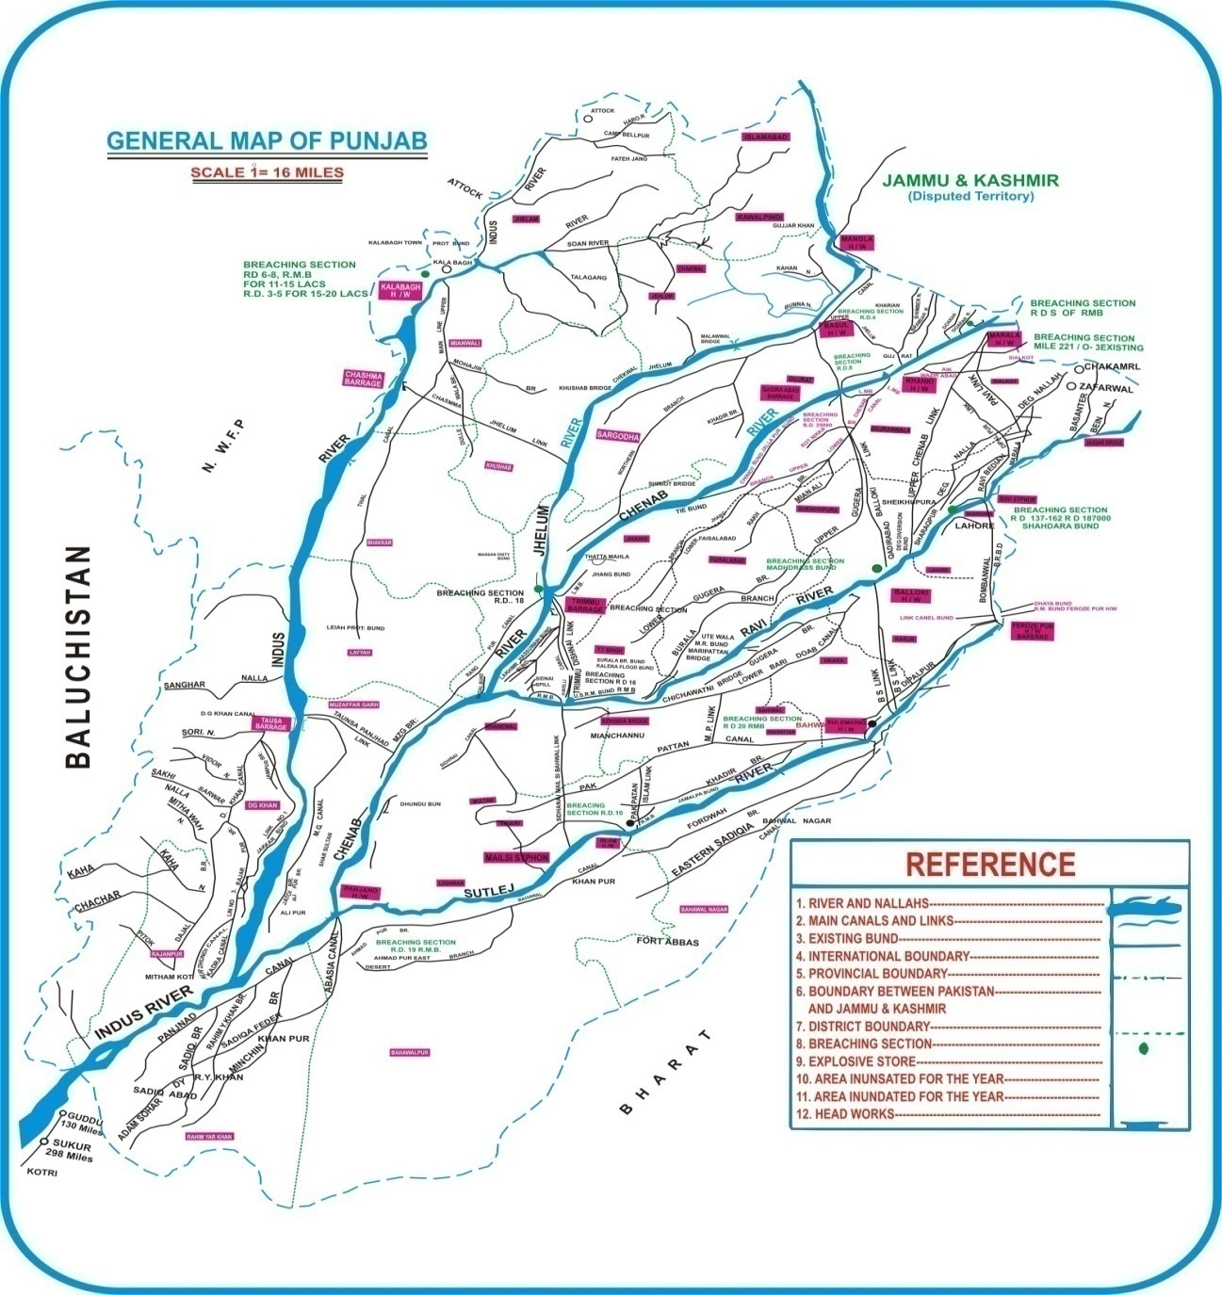

Slide 48
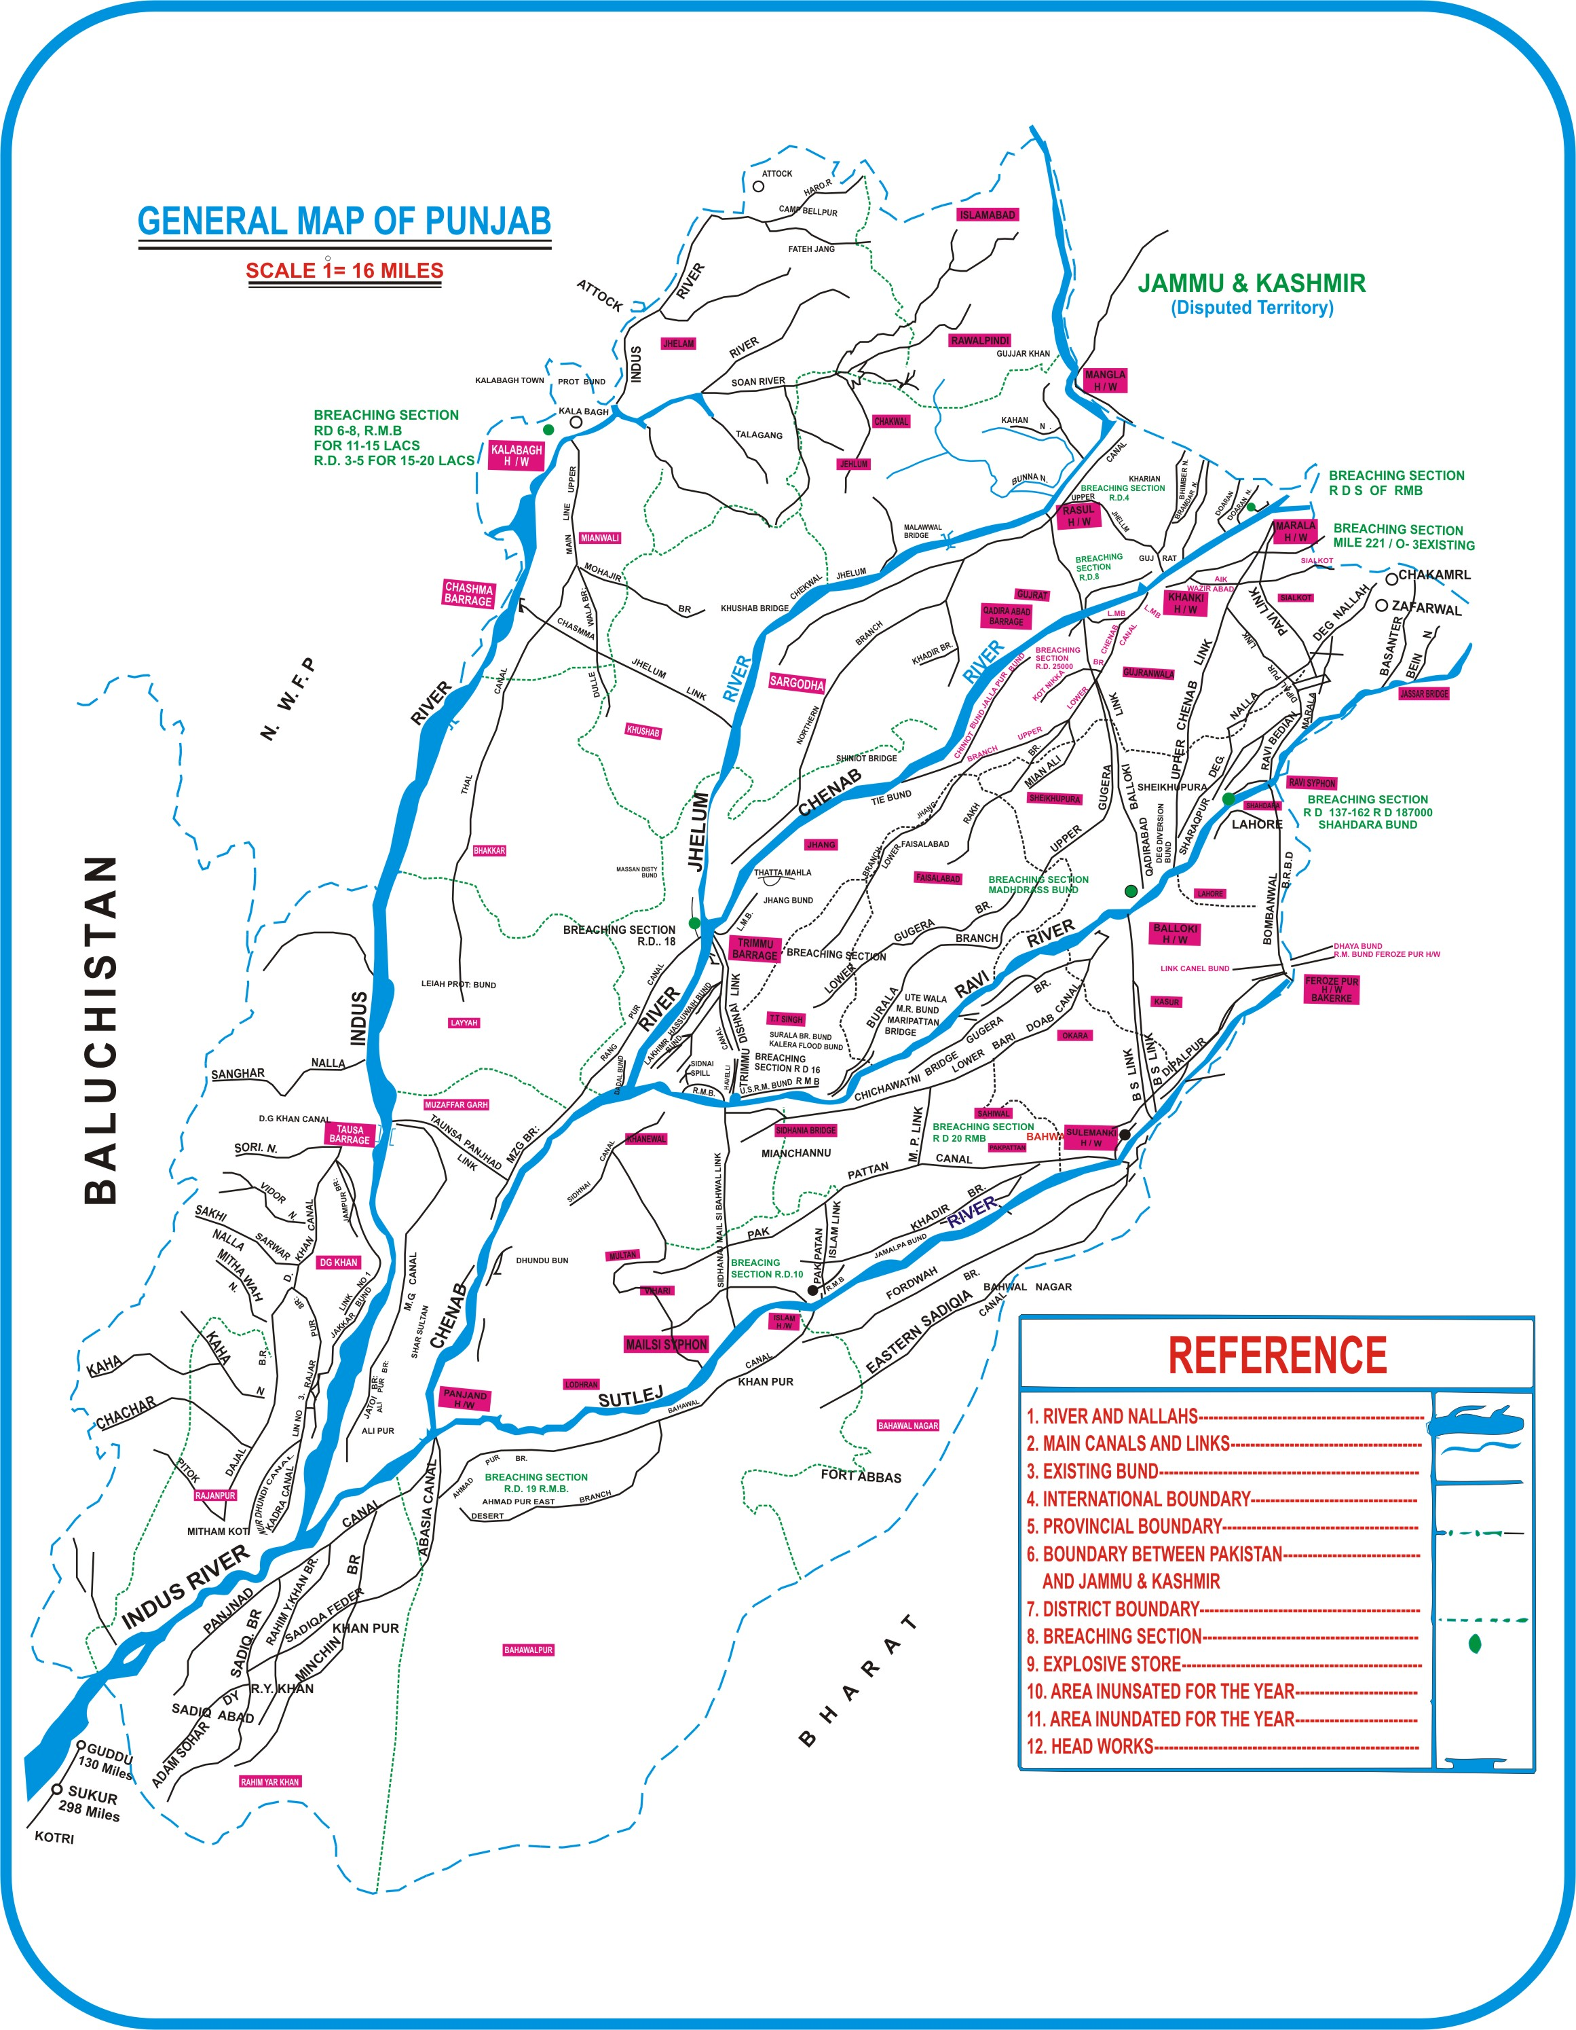

Slide 49
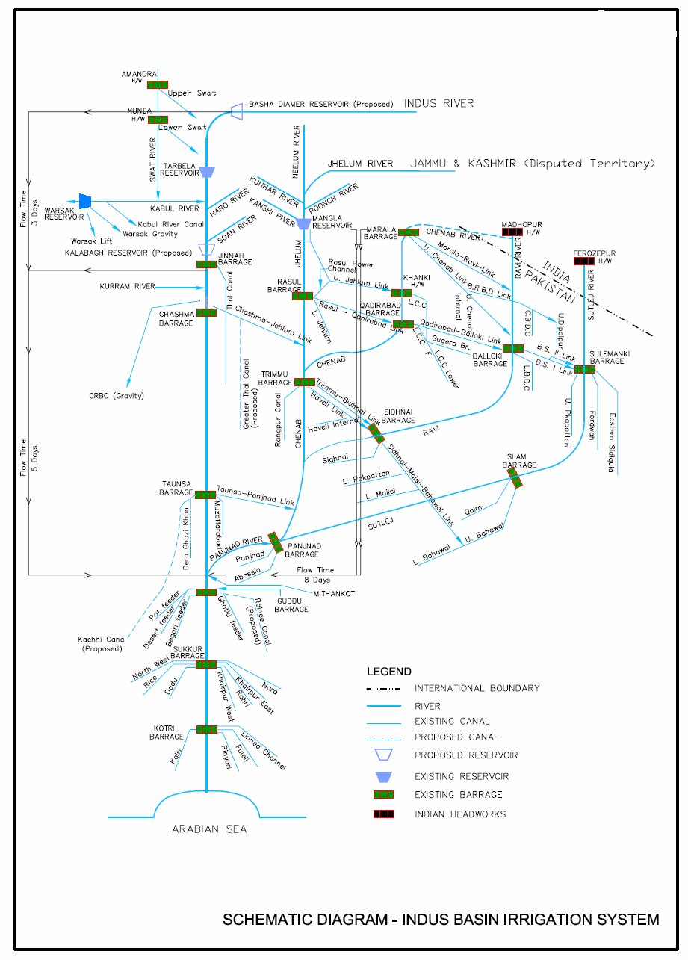
Schematic Diagram of the Pakistani Indus Basin System
04-Feb-18
49

Slide 50
ZOOMED

Slide 51
ZOOMED

Slide 52

ZOOMED

Slide 53
Productivity Per Unit of Water
Crop water productivity (WP) or water use efficiency (WUE) expressed in kg/m³ is an efficiency term, expressing the amount of marketable product (e.g. kilograms of grain) in relation to the amount of input needed to produce that output (cubic meters of water).
Canada 8.72 kg/ m³
USA 1.56 kg/ m³
China 0.82 kg/ m³
India 0.39 kg/ m³
Pakistan 0.13 kg/ m³
Productivity Per Unit of Land
France 7.60 T/ha
Egypt 5.99 T/ha
Saudi Arabia 5.36 T/ha
Punjab (India) 4.80 T/ha
Punjab (Pak) 2.30 T/ha
Pakistan (Average) 2.24 T/ha
Notes:
53
Productivity per Unit of Water
Pakistan’s productivity per unit of water is one of the lowest in the world. It is only one third of that of India.

Slide 54
Assignment
REVIEW OF INDUS BASIN IN CONTEXT OF:
IRRIGATION SYSTEM & its Structures
Strengths, Weaknesses, Opportunities, threats

