Slide 1
Silt Control in Irrigation Channels

Slide 2
Silt problems
Choking of UBDC (1870)
Deposition of silt in MRLink (9 ft out of 14.5 ft)
Sedimentation in Reservoirs
  1-2% per year
  Tarbela 30%
  Mangla 30%
  Chashma 60%

Slide 3
Methods of Silt Control
Methods of silt control
By exclusion of silt at the entrance
Divide wall and pocket
Training wall and river bend
By ejection of silt from the canal
Silt excluder
By proper channel design
By Proper design and setting of outlets

Slide 4
Methods of Silt Control
Headworks should be so arranged to exclude the silt as much as possible from the canal.
To make arrangements to eject the silt which has already entered the canal, or properly distribute it to the off-taking distributaries
To design an unlined channel which will produce the required non-silting and no-scouring velocity, in other words a design that will ensure that the amount of silt entering the canal is passed on the field.
To design the outlets and their setting so as to draw an equitable share of silt.

Slide 5
1.By exclusion of silt at the entrance
Divide Wall and Pocket
A divide wall parallel to headworks create pocket in front of canal entrance where silt is deposited due to reduction in velocity.
  Length of wall:(To keep turbulence away. U/s side up to last gate of head regulator and D/s side beyond HJ disturbance.
  Width of pocket:
    Cross section must be large enough:
      To carry Canal Discharge,
      To maintain Sluicing Velocity Sufficient for flushing sediment,
      15% of flood,
      To carry Low flows during construction
  Crest height of weir: lower enough to facilitate flushing
  Crest height of head regulator: High enough from bed.
  Convergence: max 1:10 to facilitate sluicing of silt
  Regulations for silt exclusion:
    Still Pond
    Semi-open flow

Slide 6
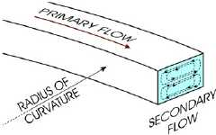
b. River Bend
If barrage is located on a river bent, then canal head regulator should be located on convex side (outer side).
It reduces silt entry to canal, as the silt is concentrated more on inner side.
Reason for silt concentration on inner side is due to spiral flow at bent.

Slide 7
Case study: Sukkur Barrage
Sukkur barrage is located on a natural river curvature at Indus River
The left bank canals are comparatively silt free while as early as 1938, 5 feet of silt was deposited on the right bank canals.
Remedial measures were adopted by producing an artificial convex side of the curve on the right bank so that comparately silt free water passes into the canal.
This was done by creating an island, which required the closure of the ten bays of the barrage which reduced its discharge capacity.
A similar problem exists at Kotri barrage, where the right bank canals have silting trouble, and the left bank canals get comparatively silt-free water.

Slide 8
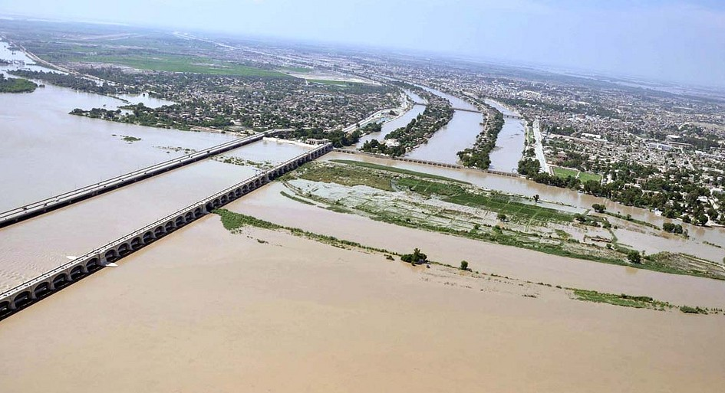
A panoramic view of Sukkur Barrage
Ref: https://ssl.panoramio.com/photo/110819077

Slide 9
Sukkur Barrage outline

Slide 10
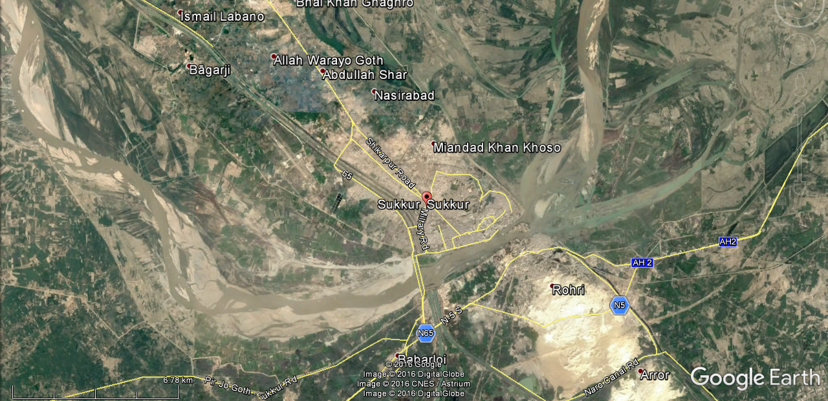
River Bent at Sukkur Barrage

Slide 11
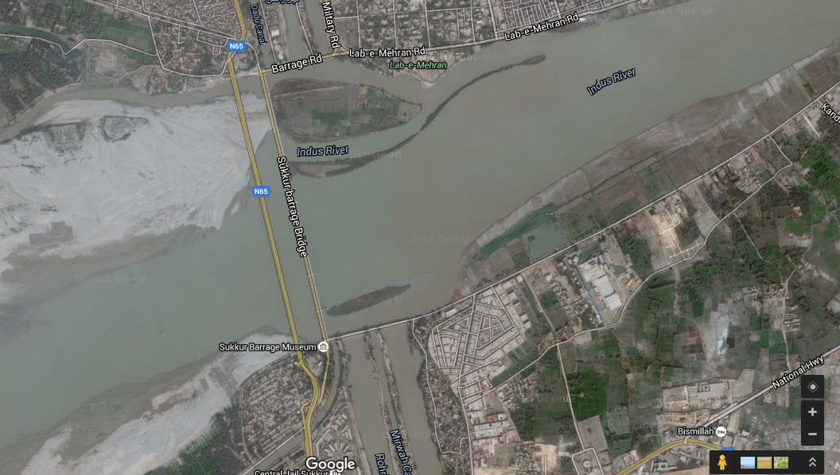
Sukkur Barrage (current status)

Slide 12
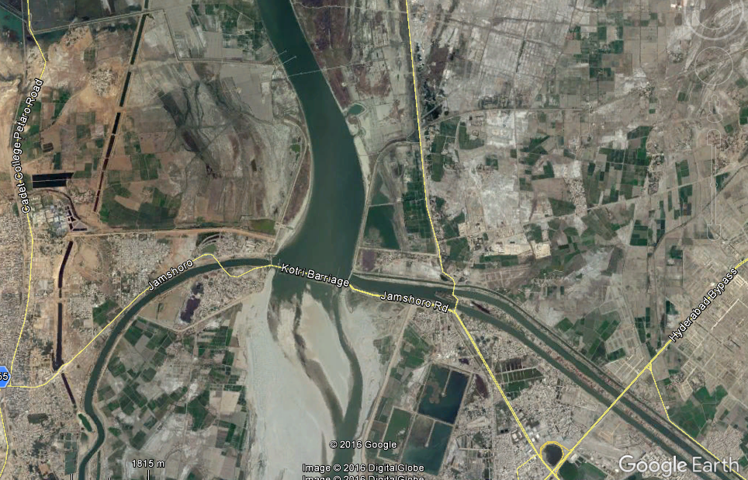
Kotri Barrage:
Problem of silt with right bank canals

Slide 13
c. Silt Excluder
B
B
To separate the silt laden water in lower level flows of river, tunnels are laid parallel to canal head regulator. The tunnels release water downstream of barrage through undersluice.
The top layers of water of river, having relatively silt free water, is allowed to go to Canal.
A
A
Sec-BB
Sec-AA

Slide 14
Silt Excluder Tunnels and Head Regulator at Taunsa Barrage (right bank)

Slide 15
Figures from Taunsa Barrage
Ref of Photographs:
Mansoob Ali Zaidi, M Akhtar Ch., Malik Ahmad Khan, Paper no 685 “Construction of Taunsa Barrage Rehablitation works” in 71st annual session proceddings of Paistan Engineering Congress

Slide 16
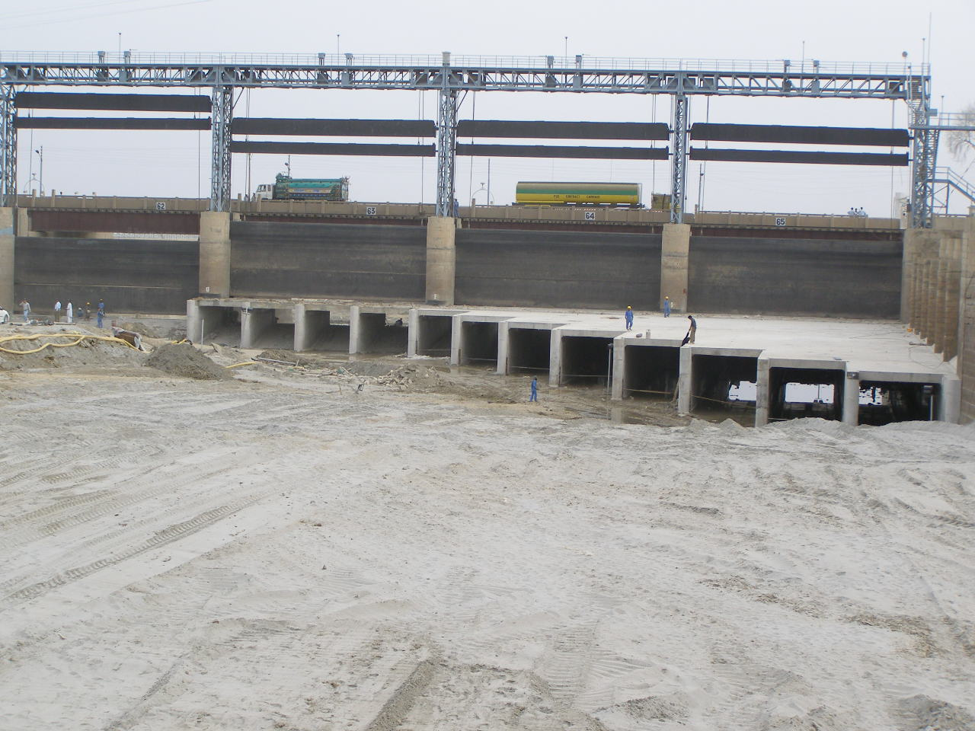
Silt excluder at Taunsa Barrage

Slide 17
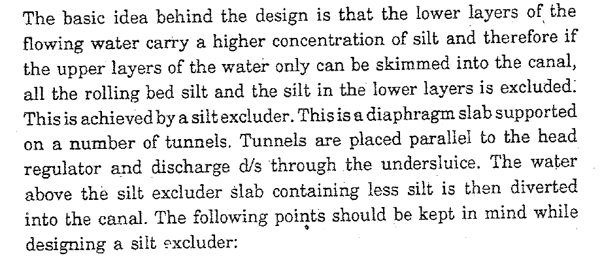

Slide 18
Silt Excluder Guidelines
Tunnels area should be such to accommodate discharge equal to 20% of canal discharges.
Velocity in the tunnels should be 6-10 ft/s
Tunnels should cover only two bays of barrage
Length of tunnel in front of regulator should be covering whole regulator. Other tunnels length may be reduced.
Divide wall length should be 1.2 – 1.4 times head regulator length
Clear height of tunnel should be 1/3 of the water depth minus slab thickness.

Slide 19
Discharge through tunnels may be calculated using:

Slide 20
Silt Excluder Efficiency
HEIGHS define Efficiency as ratio of silt concentration escaped to that of in approach channel.
Another Method as Adopted in Upper Jhelum Canal
  where I_{x} is silt concentration in escaped water (water going d/s into barrage), I_{c} is silt concentration in canal, I_{f} is silt concentration in approach channel.

Slide 21
Methods of silt ejection and proper distribution:
Tunnel Type Ejector
Vortex Tube Type Ejector
Settling Basin
Guide Vanes
Angle of Diversion
Distribution to outlets

Slide 22
i) Tunnel Type Silt Ejector
To further reduce the silt that has entered into canal, silt ejector is constructed some distance downstream from the head regulator (about 1000 yard down stream)
Bottom layers of water are ejected through tunnels, and diverted to river.
Size of tunnels should be such to accommodate 20% of canal discharge.
Height of tunnel should be 20-25% of depth of water in canal
Velocity may be 8-10 ft/s
A minimum working head of 2.5 ft is required.
Silt laden water is released to river / drain through gated structure.

Slide 23
ii) Vortex Tube Silt Excluder
A tube (4” or larger) is laid across the canal bed.
Water with bed load enters the tube, and escapes from a side of the tube, along with bed load.

Slide 24
iii) Settling Basins
Settling basins are the enlarged sections in the canal d/s of the head regulator.
They are constructed by widening and deepening the canal sections, which will produce lower velocities and thereby permit the sediment load in suspension to settle.
Then by the help of a dredger, some other mechanical means, or sluicing, the settled load is removed and transported away from the canal.

Slide 25
iv) Guide vanes
For proper distribution of silt between the parent channel and branch or distributary channel.
Two types:
  Bottom vane: The basic principle of the bottom guide vanes is to deflect the bottom layers of the canal water away from the distributary head regulator so that the clearer water of the top layers enters the branch or distributary.
  Surface Vanes: It diverts the surface water towards the branch or distributary.

Slide 26
v) Angle of diversion
Usually the distributary takes an excessive share of silt (if placed at 90º) from the main canal, resulting in heavy silting at the head reach.
A 90° off-take (i.e. where off-take is perpendicular to main channel) produces in effect a curvature in flow with off-take as if placed on the inside of the curve.
It is possible to reduce the silt entry to the off-taking channel by having a suitable angle of diversion given to the off-take, without having to use silt vanes/excluders.
Suitable angle (other than 90º) should be selected by model study.

Slide 27
Sheet Piles Installation

Slide 28
Inverted Filter, Block, and Stone Apron

Slide 30
Siltation Problems at Bent
There can be serious problem of island formation in the river channel close to the barrage if floods are of lower intensity than the design flood.
The new Sidhnai barrage located on a natural curve on Ravi which provides excellent silt free water for the Sidhnai Feeder canal and Sidhnai Mailsi link, on the left bank, has resulted in a huge bela (island) formation on the right side in the river.

Slide 31
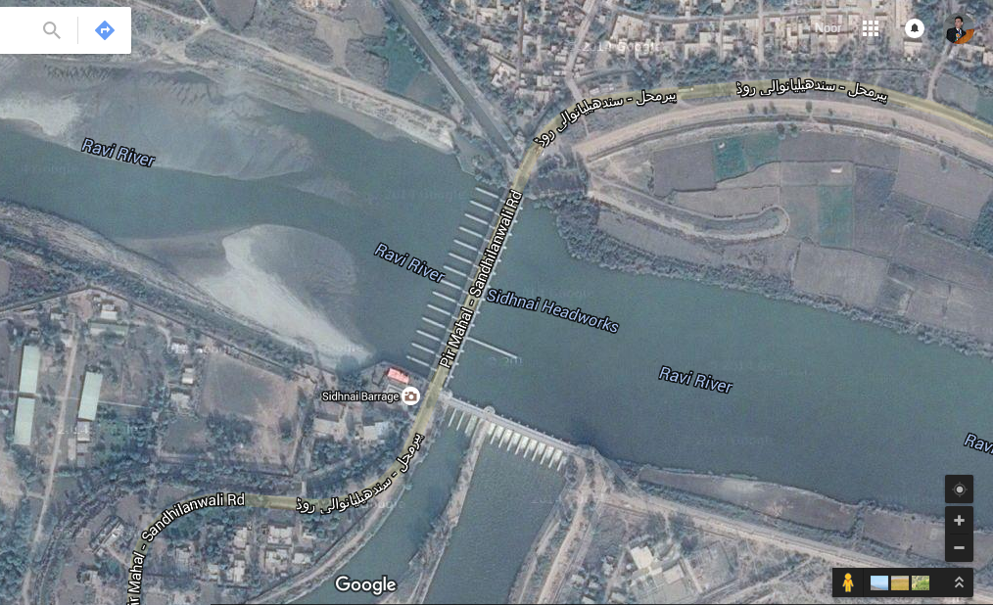
Sidhnai Barrage at Ravi

