Slide 1

Construction Safety
A summary of various hazards and their remedies in light of OSHA (Part 2)
Faizan Shafique

Slide 2
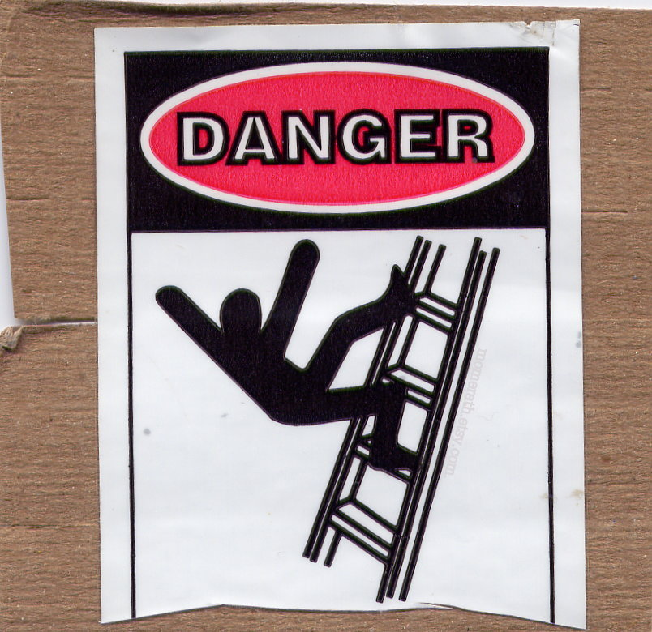
Stairs and Ladders

Slide 3
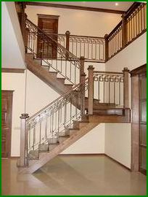
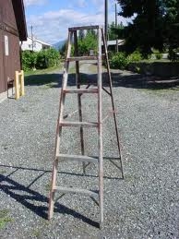
Difference

Slide 4
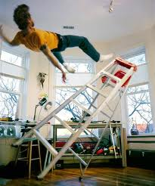
Hazards
Stairways and ladders cause many injuries and fatalities among construction workers
About half the injuries are caused by slips, trips and falls from ladders and stairways

Slide 5
Requirement
There must be a stairway or ladder at points of access where there is an elevation break of 0.5m (19 inch) or more.
Break in elevation
0.5m

Slide 6
Stairs
Install between 30 and 50 degrees.
Must have uniform riser height and tread depth, with less than a 1/4-inch variation.
Uniform - 30 & 50 deg. angle
Uniform - 30 & 50 deg. angle
No more than 1/4 inch
variation in any stairway system
No more than 1/4 inch
variation in any stairway system

Slide 7
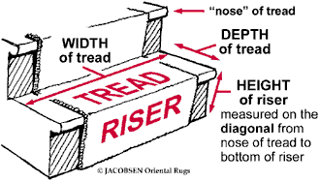
Stairs
As a rule of thumb, The riser must not be more than 8” and tread not less than 11”

Slide 8

Stair rails
Stairways with four or more risers or more than 30 inches high must have a stairrail along each unprotected side or edge.

Slide 9
Stair-rail requirements
Rails must be able to withstand a force of about 100 Kgs
The height of stair-rails must be 36 inches, measured from the nose of the stairs to the top of the rail.

Slide 10
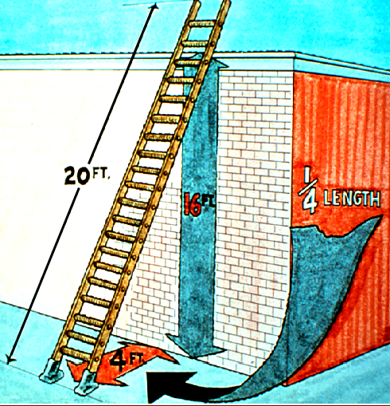
Ladder angle
Non-self-supporting ladders:
(which lean against a wall or other support)
  Position at an angle where the horizontal distance from the top support to the foot of the ladder is 1/4 the working length of the ladder

Slide 11
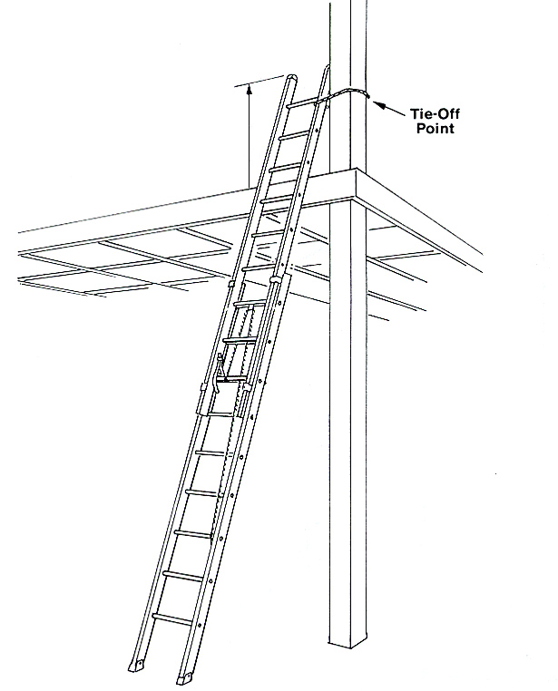
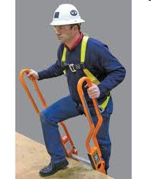
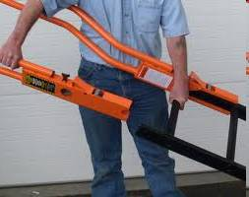
Ladder Rail Extension
When using a portable ladder for access to an upper landing surface, the side rails must extend at least 3 feet above the upper landing surface

Slide 12
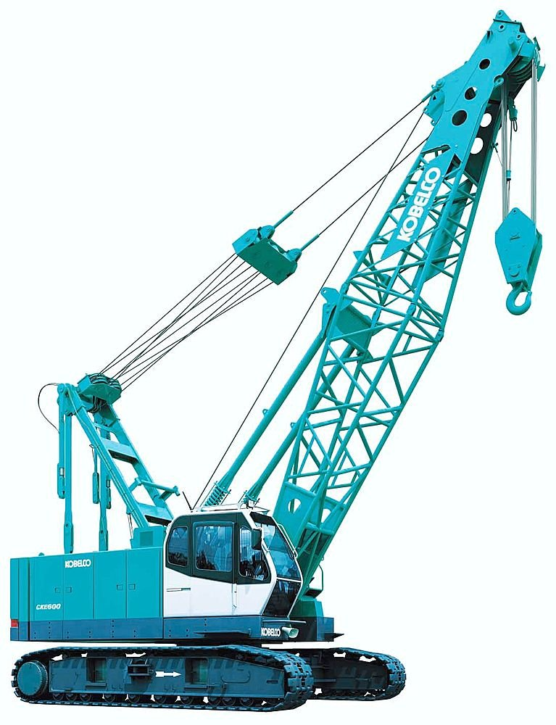
Cranes

Slide 13
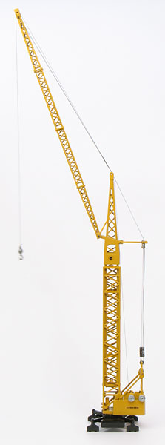
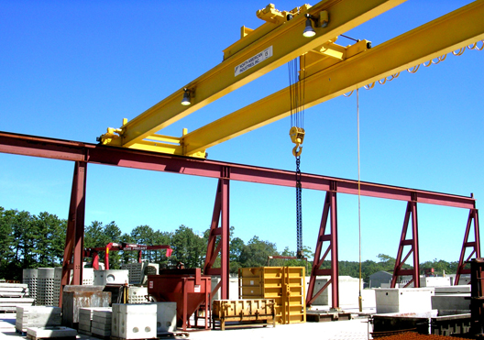

Cranes
Cranes is a broad class of construction equipments used for lifting and placing loads. A crane uses one or more machines like a hoist to produce mechanical advantage and thus move loads beyond the normal capability of a human. They can be used both to lift and lower materials and to move them horizontally.

Slide 14
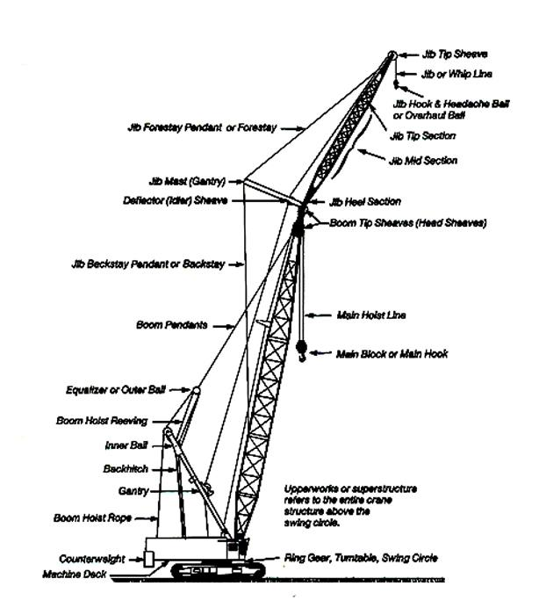
Excavations
Hoist - Used to lift and lower load.
Boom – An inclined spar, strut, or other long member supporting the hoist
Jib – Extension attached to the boom point to provide added boom length for lifting specified loads.
JIB
HOIST
BOOM
Counter Weight

Slide 15
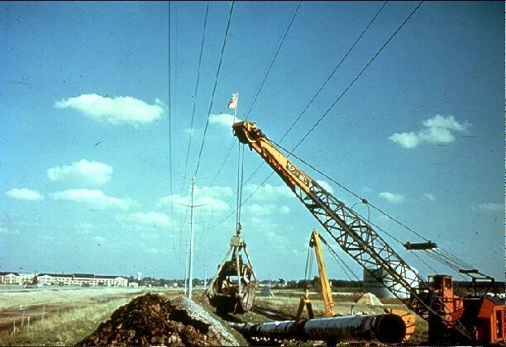
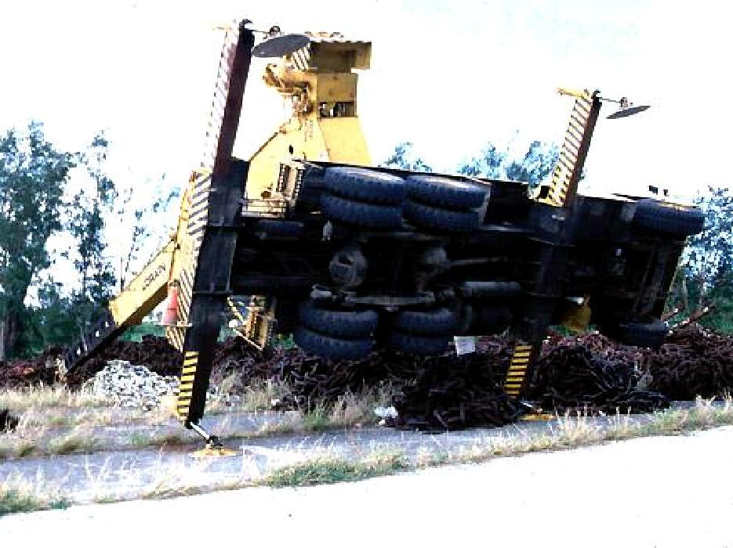
Major causes of crane accidents
Contact with power lines
Overturns and Falls
Mechanical failures

Slide 16
Crane hazards
Improper loading
Excessive speeds
No hand signals
Inadequate inspection and maintenance
Unguarded swing radius
Working too close to power lines
Shattered windows
No steps/guardrails walkways
No boom angle indicator

Slide 17
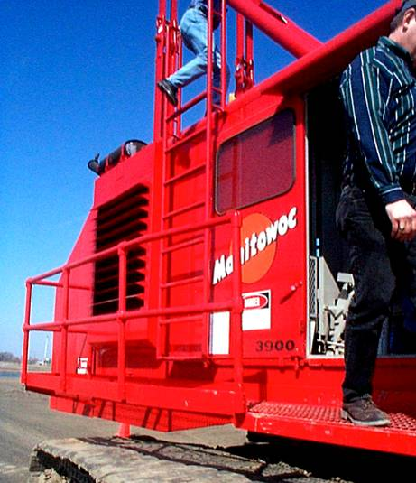
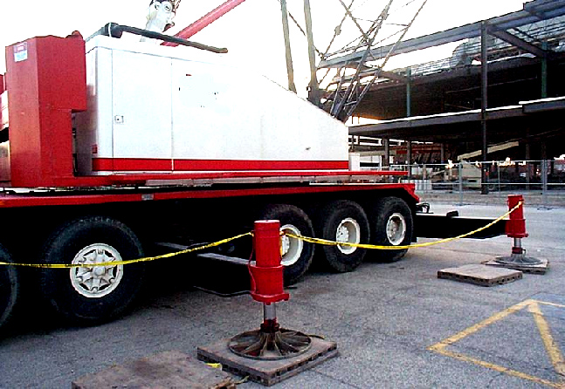
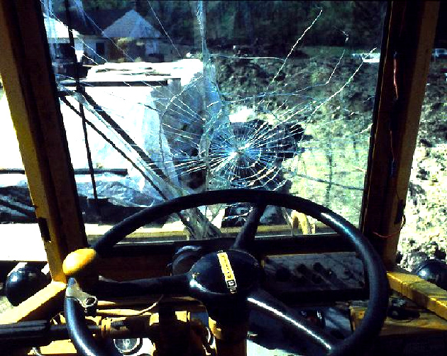
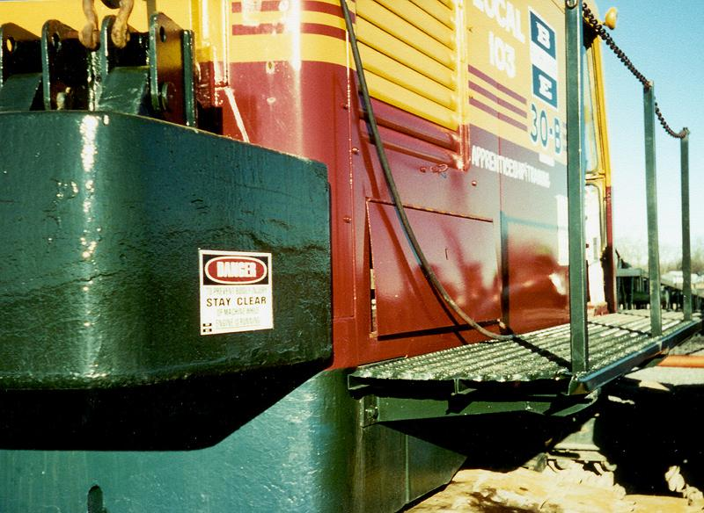
Crane hazards

Slide 18
Thank you for listening

