Slide 1
Construction Safety in Pakistan
Faizan Shafique

Slide 2
Conclusions of Research by Farooqi, Arif and Rafeeqi
NED University (2008)
The top three safety non-performance practices at building construction work sites are:
1. Ear defenders not worn (while using noisy equipment)
2. Protective footwear not worn
3. Face masks not worn (in dusty conditions)

Slide 3
Conclusions of Research by Farooqi, Arif and Rafeeqi
NED University (2008)
Most of the safety non-performance issues belong to self protection category. This shows that the site workers themselves are either unaware of the importance of personnel safety practices or they do not want to wear protective gears and kits as they consider it as a hindrance in their work productivity. Also, it was observed that the site management seemed non-interested in emphasizing the need of personnel safety practices among their workers.

Slide 4
Conclusions of Research by Farooqi, Arif and Rafeeqi
NED University (2008)
Most of the companies lie in the range of extremely unsafe to moderately unsafe (about 58%). This shows that the overall level of the industry as regard to site safety needs drastic improvement. Safety seems to be on the less priority on the agenda even during the execution phase which is not a healty trend. A mean value of Safety Performance Index of 0.52 indicates that even the basic practices required for safety are not present at most construction sites. Also, the scattered safety performance levels of firms indicates lack of standard safety management systems.

Slide 5
Top 10 Safety Implementation Barriers in pakistan
Dr Rafiq M. Chaudhry, NUST
Worker cooperation/ behavior
Perception that safety hinders productivity and/ or quality
Lack of owner/ top management commitment and support
Lack of safety awareness and knowledge
Lack of teamwork/ partnering approach towards safety
Lack of familiarity & expertise with safety management techniques
Absence of safety regulatory framework in the industry
Complicated safety work rules make the workers non-responsive
Lack of proper training of employees
Lack of accident liability

Slide 6
According to another research done by Hafiz Zahoor and Dr Rafiq M. Chaudhry for Rawalpindi/ Islamabad region
The most neglected safety practices requiring special emphasis to enhance the safety performance are; safety training is not provided to employees of subcontractors, refresher safety training sessions are not conducted for all workers, workers take unnecessary risks when not being supervised, subcontractors are not encouraged to participate in safety meetings, and no job specific safety training is given to workers before star
Workers sometimes do not follow safety rules and procedures and they have a tendency to take unnecessary risks when not being supervised. Moreover, workers do not feel comfortable using personnel protective equipment.
Stakeholders’ emphasis is only on improving quality, and reducing cost and time whereas safety is least on their agenda.

Slide 7
Pakistan-US Science and technology cooperation program
Establishment of a Center of Excellence to Conduct and Promote Construction Safety Research, Education, and Training in Pakistan
Jimmie Hinze, University of Florida, and Salman Azhar, Auburn University
Rafiq M. Choudhry, National University of Sciences and Technology
Pakistani Funding (HEC): $107,661
US Funding (Department of State): $208,035
Project Dates: November 15, 2010 - November 14, 2013

Slide 8
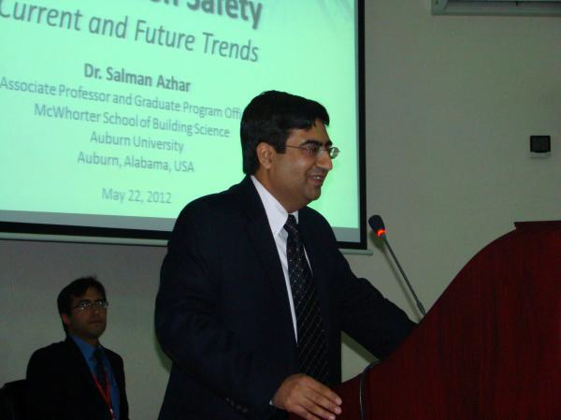
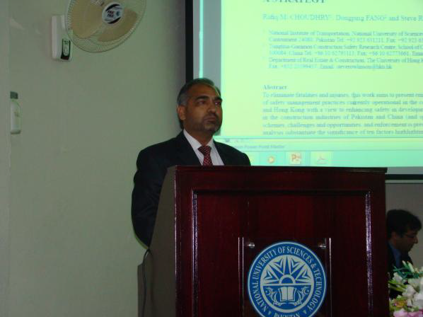
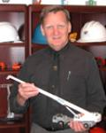
Dr. Salman Azhar
Dr. Rafiq M. Chaudhry
Dr. Jimmie Hinze

Slide 9
Thank you for listening

