Slide 1


HI-504: Irrigation Engineering Practices
Prof. Dr. Abdul Sattar Shakir
Engr. Usman Ali

Slide 2
Course Outline
HI-504: Irrigation Engineering Practices
Soil-water-plant relationship, methods of estimating crop water requirements
Determination of losses in irrigation system
Methods of surface, sub-surface and sprinkling irrigation, their suitability and economics in water saving.
Economics of lined channels. Irrigation efficiencies, Project efficiency, operation efficiency, and economic efficiency.
Irrigation distribution network: Planning and design of different components. Layout of field channels and outlets. Land shaping and leveling.
Irrigation scheduling: Dynamic Crop response model. Modeling or irrigation schedules. Warabandi distribution system and its constraints
Diagnostic analysis of irrigation systems.
Development Model.
System perspectives:
  Interdisciplinary approach. Identification of problems. Establishment of objectives. Allocation of responsibility. Information collection. Development of work plans and methods.
  Technical social and economic data collection. Data analysis. On-farm water management practices, physical constraints, socio-economic problems. Traditional practices.

Slide 3
List of Expected Submissions
1 | Indus Basin Strength, Weaknesses, Opportunitites, and Threats (SWOT Analysis)
2 | Comsumptive use using Blaney Criddle Method
3 | Numerical of soil water plant relationship (time of irrigation, scheduling of irrigtion, capacity of system, etc)
4 | ET0 using Penmann monthieth eq
5 | Kc Single and Dual
6 | Lining B/C Analysis
7 | System Analysis / Linear programming / Graphical Method / Excel Solver
8 | Warabandi
9 | Fall Design
10 | OFWM, how to find cutting and filling for precision leveling
11 | Methods of Irrigation, Deciding the no of Sprinklers for a field
12 | Gravity Irrigation System Design

Slide 4
Lecture Delivery Plan
Week | Topic
1 | Introduction of subject, Introduction of Irrigation system of Pakistan
2 | Planning and design of different components. Layout of field channels and outlets. Land shaping and leveling.
3 | Soil-water-plant relationship. Methods of estimating crop water requirements
4 | Estimating crop water requirements using Penmann Montieth Eq.
5 | Irrigation scheduling: Dynamic Crop response model. Modeling of irrigation schedules.
6 | Losses in irrigation system and its determination. Economics of lined channels.
7 | Irrigation distribution network: Planning and design of different components. Layout of field channels and outlets. Warabandi distribution system and its constraints
8 | Land shaping and leveling. Irrigation efficiencies, Project efficiency, operation efficiency, and economic efficiency.
9 | Comparison of surface, sub-surface and sprinkling irrigation, their suitability and economics in water saving
10 | Diagnostic analysis of Irrigation systems.
11 | Development Model.
12 | System perspectives:
13 | Interdisciplinary approach. Identification of problems. Establishment of objectives. Allocation of responsibility. Information collection. Development of work plans and methods.
14 | Technical social and economic data collection. Data analysis. On-farm water management practices, physical constraints, socio-economic problems. Traditional practices.

Slide 5
Reference Material
Crop Evapotranspiration: Guidelines for computing crop water requirements, FAO Irrigation and Drainage Paper No 56 by Food and Agriculture Organization of the United Nations (1998) (available on http://www.fao.org/docrep/X0490E/X0490E00.htm, or www.kimberly.uidaho.edu/ref-et/fao56.pdf )
Irrigation Engineering and Hydraulic Structures by Santosh Kumar Garg (1999)
Irrigation Management, Volume II, by B.L. Darra, and C.S. Raghuvanshi (1999)
Irrigation Water management: Principles and Practice by Dilip Kumar Majumdar (2000)
Irrigation Engineering by G.L. Asawa (1993)
Fundamental principles of Irrigation Engineering by VB Priyani (1979)

Slide 6
Irrigation and drainage papers by FAO
IRRIGATION AND DRAINAGE PAPERS
1 Irrigation practice and water management, 1971 (Ar* E* F* S*)
1 Rev. 1 Irrigation practice and water management, 1984 (E*)
2. Irrigation canal lining (New edition, 1977, available in E, F and S in the FAO Land and Water Development Series, No. 1)
3. Design criteria for basin irrigation systems, 1971 (E*)
4. Village irrigation programmes - a new approach in water economy, 1971 (E* F*)
5. Automated irrigation, 1971 (E* F* S*)
6. Drainage of heavy soils, 1971 (E* F* S*)
7. Salinity seminar, Baghdad, 1971 (E* F)
8. Water and the environment, 1971 (E* F* S*)
9. Drainage materials, 1972 (E* F* S*)
10. Integrated farm water management, 1971 (E* F* S*)
11. Planning methodology seminar, Bucharest, 1972 (E* F*)
12. Farm water management seminar, Manila 1972 (E*)
13. Water use seminar, Damascus, 1972 (E* F*)
14. Trickle irrigation, 1973 (E* F* S*)
15. Drainage machinery, 1973 (E* F*)
16. Drainage of salty soils, 1973 (C* E* F* S*)
17. Man's influence on the hydrological cycle, 1973 (E* F* S*)
18. Groundwater seminar, Granada, 1973 (E* F* S*)
19. Mathematical models in hydrology, 1978 (E*)
20/1. Water laws in Moslem countries - Vol. 1, 1973 (E* F*)
20/2. Water laws in Moslem countries - Vol. 2, 1978 (E F)
21. Groundwater models, 1973 (E*)
22. Water for agriculture - index, 1973 (E/F/S*)
23. Simulation methods in water development, 1974 (E* F* S*)
24. Crop water requirements (rev.) 1977 (C* E F S)
25. Effective rainfall, 1974 (C* E* F* S*)
26/1. Small hydraulic structures - Vol. 1, 1975 (E* F* S*)
26/2. Small hydraulic structures - Vol. 2, 1975 (E* F* S*)
27. Agro-meteorological field stations, 1976 (E* F* S*)
28. Drainage testing, 1976 (E* F* S*)
29. Water quality for agriculture, 1976 (E* F* S*)
29. Rev. 1 Water quality for agriculture, 1985 (C* E* F* S*)
30. Self-help wells, 1977 (E*)
31. Groundwater pollution, 1979 (C* E* S)
32. Deterministic models in hydrology, 1979 (E*)
33. Yield response to water, 1979 (C* E F S)
34. Corrosion and encrustation in water wells, 1980 (E*)
35. Mechanized sprinkler irrigation, 1982 (C E* F S*)
36. Localized irrigation, 1980 (Ar* C E* F S*)
37. Arid zone hydrology, 1980 (E*)
38. Drainage design factors, 1980 (Ar C E F S)
39. Lysimeters, 1982 (C E* F* S*)
40. Organization, operation and maintenance of irrigation schemes, 1982 (C** E* F S*)
Ref: http://www.fao.org/Ag/agl/public.stm#aglwbu

Slide 7
Irrigation and drainage papers by FAO
41. Environmental management for vector control in rice fields, 1984 (E* F* S*)
42. Consultation on irrigation in Africa, 1986 (E F)
43. Water lifting devices, 1986 (E F)
44. Design and optimization of irrigation distribution networks, 1988 (E F)
45. Guidelines for designing and evaluating surface irrigation systems, 1989 (E*)
46. CROPWAT - a computer program for irrigation planning and management, 1992 (E F* S*)
47. Wastewater treatment and use in agriculture, 1992 (E*)
48. The use of saline waters for crop production, 1993 (E)
49. CLIMWAT for CROPWAT, 1993 (E)
50. Le pompage éolien, 1993 (F)
51. Prospects for the drainage of clay soils, 1995 (E)
52. Reforming water resources policy, 1995 (E)
53. Environmental impact assessment of irrigation and drainage projects,1995 (E)
54. Crues et apports, 1996 (F)
55. Control of water pollution from agriculture, 1996 (E* S)
55. Lucha contra la contaminación agrícola de los recursos hídricos, 1997 (E* S)
56. Crop evapotranspiration: guidelines for computing crop water requirements, 1998 (E)
57. Soil salinity assessment: methods and interpretation of electrical conductivity measurements, 1999 (E)
58. Transfer of irrigation management services: guidelines. 1999 (E F S)
58. Transferencia de la gestión des riego - Directrices, 2001 (E F S)
58. Transfert des Services de Gestion de l 'Irrigation - Directives, 2001, (E F S)
59. Performance analysis of on-demand pressurized irrigation systems,2000 (E)
60. Materials for subsurface land drainage systems, 2000 (E)
61. Agricultural drainage water management in arid and semi-arid areas, 2002 (E)
Ref: http://www.fao.org/Ag/agl/public.stm#aglwbu

Slide 8
Introduction
Definition of Irrigation:
“Artificial application of water on an agricultural land for the assured growth of plant life” (Priyani 1979).
“Science of Artificial Application of Water to the land, in accordance to the ‘crop requirements’, through out the ‘crop period’ for full fledge nourishment of crop” (SK GARG, 1999)
Rainfed Agriculture vs. Irrigated Agriculture?
Why Irrigation?

Slide 9
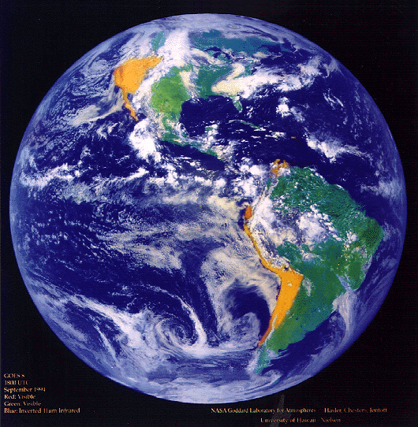
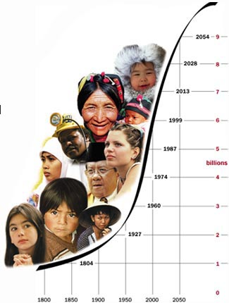
WHY IRRIGATION?
Population Explosion (Global Scenario)
Population is increasing very fast
27-1-2015 Estimated Population = 7.291 Billion Ref: http://www.worldometers.info/population/

Slide 10
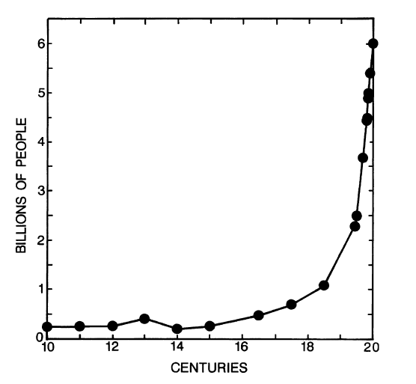
What is our challenge?
The human population growth curve

Slide 11
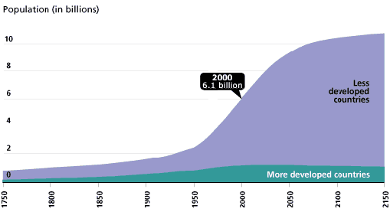
WHY IRRIGATION? (Contd..)
Problem with less developed countries
The increase is more severe for less developed countries

Slide 12
How food requirements are being fulfilled
Is food demand being fulfilled by More CROPPED AREA?
During 1910-1995 in the World
  Population raised by 251%
  Cropped area per capita reduced by 50%
Yet World is fulfilling the food and fiber needs of 6-7 billion of population.
HOW the raised population is being taken care off?

Slide 13
Increased population and Irrigation (Continued)
This was solved by:
An increase in Irrigated Area by 435%
Through an increase in reservoir’s storage capacity by 116 times (from 114 km³ to 13,152 km³)
An increase of 50% in Irrigated Area per capita
Which lead to increased food protections.

Slide 14
Increase in Storage Capacity and Irrigated area in the World

Slide 15
Irrigated area in USA
During 1910-1995 in USA
  Population raised 184%
  Cropped area per capita reduced by 70%
  Cropped area reduced by 7%
Yet USA is largest manipulator of World’s corn market (largest exporter of corns),
HOW the raised population of USA is being taken care off?

Slide 16
Irrigated area in USA (continued)
One major factor is
An increased Irrigated area by 353%.
through
An increased reservoir’s storage capacity in USA by 90 times (from 37km³ to 3,335 km³)
Which lead to
Increased food protection in USA

Slide 17
Increase in Storage Capacity and Irrigated area in USA

Slide 18
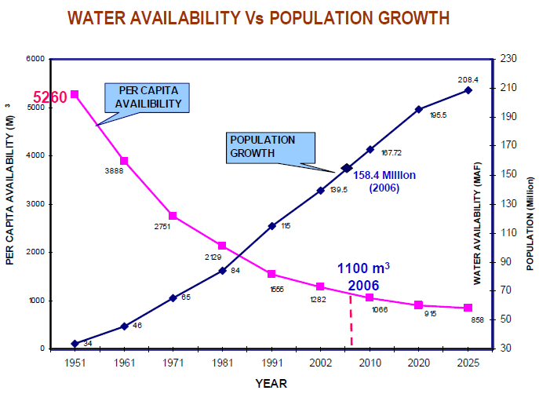
Pakistan’s Water availability per capita

Slide 19
WATER USE FOR IRRIGATION NEED TO BE RATIONALIZED
Current IRRIGATION WITHDRAWLS ARE not sustainable
High-Income Countries
Global
Low and Medium Income Countries
Agricultural Use
Variation in Sector-wise water demand
Domestic Use
Industrial Use

Slide 20
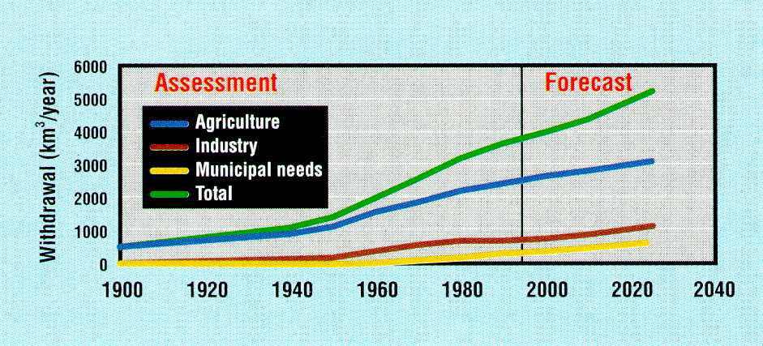
Forecast of Demands by sectors
Sectoral demands increasing and new demands emerging such as for environmental and river maintenance

Slide 21
Soil-Water-Plant relationship
Soil as a porous media
Provides
  Physical support
  Nutrients
  Water &
  Air

Slide 22
Soil Properties
Texture
  Definition: relative proportions of various sizes of individual soil particles
  USDA classifications
    Sand: 0.05 – 2.0 mm
    Silt: 0.002 - 0.05 mm
    Clay: <0.002 mm
  Textural triangle: USDA Textural Classes
  Coarse vs. Fine, Light vs. Heavy
  Affects water movement and storage
Structure
  Definition: how soil particles are grouped or arranged
  Affects root penetration and water intake and movement

Slide 23
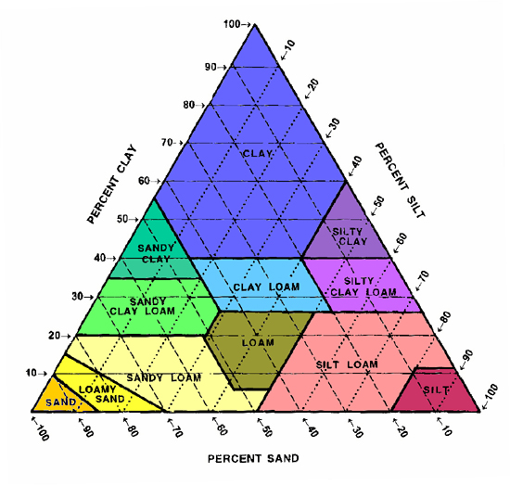
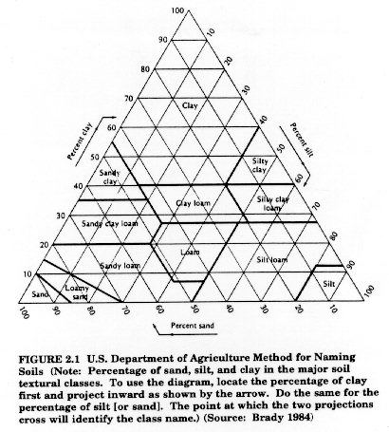
USDA Textural Triangle

Slide 24
Moisture Contents
Water (or moisture) in Soil
  Hygroscopic Moisture
  Capillary Moisture
  Gravitational (or free) Moisture
Oven dry soil = zero moisture
Air dry soil = Hygroscopic moisture
Wilting Coefficient
  The moisture content (%) in soil above which the water is available for the plant for growth.
  If moisture content in soil is equal or greater than about 1.5 times of Hygroscopic m.c. then water is available to plant
Max. Capillary Capacity (or Field Capacity): The moisture content (mc) above which the water will start flowing under gravity.

Slide 25
Soil Water
Saturation point
Gravitational moisture
Max. Capillary Cap.
(or Field Capacity)
Moisture (%)
Capillary moisture
Wilting point (or Coeff.)
Air dry soil
Hygroscopic moisture
0 (%)
Oven dry soil
Ref. Wikipedia:
Field capacity is the amount of soil moisture or water content held in soil after excess water has drained away and the rate of downward movement has materially decreased, which usually takes place within 2–3 days after a rain or irrigation in pervious soils of uniform structure and texture.
The physical definition of field capacity (expressed symbolically as θ_{fc}) is the bulk water content retained in soil at −33 J/kg (or −0.33 bar) of hydraulic head or suction pressure.

Slide 26
Field Capacity (FC or θ_{fc})
  Soil water content where gravity drainage becomes negligible
  Soil is not saturated but still a very wet condition
  Traditionally defined as the water content corresponding to a Soil Water Potential of -1/10 to -1/3 bar (tension in soil or pressure below atmospheric pressure)
Permanent Wilting Point (WP or θ_{wp})
  Soil water content beyond which plants cannot recover from water stress even if placed in humid environment
  Still some water in the soil but not enough to be of use to plants
  Traditionally defined as the water content corresponding to -15 bars of Soil Water Potential

Slide 27
Available Water
Definition
  Water held in the soil between field capacity and permanent wilting point
  “Available” for plant use
Available Water Capacity (AWC)
  AWC = θ_{fc} - θ_{wp}
  Units: depth of available water per unit depth of soil, “unitless” (in/in, or mm/mm)
  Measured using field or laboratory methods
Readily Available Water Capacity (RAWC)
  Taken as 75-80% of AWC

Slide 28
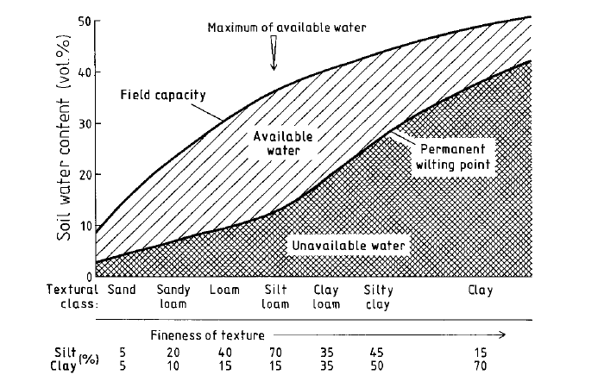
Depending on soil texture, which is determined by the particle-size distribution, soils will vary in water content at field capacity and at the permanent wilting point. Both characteristic values enclose the plant-available water content. Silt loam soil contains the maximum of available water. The water at the permanent wilting point is not available to plants. The fineness of texture increases with
the silt and clay content, presented as approximate percentages.
Ref: Lecture presentation of
Dr. Heba Al-Fares, An-Najah National University, Palestine, available on google document

Slide 29
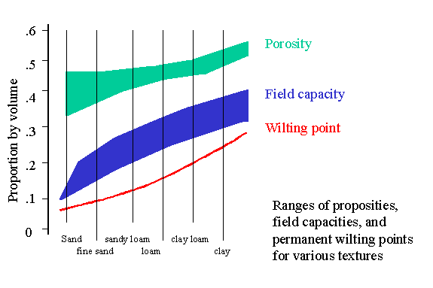
Range of Porosity Values
Soil Type | Porosity, p_{t}
Unconsolidated deposits
Gravel | 0.25 - 0.40
Sand | 0.25 - 0.50
Silt | 0.35 - 0.50
Clay | 0.40 - 0.70
porosities
Ref: http://www.ldeo.columbia.edu/~martins/climate_water/slides/soil_parameter_ranges.gif, accessed on 10-2-15

Slide 30
Important Moisture Contents
USDA Soil Type | Field Capacity (%) |  |  | Wilting point % |  |  | Available MC %
 | min | max | mean | min | max | mean | min | max | mean
Sand | 7 | 17 | 12 | 2 | 7 | 5 | 5 | 10 | 8
Loamy sand | 11 | 19 | 15 | 3 | 10 | 7 | 8 | 9 | 9
Sandy loam | 18 | 28 | 23 | 6 | 16 | 11 | 12 | 12 | 12
Loam | 20 | 30 | 25 | 7 | 17 | 12 | 13 | 13 | 13
Silt Loam | 22 | 36 | 29 | 9 | 21 | 15 | 13 | 15 | 14
Silt | 28 | 36 | 32 | 12 | 22 | 17 | 16 | 14 | 15
Silt Clay Loam | 30 | 37 | 34 | 17 | 24 | 21 | 13 | 13 | 13
Silty Clay | 30 | 42 | 36 | 17 | 29 | 23 | 13 | 13 | 13
Clay | 32 | 40 | 36 | 20 | 24 | 22 | 12 | 16 | 14
Ref: FAO-56

Slide 31
Water-Holding Capacity of Soil
Effect of Soil Texture
Coarse Sand Silty Clay Loam
Dry Soil
Gravitational Water
Water Holding Capacity
Available Water
Unavailable Water

Slide 32
Conversion of Moisture Contents into Volume (or Depth) of Water
Soil water content
  Mass water content (θm)
  θ_{m} = mass water content (fraction)
  M_{w} = mass of water evaporated, g
  (≥24 hours at 105ºC)
  M_{s} = mass of dry soil, g
Bulk Density (ρ_{b})
  ρ_{b} = soil bulk density, g/cm³
  M_{s} = mass of dry soil, g
  V_{b} = volume of soil sample, cm³
  Typical values: 1.1 - 1.6 g/cm³
Particle Density (ρ_{p})
  ρ_{P} = soil particle density, g/cm³
  M_{s} = mass of dry soil, g
  V_{s} = volume of solids, cm³
  Typical values: 2.6 - 2.7 g/cm³

Slide 33
Conversion of Moisture Contents into Volume (or Depth) of Water

Slide 34
Definitions
Crop Period (days, Sowing to Harvesting)
Base Period (“B days”, First watering to last watering)
Delta (“Δ”, Total quantity in units of depth)
Water Allowance: Discharge in cusecs Allocated for 1,000 acres land in a canal command.
Duty (of water, “D”): Area (hectares) irrigated by a unit discharge (may be cumecs) provided over whole base period (B days)
In SI Units: 1 x (B x 86400) / (D x 10,000) = Delta (meters)
  Or Δ = 864 B/D centimeters
Find Delta of a crop if its duty is 864 hectares/cumecs on a field, the base period is 120 days.
Ans: 120cm

Slide 35
Duty
Duty at various places
Factors Affecting Duty
  Type of crop
  Climate & season
  Useful rainfall
  Type of soil
  Efficiency of cultivation method

Slide 36
Irrigation Efficiencies
Efficiency of Water Conveyance
  Ratio of water delivered by the channel to water delivered to the channel
Efficiency of Water Application
  Ratio of water for root zone to the water supplied to field
Efficiency of Water Storage
  Ratio of water supplied (or stored) in root zone to the water needed by the root zone (or water that can be stored in root zone).
Water Distribution Efficiency (Uniformity Coefficient)
    =(1-d / D), where
    d is the average of absolute deviations of water applied from mean water applied in the field
    D is the mean water applied in the field.

Slide 37
Estimating depth and frequency of irrigation based on soil moisture
Numerical to be solved and submitted:
From book of S.K. GARG.
  Examples 2.1 to 2.7
  Examples 2.8, 2.10, 2.12
  Table 2.13, 2.14
  Examples 2.13, 2.14

Slide 38
Land use of Pakistan
No. | Type | Area Million Hectares (2003-04)¹ | Area Million Hectares (2010-11)*
1 | Geographical Area | 79.61 | 79.61
2 | Area Reported | 59.47 | 57.18
3 | Not Available for Cultivation | 24.20 | 23.53
4=2-3 | Agricultural Land | 35.27 | 33.65
5 | Forest Land | 4.04 | 4.23
6=4-5 | Arable Land | 31.23 | 29.42
7 | Culturable Waste | 9.10 | 7.82
8=6-7 | Cultivated Area | 22.13 | 21.41
9 | Current Fallows | 6.05 | 5.63
10=8-9 | Net Area Sown | 16.08 | 15.92
11 | Area Sown more than Once | 6.40 | 7.48
12=10+11 | Total Cropped Area | 22.48 | 23.4
Ref: ¹ Pakistan Statistical Year Book, 2005, Federal Bureau of Statistics, Statistics Division, Govt. of Pakistan (FPS-381/1200).
* http://www.pbs.gov.pk/sites/default/files/agriculture_statistics/publications/Agricultural_Statistics_of_Pakistan_201011/tables/Table61.pdf

Slide 39
Definitions for land-use types
AREA REPORTED is the total physical area of the villages/deh, tehsils or districts etc.
AREA NOT AVAILABLE FOR CULTIVATION is that uncultivated area of the farm which is under farm home steads, farm roads and other connected purposes and not available for cultivation.
FOREST AREA is the area of any land administered as forest under any legal enactment dealing with forests. Any cultivated area which may exist within such forest is shown under heading cultivated area.
CULTURABLE WASTE is that uncultivated farm area which is fit for cultivation but was not cropped during the year under reference nor in the year before that.
CURRENT FALLOW (ploughed but uncropped) is that area which is vacant during the year under reference but was sown at least once during the previous year
CULTIVATED AREA is that area which was sown at least during the year under reference or during the previous year. Cultivated Area = Net Area sown + Current Fallow.
NET AREA SOWN is that area which is sown at least once during (Kharif & Rabi) the year under reference.
AREA SOWN MORE THAN ONCE is the difference between the total croped area and the net area sown.
TOTAL CROPPED AREA means the aggregate area of crops raised in a farm during the year under reference including the area under fruit trees.

Slide 40
Area Irrigated by Various Sources in Pakistan (2010-11): Total Area 18 M. Hactare
http://www.pbs.gov.pk/content/agriculture-statistics-pakistan-2010-11

Slide 41
Crops
Kharif (April-Sep)
  Rice, Maiz, Sorghum (Jawar), Millet (Bajra), Cotton
Rabi (Oct.- March)
  Wheat, Gram (Channa), Barley (Jau)
Other
  Sugarcane (Perennial), Vegetables (potato, onions, etc.)

Slide 42
Crops, Area and Yield in Pakistan (1994-2004)
 | Cropped Area Under various crops (000, hactare), Total cropped area= 22.48 million hactare
Major Crop | 1994-95 | 95-96 | 96-97 | 97-98 | 98-99 | 99-00 | 2000-01 | 01-02 | 02-03 | 03-04 | Average 1994-2004 | % age
Wheat | 8169.8 | 8376.5 | 8109.1 | 8354.6 | 8229.9 | 8463 | 8180.8 | 8057.5 | 8033.9 | 8216.2 | 8,219 | 47.4%
Cotton | 2652.8 | 2997.3 | 3148.6 | 2959.7 | 2922.8 | 2983.1 | 2927.5 | 3115.8 | 2793.6 | 2989.3 | 2,949 | 17.0%
Rice | 2124.6 | 2161.8 | 2251.1 | 2317.3 | 2423.6 | 2515.4 | 2376.6 | 2114.2 | 2225.2 | 2460.6 | 2,297 | 13.2%
Sugarcane | 1009 | 963.1 | 964.5 | 1056.2 | 1155.1 | 1009.8 | 960.8 | 999.7 | 1099.6 | 1074.5 | 1,029 | 5.9%
Gram | 1064.5 | 1118.9 | 1100.2 | 1102.3 | 1076.9 | 971.8 | 905 | 933.9 | 963 | 982.3 | 1,022 | 5.9%
Maize | 889.5 | 938.7 | 927.7 | 932.6 | 962.2 | 961.7 | 944 | 941.6 | 935.5 | 947.1 | 938 | 5.4%
Bajra (millet) | 508.5 | 406.8 | 302.9 | 460 | 462.5 | 313 | 389.6 | 417.1 | 349.3 | 539.3 | 415 | 2.4%
Jowar (Sorghum) | 438.2 | 417.8 | 369.6 | 390.3 | 382.7 | 357.4 | 353.6 | 357.6 | 338.1 | 342.5 | 375 | 2.2%
Oil Seeds(sunflower) | 68.3 | 86.2 | 98.5 | 98.4 | 144.1 | 114.2 | 59 | 65.1 | 110 | 258 | 110 | 0.6%
Ref: Pakistan Statistical Year Book, 2005, Federal Bureau of Statistics, Statistics Division, Govt. of Pakistan (FPS-381/1200).
 | Yield of Important Crops in Pakistan (Kg/hactare)
Major Crops | 1994-95 | 95-96 | 96-97 | 97-98 | 98-99 | 99-00 | 2000-01 | 01-02 | 02-03 | 03-04 | Average 1994-2004
Wheat | 2081 | 2018 | 2053 | 2238 | 2169 | 2490 | 2325 | 2262 | 2388 | 2373 | 2,240
Cotton | 558 | 601 | 506 | 528 | 512 | 641 | 624 | 579 | 622 | 572 | 574
Rice | 1622 | 1835 | 1912 | 1870 | 1928 | 2050 | 2021 | 1836 | 2013 | 1970 | 1,906
Sugarcane | 47000 | 44000 | 50000 | 48000 | 46000 | 45000 | 48000 | 47000 | 47000 | 50000 | 47,200
Gram | 525 | 607 | 540 | 696 | 648 | 581 | 439 | 388 | 701 | 622 | 575
Maize | 1482 | 1602 | 1607 | 1627 | 1730 | 1718 | 1741 | 1768 | 1857 | 2003 | 1,714
Bajra (millet) | 449 | 397 | 481 | 459 | 460 | 497 | 511 | 519 | 542 | 508 | 482
Jowar (Sorghum) | 601 | 610 | 593 | 593 | 595 | 617 | 618 | 620 | 599 | 607 | 605
Oil Seeds(sunflower) | 1253 | 1270 | 1307 | 1317 | 1302 | 1311 | 1163 | 1174 | 1199 | 1403 | 1,270
Ref: Pakistan Statistical Year Book, 2005, Federal Bureau of Statistics, Statistics Division, Govt. of Pakistan (FPS-381/1200).

Slide 43
Crops, Area and Yield in Pakistan 2011-14
CROP/YEAR | 2013-14 (Provisional) |  |  | 2012-13 |  |  | 2011-12
 | Area, 000 Ha | Production, 000 tonnes | Yield, tonne/ha | Area, 000 Ha | Production, 000 tonnes | Yield, tonne/ha | Area, 000 Ha | Production, 000 tonnes | Yield, tonne/ha
Wheat | 9039 | 25285.6 | 2.797 | 8660.2 | 24211.4 | 2.796 | 8649.8 | 23473.4 | 2.714
Maiz | 1116.6 | 4527.2 | 4.054 | 1059.5 | 4220.1 | 3.983 | 1087.4 | 4338.4 | 3.990
Rice | 2789.3 | 6798.1 | 2.437 | 2308.8 | 5535.9 | 2.398 | 2571.2 | 6160.4 | 2.396
Sugercane | 1172.5 | 66469 | 56.690 | 1128.8 | 63749.9 | 56.476 | 1057.5 | 58397 | 55.222
 | th. Ha | th. Bales | bales/ha | th. Ha | th. Bales | bales/ha | th. Ha | th. Bales | bales/ha
Cotton* | 2805.7 | 12769 | 4.551 | 2878.8 | 13030.7 | 4.526 | 2834.5 | 13595 | 4.796
* Cotton production in thousands bales, of 375lb each
Ref: http://www.pbs.gov.pk/sites/default/files//tables/area_production_crops_0.pdf, 27-2-15

Slide 44
Salient details of some crops
Ref. Asawa, 1993 /p25
* Other
Crop | Sowing | Harvesting | Crop duration (days) | Yield (100 Kg /ha) | Delta (mm)
Rice | June-July | Oct. -Nov. | 120-160 | 20-40 | 1500-2000, 1200*
Maize | June-July | Sep.-Oct. | 100-125 | 15-30 | 150-200
Sorghum (Juvar) | June-July | Oct.-Nov. | 100-120 | 15-30 | 150-200
Millet (Bajra) | July | Oct.-Nov. | 90-110 | 15-30 | 150-200
Cotton | April-May | Nov.-Jan. | 150-180 | 2-5 (with seeds) | 500-700
Wheat | Nov-Dec. | April-May | 125-150 | 20-40 | 300-400
Gram | Sep-Oct | March | 150 | 35 | 300
Sugarcane | Oct.-Nov. and Feb-March | Oct.-April | 300-325 | 400-450 | 1500-2000, 1200*

Slide 45
Water Required per Kg of a Crop
Major Crops | Average Yield in Pakistan kg / hact. 1994-2004 | Yield Kg/m² | Water Required (Delta, mm) | Avg. Water Required (Delta, m³/m²) | Water Required Liters/Kg of crop | As compa-red to wheat
Wheat | 2,240 | 0.224 | 300-400 | 0.35 | 1,563 | 1.0
Cotton | 574 | 0.057 | 500-700 | 0.60 | 10,453 | 6.7
Rice | 1,906 | 0.191 | 1500-2000 | 1.75 | 9,182 | 5.9
Sugarcane | 47,200 | 4.720 | 1500-2000 | 1.75 | 371 | 0.2
Maize | 1,714 | 0.171 | 150-200 | 0.18 | 1,021 | 0.7
Bajra (millet) | 482 | 0.048 | 150-200 | 0.18 | 3,631 | 2.3
Jowar (Sorghum) | 605 | 0.061 | 150-200 | 0.18 | 2,893 | 1.9
Virtual
Water??

Slide 46
Virtual water
“The concept of virtual water helps us realize how much water is needed to produce different goods and services”.
“In semi-arid and arid areas, knowing the virtual water value of a good or service can be useful towards determining how best to use the scarce water available”.
Ref. Wiki
Allan (2005) stated: "The water is said to be VIRTUAL because once the wheat (crop) is grown, the real water used to grow it is no longer actually contained in the wheat”.

Slide 47
Virtual Water for some products
Global Water Use: 6390 Gm³/year
Virtual Water for production of:
  Maize: 900 m³/ton
  Wheat: 1300 m³/ton
  Rice (husked): 3000 m³/ton
  Chicken meat: 3900 m³/ton
  Beef: 15500 m³/ton
Global trade results in Virtual water trade:1625 Gm³/year

Slide 48
Design of Irrigation Scheme
Gross Command Area (GCA):
Culturable Command Area (CCA):
Non Culturable Command Area (NCCA):
CCA=GCA-Non Culturable Command Area
Chak?
Alignment of Irrigation Channels:
The alignment of irrigation channels can be divided into two parts, namely
Alignment of canals and distributory.
Alignment of water course.

Slide 49
Alignment of canals and distributory
Main Canal (Head Reach), Main Canal, Branch Canal, Distributory, Minors.
Main Canal Head reach (normally in cutting)
Canal is taken to centre of command area, and at ridge
Branch Canal usually have discharge > 30 cumecs (1,000 cusecs)
Distributory (normally less than 30 cumecs) with Outlets
If Distributory is such that Water Course (WC) is more than 3 km, or WC capacity required is > 85 liters/sec (3 cusec) then better to form a Minor canal and reduce length of WC.
Minor has cap < 2.5 cumecs (≅ 90 cusecs)
70 m
80
Ridge Line??
Valley Line??
90

Slide 50
Alignment of canals and distributory
The entire tract (land) should be irrigated by flow-irrigation.
Prefer ‘watershed canals’ over the ‘contour canals’
Least cut and fills (use falls if required),
Most economical alignment to be selected out of many
Least crossings
Avoid cities
Avoid well irrigated areas
Branch & main without outlets
Make distributaries such that Water Course length should be < 2 miles
Scale 2” to a mile Sheets, contour interval 5’

Slide 51
Curvature
Capacity of Channel Cusecs (cumecs in brackets) | Minimum Radii of curves feet, (m in brackets)
Over-3000 (> 100 cumec) | 5000 (1500 m)
3000-1000 (100-30) | 3000 (900)
1000-500 (30-15) | 2000 (600)
500-100 (15-3) | 1000 (300)
100-10 (3-0.5) | 500 (150)
Less than 10 (< 0.5 cumec) | 300 (100 m)

Slide 52
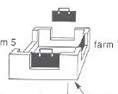
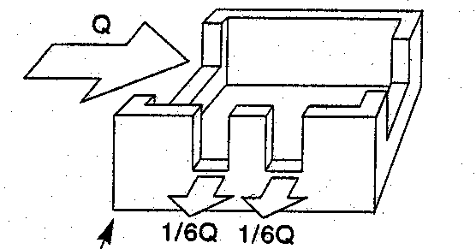
Alignment of Water Course
Use scale of 8" to a mile (1:8000) and spot levels at every corner of 500 ft.
Economical
Minimum in length.
Aligned within one “Rectangle” (Muraba = 25 acer = 990 ft x 1100 ft)
Minimize the losses by irrigating on both sides.
One nakka (Connection) is sanctioned for each Rectangle (Muraba)
  a second may be provided if much necessary

Slide 53
One Square (Muraba)
1100 x 990 ft
25 acres of 220' x 198'
 | 11 | 11 | 11 | 11 | 11 | 11 | 11 | 11 | 11 | 11
24.75 | marla | marla | marla | marla | marla | marla | marla | marla | marla | marla
24.75 | marla | marla | marla | marla | marla | marla | marla | marla | marla | marla
One Kanal
110 x 49.5 ft
20 marlas of 22' x 12'-3"
 | 22 | 22 | 22 | 22 | 22
12.375 | marla | marla | marla | marla | marla
12.375 | marla | marla | marla | marla | marla
12.375 | marla | marla | marla | marla | marla
12.375 | marla | marla | marla | marla | marla
One Kanal
110 x 49.5 ft
20 marlas of 11'x 24'-9"

Slide 54
Factors affecting Cropping Pattern
Soil Characteristics
Climatic Condition
Water Quantity and Quality
Economic Benefits
Self Sufficiency (Staple, Food and Fodder)
Diversity to reduce risk of full failure
Storage facilities
Local farmer’s preference

Slide 55
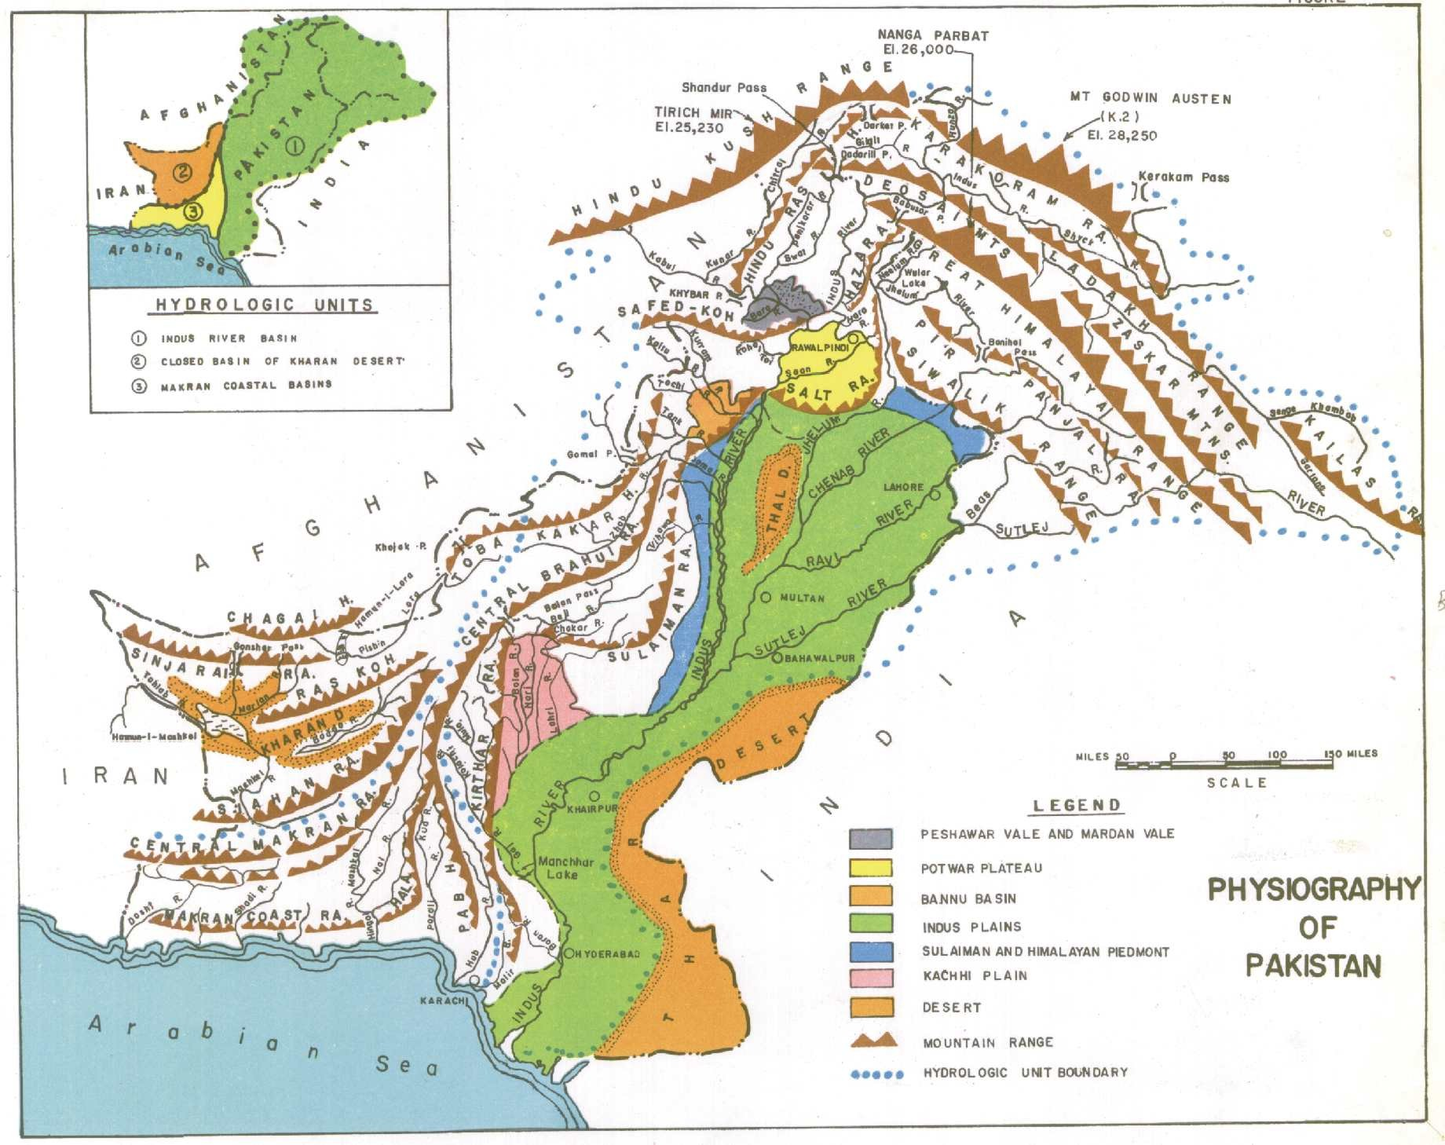
Physiography of Pakistan

Slide 56
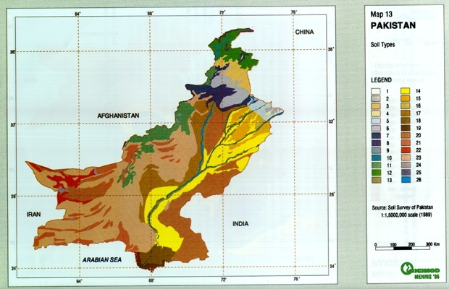
Soil Types of Pakistan

Slide 57

Soil Types of Pakistan
Soil Type | Area | %age
 | (000’ ha)
1. Loamy and sandy stratified soils | 1 | 0.1
2. Loamy and clayey non-calcareous soils | 4.6 | 0.6
3. MOUNTAINS: Loamy shallow soils | 18.6 | 2.3
VALLEYS : Loamy non-calcareous soils
4. Loamy sandy stratified soils | 1.5 | 0.2
5. Loamy clayey non-calcareous soils | 7.7 | 1
6. Loamy non-calcareous soils of alluvial/loess plains | 18.2 | 2.3
7. MOUNTAINS: Loamy and shallow soils | 10.2 | 1.3
VALLEYS : Laomy soils
8. MOUNTAINS: Rock out-crops loamy and shallow soils | 17 | 2.1
VALLEYS : Loamy soils
9. Loamy partly gravelly soils | 0.7 | 0.1
10. MOUNTAINS: Loamy shallow soils and rock out-crop | 2.7 | 0.3
VALLEYS : Loamy soils
11. MOUNTAINS: Rock out-crop and loamy very shallow soils | 41.7 | 5.2
VALLEYS : Loamy soils
12. MOUNTAINS:Rock outcrop, some loamy very shallow | 22.7 | 2.9
soilsVALLEYS : Mainly loamy soils
13. Laomy sandy stratified soils | 18.8 | 2.4
14. Loamy clayey soils | 90.4 | 11.4
15. Loamy soils of old river terraces | 21.9 | 2.8
16. Laomy clayey mainly dense saline sodic soils | 2 | 0.3
17. Loamy and clayey partly slaine sodic soils | 52.7 | 6.6
18. Mainly loamy saline soils | 15.3 | 1.9
19. Silty and calyey saline soils | 5.6 | 0.7
20. Rolling to hilly sandy soils | 116.9 | 14.7
21. Mainly loamy partly gravelly soils | 46.6 | 5.8
22. Mainly loamy partly gravelly soils | 16.7 | 2.1
23. MOUNTAIND: Rocky out-crop with patchy soils | 244.5 | 30.6
VALLEYS : Mainly loamy partly gravelly soils
24. Clayey and loamy severly slaine sodic soils | 2.7 | 0.3
25. Glaciers and snow caps | 3.4 | 0.4
26. Rivers | 13 | 1.6
TOTAL: | 796.1 | 100

Slide 58
Crops vs. Soil type
Heavy retentive soils (>40% clay) are good for rice & sugarcane
Light sandy soil (2 – 8% clay) is suitable for gram, fodder, pulses etc
Medium or normal soil (10-20% clay) is good for wheat, cotton, maize, vegetables, oil seeds etc.
Crop Rotations
Benefits of crop rotation:
  Increase fertility of crop,
  reduce diseases, and
  reduce insects
Examples:
  Wheat → Sorgum (Juvar) →Gram
  Rice → Gram
  Cotton → Wheat → Gram or Sugarcane
  Cotton → Juvar → Gram

Slide 59
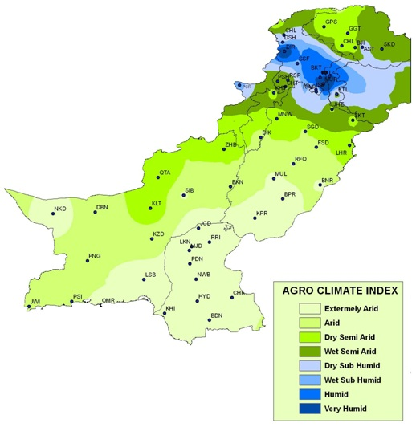
Pakistan: Aridity based on Moisture Index (%age)
http://namc.pmd.gov.pk/zone.php?type=c dated: 225-2-2013

Slide 60
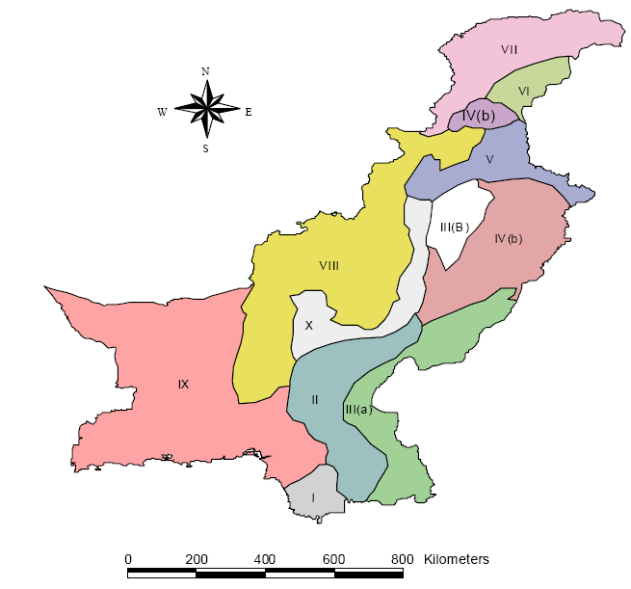
Pakistan Agro-climatic Zones
I Indus Delta
II Southern irrigated
III Sandy Desert (a&b)
IV Northern Irrigated plains (a&b)
V Barren lands
VI Wet mountains
VII Northern dry mountains
VIII Western dry mountains
IX Dry western plateau
X Suleiman Piedmonts

Slide 61
Pakistan Agro-climatic Zones
Zone I: Delta, arid, marine, temperature 20-40 ºC.
The soils are clayey and silty.
Rice, sugarcane, banana and pulses
Zone II: Southern Irrigated Plains, The soils are silty and sandy loam. Cotton, wheat and sugarcane are grown on the left bank of the Indus and Rice, wheat and gram on the right bank
Zone III: Sandy Desert (a). The maximum rainfall is 300-500 mm. The soils are sandy and loamy fine sand. The land is used for grazing.
Sandy Desert (b). Thal
Source PARC, 1980

Slide 62
Pakistan Agro-climatic Zones
Zone IVa: Northern Irrigated Plain (a) - Flood Plains and Bar Uplands. Semi Arid. The soils are sandy, loam-clay and loam. The canal irrigated crops are wheat, rice, sugar cane, oilseed and millets in the north and wheat, cotton, sugar cane, maize, citrus and mangoes in the centre and south.
Zone IVb: Northern Irrigated Plain (b) - alluvial valleys of Peshawar and Mardan. The climate is semi-arid. The soils are silty clays and clay loams. The main crops are sugar cane, maize, tobacco, wheat, berseem, sugar beet and orchards.
Zone V: Barani (Rainfed) Lands. In the North the mean monthly rainfall is 200 mm in summer and 35 to 50 mm in winter. The main crops are wheat, millet, oilseed and pulses.
Def. of Aridity

Slide 63
Pakistan Agro-climatic Zones
Zone VI: Wet Mountains - High Mountains. The mean monthly rainfall is 235 mm in summer and 116 mm in winter. The soils consist of silt loams to silty clays. A small area is under Rainfed agriculture but most of it is under forest.
Zone VII: Northern Dry Mountains. The valley soils are deep and clayey. Most of the area is used for grazing.
Zone VIII: Western Dry Mountains. Most of the land is used for grazing. On part of the loamy soils wheat and fruit crops are grown.
Zone IX: Dry Western Plateau - mountainous areas. The land is used mainly for grazing. Melons, fruit crops, vegetables and wheat are grown where water is available.
Zone X: Sulaiman Piedmont - plains of the Sulaiman Range. The climate is arid and hot. Irrigation relies on floods of the hill torrents.

Slide 64
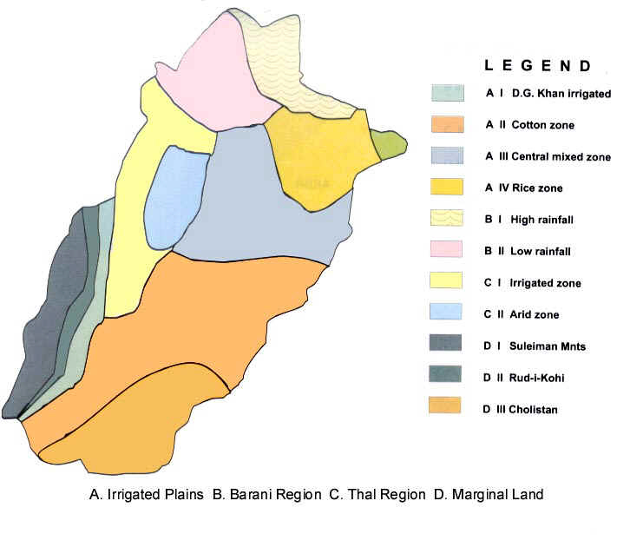
Punjab Agro-Climatic Zones
B I
B II
A IV
C I
C II
A III
D I
D II
A II
C II
D III
Ref http://www.parc.gov.pk/maps/

Slide 65
Cropping Pattern Katchi Canal
Existing (Pre-Canal Pattern):
Crops | Cropped Area (Acres) | Intensities Percent of CA
Kharif
Sorgum | 11,285 | 1.58
Oil Seeds | 357 | 0.05
Pulses | 1,070 | 0.15
Fodder | 2,068 | 0.29
Others | 143 | 0.02
Total Kharif | 14,902 | 2.09
Crops | Cropped Area (Acres) | Intensities Percent of CA
Rabi
Wheat | 4,848 | 0.68
Gram | 214 | 0.03
Oil Seeds | 4,706 | 0.66
Total Rabi | 9,768 | 1.37
ANNUAL : | 24,670 | 3.46

Slide 66
Aridity~Drought~Famine
Aridity ≠ Drought ≠ Famine
but
Aridity may/may not lead to Drought and
Drought may/may not lead to Famine

Slide 67
Definitions
Aridity
  It is characterized by ratio of Annual Average Rainfall (P) and Annual Average Evapotranspiration (PE) at a certain location.
  Generally if P at a location is much less than PE (approx. <0.5), the location is declared as Arid
  37% of the world area is ARID
Source : WMO-UNEP Report (1996):
Interactions of Desertification and Climate as on http://www.sdnpbd.org/sdi/international_days/wed/2006/desertification/index.htm

Slide 68
Aridity Index
Climate Zone | P / PE ratio | % of world covered
Hyper-arid | <0.05 | 7.5
Arid | 0.05-0.20 | 12.5
Semi-arid | 0.21-0.50 | 17.5
Dry sub-humid | 0.51-0.65 | 9.9
Humid | > 0.65 | 39.2
Cold | > 0.65 | 13.6
Source of Inf.: WMO-UNEP Report (1996): Interactions of Desertification and Climate as on http://www.sdnpbd.org/sdi/international_days/wed/2006/desertification/index.htm

Slide 69
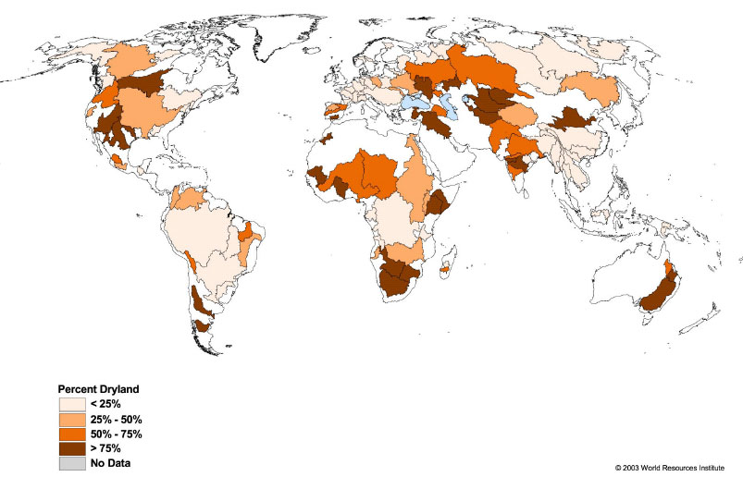
Dry lands by River Basin
Asia

