Slide 1
Performance Assessment and the Indicators
May 2016
Ref:
1. Irrigation and Drainage Performance Assessment by MG Bos, MA Barton, DJ Molden, 2005.
2. Performance Indicators for Irrigation Canal System Managers or Water Users Associations, By David E. Nelson

Slide 2
Performance Assessment
Systematic observation, documentation and interpretation of the management of an irrigation and drainage system, with the objective of ensuring that the input of resources, operational schedules intended outputs, and required actions proceed as planned.
(Bos, Barton, and Molden, 2005).

Slide 3
Advantages of Performance Assessment
Performance Assessment:
Leads to Water Management Policy and Strategy
Strategy leads to operational Plans and Actions.
Implementation of Plans needs the Resources.
Thus assessment is required for better policies, strategies, plans, actions, and resource allocation.
Assessment also help in:
Plotting / showing Time series of performance indicators against Critical Values or Bench Marks, to readily assess status.
Amicable use of various resources (land, water, human, finance) is assessed by comparing with Targeted values
Impact of management actions on use of Resources and Crop yields can be monitored wrt to targets
Systematic presentation of indicators enhance the communication between the stakeholders.
Ref: Bos, MA Barton, DJ Molden, 2005.
Notes:
Policy→ Strategy →Plans →Actions
A Policy is defined as a definite course of action, whereas a Strategy is an educated method or a series of maneuvers dedicated to a specific result. Policies tend to be a requirement dictated by a higher order, while strategies may be used in an attempt to follow a policy.
An example of policy and strategy is seen in a country's foreign policy. Foreign Policy is a regulation meant to safeguard a country's interests, and within that are strategies, such as international relations, used to achieve those goals. Other examples include the ‘No Child Left Behind Act’, which acts as a policy, and after-school tutoring, which is a strategy.
Strategy is what you want to do and Plan is how you will do it.

Slide 4
Why Performance Assessment
Currently 790 million Hungry people
To fulfill the needs of growing population:
  Increase in irrigation withdrawals during 1995-2025:
    14% by FAO estimates, and 17% by IWMI estimates
  Food enhancement required during same period is 40%
Society is demanding much more from Irrigated Agriculture, through:
  More food per drop
  Further development without environmental degradation
  Increased farmer’s income
  Reduce poverty
790 Million Hungry People
Population Milestones:
8 Billion: 2024
7 Billion: 2011
6 Billion: 1999
5 Billion: 1987
4 Billion: 1974
3 Billion: 1960
2 Billion: 1927
1 Billion: 1804

Slide 5
Why Performance Assessment
  Thus vertical expansion (efficiency enhancement) is a must in addition to horizontal growth
  Performance Assessment is KEY to Vertical & Horizontal Expansion
    more crop per drop
    more crop per area, etc.
    more water for further development

Slide 6
Hungry Planet
World: 2780 kcal/person/day
Sub-Saharan Africa: 2240 kcal/person/day
Pakistan:
2293 kcal/person/day
Ref: http://www.internationalbusinessguide.org/hungry-planet/
Notes:
What we eat, and how much:
Dietary energy consumption per person around the world. The dietary energy consumption per person is the amount of food, in kcal per day, for each individual in the total population.
World: 2780 kcal/person/day
Developed countries: 3420 kcal/person/day
Developing World: 2630 kcal/person/day
Sub-Saharan Africa: 2240 kcal/person/day
Central Africa: 1820 kcal/person/day
Kilocalorie: A unit of measurement of dietary energy. One kcal equals 1,000 calories
Calories consumed per capita: Top countries
Austria, 3800 calories a day
U.S. 3,770 calories a day
Greece, averaging 3710 calories.
Belgium 3690 calories.
Americans as a total population eat a total of 815 billion calories of food each day: roughly 200 billion more than needed – enough to feed 80 million people.

Slide 7
Hungry planet: Overshooting
Ref: http://www.internationalbusinessguide.org/hungry-planet/

Slide 8
Hungry Planet: American Standard
Ref: http://www.internationalbusinessguide.org/hungry-planet/

Slide 9
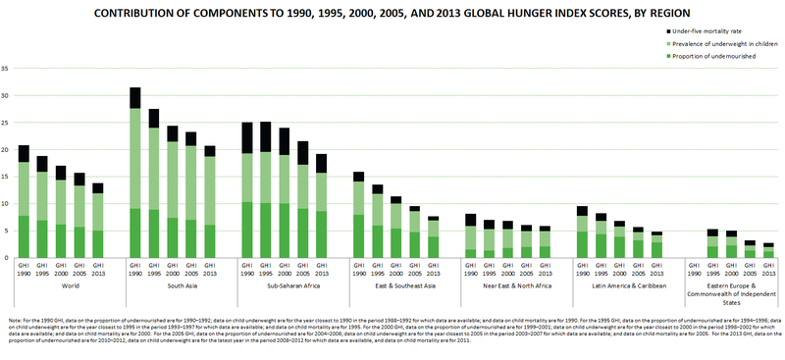
Global Hunger Index (GHI) by Regions
Ref. IFPRI

Slide 10
Various kinds of Performance Assessments
Operational PA:
  to answer, “AM I DOING THINGS RIGHT?”
Strategic PA
  to answer, “AM I DOING RIGHT THINGS?”
Diagnostic PA
  For Scheme Manager (to understand low or high performance)
  For Consultants (for planning interventions)
  For Govt agencies (if the system is meeting the objectives)
  For research Institutes (to understand generic causes of high or low performances)
Comparative PA (one system to other, and to targets)

Slide 11
Why Indicators
Performance Assessment requires Indices, and indicators for quantifying the performance.
Users:
System’s manager, staff, and water users are users of Indicators.

Slide 12
Terminology | Definition | Remarks
Key parameter | A quantifiable (measureable) parameter that influences irrigation or drainage performance. | e.g. flow rate, crop yield, irrigation fee, groundwater depth.
Actual value | Measured or Calculated Value or Quantity of a Key Parameter | e.g. measured flow rate, crop yield, irrigation fee, groundwater depth
Benchmark | The desired value of process output parameter (or of the performance indicator). Used for Comparison. | The benchmark level is set by comparison with best practices of comparable processes.
Critical value | The critical value of the key parameter quantifies a physical process whereby the concentration of a chemical limits crop yield, hampers health, if a critical value is passed | e.g. the salinity of irrigation water has a critical value that reduces crop yield if passed.
Intended value | Value of a measureable parameter that the service providing organization is trying (intends) to achieve. | The intended value should be based on (agreed) service level or on the strategy.
Service level | Amount of goods or service (e.g. water) provided by a service provider to a user. The user can be another organization, a person or a group of people, deemed necessary for proper and effective functioning. | Should be besed on the (national) water law and a service arrangment or agreement between providers and users
Taget value | The desired value of a performance indicator. | See also benchmark
Bos, MA Barton, DJ Molden, 2005.

Slide 13
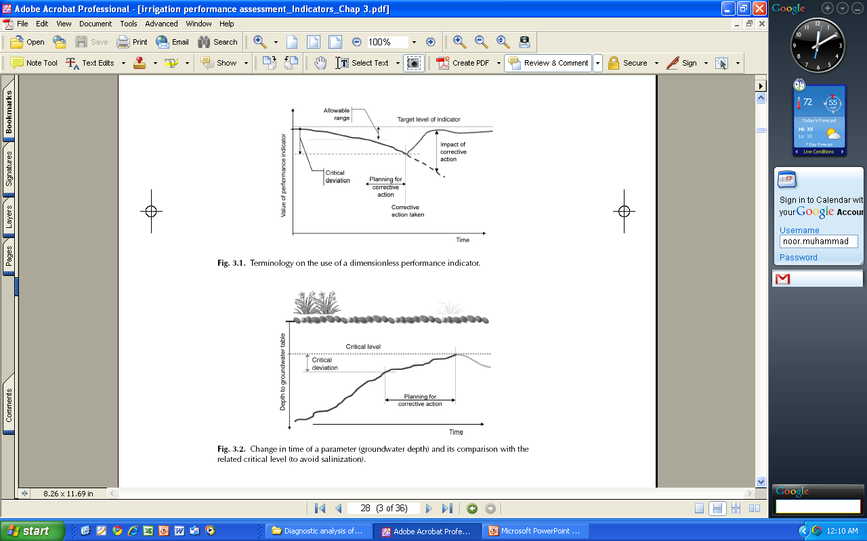
Terminology
Bos, MA Barton, DJ Molden, 2005.

Slide 14
Terminology
Bos, MA Barton, DJ Molden, 2005.

Slide 15
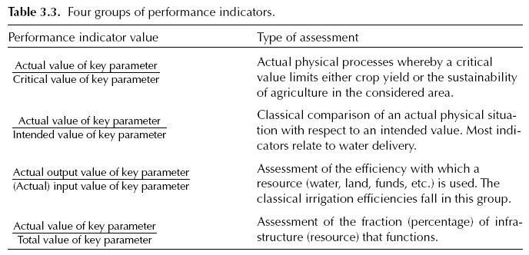
Types of Indicators

Slide 16
Indicators for existing system
(David E. Nelson )
Water Delivery
1. Tail-end Supply Ratio: TSR = N_{S} / N_{T}
2. Area Uniformity: AU = D_{W}/D_{AVE}
3. Delivery Timeliness Ratio: D_{TR} = N_{t}/N_{T}
Maintenance:
4. Carrying Capacity Ratio: CCR = C_{A}/C_{D}
5. Poor Structure Ratio: PSR = N_{P}/N_{T}
Financial:
6. Fee Collection Performance: FCP = F_{C}/F_{A}
7. Maintenance Budget Ratio: MBR = E_{M}/E_{O&M}
8. Personnel Cost Ratio: PCR = E_{P}/E_{T}
9. Manpower Numbers Ratio: MNR = N_{S}/A_{T}
10. Financial Self Sufficiency: FSS = I_{F}/E_{T}
Sustainability:
11. Sustainability of Irrigated Area: SIA = A_{C}/A_{I}
12. Relative Groundwater Depth: RGD = D_{A}/Dm
13. Area/Infrastructure Ratio: AIR = A_{T}/L_{C}
Ref: Performance Indicators for Irrigation Canal System Managers or Water Users Associations,
By David E. Nelson (USBR)

Slide 17
Water Delivery:
1. Tail-end Supply Ratio:
TSR = N_{S} / N_{T}
N_{S} is the number of days that sufficient water reached the end of the canal system
N_{T} is the total number of days the canal system was delivering water.
The ratio ideally should be close to one.
Preferably it is based on daily ditch rider records of sufficiency, but a flow recorder can be used at the final waste way.
With flow recorders, not spilling does not necessarily imply a shortage, but spilling indicates that sufficient water was reaching the end of the canal.
In the USA, a typical value for water spilling at the terminal waste way might be around 70% of the time.

Slide 18
2. Area Uniformity:
AU = D_{W}/D_{AVE}
D_{W} is the water depth (volume/irrigated area) for the worst supplied area in the system.
D_{AVE} is the average water depth supplied to the whole system during the same time period.
A ratio of one is perfect. Values below one indicate the relative inequity.
The ratio is calculated from the total water delivered to major sections of the system and the irrigated area of those sections.
It is a rough indicator of fairness of water deliveries on systems which do not measure water at each turnout.
Soils differences return flows, and use of groundwater can affect values calculated for different areas.
Values found in USA: 0.70, 0.72, 0.76
India: values from roughly 0.50 to 0.90 (From data in Santhi and Pundarikanthan, 1999)

Slide 19
3. Delivery Timeliness Ratio:
DTR = N_{t}/N_{T}
N_{t} is the number of orders where water was delivered within the target time.
N_{T} is the total number of orders (from the individual water order records).
The ratio should be close to one.
Number found in USA: 78% (within 2 days), in a water-short year.
In a district in southwest USA, 72% of deliveries occurred within 1 day and 90% were within 2 days. (Palmer et al, 1991)
A survey of 58 irrigation districts in California USA, indicated that deliveries were nearly always made on the date requested, with an average failure rate of only 0.59 a year per turnout (Burt et al, 2000)

Slide 20
Maintenance:
4. Carrying Capacity Ratio:
CCR = C_{A}/C_{D}
C_{A} is actual canal capacity for the selected canal (measured at designed head)
C_{D} is the designed canal capacity for the selected canal.
The ratio should be close to one.
Ijir and Burton (1998) found 70% on a main canal in Nigeria.
The author has found flow ratios from about 0.60 to 1.36 (using typical peak flows during the last few years, and not necessarily at the designed head).
Canal flows higher than the designed capacity are also undesirable because of the risk of canal failure.
A similar indicator is Delivery Performance Ratio
DPR = Actual Discharge / Intended Discharge
(more on slide 32)

Slide 21
5. Poor Structure Ratio:
PSR = N_{P}/N_{T}
N_{P} is the number of structures in poor condition (not functioning adequately or at risk of failure)
N_{T} is the total number of structures on the system.
Ideally this ratio should equal zero.
The author has found a range of <1% to 20% in the USA.
for a scheme in Nigeria PSR is 89%, but the definition was not exactly comparable (Ijir and Burton,1998)
Other similar indicators: Structure Condition Index, which is the number of structures working normally divided by the total number of structures.

Slide 22
Financial:
6. Fee Collection Performance:
FCP = F_{C}/F_{A}
F_{C} is the annual amount of water charges collected.
F_{A} is the annual amount of water charges assessed.
The ratio should be close to one.
The author has found values from 62% to near 100%.
FCP for a scheme in Nigeria is 80% (Ijir and Burton, 1998)
The FCP value depend upon
  financial problems and/or status of the irrigators,
  lack of support from the irrigators (depending upon their perception of system effectiveness), or
  a poor collection program.
Other similar indicators: Fees Recovery Ratio

Slide 23
7. Maintenance Budget Ratio:
MBR = E_{M}/E_{O&M}
Financial:
E_{M} is the average annual expenditures for maintenance.
E_{O&M} is average annual expenditures for both operations and maintenance.
This ratio is used to detect whether maintenance is being neglected.
The optimum value may vary from region to region, but in the USA it appears to be about 50% for mature systems (older than about 30 years) with very few pipelines.
Ijir and Burton (1998) found 16% for a scheme in Nigeria.
Allen and Brockway (1977) found that systems in Idaho in the United States spent 60-70% on maintenance.

Slide 24
8. Personnel Cost Ratio:
PCR = E_{P}/E_{T}
Financial:
E_{P} is annual expenditures on personnel (wages, fringe benefits, training, etc.).
E_{T} is total annual expenditures (staff + maintenance).
This ratio is used to monitor expenditures on personnel, which tend to become too high relative to other costs.
The optimum may be between 50% and 60%.
A higher value may not be indicator of over staff, but may be less spending on maintenance (small E_{T})

Slide 25
9. Manpower Numbers:
Ratio MNR = N_{S}/A_{T}
Financial:
N_{S} is number of staff (full-time equivalent)
A_{T} is total irrigated area
This ratio will likely vary widely between regions, due to such things as labor productivity and intensity of irrigation.
In the USA, the author has found a range from 0.4 to 1.0 per thousand hectares on systems which shut down for the winter (northern great plains of USA), and 1.36 on a year-round system with 24 hour a day ditch-rider service (Arizona).
Ijir and Burton (1998) found 20 per thousand hectares for a scheme in Nigeria, and suggest a targeted MNR of 6.

Slide 26
10. Financial Self Sufficiency:
FSS = I_{F}/E_{T}
Financial:
I_{F} is income from water user fees and other local income (not including subsidies).
E_{T} is total annual expenditures (including O&M and cost of Borrowing for initial construction).
For financial self sufficiency, this should be near one.
In the USA, most systems are in the 90% to 100% range, but construction cost repayment is often significantly subsidized and thus not truly reflected in the total annual expenditures.
Molden et al (1998) reported values for 16 systems ranging from 28% to 139%, but these numbers were based on O&M expenditures, not total expenditures, which often leads to values higher than 100%.
Higher than 100% some times mislead that the farmers are being overcharged. But actually it is because the initial cost is not included.
Kloezen and Garces-Restrepo (1998) reported values ranging from 78% to 108% on a system in Mexico, but again it was based only on O&M expenditures, not total expenditures.

Slide 27
Sustainability:
11. Sustainability of Irrigated Area:
SIA = A_{C}/A_{I}
A_{C} is current total irrigated area.
A_{I} is initial total irrigated area when system development was completed.
This should be near one. The ratio integrates the effect of many variables which affect sustainability.
The author has found values from about 50% to over 100%.
If it is significantly less than at completion? Why has it decreased?
If it is significantly higher? Are design capacities being exceeded?

Slide 28
12. Relative Groundwater Depth:
RGD = D_{A}/D_{m}
Sustainability
D_{A} is actual depth to the water table.
D_{m} is the minimum intended depth to the water table, based on most sensitive crop.
This indicator should be greater than one. If not, it is likely that drainage improvements are needed, or over-irrigation (applying too much water) needs to be reduced.
Real-world values from 0 to >100 can occur.

Slide 29
Area/Infrastructure Ratio:
AIR = A_{T}/L_{C}
A_{T} is the total irrigated area.
L_{C} is the total length of canals and laterals on the system.
This indicates how much irrigated land is available to support the cost of the infrastructure.
The ratio is likely to vary widely from region to region, because of varying profitability of crops grown and intensity of irrigation practiced.
In the northern USA, roughly 35 hectares or more per kilometer is required to support the cost of the system.

Slide 31
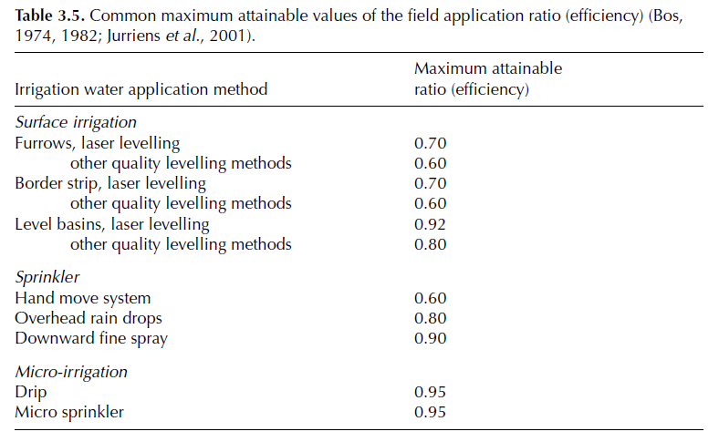
Indicators by Bos et al (2005)

Slide 32
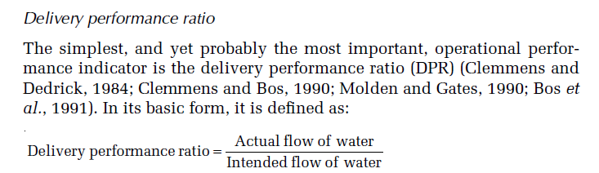
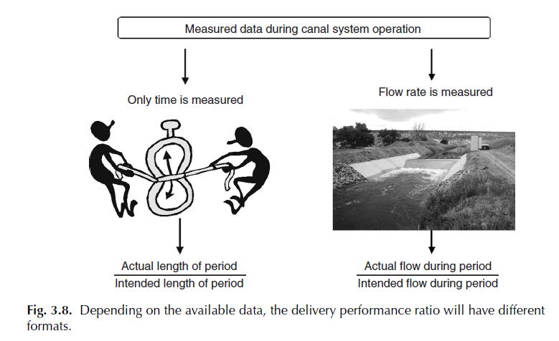
Indicators by Bos et al (2005)

Slide 33
Graphical Representation of Problem Identification and Indicators

Slide 34
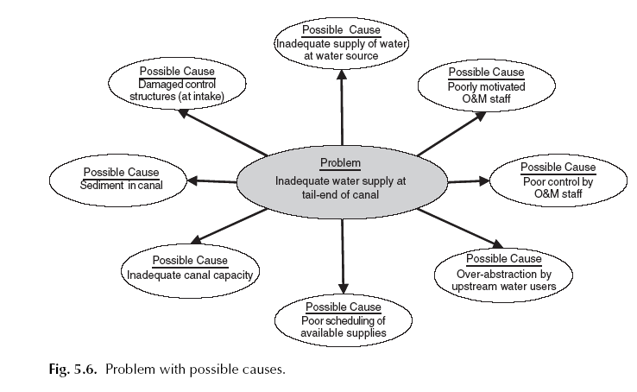
Problem and Cause Identification

Slide 35
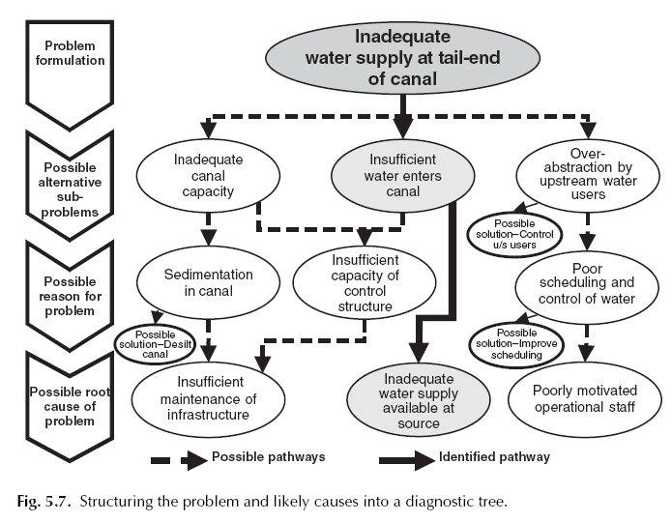
Diagnostic Tree Method for Identification of problem and possible solution

Slide 36
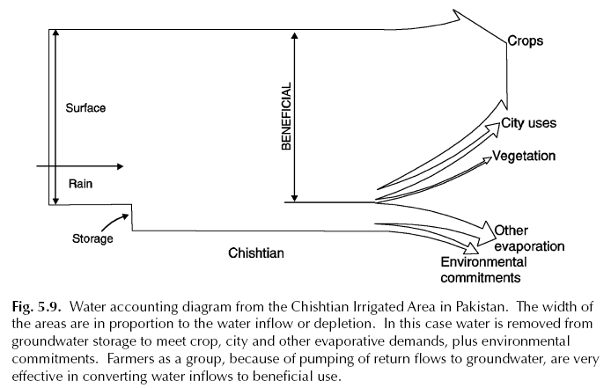
Water Accounting & its Presentation

Slide 37
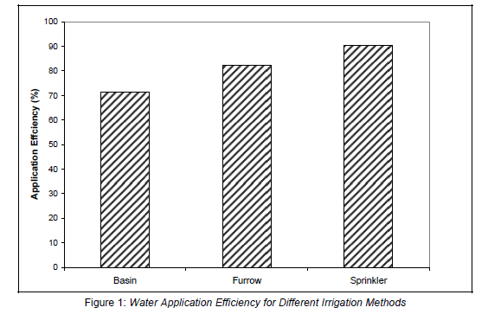
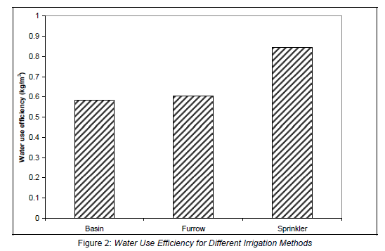
Graphs of Indicators
Water Use Eff.= Crop Mass (kg) produced
per unit of water (kg/m3)
Applic. Eff. = Water Used by the crop
/ Water Supplied in field

Slide 38
REFERENCES
Abernethy, Charles L., K. Jinapala, and I.W. Makin. 2001. Assessing the Opinions of Users of Water Projects. Irrigation and Drainage, Volume 50, Number 3: 173-193.
Allen, Richard G. and Charles E. Brockway. 1977. Operation and Maintenance Costs and Water Use by Idaho Irrigation Projects. In Advances in Irrigation and Drainage. American Society of Civil Engineers, New York: 160-173.
Biswas, Asit K. 1990. Monitoring and Evaluation of Irrigation Projects. Journal of Irrigation and Drainage Engineering, Vol. 116, No. 2: 227-242.
Bos, Marinus G. 1997. Performance Indicators for Irrigation and Drainage. In Irrigation and Drainage Systems, Vol 11, p 119-137. Kluwer Academic Publishers, Netherlands.
Burt, Charles, Andrew Mutziger, and Darren Cordova. 2000. Benchmarking of Flexibility and Needs - Survey of Irrigation Districts, USBR Mid-Pacific Region. Irrigation Training and Research Center, San Luis Obispo, California 93407, USA.
Burt, Charles M. and Stuart W. Styles. 1999. Modern Water Control and Management Practices in Irrigation. Water Report 19, Food and Agriculture Organization of the United Nations, Rome: 211-223.
Burt, Charles M. 1998. Index Helps Irrigation Districts Rate Flexibility of Deliveries. Irrigation Business and Technology (Nov. 1998, p 24-28), Irrigation Association, Falls Church, Virginia 22042-6638 USA.
Ijir, T.A. and M.A. Burton. 1998. Performance Assessment of the Wurno Irrigation Scheme, Nigeria. ICID Journal, Vol. 47, No. 1: 31-46.
Kloezen, Wim H. and Carlos Garces-Restrepo. 1998. Assessing Irrigation Performance with Comparative Indicators: The Case of the Alto Rio Lerma Irrigation District, Mexico. Research Report 22, International Water Management Institute, Columbo, Sri Lanka.
Loof, Rainer, C.L. Abernethy, and V.S. Mishra. 2000. Gate Operation Rules in Canal Irrigation Systems: A Case Study of Khageri Irrigation System, Nepal. ICID Journal, Volume 49/No. 3: 1-24.
Molden, David, R. Sakthivadivel, Christopher J. Perry, Charlotte de Fraiture, and Wim H. Kloezen. 1998. Indicators for Comparing Performance of Irrigated Agricultural Systems. Research Report 20, International Water Management Institute, Columbo, Sri Lanka.
Palmer, Joel D., Albert Clemmens, and Allen R. Dedrick. 1991. Field Study on Irrigation Delivery Performance. Journal of Irrigation and Drainage Engineering, Vol 117/No. 4: 567-577.
Santhi, C. and N.V. Pundarikanthan. 1999. Application of Management Information System in Improving Irrigation System Performance in a Developing Country. Water International, Vol. 24/No. 3: 229-239.

Slide 39
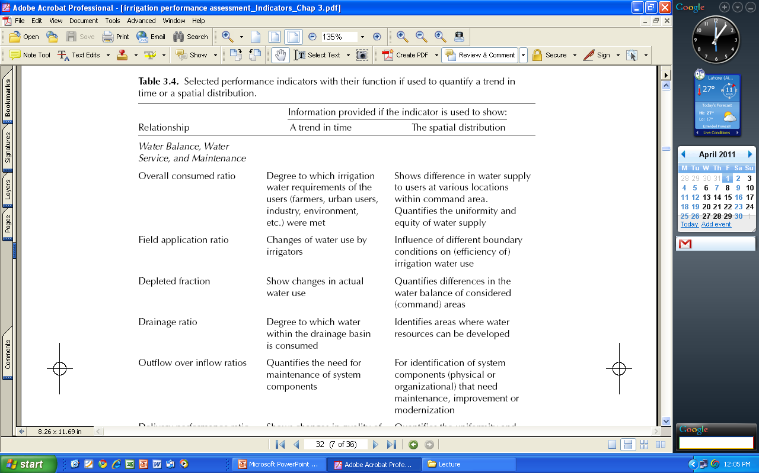
Indicators for Water Balance, Water Service and Maintenance
Ref: Irrigation and Drainage Performance Assessment by MG Bos, MA Barton, DJ Molden, 2005.

Slide 40
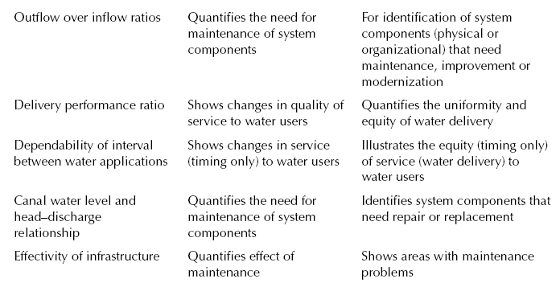
Indicators for Water Balance, Water Service and Maintenance
Ref: Irrigation and Drainage Performance Assessment by MG Bos, MA Barton, DJ Molden, 2005.

