Slide 1
Types of Evapotranspirations
Reference crop evapotranspiration (ET_{o})
Crop evapotranspiration under standard conditions (ET_{c}) and
Crop evapotranspiration under various management and environmental conditions (ET_{c adj}).
Units: Depth of water per unit time (mm/day)
  Can also be expressed in units of Energy per unit area per unit time (MJ.m⁻².day⁻¹)
  About 2.45 MJ/m² are required for evaporation of a mm of water (depends on latent heat of vaporization λ=2.501-0.002362 T) MJ.Kg⁻¹. [1kg water=1litre= 0.001m³= 0.001m (1mm) water over 1 m² area]
  The evapo-transpiration rate expressed in units of MJ m⁻² day⁻¹ is represented by λET, the latent heat flux.

Slide 2
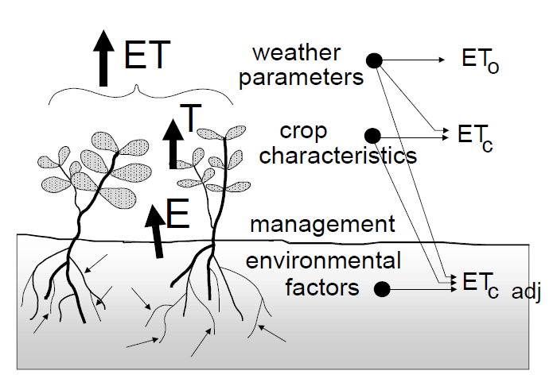
Types of Evapotranspirations

Slide 3
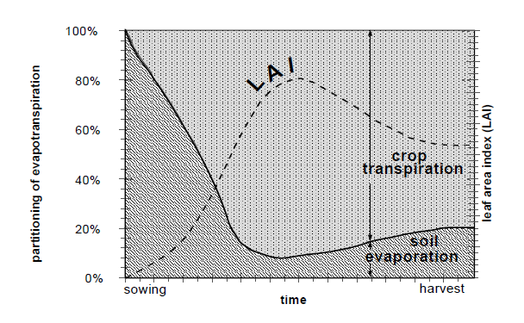
Variation of Evaporation and Transpiration

Slide 4
Types of Evapotranspirations
Kc are estimated through experiments

Slide 5
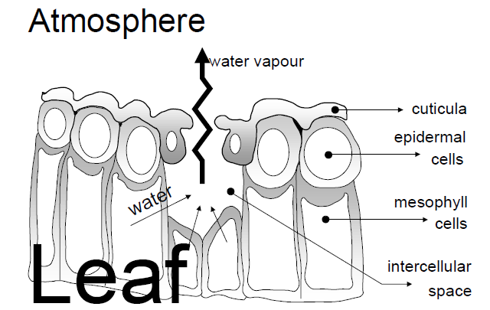
Transpiration through Stomata

Slide 6
Sample ET_{o}

Slide 7
Comparison of various methods by ASCE and EU
ASCE Committee compared ETo computed from 20 different methods with ETo measured from Lysimeter results of 11 carefully selected experiments in different climatic conditions.
Following are major findings regarding 4 methods of FAO-24 (Blaney Criddle, Modified Penmann, Radiation, Pan Evaporation);
The Modified Penman methods over estimate (upto 20%) & it may require local calibration of the wind function to achieve satisfactory results.
The Radiation Methods show good results in humid climates where the aerodynamic term is relatively small, but performance in arid conditions is erratic and tends to underestimate evapotranspiration.
Temperature methods remain empirical and require local calibration in order to achieve satisfactory results. A possible exception is the 1985 Hargreaves’ method which has shown reasonable ETo results with a global validity.
Pan evapotranspiration methods clearly reflect the shortcomings of predicting crop evapotranspiration from open water evaporation. The methods are susceptible to the microclimatic conditions under which the pans are operating and the rigour of station maintenance. Their performance proves erratic.
The relatively accurate and consistent performance of the Penman-Monteith approach in both arid and humid climates has been indicated in both the ASCE and European studies.
Ref: Page 17-18, Chap-2, FAO-56

Slide 8
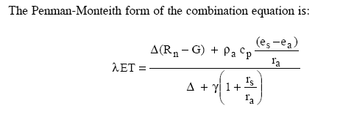
Penman-Monteith Equation
Where:
λET = Latent heat flux , Energy MJ m⁻² day⁻¹
(Divide by 2.45 to convert it to mm/day)
R_{n} is the net radiation,
G is the soil heat flux,
(e_{s} - e_{a}) represents the vapour pressure deficit of the air,
ρ_{a} is the mean air density at constant pressure,
c_{p} is the specific heat of the air,
Δ is the slope of saturation vapour pressure vs Temp curve,
is the psychrometric constant, and
r_{s} and r_{a} are the (bulk) surface and aerodynamic resistances.

Slide 9
Aerodynamic resistance (r_{a})
Z_{om}=0.123h, and Z_{oh}=0.0123h, d=0.67h where h is height of crop
For Reference crop of height 0.12 m and a standardized height for wind speed, temperature and humidity at 2 m (z_{m} = z_{h} = 2 m),
the aerodynamic resistance r_{a} [s m⁻¹] =208/u₂

Slide 10
Aerodynamical resistance over hypothetical reference crop

Slide 11
If wind is not measured at standard height of 2m

Slide 12
Surface resistance (r_{s})
LAI = Leave Area/Soil Area
Active LAI = Sun-lit area of canopy
for Reference Crop:
LAI_{active} = 0.5 LAI
LAI = 24 h
h = height of crop = 0.12 m
And
r₁= 100 s.m⁻¹
For most of the crops LAI varies between 3-5.
It is maximum at flowering time.
LAI can be measured directly by harvesting all green healthy leaves from vegetation over say 1 m².
Only one side of the leave area is considered.

Slide 13

FAO Penman-Monteith Equation for Reference Crop
Putting various equations for REFERENCE CROP, the FAO-Penman-Montieth Eq., can be written as:
Where:
ET_{o} = Eavpotranspiration of Ref. Crop.; mm/day
R_{n} is the net radiation,MJ/m²/day
G is the soil heat flux,
T is mean daily temp, at 2m height, ºC
(e_{s} - e_{a}) represents the vapour pressure deficit of the air,
Δ is the slope of saturation vapour pressure vs Temp curve,
is the psychrometric constant, and
u2 wind speed at 2 m

Slide 14
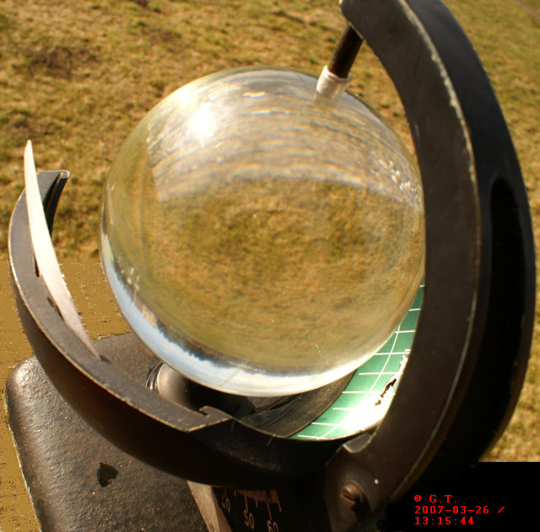
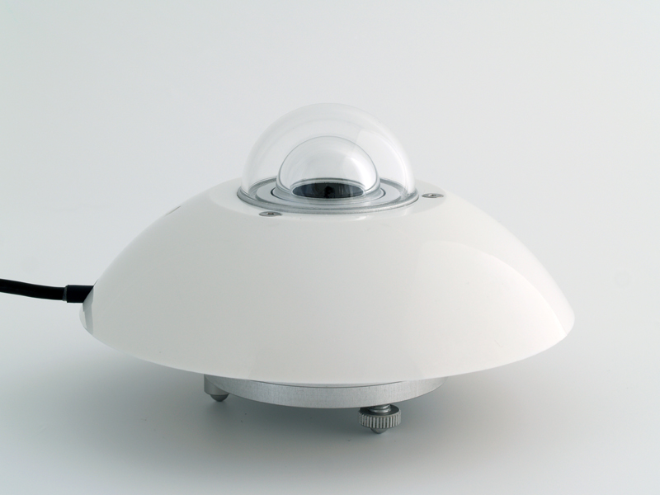
Sunshine measurements
Heliograph (Campbell Stoke)
Pyranometer,
solariometer, radiometer to measure the solar radiations

Slide 15
Components of Radiation
R_{ns} = R_{s} – α R_{s}= (1 - α ) Rs
R_{n} = R_{ns} - R_{nl}

Slide 16
Extraterrestrial Radiation
Solar Constant (Gs)
The radiation striking a surface perpendicular to the sun's rays at the top of the earth's atmosphere, called the solar constant, is about 0.082 MJ m⁻² min⁻¹
Extraterrestrial Radiation is function of location and season
Shortwave Radiation
Radiations reaching ground surface (Rs)
On clear days it is 0.75 times of Ra
On cloudy days it is 0.25 times of Ra
Net Shortwave radiation Rn
Rs - Albedo (Rs)

Slide 17

Extraterrestrial Radiation
Inverse of the square of the relative distance Earth-Sun
Determine Ra (Extraterrestrial Radiation)
for Lahore for 21 March
or
where

Slide 18

Day light hours
Day Light Hours =
Solar (shortwave) Radiation =
a_{s}=0.25, b_{s}=0.5

Slide 19

Net Long wave Radiation
or
R_{ns} = R_{s} – α R_{s}= (1 - α ) Rs
R_{n} = R_{ns} - R_{nl}

Slide 20
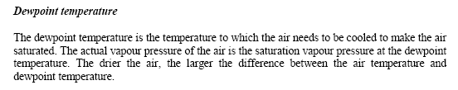
Vapour Pressure Saturated and Actual
Preference:
Tdew
RH max and RH Min
RH max
RH mean

Slide 21
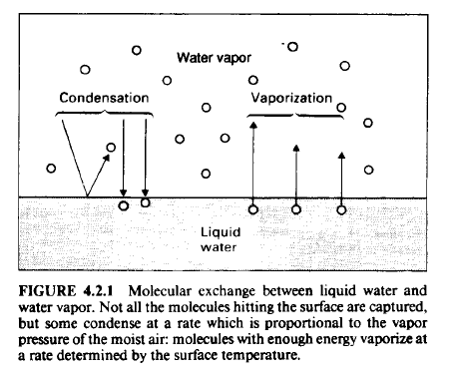



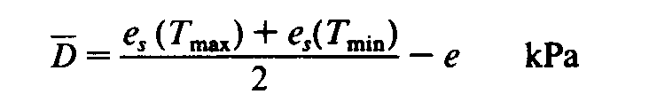
Vapor Pressure
Latent Heat of Vaporization
Clausius Clapeyron Equation
Δ = Gradient of e_{s} w.r.t. T
D=Vapor Pressure Deficit = e_{s}- e
Hygrometer: to measure the RH
Psychrometer: to measure the Dry &
Wet Bulb Temp.

Slide 22
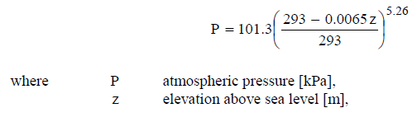
e_{a} from dry bulb, wet bulb temp

Slide 23
Table for Vapor Pressure from Dry and Wet Bulb Temp. (Aspirated Psychometer)

Slide 24
Table for Vapor Pressure from Dry and Wet Bulb Temp. (Non-ventilated Psychometer)

Slide 25
Outgoing heat conduction to Soil
Δz is 0.1 to 0.2 for daily calc. and
is up to 2 m for monthly calculations
For time period from 1 day to 10 days, G/day is negligible

Slide 26
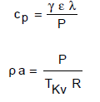

Other parameters

Slide 27
Exercise
Find ETo (mm/day) for Lahore with following data:
Tmax= 25ºC
Tmin= 13 ºC
Tdew = 15 ºC
RH max=70%
RH min =55%
Z= 216 m
Lat. 33.5 N
Date 1-4-2015
u2= 2 m/s
Ca=1.01
Cs=2.1
Lembda=2.45
…. Assume other data

Slide 28
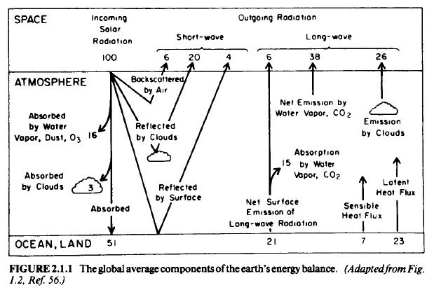

Slide 29
Basic Laws of Emission
Stefan’s Law (Stefan Boltzmann’s Law)
W =σ T⁴
W = total radiant exitance watts / m²
σ = Stefan Constant = 5.6697 x10⁻⁸ W m^{-2 o}K⁻⁴

Slide 30

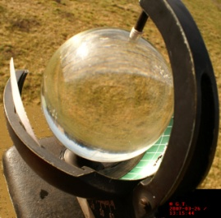
Net Radiation
Symbols used in this slide are from Handbook of Hydrology
In other slides, symbols are that of FAO-56
Angstrom
formulae
N= Total sunshine hours/day
n = actual sunshine hours/day
So= Solar radiation above atmosphere MJ/m2/day = Rso in FAO-56
e_{d}= vapor pressure KPa = e_{a} in FAO 56
f= adjustment for cloud cover
ε’= emissivity coeff.
For measuring sunshine hours use
Campbell-Stokes heliograph

