Slide 1
Losses in Irrigation System

Slide 2
Content
Losses
How to measure
Historical Estimates of losses measurements
Some empirical formulae
Lining of canals
B/C analysis

Slide 3
Types of losses
Seepage
  Major reason of water lost
  Vary from 2 to 50%
Evaporation
  Depend on climatic perimeters and surface area
  2-3% of canal diversions
  Max. in Kharif, and is limited to 7% of flow.

Slide 4
Methods used to measure Seepage
  Direct Methods
    Ponded Test method
    Inflow outflow method
    Seepage meter
  Indirect Methods
    Steady state method
    Canal closure method

Slide 5
Direct Methods
Ponded method
  Canal is filled with water.
  Inflow and outflow is stopped
  Losses measured through change in water level in canal at regular interval (e.g. daily)
  Have to close the canal, and not recommended for Main Canals
Inflow Outflow Method (frequently used)
  Water budgeting is done
  Flows are measured at upstream, downstream end and diversions
  Seepage = Inflows – Outflows
  Relatively Quick, Simple, but depends on accuracy of discharge measurement (Notch Coefficient? Current Meter?)

Slide 6
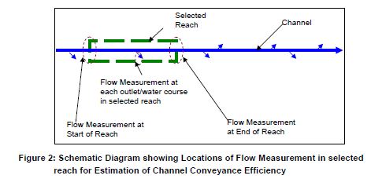
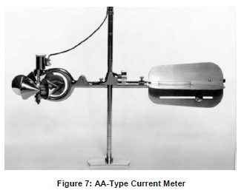
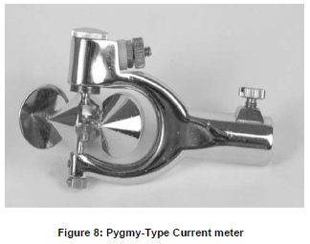
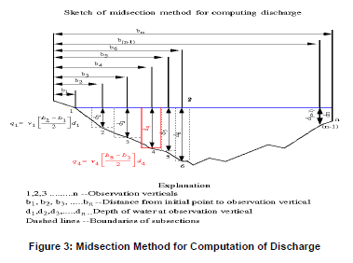
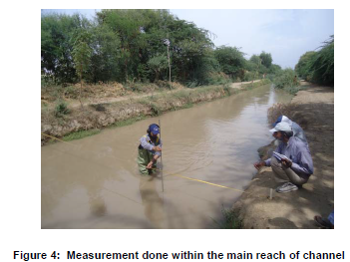
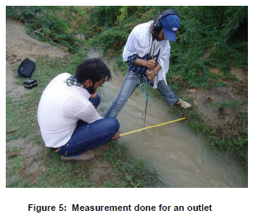
Inflow outflow method
Ref:

Slide 7
Seepage Meters
It has been used for seepage measurement in Canals, Rivers, Coral Reefs, Marine Environment
The basic concept of the seepage meter is to cover and isolate part of the sediment-water interface (the bed of channel) with a chamber open at the base and measure the change in the volume of water contained in a bag attached to the chamber over a measured time interval.
The classic design of Lee (1977) consists of a 15-cm end section of a 55-gallon (~200L) drum, which is inserted into the sediment.
A stopper with a tube is inserted into a hole in the top of the drum and a plastic bag is attached to the tube with rubber bands.
The time when the bag is connected and when it is subsequently disconnected is recorded, as well as the change in the volume of water in the bag.
The seepage flux (Q/A) is calculated as:
Q/A=(V_{f}-V_{o}) / (t A), where V_{f} & V_{o} are final and initial volume of water in bag, respectively. A is bottom area, t is interval.

Slide 8
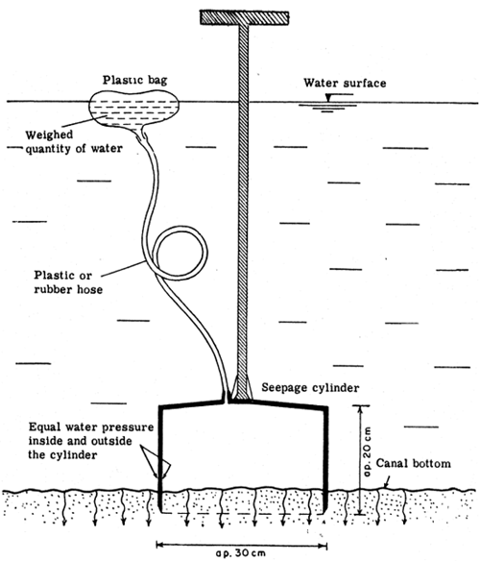

Slide 9
Methods of loss measurement
Indirect:
  Steady State
    Knowledge of soil permeability and water table level is required
    Flow net is drawn based on water table around canal
    Seepage losses are calculated, using Darcy Formulae
      Q = K i A
      Q = Seepage flow
      K = Permeability
      i = Head Loss Gradient = H_{L}/L
      A = Area of flow
      Q/A = discharge velocity (not actual velocity, that depends on capillary area)
(for further detail on flownet: GARG page 1058-1059,
)

Slide 10
Indirect method (Steady state)
Canal Section
Flow lines
H
Water Table
Percolation: When seepage reaches to water table (H is effective)
Absorption: When saturation line due to seepage is above the Water Table
(Full H is not effective, rather head upto saturation line+Capillary head is active)

Slide 11
Indirect method
Canal Closure Method:
  Continuous observation of Water table profile is done during canal level fluctuations (before, during and after canal closure) near a canal.
  Seepage is computed by simple graphical means using observed water table profile with time.
  This method was performed on 44 canals in Sukkur and Kotri command canals during annual closure of Dec/Jan1964, April/May 1964.
  Difficult and not much reliable.

Slide 12
Factors affecting Seepage
Type of seepage
  (Percolation or absorption)
Soil permeability
Condition (age) of a canal
  Seepage through silted canal is less than a new canal
Amount of silt in canal
  More silt: less seepage
Velocity of canal
  More is velocity, less will be losses
Full Supply Level wrt Ground Level and Water Table
X-Section and wetted perimeter
Maintenance of the canal

Slide 13
Seepage Losses in Irrigation Canals in Pakistan
Many studies to estimate the seepage losses
Col Dyas (1863): First Civil Engineer: Experiments on Mainline Upper Bari Doab: To determine seepage losses.
  Estimated that losses are of order of 20% of Canal Head Discharges
  Proposed P=C (d)^{0.5}
  where C is coefficient, d is depth in ft, and P is loss in cusecs per million sq ft. of wetted perimeter.
Other studies: Higham, Kennedy, Lacey, Ivens and Hulton.

Slide 14
Early studies
Higham (1874): Bari Doab Canal
  12.74% of flow of 2114 cusecs (Head reaches)
  19.1% of flow of 336 cusecs for lower reach
Kennedy (1881-82): Sirhind Canal (Punjab): Cold Season:
  Out of 100 Cusec entering the canal at head:
    20 cusecs (20%) is lost in Main Canal
    6 cusecs in distributaries (6% of head flow, or 7.5% of Distributaries flow)
    21 cusecs in village water course (21% of head flow, or
    28.4 % of flow in water course)
Results of early studies (before 1920) are of wide range (4 to 20 cusecs per MSF)

Slide 15
Sharma (1938-40) studies
S No | Canal | Range of Losses (Cusecs/MSF)
1 | Upper Jhelum | 2.3 to 8.5
2 | Upper and Lower Chenab | 2.5 to 9.0
3 | Pauliani Distributary | 1.0 to 2.5
4 | Mangtanwala Branch | 0.5 to 6.5
5 | Biknar Main Line (Lined canal) | 1.5 to 2.0
For Punjab a range of 0.5 to 9 cusecs per MSF

Slide 16
Irrigation Deptt Punjab Experiments
For Eastern Channels:
  Qs=5 Q^{0.0625}
  Qa=0.0133 L Q ^{0.5625}
  L is length in thousands feet, Qs is seepage loss (cusec) per MSF of wetted perimeter, Qa is seepage loss in cusecs, and Q is channel discharge in cusecs
Water and Soil Investigation Division (WASID) of WAPDA Studies:
  Inflow outflow method
  300 independent measurements
  70 were selected based on consistency
  Wider Variation of losses are found

Slide 17
Irrigation Deptt. Studies
Canal | Doab | RD | Method | Seepage (Cusecs per MSF) | Reference
Jhang Br | Rechna | 260 to 32,260 | Statistical | 10.3 | A.R. IRI 1938
Kasur Br | Bari | 8500 to 104400 | Current meter and sounding rod by Malhotra | 10.5 | -do-
Main Ali Br. Of Lower Chenab Canal | Rechna | 0 to 134, 850 | Statistcial methods | 13.7 | A.R. IRI 1940
Kasur Br | Bari | 8500 to 104,400 | Sharp crested weir at two sections | 4.8 to 7.5 | A.R. IRI 1941
Punjab all | All doabs |  | Analysis by Crump using 20 years data | 8 - 25 | Punjab Engg Cong. Paper no 248, 1947

Slide 18
WASID (WAPDA) Studies
Doab | Canal | Seepage (Cusecs per MSF) | Seepage (Cusecs per Canal Mile)
Thal | Mohajir (Lined) | 9.85 | 3.3 – 8.6
 | Rangpur | 6.05 to 14.6 | 2.6 to 9.3
 | Mainline (lined) | 21.7 | 9.9
 | Munda (Lined) | 21.73 to 48.92 | 4.13 to 9.46
 | Piplan Dist. | 8 | 0.66
Chaj | UJC | 7.9 | 10.9
 | LJC | 19.18 | 16.73
Rechna | Burala | 6.3 to 22.4 | 2.4 to 13.1
 | Manawala | 2.74 | 0.64
Bari | BRB Link (Lined) | 10.16 to 5.85 | 11.7 to 7.3

Slide 19
Regional plan for Northern Indus Plains (1967)
Losses in Link Canals
  BRBD : 8 cusecs per MSF
  MR : 8
  B-S II : 6
  Q-B : 8
  R Q : 8
  S-M : 2 (80% lined)
  T-S : 8
  C-J : 12
  T-P : 12
Losses in Rabi are taken as 80% of Kharif
Losses in Main canals are also taken as 8 cusecs/MSF

Slide 20
Lower Indus Report
Till 1960 no study for Lower Indus
1963-64 Sir Mac Donnald and Partners Study
Methods used:
  Direct Methods
    Ponded Test method (not for main canals)
    Inflow outflow method (Loss=Inflow-Outflow)
  Indirect Methods
    Steady state method
    Canal closure method

Slide 21

Losses in Sindh Canals
Ref: (Lower Indus Report)
Canal | Seepage (Cusecs per MSF)
North West Canal | 5.6
Kirthar Branch | 4
Raine | 2.5
Dadu | 4.2
Johi Br. | 6.1
Khairpur Br. | 4.3
Rohri Canal | 5.8
Nusrat Br. | 7.5
Jam Br. | 4.8
Ref: Sindh WSIP study, 2012 by Nespak, ACE & Temelsu,2012.

Slide 22
Harza Study (late 1960)
Based on observation of earlier researches
Assumed that Loss is linear function of canal withdraw
Calculated the coefficients (SLB) for full supply flow and SLA for Low flows.
  Loss = SLA Q or
  Loss = SLB Q_{max.}
  While Q is flow in cusecs, Loss is cusecs per MSF.
For 45 canal commands studied:
  SLA varied between 0.2 to 0.4 and
  SLB Varied between 0.1 to 0.2
For Link Canals,
  SLA varied between 0.006 to 0.132 and
  SLB Varied between 0.005 to 0.13

Slide 23
CRBC Study
(Siddiqu et al. 1990-92)
Earthen Channel: RD 0 to RD 120+000
Concrete Lined Channel: RD 120 to RD 260
Water table varies between 3-10 ft along the channel
Mainly Fine textured soils in the project (22% is coarse)
Used Inflow-Outflow method
Losses cusecs/MSF
  Unlined Channel:
    Weighted Average, Max., Min = 4.381, 11.01, 0.8
  Lined Channel
    Weighted Average, Max., Min = 2.97, 6.32, 1.281

Slide 24
Other studies
Ref: Garg SK (1999)
  Loss = 0.005 (B+D)^{2/3} (Used in UP India)
  Loss in cumecs per km length
  B is width and D is depth of channel in meter
  Loss = 1.9 Q ^{1/6} (Used in Indian Punjab)
  Loss in cumecs per million sq. meter of wetted perimeter,
  Q is flow in cumecs

Slide 25
Lining of Canals
(Ref: Garg, 1999)
To stabilize the earthen surface of the canal using: Concrete or bricks, tiles or asphalt, Geomembrane.
Can reduces losses upto 90% of original losses
Lined canal normally costs 2-2.5 times that of unlined canal
Benefit cost analysis should be carried out before decision of lining

Slide 26
Benefits of Lining
Seepage control
  Can be a single factor for decision
  Result in more water availability which will lead to
    Small storage reservoirs,
    Small sections of channel for same command area

Slide 27
Seepage through various surfaces
(Garg, 1999)
S No | Type of lining | Initial seepage (Cumecs per MSM) | Stabilized Seepage (Cumecs per MSM) after lining or stabilizing
1 | Unlined Channel | 7.4 | 3.4
2 | 30x15x5 cm tiles using 1:3 c/s mortar | 0.17 | 0.009
3 | PCC 1:3:6, 10 cm, | 0.13 | 0.007
4 | 10cm Lime concrete 1(cement):5(lime):12(Surkhi): 24(Brick ballast) | 0.4 | 0.13
  In general
  For Lined Channels: Qs = 1.25 Q^{0.056}
  where Qs =Absorption loss per million Sq.ft

Slide 28
Benefits of Lining
Prevention of Water Logging and Salinity
  1 Millions acre of land were being wasted due to Water Logging and Salinity (in 1960’s)
Increase in Channel Capacity
  Due to reduced “n” value
Increase in command Area
  Mild slopes (without sedimentation) will result in higher levels and thus larger command
Reduction in Maintenance Cost
  Less silt removal (Bhul Safai), less weeds removal and less repairs
Reduced Breaches (flooding)

Slide 29
Financial Justification
Annual Benefits: =mC₁+pC₂
  Where: m = Water saved by lining (cumecs)
  p = Fraction of maintenance cost saved due to lining
  C₁= Cost (or revenue) of Water per Cumec (Rs/cumec)
  C₂= Cost of Maintenance of unlined channel (Rs)
Annual Cost
  If C= Capital Cost on Lining (Rs)
  Y= Life of Lining (years)
  r = Interest Rate (%)
  Annual Cost = cost per year + interest per year
  = C/Y + 0.5 r C (considering the time value of money)
Annual Benefit/Annual Cost should be at least 1 for a decision of installing Lining

Slide 30
Example 5.1 (Garg 1999)
Current Seepage Loss = 3.3 cumecs/MSM
Seepage loss with lining = 0.008 Cumec/ MSM
Lining with 10 cm (PCC)
Cost of lining = Rs 30,000 / 10 sq m
Annual Revenue from crop = Rs 50 million/cumecs
Q = 83.5 cumecs
Sectional Area= 108 m²
Wetted perimeter (unlined channel) = 44.5 m
Wetted perimeter (lined channel) = 44 m
Annual Cost of maintenance of unlined channel = Rs 2000 / 10 sq m
p = 0.4 (saving in maintenance cost)
r = 10%
Assume suitable values if missing

