Slide 1

Department of Civil Engineering
Civil Engineering Department
CE-101 Elementary Surveying

Slide 2
Electronic Distance Measurement (EDM)
A major advance in surveying instrumentation occurred approximately 60 years ago with the development of electronic distance measuring (EDM) instruments.
These devices measure lengths by indirectly determining the number of full and partial waves of transmitted electromagnetic energy required in traveling between the two ends of a line. In practice, the energy is transmitted from one end of the line to the other and returned to the starting point; thus, it travels the double path distance. Multiplying the total number of cycles by its wavelength and dividing by 2, yields the unknown distance.

Slide 3
History Of EDM
Development of this type of technology started during World War II with the development of RADAR (Radio Detection and Ranging).
Radars returned the distance to an object (and later versions the speed of the object through the Doppler shift) by timing the length of time the from the transmission of a pulse to its return. Accuracy was set by timing resolution (1msec=300meters).
In 1949, Dr. Erik Bergstrand of Sweden introduced the Geodimeter (Geodetic Distance Measurement) that used light (550 nm wavelength) to measure geodetic quality distances (instrument weighed 100kg).

Slide 4
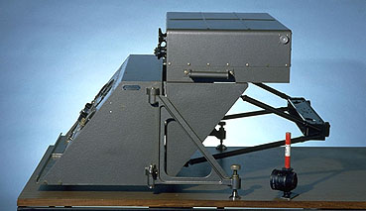
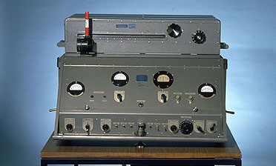
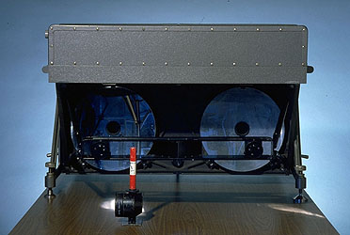
Geodimeter
First units circa 1959 (50 kg each for measurement unit and optics
Distance range was about 10 mi during daylight and 25 mi at night

Slide 5
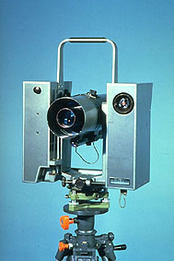
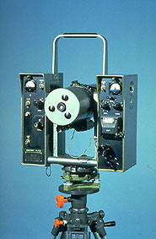
Later model Geodimeter
Example of a latter model Geodimeter (circa 1966)
Front and back views

Slide 6
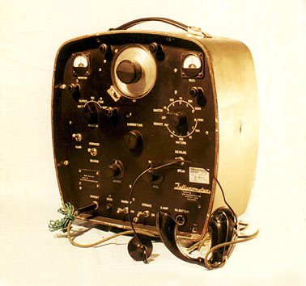
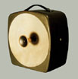
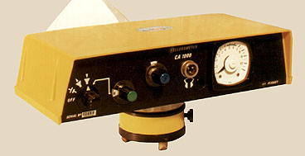
Tellurometer
In 1957, a second EDM apparatus, the tellurometer, was introduced. Designed in South Africa by Dr T. L. Wadley, this instrument transmitted microwaves, and was capable of observing distances up to 50 mi (80 km) or more, day or night.
Back and front of instrument (9 kg with case)
1970’s version (1.7kg)

Slide 7
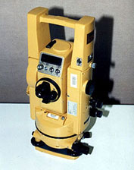
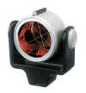
Modern Versions
These types of measurements are now directly built into the telescope assemblies of theodolites and you can see these on most construction sites. The angles are now also read electronically (compared to glass optical circles).
Modern example (circa 2000)
Corner cube reflector, Infrared light source used

Slide 8
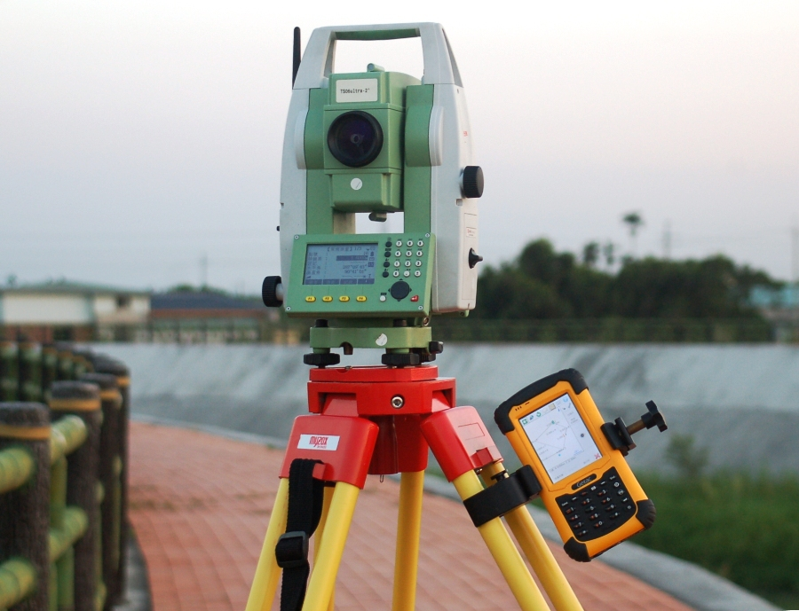
Modern Versions (contd.)
In the modern generation, EDM instruments are combined with digital theodolites and microprocessors to produce total station instruments. These devices can simultaneously and automatically observe both distances and angles.

Slide 9
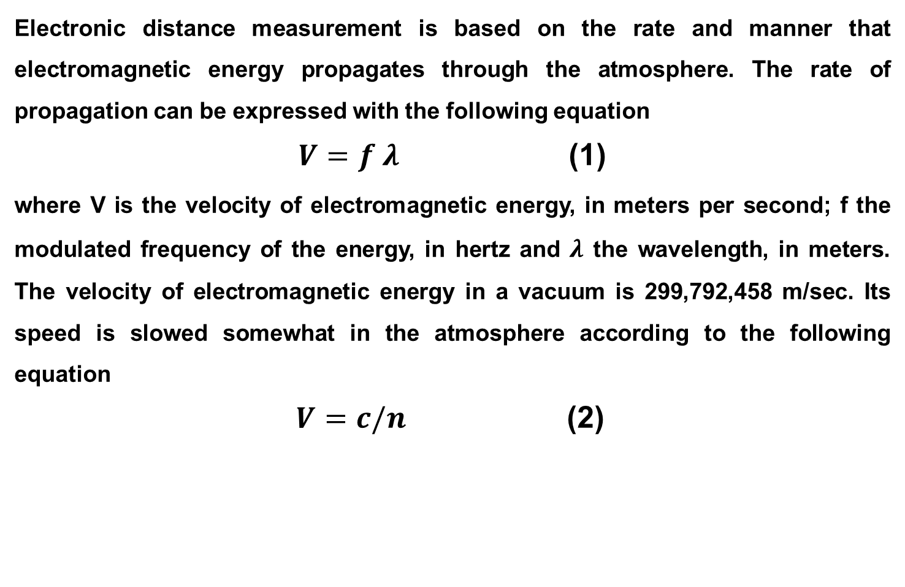
Principal of EDM
Electronic distance measurement is based on the rate and manner that electromagnetic energy propagates through the atmosphere. The rate of propagation can be expressed with the following equation
$V=f λ$ (1)
where V is the velocity of electromagnetic energy, in meters per second; f the modulated frequency of the energy, in hertz and $λ$ the wavelength, in meters. The velocity of electromagnetic energy in a vacuum is 299,792,458 m/sec. Its speed is slowed somewhat in the atmosphere according to the following equation
$V=c/n$ (2)

Slide 10
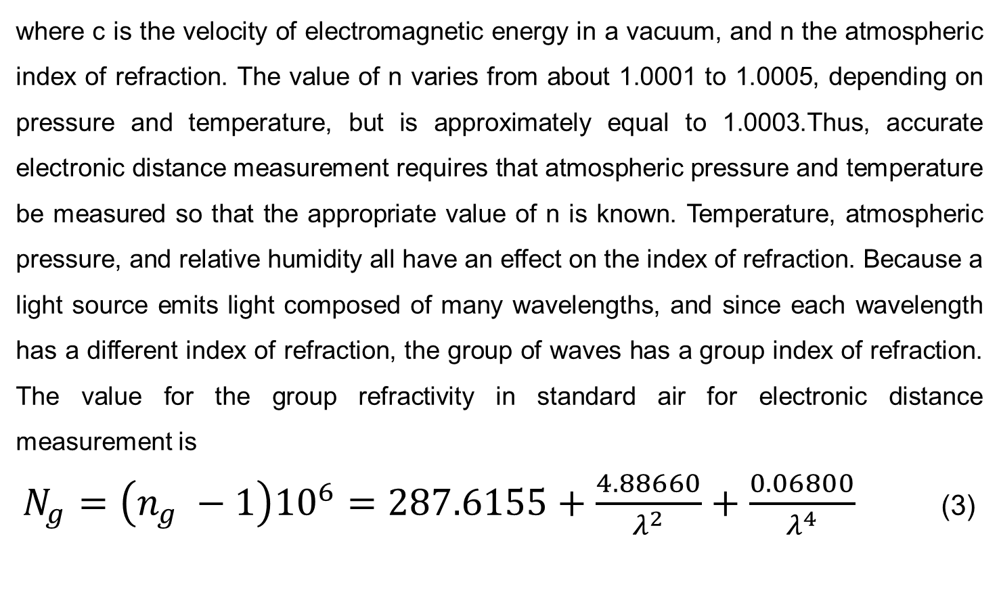
Principal of EDM (contd.)
where c is the velocity of electromagnetic energy in a vacuum, and n the atmospheric index of refraction. The value of n varies from about 1.0001 to 1.0005, depending on pressure and temperature, but is approximately equal to 1.0003.Thus, accurate electronic distance measurement requires that atmospheric pressure and temperature be measured so that the appropriate value of n is known. Temperature, atmospheric pressure, and relative humidity all have an effect on the index of refraction. Because a light source emits light composed of many wavelengths, and since each wavelength has a different index of refraction, the group of waves has a group index of refraction. The value for the group refractivity in standard air for electronic distance measurement is
$N_{g}=\left(n_{g} −1\right){10}^{6}=287.6155+\frac{4.88660}{λ^{2}}+\frac{0.06800}{λ^{4}}$ (3)

Slide 11
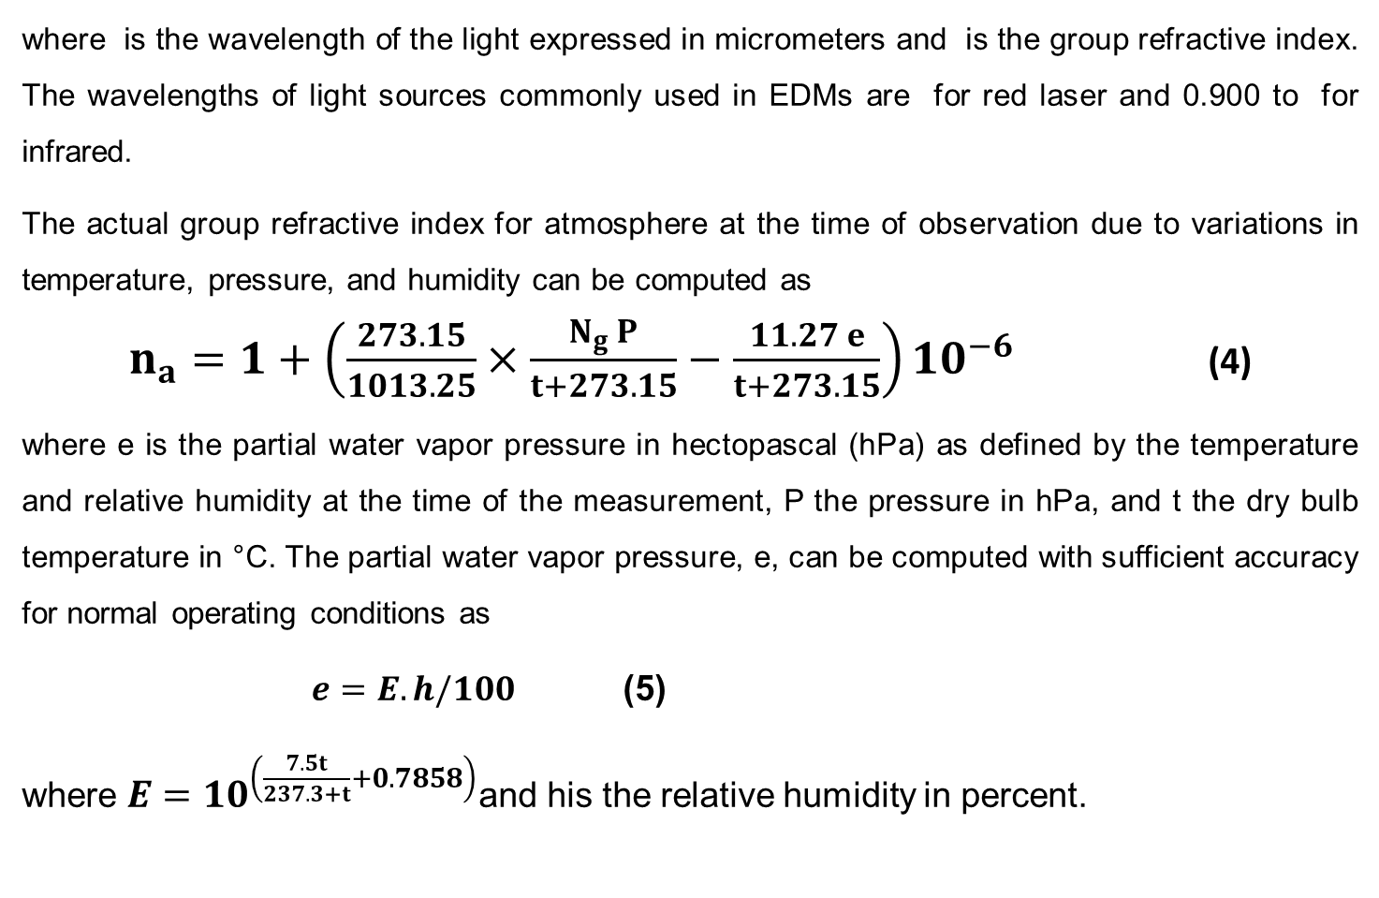
Principal of EDM (contd.)
where is the wavelength of the light expressed in micrometers and is the group refractive index. The wavelengths of light sources commonly used in EDMs are for red laser and 0.900 to for infrared.
The actual group refractive index for atmosphere at the time of observation due to variations in temperature, pressure, and humidity can be computed as
$n_{a}=1+\left(\frac{273.15}{1013.25}×\frac{N_{g} P}{t+273.15}−\frac{11.27 e}{t+273.15}\right){10}^{−6}$ (4)
where e is the partial water vapor pressure in hectopascal (hPa) as defined by the temperature and relative humidity at the time of the measurement, P the pressure in hPa, and t the dry bulb temperature in °C. The partial water vapor pressure, e, can be computed with sufficient accuracy for normal operating conditions as
$e=E.h/100$ (5)
where $E={10}^{\left(\frac{7.5t}{237.3+t}+0.7858\right)}$and his the relative humidity in percent.

Slide 12
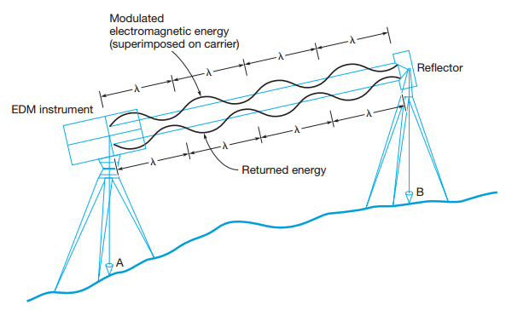
Generalized EDM Procedure
The procedure of measuring a distance electronically is depicted in Figure.

Slide 13
Generalized EDM Procedure (contd.)
An EDM device has been centered over station A by means of a plumb bob or optical plumbing device.
The instrument transmits a carrier signal of electromagnetic energy to station B.A reference frequency of a precisely regulated wavelength has been superimposed or modulated onto the carrier.
A reflector at B returns the signal to the receiver, so its travel path is double the slope distance AB.
In the figure, the modulated electromagnetic energy is represented by a series of sine waves, each having wavelength The unit at A determines the number of wavelengths in the double path, multiplied by the wavelength in feet or meters, and divided by 2 to obtain distance AB.

