Slide 1
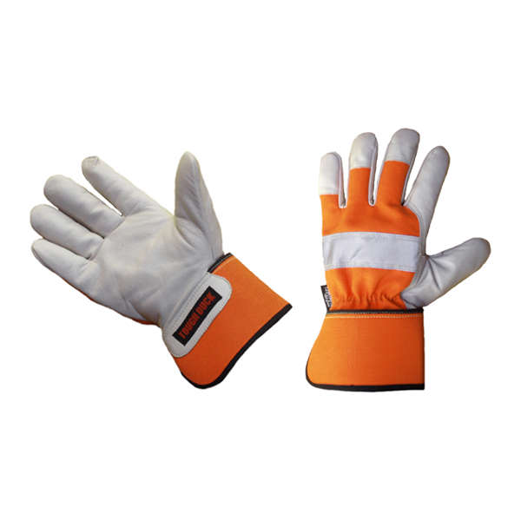
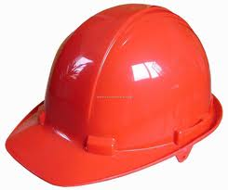
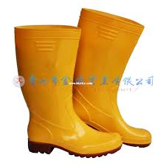
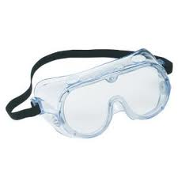
Personal Protective Equipment (PPE) for construction
Faizan Shafique

Slide 2
What is PPE ?
(According to Queensland Government) Personal protective equipment (PPE) is any clothing, equipment or substance designed to protect a person from risks of injury or illness.

Slide 3
Importance of PPE in construction
Construction workers are constantly faced with new situations that may be potentially hazardous.
Workers work with potentially dangerous tools and equipment amidst a clutter of building materials.

Slide 4
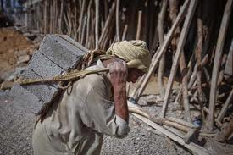

Slide 5
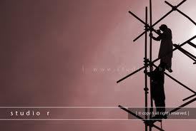

Slide 6
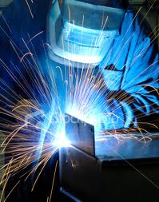
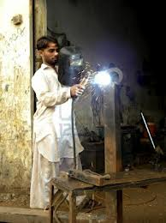

Slide 7
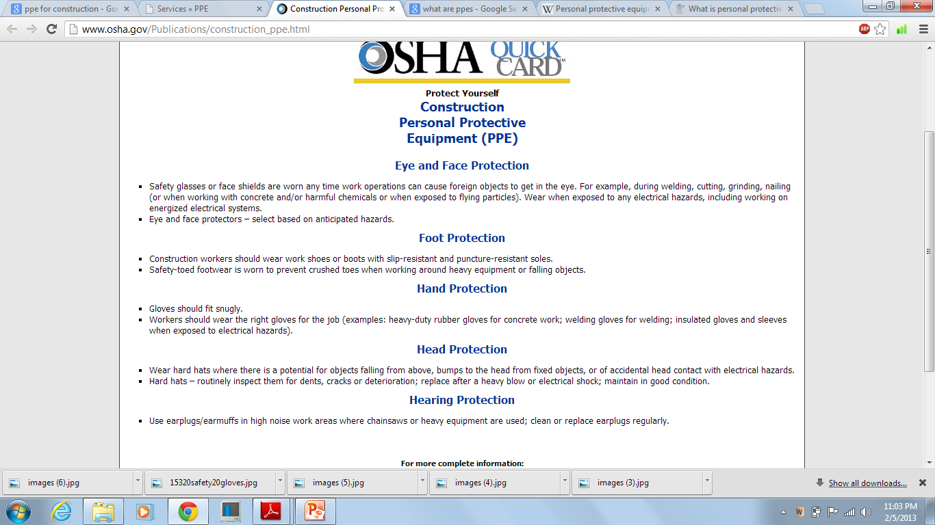

Slide 8
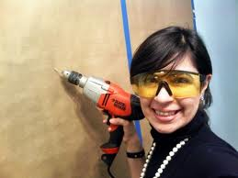
EYE PROTECTION

Slide 9
When must Eye Protection be Provided?
When any of these hazards are present:
Dust and other flying particles, such as metal shavings or sawdust.
Corrosive gases, vapors, and liquids.
Molten metal that may splash.
Potentially infectious materials such as blood or hazardous liquid chemicals that may splash.
Intense light from welding and lasers.

Slide 10
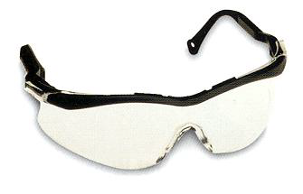
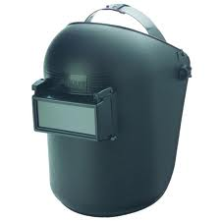
Types of PPE for Eye Protection
Safety Glasses
Safety Goggles
Welding Shield

Slide 11
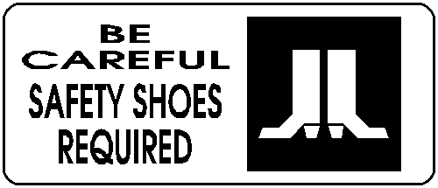
FOOT PROTECTION

Slide 12
When must Foot Protection be provided?
When any of these are present:
Heavy objects such as barrels or tools that might roll onto or fall on employees’ feet.
Sharp objects such as nails or spikes that might pierce ordinary shoes.
Molten metal that might splash on feet.
Hot or wet surfaces.
Slippery surfaces.

Slide 13
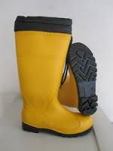
Characteristics of Safety shoes
Impact-resistant toes and heat-resistant soles protect against hot surfaces common in roofing and paving.
Some have metal insoles to protect against puncture wounds.
May be electrically conductive for use in explosive atmospheres, or nonconductive to protect from workplace electrical hazards.

Slide 14

HAND PROTECTION

Slide 15
When must Hand Protection be provided?
When any of these are present:
Burns
Bruises
Abrasions
Cuts
Punctures
Fractures
Amputations
Chemical Exposures

Slide 16
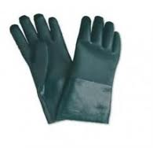
Types of Protective gloves
Durable gloves made of metal mesh, leather, or canvas
Protects from cuts, burns, heat
Fabric and coated fabric gloves
Protects from dirt and abrasion
Chemical and liquid resistant gloves
Protects from burns, irritation, and dermatitis
Rubber gloves
Protects from cuts, lacerations, and abrasions

Slide 17
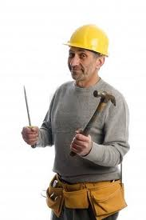
HEAD PROTECTION

Slide 18
Causes of Head Injuries
Falling objects such as tools.
Bumping head against objects, such as pipes or beams.
Contact with exposed electrical wiring or components.

Slide 19
Selecting the Right Hard Hat
Class A
General service (building construction, shipbuilding, lumbering)
Good impact protection but limited voltage protection
Class B
Electrical / Utility work
Protects against falling objects and high-voltage shock and burns
Class C
Designed for comfort, offers limited protection
Protects against bumps from fixed objects, but does not protect against falling objects or electrical shock

Slide 20

HEARING PROTECTION
When it’s not feasible to reduce the noise or its duration – use ear protective devices

Slide 21

When must HEARING PROTECTION be provided?
When an employee’s noise exposure exceeds an 8-hour time-weighted average (TWA) sound level of 90 dBA.

Slide 22
Permissible Noise levels and Duration of Exposure
Noise level in dBA | Permissible exposure time in hours per day
90 | 8
92 | 6
95 | 4
97 | 3
100 | 2
102 | 1.5
105 | 1
107 | 0.75
110 | 0.5
115 | 0.25
No exposure is allowed beyond 115 dBA

Slide 23
When must HEARING PROTECTION be provided?
“Rule of Thumb”
If you CANNOT communicate without shouting at 3 feet then hearing protection should be used.

Slide 24
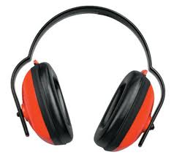
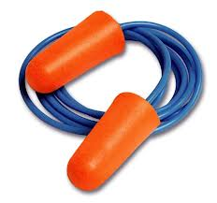
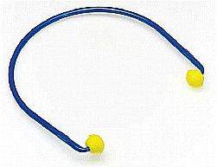
Examples of HEARING PROTECTION
Earmuffs
Earplugs
Canal Caps

Slide 25
Thank you for listening

