Slide 1
Structural mechanics (CE-312)
Dr. Umbreen-Us-Sahar
Assistant Professor
Department of Civil Engineering
University of Engineering and Technology

Slide 2
Strain Rosette
When performing a tension test on a specimen, the normal strain in the material is measured using an electrical-resistance strain gauge.
It consists of a wire grid or piece of metal foil bonded to the specimen. For a general loading on a body, however, the strains at a point on its surface are determined using a cluster of three electrical-resistance strain gauges, arranged in a specified pattern. This pattern is referred as a strain rosette.

Slide 3
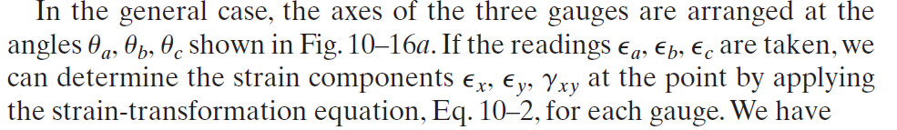
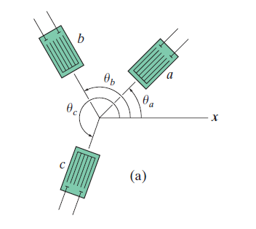

Slide 4
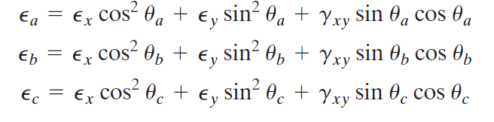

Slide 5
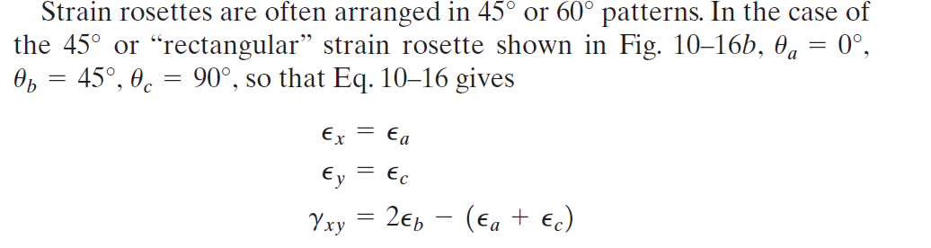
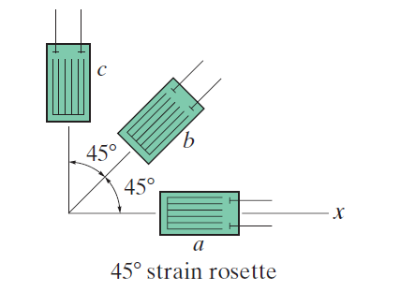

Slide 6
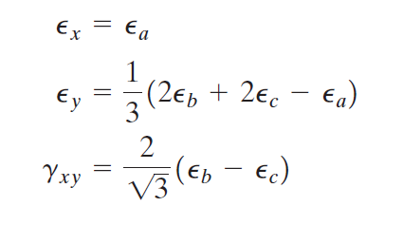
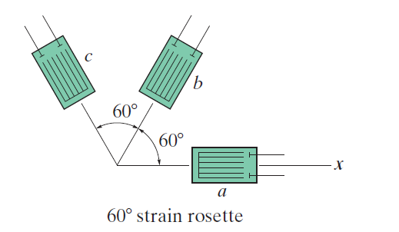

Slide 7
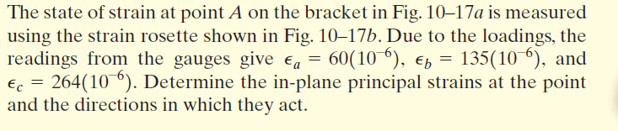
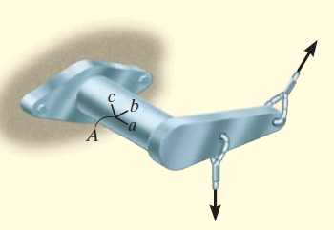
Example

Slide 8
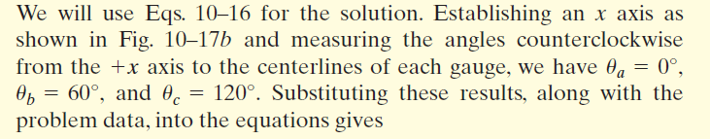
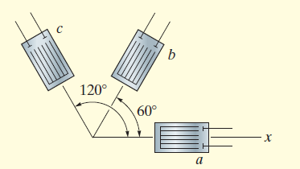

Slide 9
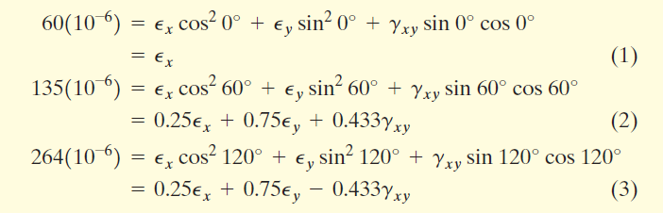


Slide 10
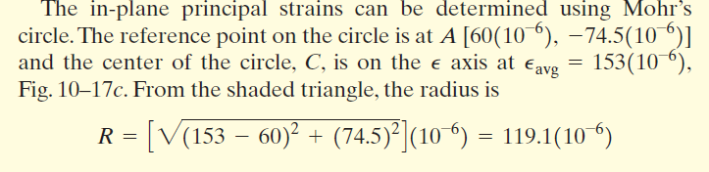
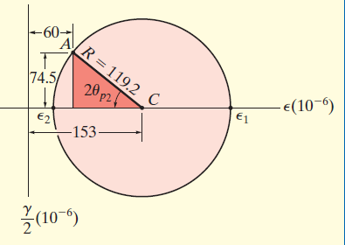

Slide 11
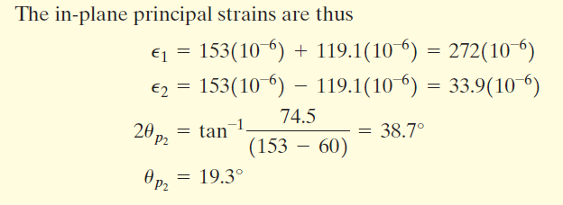
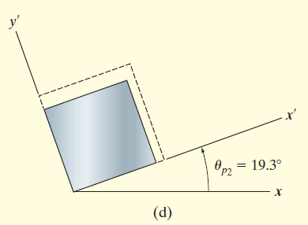

Slide 12
Poisson’s ratio : It is the ratio of strain in latitude direction to strain in axial direction.
0.2 to 0.35
Dilation: The change in volume per unit volume of any material is called volumetric strain or dilation.
Bulk Modulus : The ratio of volumetric stress to volumetric strain is called as bulk modulus or volume modulus of elasticity.
Modulus of Rigidity : This is the ratio of shear stress to shear strain. Or the slope of shear stress ~ shear strain curve from zero to PL is called as Modulus of Rigidity.
60 to 80 MPa. For steel
Modulus of Elasticity : 200 GPa for steel

Slide 13
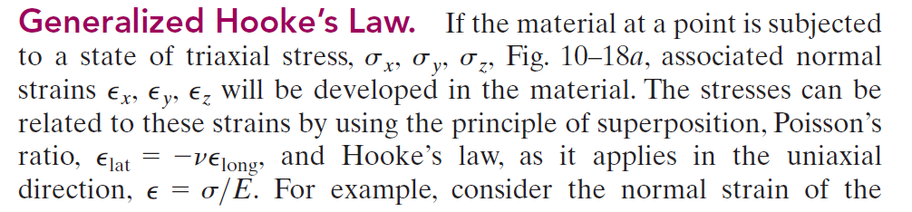
Relation between Elastic constants
Assumption: Material is homogeneous and isotropic and behaves as linear-elastic manner.

Slide 14
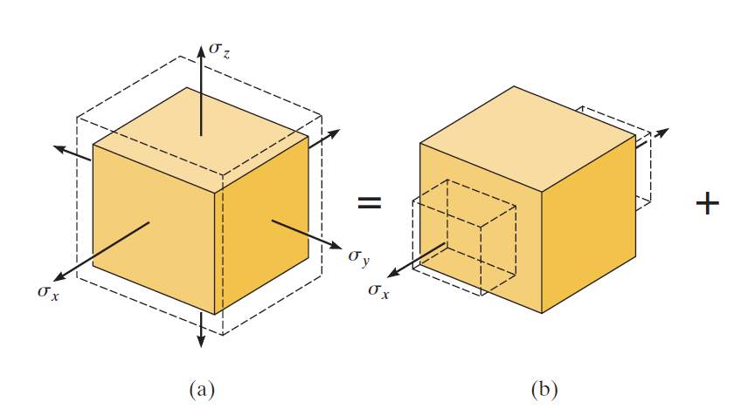
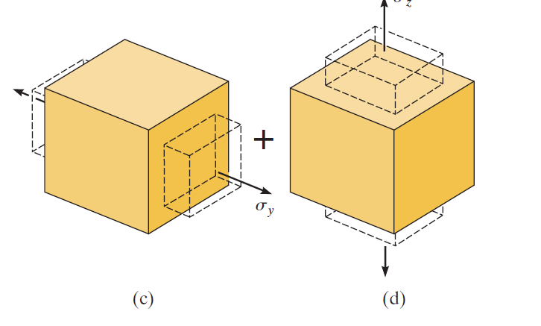

Slide 15
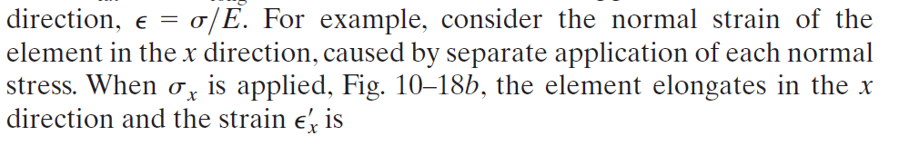
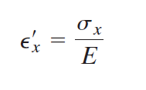
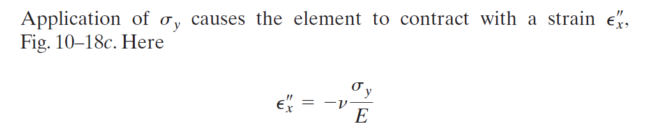

Slide 16
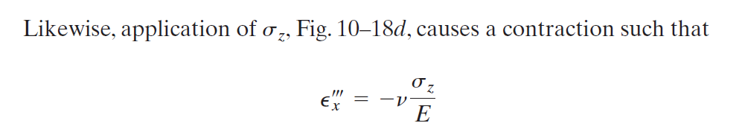
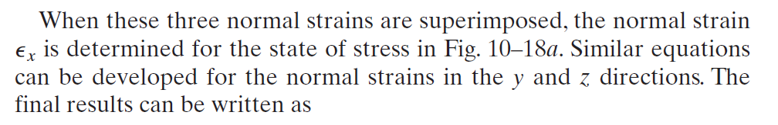
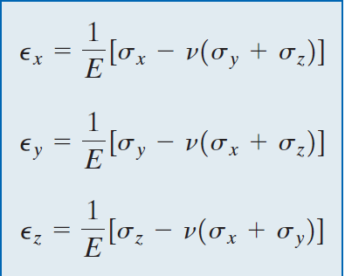

Slide 17
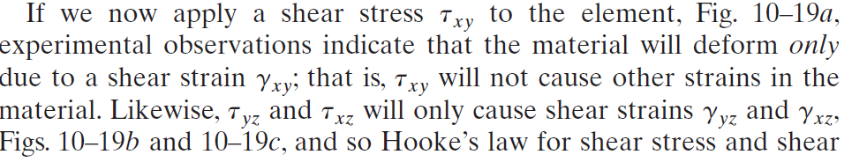
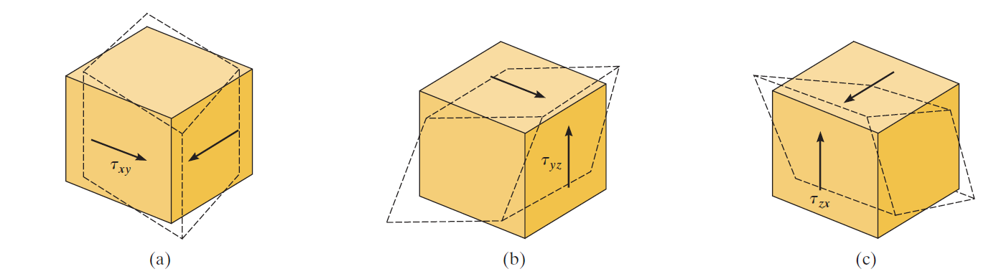

Slide 18
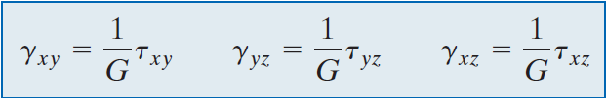

Slide 19

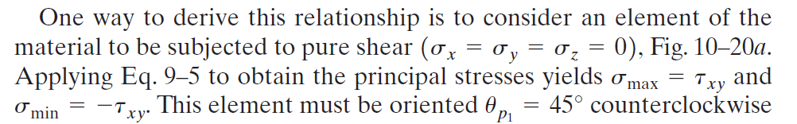
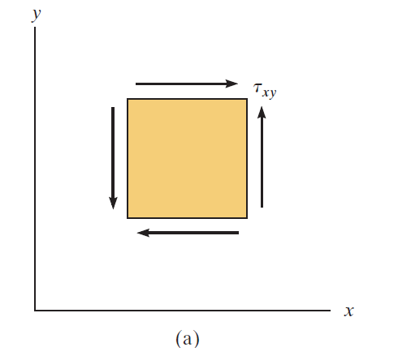
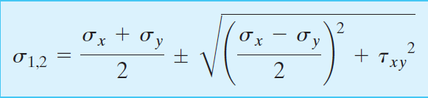
Derivation:

Slide 20
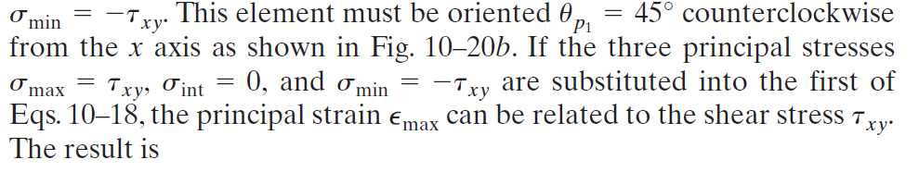
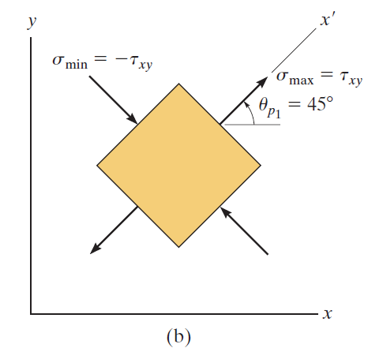


Slide 21
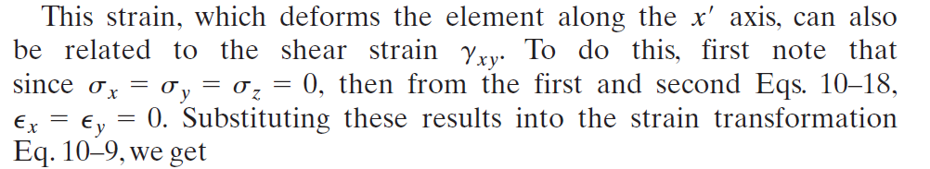


Slide 22
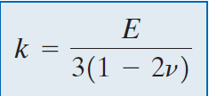
Derivation:
Assumptions:
Stresses are hydrostatic, i.e.,
Hook’s law is applicable.
Material is orthotropic.
Higher order terms are neglected.

Slide 23
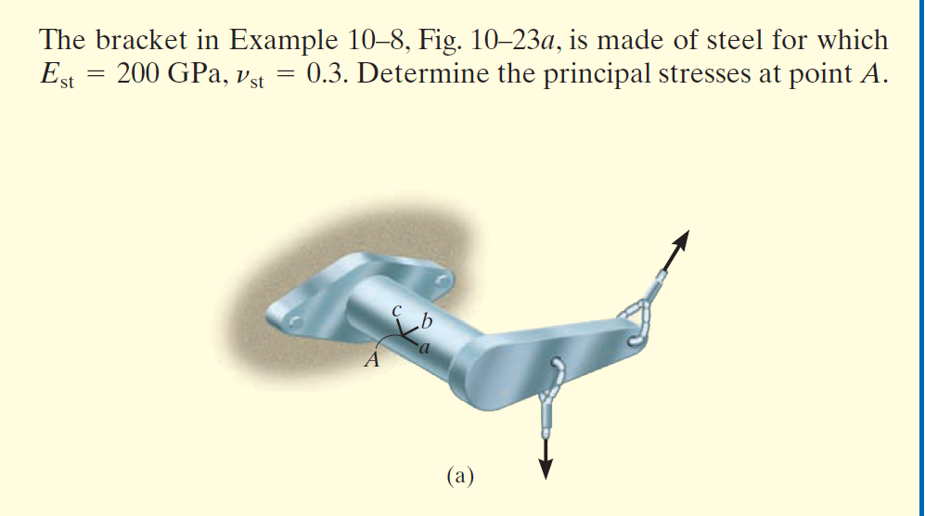
Example

Slide 24
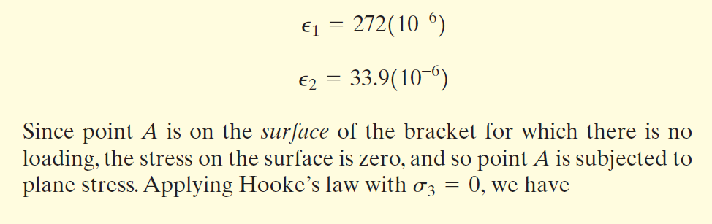
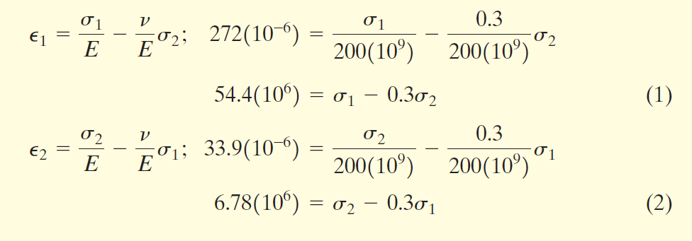

Slide 25
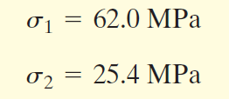
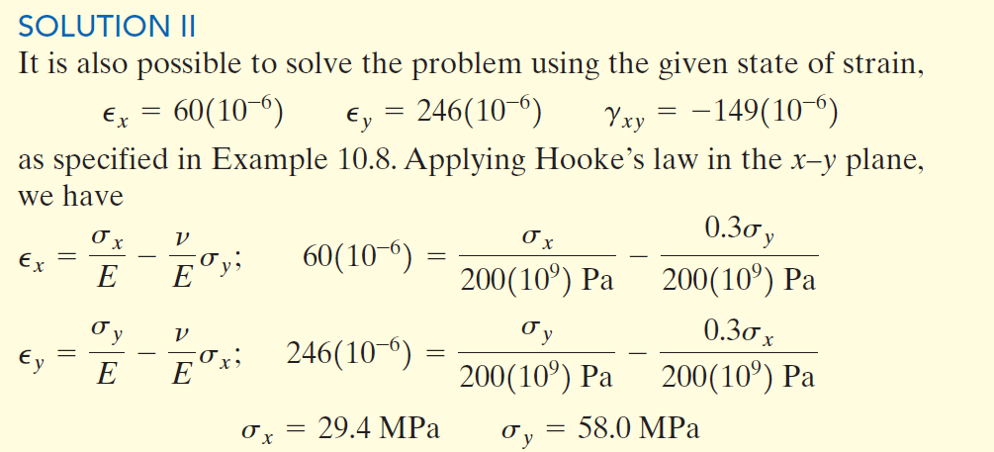

Slide 26
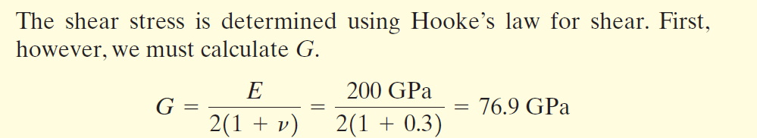
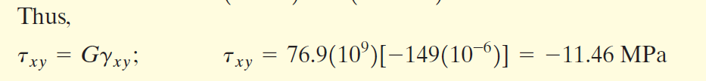

Slide 27
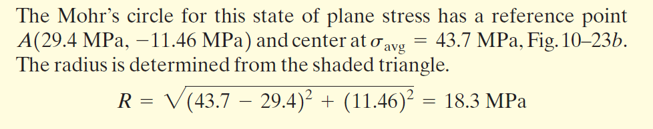
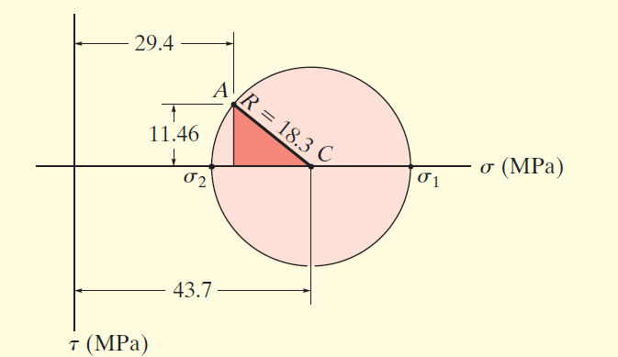
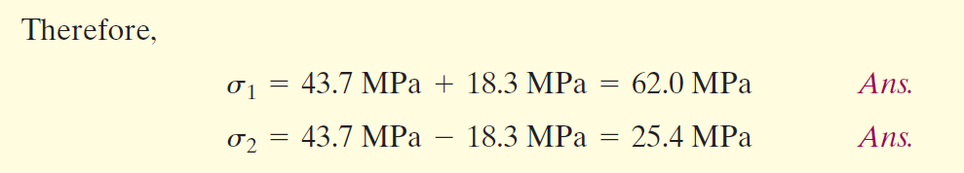

Slide 28
Assignment:1 Derive the equations for plane strain transformation ( Reference: RC Hibbler 8th edition, Chapter 10)
Assignment:2 How strain is measured by electrical resistance strain gauges. Explain its working principal.
Assignment:3 Solve the following numerical problems form RC Hibbler 8th Edition.
9.2 to 9.17, 9.22, 9.24, 9.51 to 9.56, 10.2 to 10.10, 10.17 to 10.21, 10.22 to 10.26,

