Slide 1
Structural mechanics (CE-312)
Dr. Umbreen-Us-Sahar
Assistant Professor
Department of Civil Engineering
University of Engineering and Technology

Slide 2
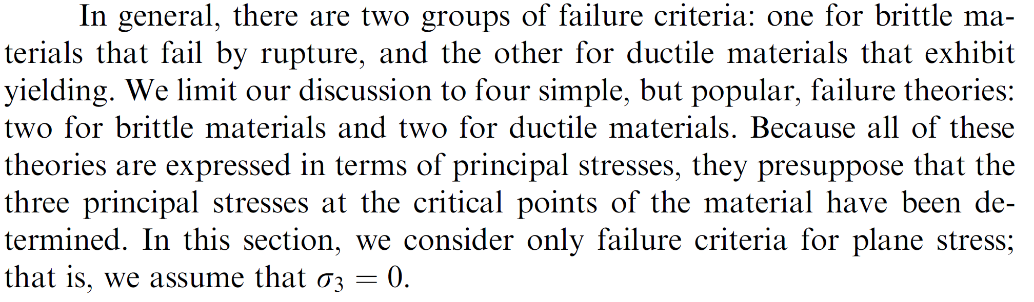
Theories of Failure
(Reference: Mechanics of Material 2nd Edition by Andrew Pytel and Jaan Kiusalaas, Chapter 12, topic 12.4)
Theories of Failure (also called as failure criteria) are used to predict the failure under more complex loading by using data obtained from a uniaxial tension or compression test.

Slide 3
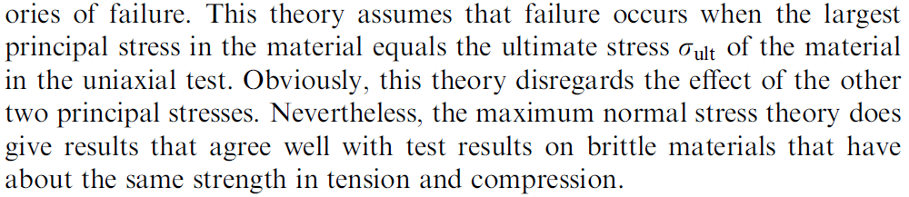
Brittle Failure
Maximum normal stress theory (By Rankine)

Slide 4
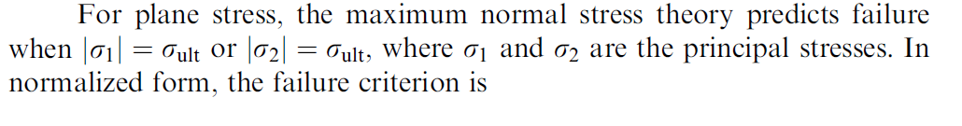
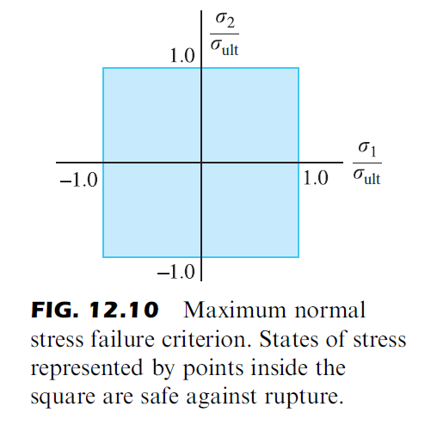
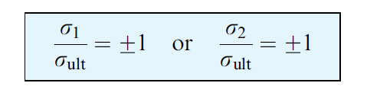

Slide 5
Mohr’s theory
Mohr’s theory of failure is used for materials that have different properties in tension and compression
To apply the theory, the ultimate tensile stress must be known and the ultimate compressive stress. ( which are determined from uniaxial load test)
The Mohr’s circle for these two states of stress are drawn on a single diagram.
The failure envelope for Mohr’s theory is obtained by drawing two lines that are tangent to the circles.

Slide 6
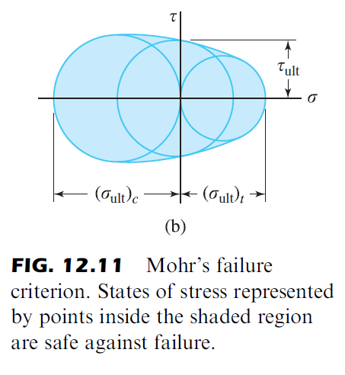
Mohr’s theory can be redifined if the ultimate shear stress (from torsion test) is also known.
The Mohr’s circle corresponding to this test can be added to the diagram.
The failure envelop is obtained by drawing curves that are tangent to each of the three circles.

Slide 7
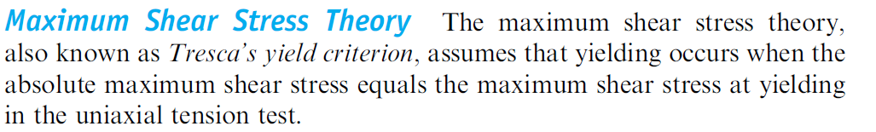
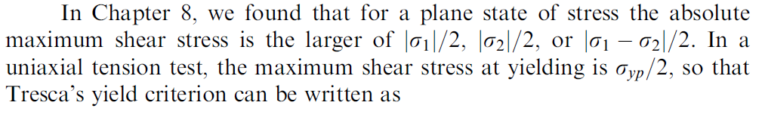
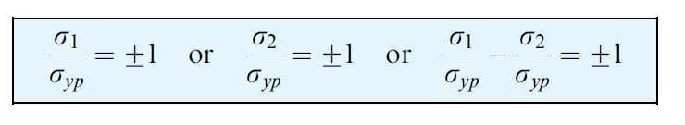
b) Ductile Materials
Maximum shear stress theory

Slide 8
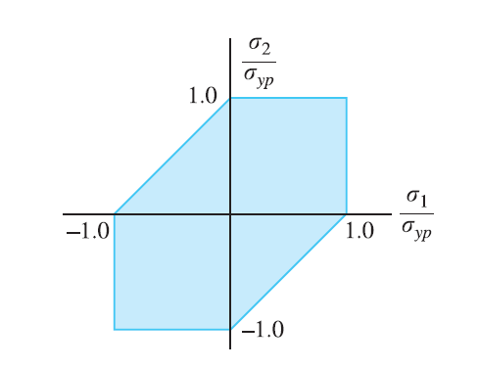
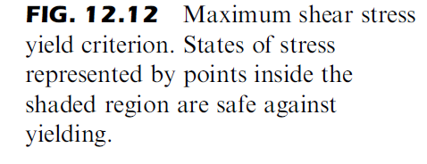
Tresca’s Hexagon

Slide 9
Maximum distortion energy theory
The work done by the forces that deform an elastic body is
Stored in the body as strain energy.
The strain energy per unit volume at a point is called as strain
Energy density.
The strain energy density can be divided into two parts:
The volumetric strain energy density( associated with a change
in the volume of a materail element
ii) The distortion strain energy density ( That changes the shape of
The element without changing its volume.

Slide 10
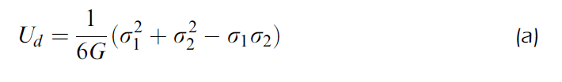
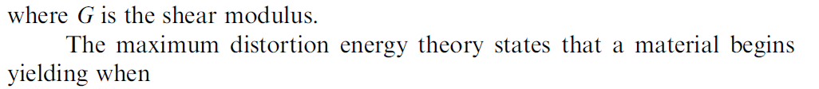

For an elastic body subjected to plane stress, the distortion strain
energy density can be shown as:

Slide 11
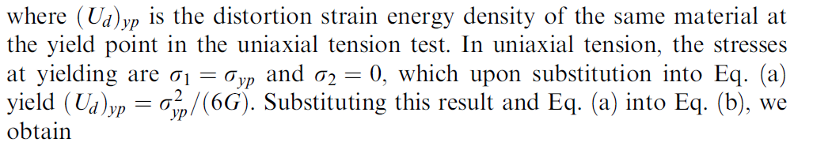
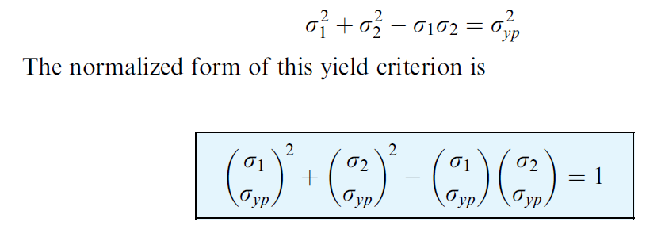

Slide 12
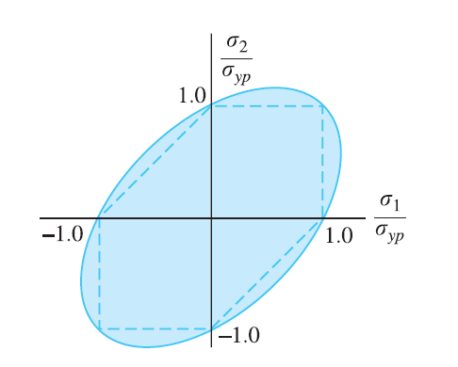
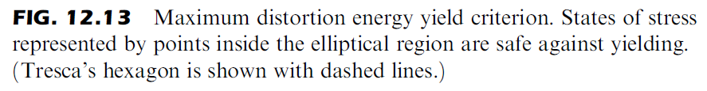

Slide 13
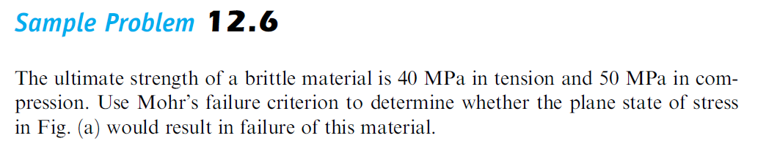
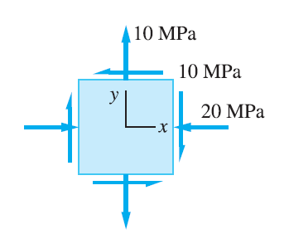

Slide 14
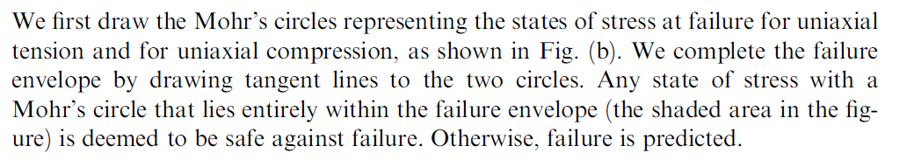
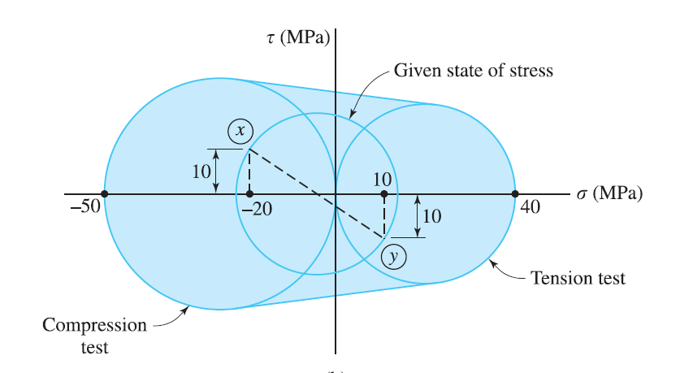

Slide 15
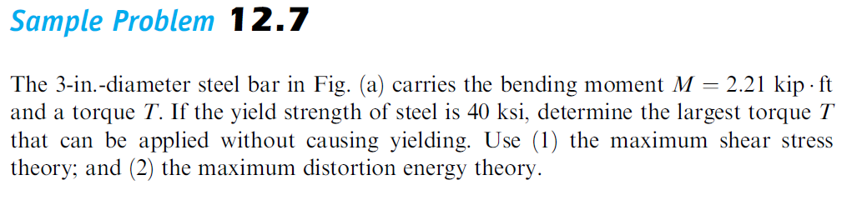
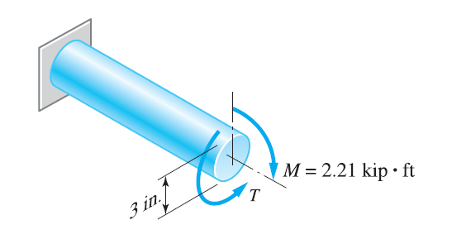

Slide 16
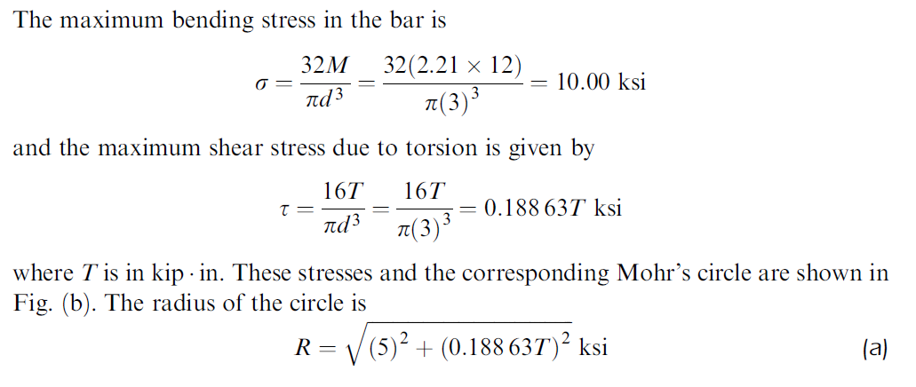

Slide 17
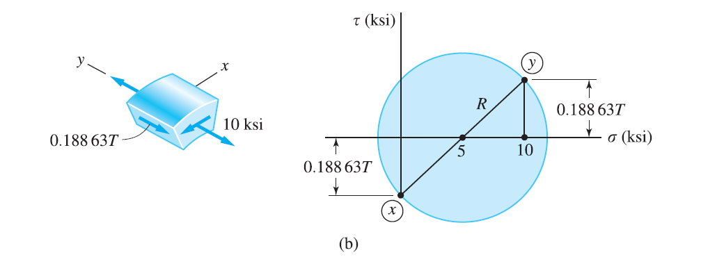

Slide 18
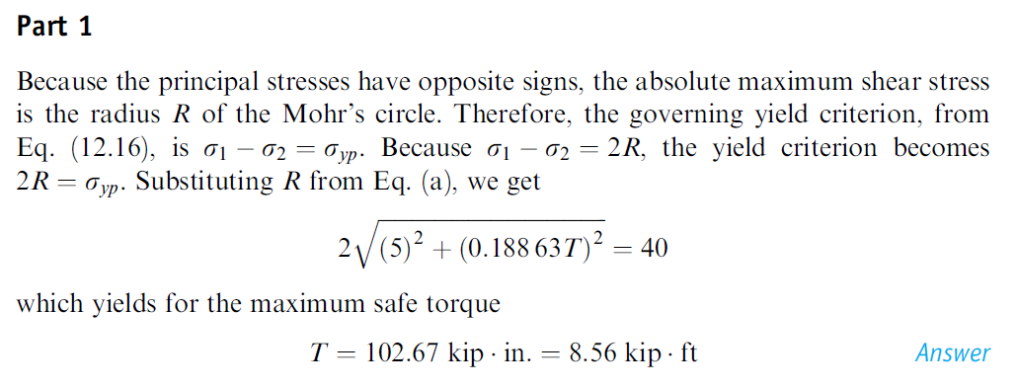

Slide 19
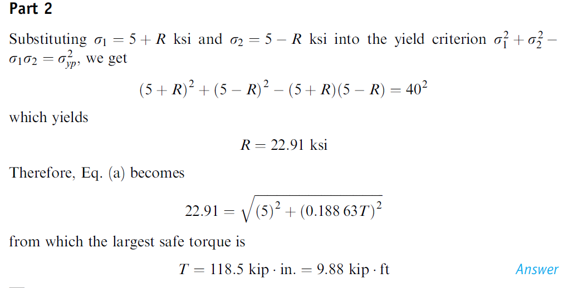

Slide 20
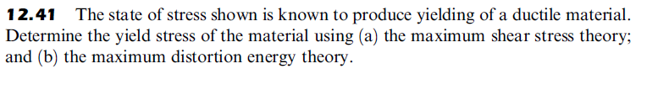
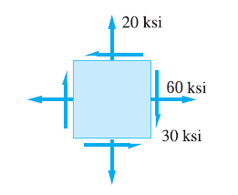

Slide 21
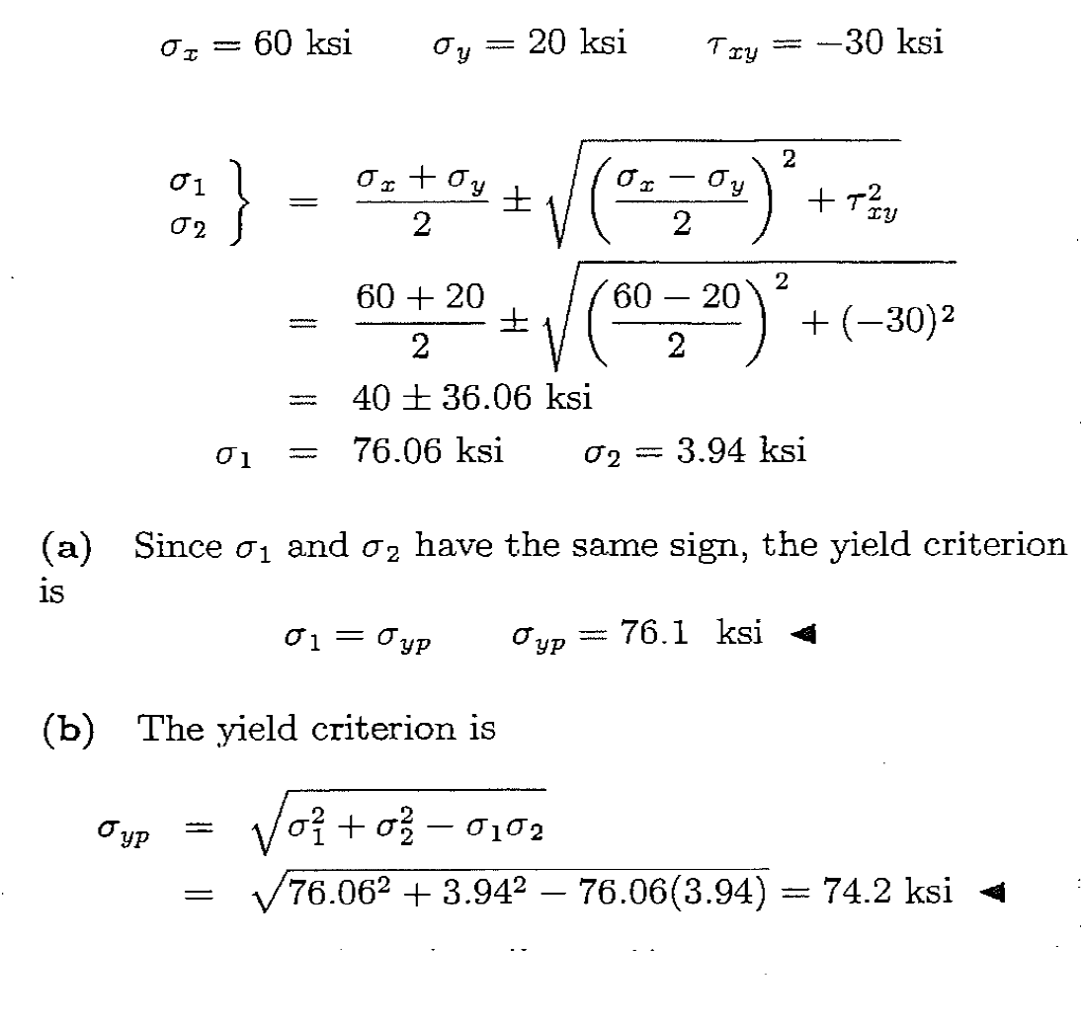

Slide 22
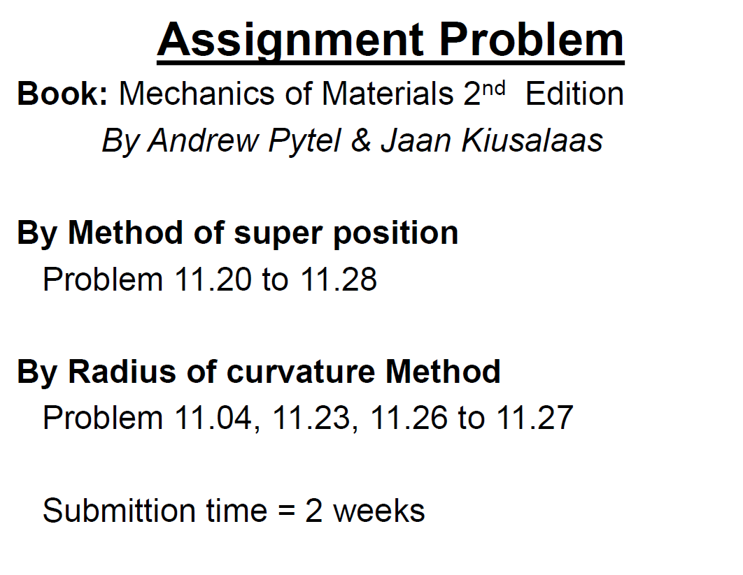
12.36 to 12.43
Submission date: 19-05-2016 (along with problems of cylinders)

