Slide 1

Notes:
-Rocks
-Types of rocks
-Igneous rocks
-Magma & Lava
-Mineralogy
-mineral layers
-silica leads to acidity
-texture
-coarser grains
-glassy
-fine grain & crypto-crystalline
-types of texture
-pheneritic :large crystals,deep underground
-aphanitic:small,rapid cooling
-porphyritic:both larger & smaller,metrix in which large phenocrysts produces when cooled in more stages.
-vesicular & amygdaloidal:depth high pressure gas dissolved,vesicles,amygdale
-ophitic:

Slide 2
ROCKS
Rock is the aggregate of minerals, or rocks are collection of one or more minerals.
TYPES OF ROCKS:
Igneous Rocks
Metamorphic Rocks
Sedimentary Rocks

Slide 3
IGNEOUS ROCKS
Igneous rocks (etymology* from Latin ignis, fire) are formed by the cooling and solidification of magma or lava.
*Etymology is the study of the history of words, their origins, and how their form and meaning have changed over time
Magma is a hot, viscous, silicate melt, containing gases. It comes from great depth below the earth’s surface. When magma comes out upon the earth’s surface, it is called lava.

Slide 4
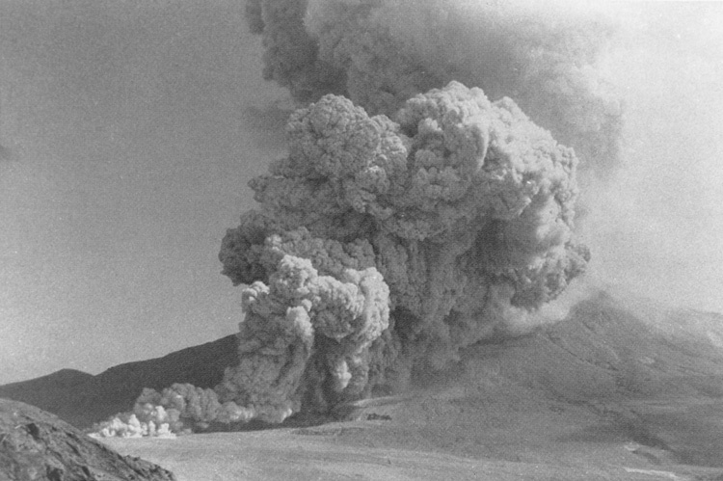
Lava erupting from Mt. St. Helens in May 1980, Washington State.

Slide 5
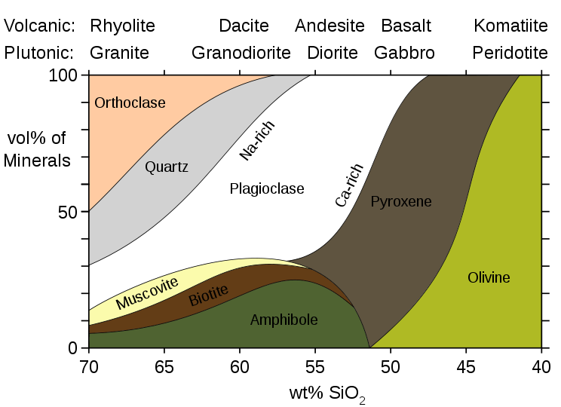
Mineralogy

Slide 6
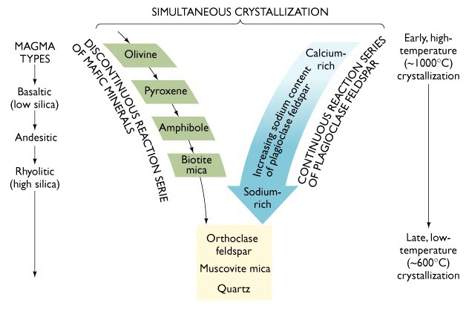

Slide 7
Mineralogy Continued
These eight minerals are normally present as essential constitutes of a rock.
Each mineral starts to crystallize at a particular temperature .The crystals formed early have a higher specific gravity.
Sequence of layers of minerals of different compositions, from high-temperature, high-specific gravity minerals at the bottom, to low-temperature, low-specific gravity minerals at the top. Such magma is said to be differentiated magma
Increasing Silica content will lead to acidity.

Slide 8
Texture
Texture means the size, shape, and arrangement of mineral grains in a rock.
The texture of a rock is governed by the cooling rate of the magma.
Slower is the rate of cooling, the coarser is the grain of the rock.
The glassy texture results from extremely rapid cooling.
Between these two extremes there are fine grained and crypto-crystalline textures.

Slide 9
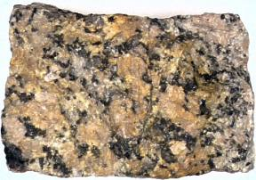
Types of textures
Phaneritic texture
Large crystals, which are generally 1/2 mm to several centimeters in size.
Slow cooling of magma deep underground.

Slide 10
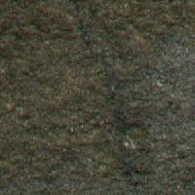
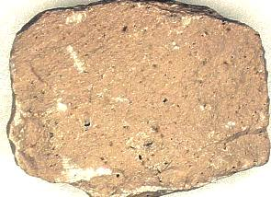
Aphanitic texture
Small crystals, which are generally less than 1/2 mm in size. h
Rapid cooling

Slide 11
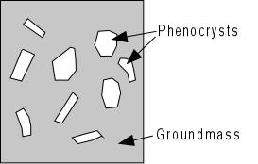
Porphyritic texture
Both larger and smaller crystals are present in the same rock.
The smaller crystals may be of fine, medium or coarse grained size and are spoken of collectively as matrix in which the larger phenocrysts are set.
The texture is frequently
produced when a rock has
cooled in two or more stages.

Slide 12
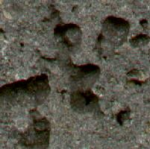
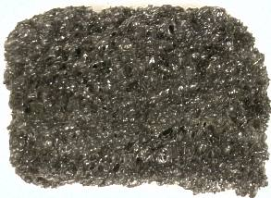
Vesicular and amygdaloidal textures
Gases dissolved in magma under the high pressures found at depth come out of solution and start to expand as the magma rises towards the surface.
Gas is trapped within the rock in cavities which are called vesicles.
A vesicle filled with mineral is called amygdale, and the rock has an amygdaloidal texture.

Slide 13
Ophitic texture
Ophitic texture is produced when plagioclase feldspar and augite crystallize at the same time to produce a felted arrangement of interlocking crystals.
Due to this reason, its strength is high and is suitable to be used as a road stone.
It is normally present in the basic hypabyssal rock dolerite.

Slide 14
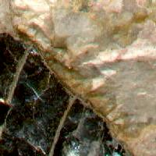
Pegmatitic texture
A pegmatitic texture is one in which the mineral grains are exceptionally large. The largest ones are, by convention, more than about 3 cm long. This texture is found in intrusive rocks.
This texture occurs in veins
of very acid igneous rock
(pegmatite),which are
sources of economically
important minerals.

Slide 15

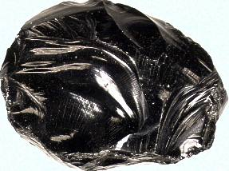
Glassy texture
Glassy textured igneous rocks are non-crystalline.
Glass results from cooling that is so fast that minerals do not have a chance to crystallize. This may happen when magma or lava comes into quick contact with much cooler materials near the Earth's surface.
Pure volcanic glass is known as obsidian.

Slide 16
Classification
On the basis of texture, the igneous rocks have been classified into three groups.
Plutonic or Intrusive rocks
Slow cooling of great volumes of magma, typically at depths of a few kilometers, within the Earth.
It is erosion that has removed the overlying rocks and revealed these plutonic intrusions at the surface.
The heat from their enormous bulk can dissipate only very slowly and they are normally coarse grained.

Slide 17
Classification Con't
Volcanic or Extrusive rocks
Magma erupts at the earth’s surface and cools rapidly.
The volatiles present in the magma escape into the atmosphere.
The texture of such rocks are fine grained or glassy.
Volcanic rocks often contain gas cavities called “vesicles”.
These rocks sometimes show “flow structure” which is the result of movement in viscous lava. It is seen as lines or streaks of different color in a rock.

Slide 18
Classification Con't
Hypabyssal rocks
Hypabyssal igneous rocks form minor intrusions which have solidified below the surface and have cooled more slowly than extrusive rocks because of the thermal insulation of the surrounding country rocks.
They are typically, but not invariably, medium-grained.

Slide 19
Laboratory
The properties of these rocks are required for your lab portion.
Granite
Obsidian
Gabbro
Basalt
Pumice

