Slide 1
Metamorphic rocks
The word "Metamorphism" comes from the Greek: meta = change, morph = form, so metamorphism means to change form.
Metamorphic rocks are created by changes induced at high temperature (up to about 600°C) and/or high pressure (around 500 MPa at 20 km depth). These changes (metamorphism) take place in the solid state.
The type of metamorphic rock produced depends on the original rock material that was metamorphosed and the temperature and pressure conditions which were imposed.

Slide 2
Agents of metamorphism
The agents who bring about metamorphism of rocks are as follows:
Physical agents: Heat, uniform pressure, and directed pressure.
Chemical agents: Chemically active water and gases.

Slide 3
Types of metamorphism
Depending upon the dominance of one or the other of the above agents, the metamorphism has been classified as follows.
Thermal metamorphism
Dynamo-thermal metamorphism
Cataclastic metamorphism
Metasomatism
Regressive metamorphism

Slide 4
Thermal metamorphism
The changes brought about in rocks are mainly due to heat, but heated magmatic waters or vapors carrying mineral matter in solution also play important part.
When the thermal metamorphism occurs in the immediate vicinity of igneous intrusions, it is called “contact metamorphism”, and when it occurs on a regional scale at depth, it is called “plutonic metamorphism”.
By thermal metamorphism clays and shales may change into porcellanite, hornfelse, even mica-schist, while sandstone and limestone may form quartzite and marbles.

Slide 5
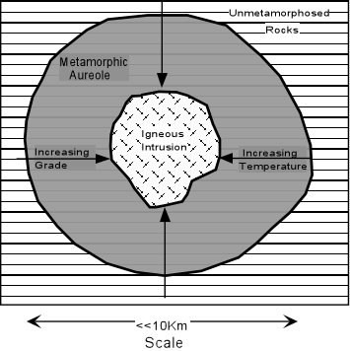

Slide 6
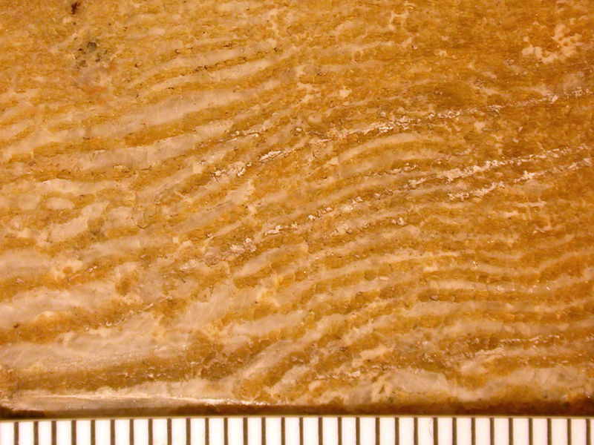
A contact metamorphic rock made of inter-layered calcite and serpentine from the Precambrian of Canada.

Slide 7
Dynamo thermal metamorphism
Also called as “regional metamorphism”.
It is caused when both directed pressure and heat act together. It leads to more or less complete re-crystallization of rocks combined with the production of new structures. The new minerals are muscovite, biotite, chlorite, talc, amphiboles, kyanite etc.
The directed pressure involved movement and shearing and therefore it is the main factor in forming foliated, banded and cleavable rocks.
The foliated rocks include slates, phyllites, schist, and gneisses.

Slide 8
Cataclastic metamorphism
Mainly directed pressure or stress predominates.
The stress produces shearing movements in the rocks and causes crushing, granulation, and powdering. Therefore, the cataclastic rocks show mainly mechanical breaking with little new minerals formation.
Cataclastic metamorphism occurs in the higher levels of the earth’s crust where rocks are mostly brittle.
Examples of cataclastic rocks are mylonites and fault breccia.

Slide 9
Metasomatism
Occurs by deposition from hydrothermal solutions (hot magmatic waters).
The replacement takes place molecule by molecule so that as new mineral is added, the old is removed and the volume of the rock remains unchanged.
The new rock frequently produces all the textural details of the original rock.
The metasomatism replacement is often accompanied by deposition of metallic ores.
Metasomatism replacement is commonly found associated with carbonate rocks as lime stones and dolomite which are easily dissolved and replaced by silica, iron ore, or other minerals.

Slide 10
Regressive metamorphism
By orogenic movements, an intensely metamorphosed rock such as schist may be transferred from a region of plutonic metamorphism (ketazone) to epizone, where normally low grade metamorphic rocks (like slates and phyllites) are formed.
In due course of time the schist may change its characters appropriate to its new environments, and may convert itself into phyllite. This process is called “regressive metamorphism”.

Slide 11
Metamorphic zones
The degree or intensity of metamorphism generally increases with depth because as the depth increases temperature and pressure also increase. From the earth’s surface downwards there are three metamorphic zones.
Epizone or upper zone
Mesozone or intermediate zone
Katazone or lower zone

Slide 12
Metamorphic zones Con’t
Epizone
The epizone lies near the earth’s crust surface where temperature is low (300°C) and directed pressure is high. In this zone cataclastic metamorphism takes place. The alteration in rocks is weak and phyllites are the typical rocks.
Mesozone
It is an intermediate zone where temperature is of the order of 300°C to 500°C. The directed pressure is also high and therefore, dynamothermal metamorphism takes place. Schists are the typical rocks of mesozone.
Ketazone
It is the bottom zone where directed pressure is absent, uniform pressure is high, and temperature is also high (500°C to 800°C). In the ketazone plutonic metamorphism predominated which produces even grained rocks.

Slide 13
Classification
On the basis of arrangement of minerals, there are two types of metamorphic rocks.
Foliated
Non-foliated
Foliation refers to flat or wavy planar features (looking like layers) caused by the alignment of platy minerals such as mica.
Foliation may also look like alternating bands of light and dark minerals.
In contrast, a non-foliated rock has interlocking grains with no specific pattern.

Slide 14
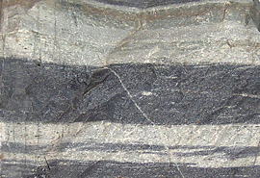
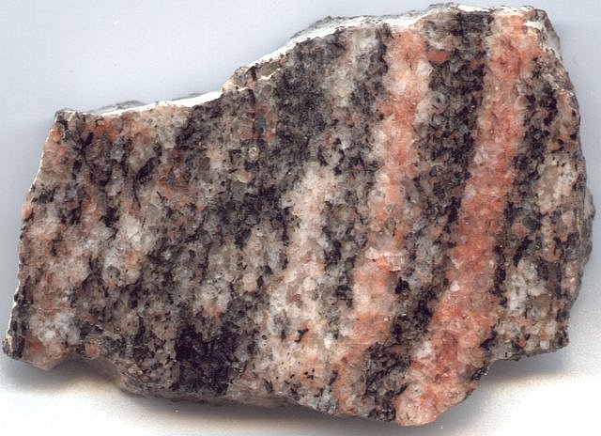
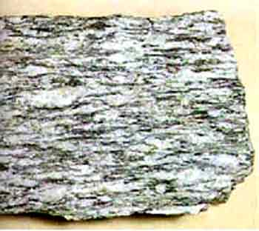
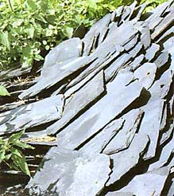

Slide 15
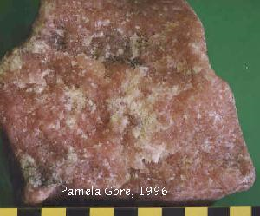
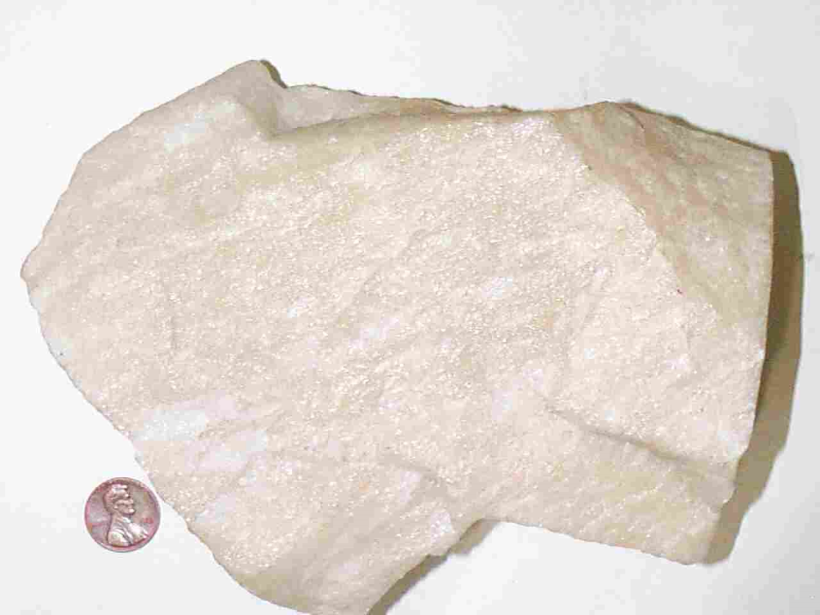
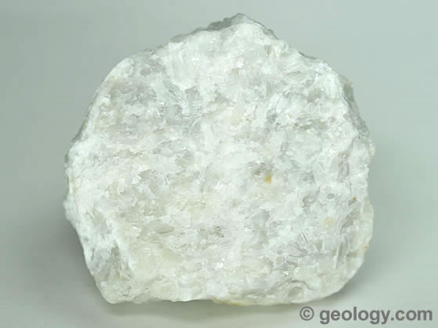
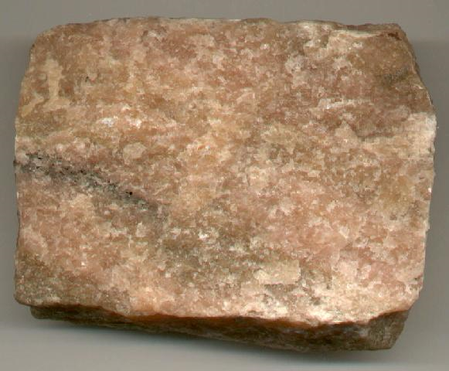

Slide 16
Grade of metamorphism
The grade of metamorphism varies directly with the amount of heat and pressure to which the rocks have been subjected.
For example, slate and phyllite which show a low grade of metamorphism are formed away from the intrusive igneous body, while a high grade metamorphic rock like gneiss, is formed near its margin.
The increase in the grade of metamorphism is also accompanied by an increase in grain size. For example, slate and phyllites are fine grained, while schists and gneisses are coarse grained.

Slide 17
Metamorphic Minerals
The minerals which occur in metamorphic rocks are divided into two groups.
Stress minerals
The stress minerals are usually flat, tabular, elongated, or flaky in nature are formed during regional metamorphism (directed pressure).
Examples of such minerals are micas, chlorite, talc, albite, amphiboles, kyanite, and staurolite.
Anti-stress minerals
The anti-stress minerals develop during thermal metamorphism (uniform pressure).
These are often equidimensional in form.
Examples of such minerals are potash feldspars, pyroxenes, olivine, andalusite, sillimanite, cordierite, and spinel.

Slide 18
Structures
The main structures of the metamorphic rocks are,
Schistose structure
Gneissose structure
Granulose structure
Slaty structure

Slide 19
Structures Con’t
Schistose structure
It is formed by parallel arrangement of flat, tabular, elongated, bladed or flaky minerals such as muscovite, biotite, chlorite, talc, and hornblende.
The rocks having schistose structure have a tendency to split readily into flakes, leaves, or thin slabs parallel to the schictosity.
Gneisses structure
A rock possessing gneissose structure exhibits a pronounced banded appearance in which light and dark colored bands alternate.
The light colored bands are composed of quartz and feldspars, while dark bands contain ferromagnesian minerals.
In gneissose rocks the planes of schictosity are poorly defined.

Slide 20
Structures Con’t
Granulose structure
Granulose (even grained) structure is produced due to predominance of equidimensional minerals such as quartz, feldspar, pyroxenes, and calcite.
The flaky minerals are either absent or present only in small amounts.
On breaking a granulose rock produces a rough fracture surface.
Slaty structure
The slaty structure is also called “slaty cleavage”.
The rock possessing slaty cleavage has a unique property of splitting into thin smooth sheets.
The slaty cleavage may form at any angle to the old bedding planes of the shale from which the slaty rock has been derived.

Slide 21
Laboratory
The properties of these rocks are required for your lab portion. (Sedimentary Rocks)
Schist 6. Conglomerates
Gneiss 7. Sandstones
Slate 8. Limestone
Marble 9. Gypsum rock
Quartzite 10. Rock Salt
11. Shale

Slide 22
