Slide 1
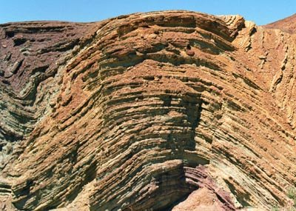
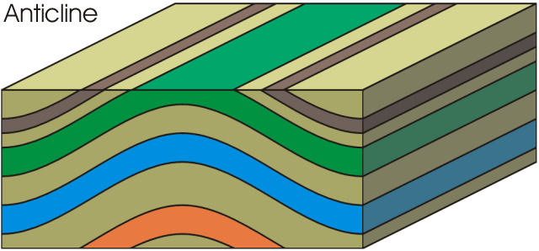
Geological Structures
2012-civil

Slide 2


Slide 3
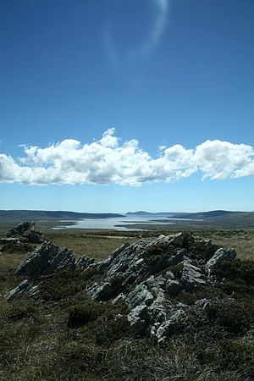
Out crop

Slide 4
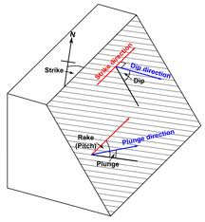
strike

Slide 5
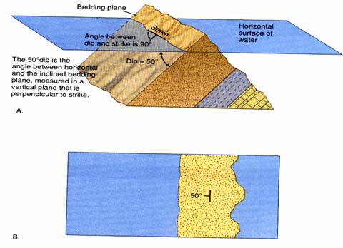
Dip & Strike

Slide 6
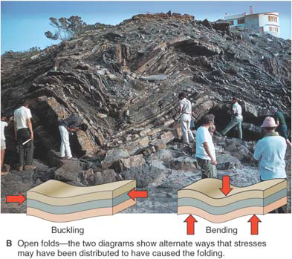
Folds

Slide 7
Main types and components
Anticline
Syncline
Components
Crestal line and trough line
Amplitude
Length
Hinge
Axial line
Limb

Slide 8
Anticline

Slide 9
Anticline

Slide 10
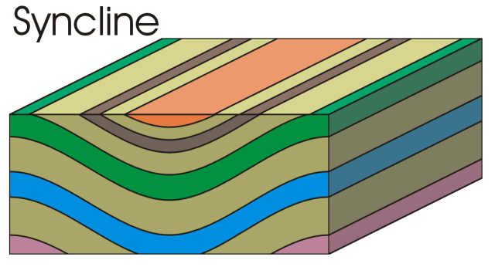
Syncline

Slide 11
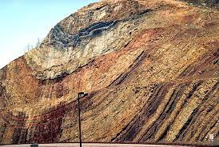
Syncline

Slide 12
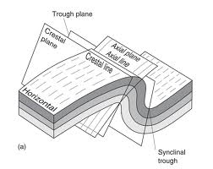
Crestal and trough line

Slide 13
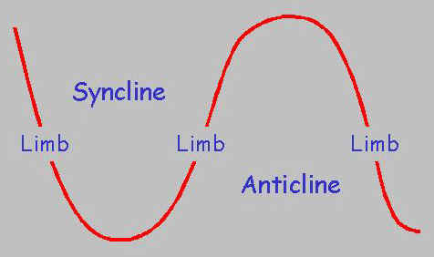
Amplitude of a Fold

Slide 14
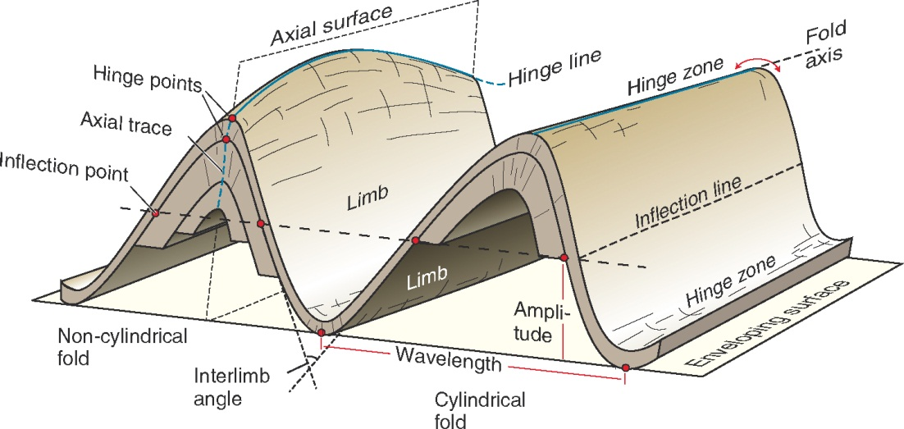
Length of a Fold

Slide 15
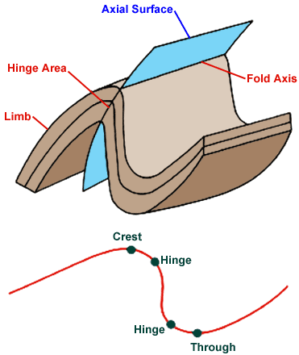
Hinge of a Fold

Slide 16
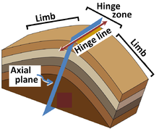
Hinge of a Fold

Slide 17
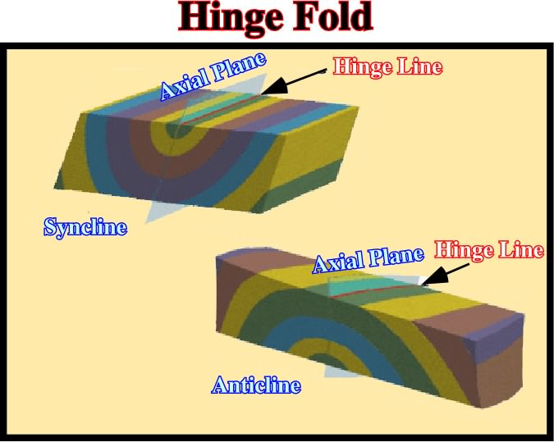
Hinge of a Fold

Slide 18
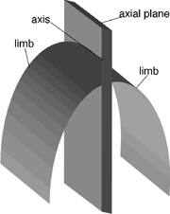
Axial Line and limb

Slide 19
Inter limb angle of a Fold

Slide 20
Types : w.r.t inter limb angle
Gentle folds
Open folds
Close folds
Tight folds
Isoclinal folds

Slide 21
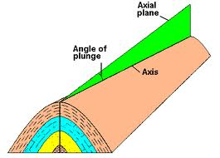
Plunge of the fold

Slide 22
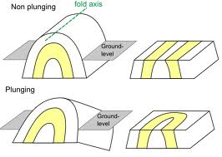
Plunge of the fold

Slide 23
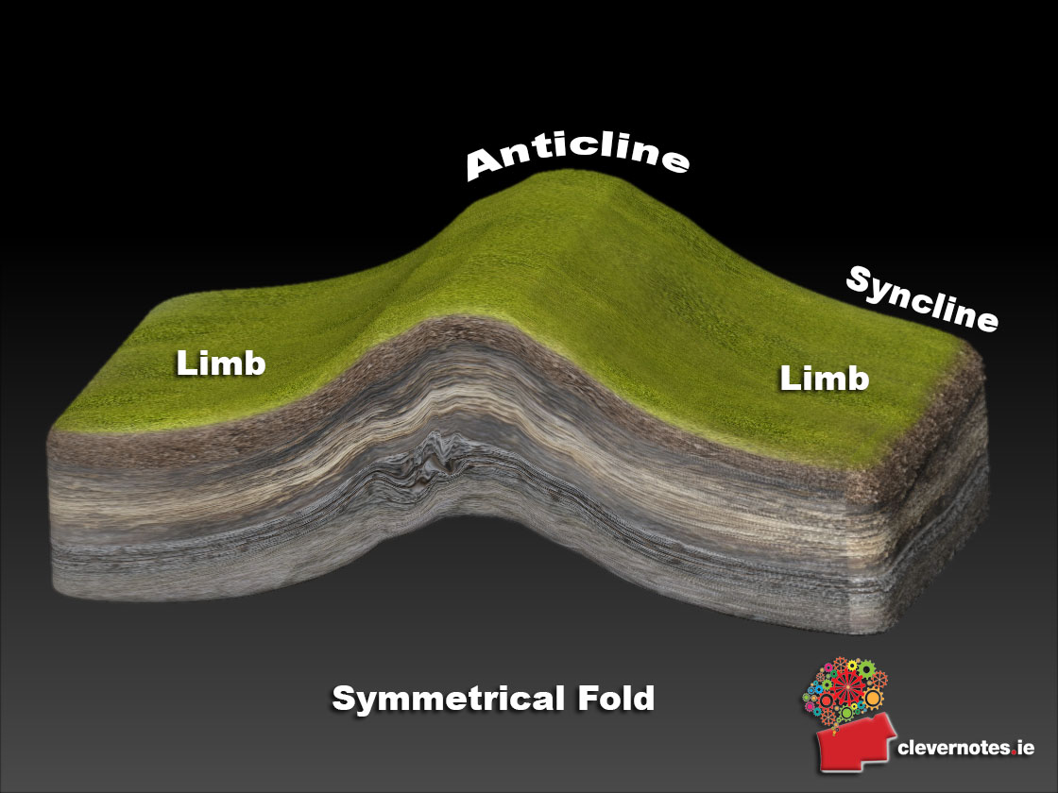
Symmetrical Folds

Slide 24
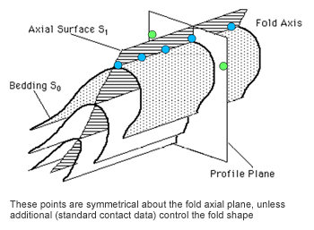
Symmetrical Folds

Slide 25
Asymmetrical Folds

Slide 26
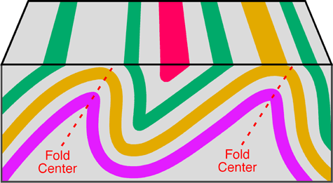
Asymmetrical Folds

Slide 27
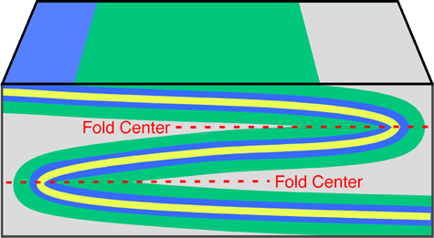
Recumbent fold

Slide 28
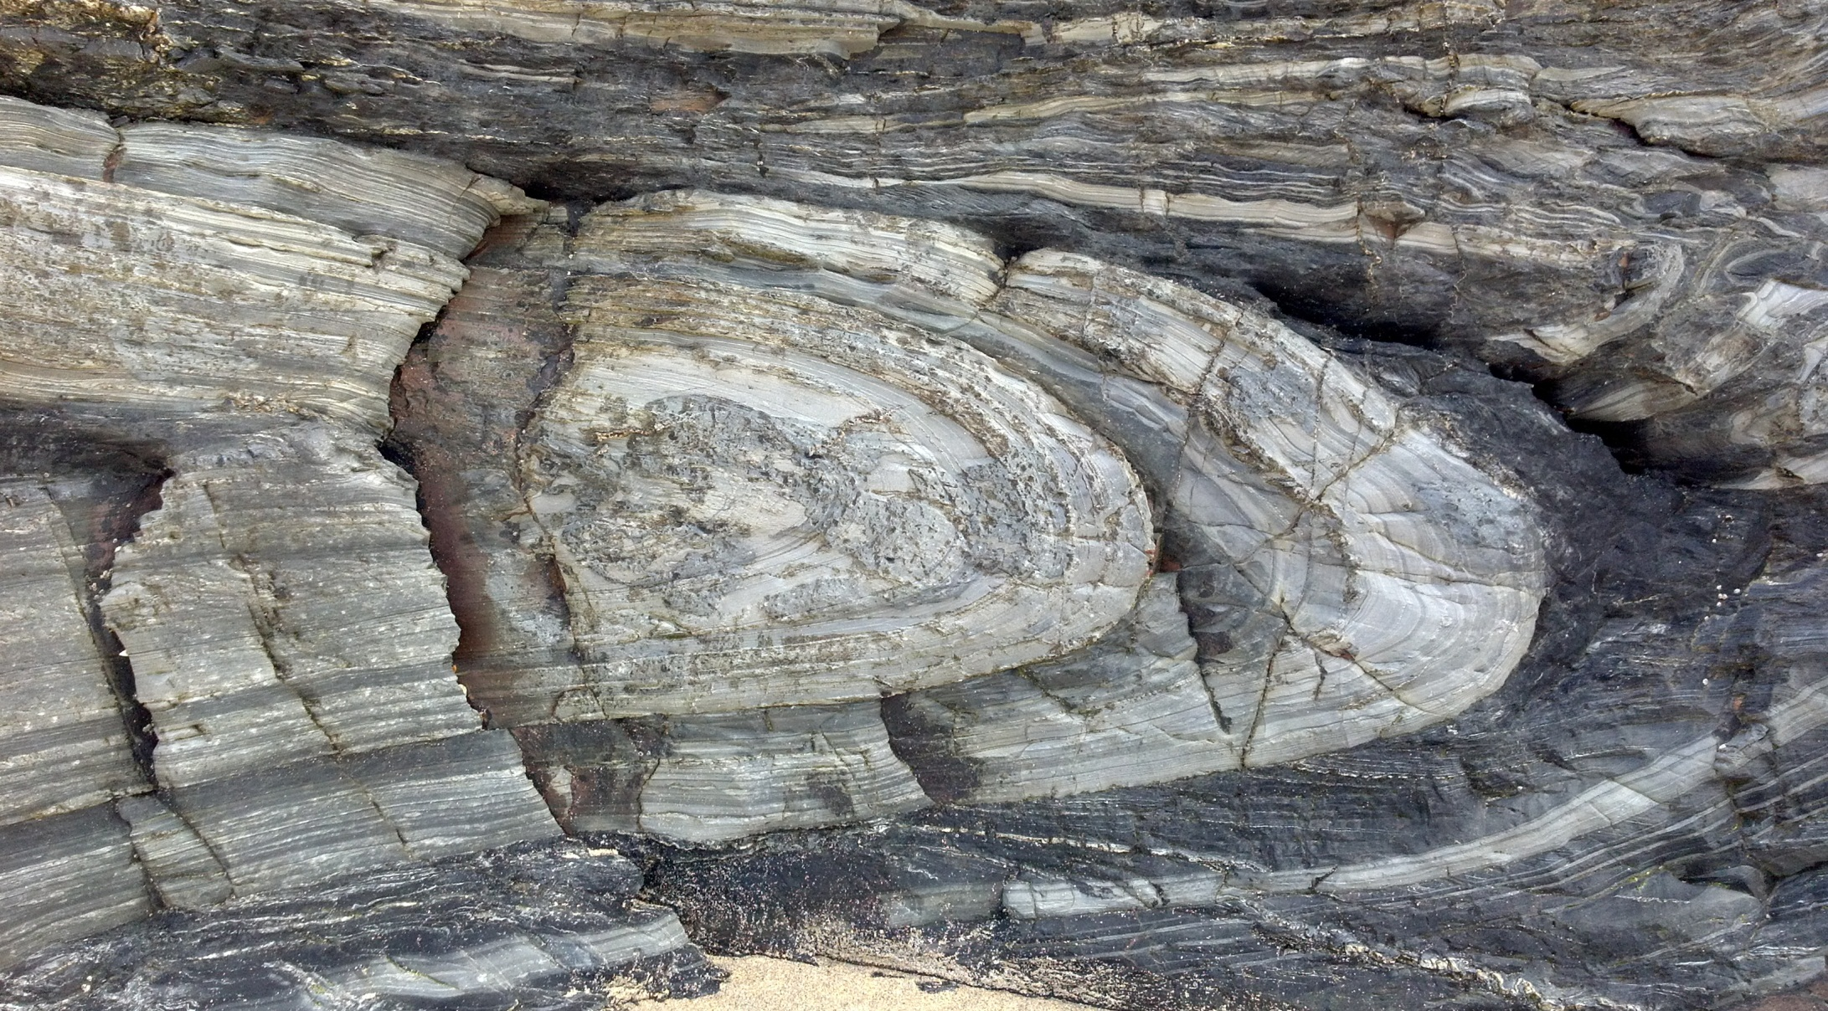
Recumbent fold

Slide 29
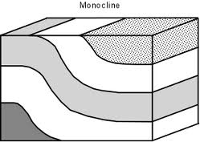
Monocline

Slide 30
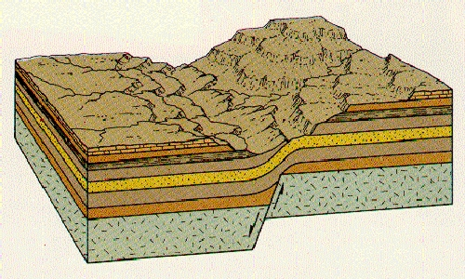
Monocline

Slide 31
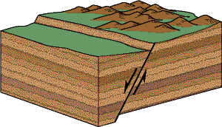
Faults

Slide 32
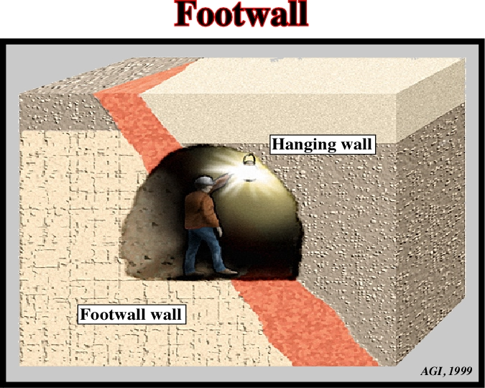
Hanging wall and foot wall

Slide 33
Types w.r.t to direction of movement
Dip-slip fault
Strike slip fault
Oblique-slip fault

Slide 34
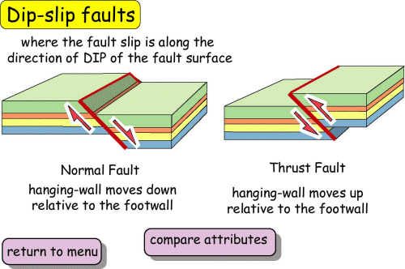
Dip-slip fault

Slide 35
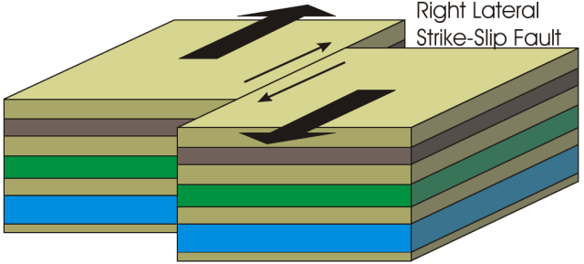
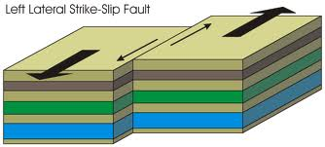
Strike slip fault

Slide 36
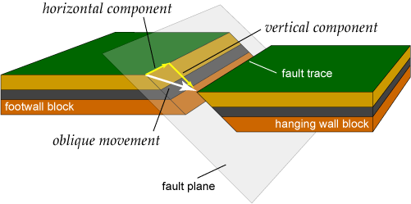
Oblique-slip fault

Slide 37
Types w.r.t nature of movement
Normal Fault
Reverse Fault
Wrench Fault
    Sinistral wrench fault
    Dextral wrench fault

Slide 38
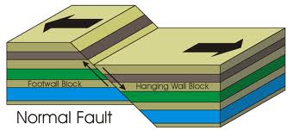
Normal Fault

Slide 39
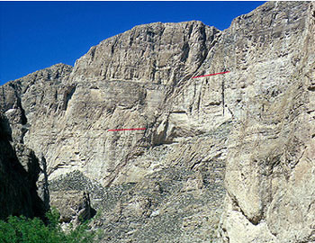
Normal Fault

Slide 40
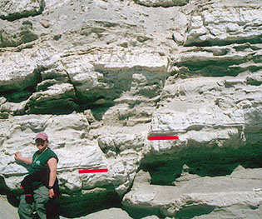
Normal Fault

Slide 41
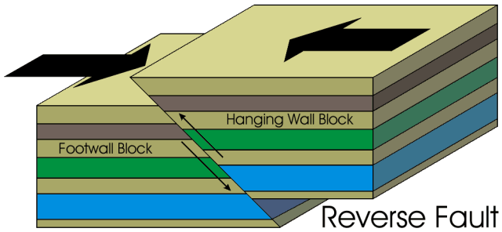
Reverse Fault

Slide 42
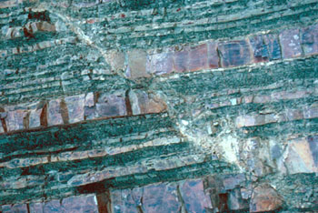
Reverse Fault

Slide 43
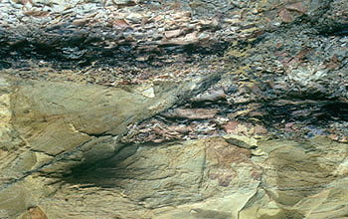
Reverse Fault

Slide 44
Sinistral and Dextral wrench fault

Slide 45
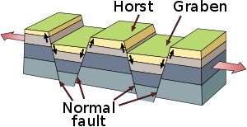
Structures of faults

