Slide 1
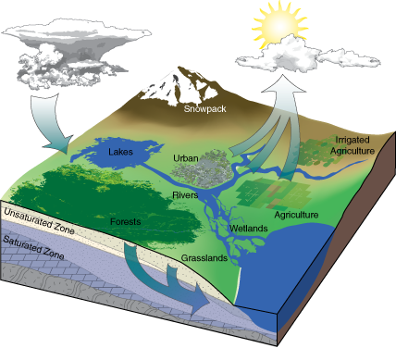
ENGINEERING HYDROLOGY
CE-332
LECTURE 1

Slide 2
REFERENCE BOOKS
Awan N. M, Surface Water Hydrology (Vol-1), National Book Foundation, Islamabad Pakistan.
Chow Ven Te, David R. Maidment, Larry W. Mays, Applied Hydrology, McGraw Hill Book International Edition.
Linsley Ray K, Kohler Max A, Joseph L.H Paulhus, Hydrology for Engineering (3rd Edition).
Maidment David R, Hand Book of Hydrology.
Wilson E.M. Engineering Hydrology.

Slide 3
CONTENTS
Introduction to Hydrology
Hydrological Cycle
Engineering Hydrology and its Domain
Scope and Significance
Hydrologic Equation and its Applications

Slide 4
INTRODUCTION TO HYDROLOGY
Hydrology is the earth science. It encompasses the occurrence, distribution, movement and properties of the waters of the earth and their environmental relations. (Warren Weissman)
Subject matter can be defined in two broad phases
  Hydrologic Data Collection
  Analysis and interpretation

Slide 5
HYDROLOGICAL CYCLE
A continuous Process by which water is transported from the oceans to the atmosphere to the land and back to the sea
The driving force for the global water transport system is provided by sun
Water quality also changes during the cycle
Evaporation
Transport through air masses
Precipitation under proper conditions
Distribution of rain water in several ways

Slide 6
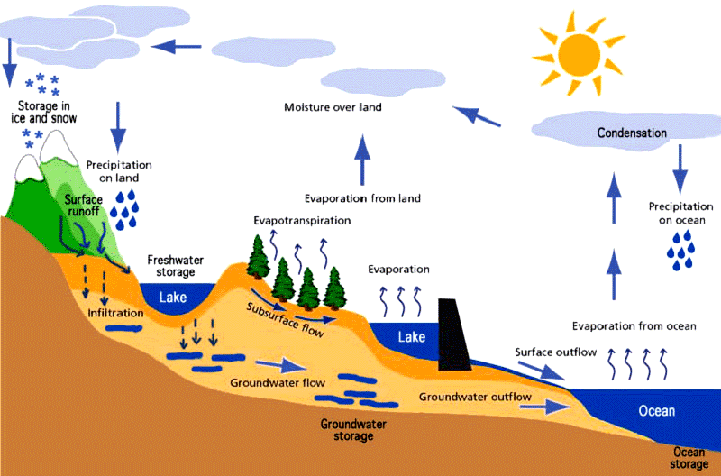
HYDROLOGICAL CYCLE

Slide 7

ENGINEERING HYDROLOGY & ITS DOMAIN
It includes those segments of the fields which are pertinent to planning, design and operation of engineering projects for the control and use of water
  What flood flows can be expected over a spillway or highway culvert or in urban storm drainage system ?
  What reservoir capacity is required for irrigation or municipal water supply during droughts ?
  What effects will reservoirs, levees and other control works exert on flood flow in stream ?
  What are reasonable boundaries for the floodplain ?

Slide 8
SCOPE & SIGNIFICANCE
Water is the basic need for human life
To cope with extreme hydrological conditions Floods and droughts
Food habits of areas are governed by the hydrologic conditions
Water resource management (Water available and water demand)
Input data required for design of hydraulic structures

Slide 9
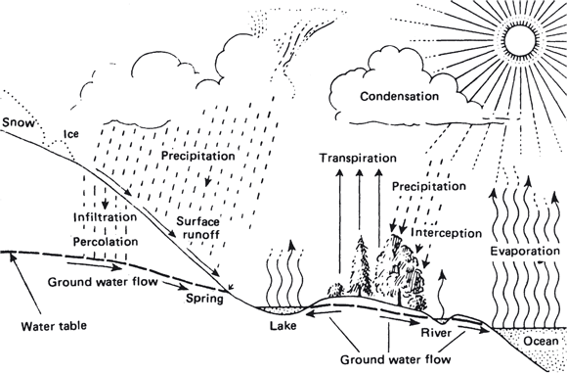
HYDROLOGICAL PROCESSES
Precipitation
Canopy interception
Evaporation
Transpiration
Infiltration
Depression storage
Surface runoff
Ground water flow
Subsurface water flow
River flow

Slide 10
HYDROLOGICAL PROCESSES
Precipitation: A process in which the moisture reaches the surface of earth from atmosphere. It is basic hydrological input. There are many forms of precipitation e.g., rainfall, snow and many others to be discussed in coming lectures
Canopy interception: is the rainfall that is intercepted by the canopy of a tree and successively evaporates from the leaves.
Evaporation: transformation of water from the surface of earth to the atmosphere. It is the reverse process of precipitation.
Transpiration: Evaporation through plants. The water which is transpired is below the surface of earth. Roots suck it and then through plants sent into atmosphere.
60% water of precipitation is lost into atmosphere by evapo-transpiration

Slide 11
HYDROLOGICAL PROCESSES
Infiltration: fraction of rain water penetrates into the ground is called infiltrate and process is known as infiltration. Land cover should be permeable.
Depression Storage: water filled in depression is called depression storage. It depends on unevenness of the surface.
Surface runoff: Rest of water that moves on the ground surface is called surface runoff. This depends on slope and amount of precipitation.
Sub-surface Flow: Infiltrated water that moves in the unsaturated zone of the soil is sub-surface flow. Also called as interflow. It moves towards the rivers. It depends on the soil type and its stratification in the area.
Ground water Flow: Flow of water in the saturated zone of soil, below ground water table. Darcy’s equation is applicable.
River Flow: Flow of water in the rivers

Slide 12
HYDROLOGIC BUDGET
About 71 percent of the Earth's surface is water-covered, and the oceans hold about 96.5 percent of all Earth's water
Total water:1,386,000,000(km³)
Fresh Water:10,633,450 km³
Rivers & Lakes: 93,113 km³
Atmospheric water:12,900 km³
Source: USGS Website
It is a balance between inflows, outflows and change in storage in a given time
A water budget reflects the relationship between input and output of water through a region
Total quantity of water available to earth is finite and indestructible
Global hydrologic system may be considered as closed
Open hydrologic sub-systems are abundant. For example, Rivers are dynamic, open systems. They take water from the global hydrological cycle, use it in their own local hydrological cycle and then return the water to the global cycle.
For any system water budget can be established

Slide 13
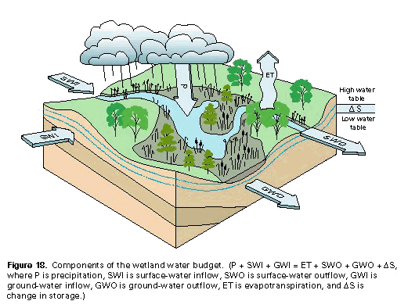
HYDROLOGIC BUDGET

Slide 14
HYDROLOGIC BUDGET
(Region selection)
A region is selected and budget is developed for that region. These regions may be
  Topographically defined (e.g, watersheds and river basins)
  Politically specified (e.g., country or city limits)
  Or chosen on some other grounds
Water Shed : an area or ridge of land which contribute its water to some river, basins or seas
Watershed Boundary: line or boundary that separates the water flowing to different rivers, basins or seas

Slide 15
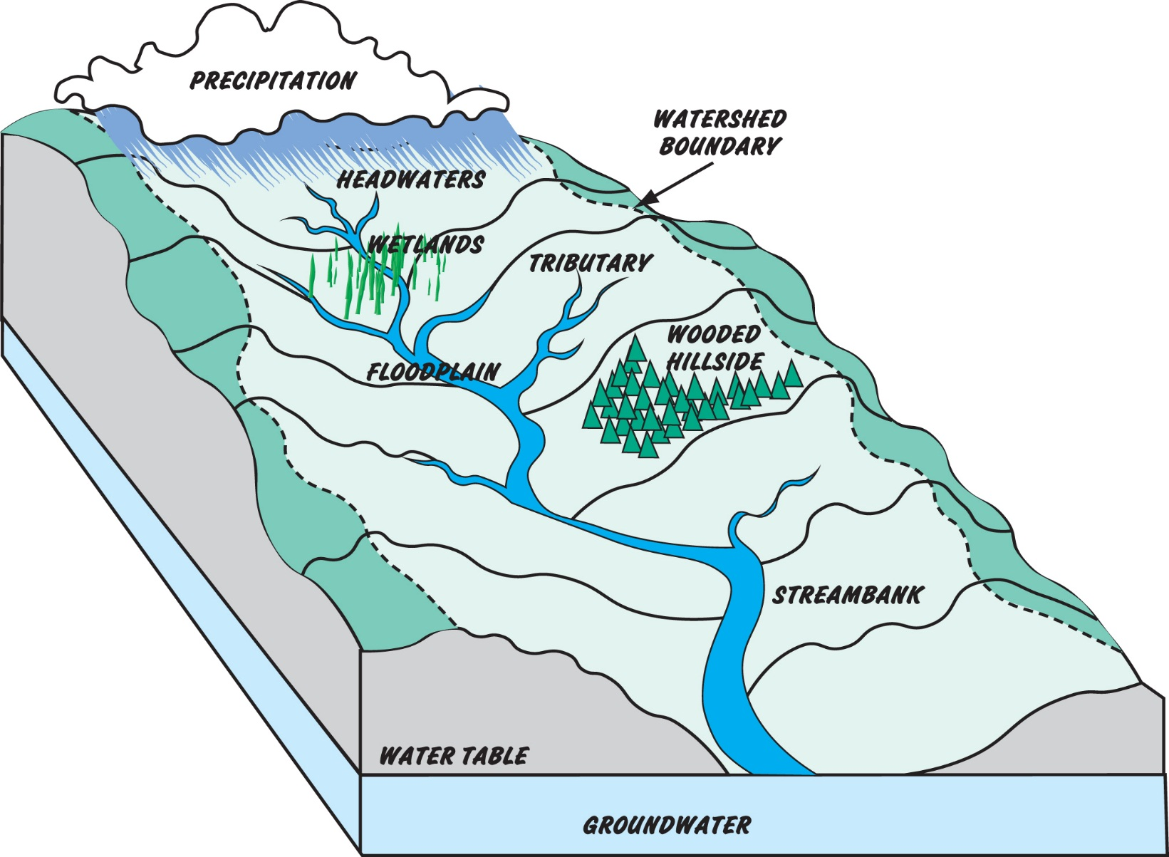
WATER SHED

Slide 16
HYDROLOGIC BUDGET

Slide 17
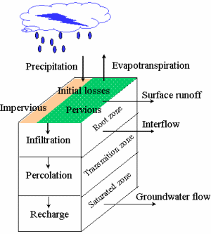
HYDROLOGIC BUDGET
E
Precipitation
Interception
Depression storage
Infiltration
Interflow
Channel Input
Aquifer Recharge
Channel Input
Deep groundwater
Overland Flow
Channel Input
ET
ET

Slide 18
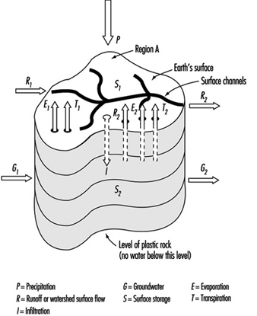
HYDROLOGIC BUDGET
(Inflows)
Precipitation (P)
Infiltration (I)
From a water channel entering in the area (R₁)
Ground water flowing into the area from adjoining areas (G₁)
Ground water effluent to a surface stream (R_{g})

Slide 19
HYDROLOGIC BUDGET
(Outflows)
Surface Runoff
Export through water channel (R₂)
Evaporation
  From ground (E_{g})
  From Surface(E_{s})
Transpiration
  From ground (T_{g})
  From Surface(T_{s})
Infiltration (I)
Groundwater flowing out of the region (G₂)

Slide 20
HYDROLOGICAL BUDGET
(Change in storage)
Ground water
Soil Moisture
Surface reservoir water and depression
Detention storage

Slide 21
HYDROLOGIC EQUATION
Hydrologic budget above the surface
P+R₁-R₂+R_{g}-E_{s}-T_{s}-I=∆S_{s}
Hydrologic budget below Ground Surface
I+G₁-G₂-R_{g}-E_{g}-T_{g}= ∆S_{g}
Total Hydrologic budget for the area
P-(R₂-R₁)-(E_{S}+E_{g})-(T_{s}+T_{g})-(G₂-G₁)= ∆(S_{g}+ S_{s})
If the subscripts are dropped fro, equation letters refer to total precipitation and net values of Surface flow, Underground flow, evaporation, transpiration and storage
  P-R-G-E-T=∆S
  And where terms G, E and T do not apply equation reduces
  P-R= ∆S

Slide 22
APPLICATIONS OF THE HYDROLOGIC EQUATION
Difficulty in solving practical problems lies mainly in the inability to measure or estimate properly the various hydrologic equation terms.
For local studies reliable estimates are often made but on global scale quantification is crude.
Precipitation is measured by rain gauges or snow gauges throughout area
Surface flows can be measured using various devices such as weirs, flumes, velocity meters and depth gauges
Under good conditions these measurements are frequently 95% or more accurate
Soil moisture can also be measured using neutron probes and gravimetric methods infiltration can be determined infiltrometers but the estimates are crude

Slide 23
APPLICATIONS OF THE HYDROLOGIC EQUATION
The extent and rate of movement of ground water is exceedingly difficult to determine.
Determination of quantities of evaporation and transpiration is also extremely difficult.
For the large drainage basins rate of evaporation, transpiration and groundwater movement are often highly heterogeneous.
In such cases hydrologic equation is a useful tool and can be employed in various ways.

Slide 24
NUMERICAL PROBLEM
In a given year, a 10,000-mi² watershed received 20in of precipitation. The average rate of flow measured in the river draining the area was found to be 700 cfs( cubic feet per second). Make a rough estimate of the combined amounts of water evaporated and transpired from the region during the year of record.
Solution:
P-R-G-E-T= ∆S
ET=P-R-G-∆S
ET=?

Slide 25
Assumptions :
Groundwater flow can be considered zero
No change in storage
Equation becomes ET=P-R
R=6000cfs
R= 8.1in
P=20in
ET=20-8.1
ET=11.9in/year

Slide 26
NUMERICAL PROBLEM
A= 25900 km²
P=510mm
R=20 cumecs
E+T=?
E+T=485.6mm

