Slide 1
HYDROGRAPHS
LECTURE 11

Slide 2
HYDROGRAPHS
A hydrograph is a continuous graph showing the properties of stream flow with respect to time
Normally obtained by means of a continuous strip recorder that indicates stage versus time (stage hydrograph) and is then transformed to discharge hydrograph by use of rating curve.
The term hydrograph generally means discharge hydrograph
The hydrograph is a result of the physiological and hydrometerological effects of watershed

Slide 3
COMPONENT ELEMENTS OF HYDROGRAPH
Direct surface runoff
Interflow
Ground water or base flow
Channel precipitation

Slide 4
DEFINITIONS OF HYDROGRAPH
Discharge
Crest Segment
Hydrograph in period of no DRO and where no reservoir regulation exists reflects discharge from ground water
Rising limb or Concentration curve
Falling Limb
Point of inflection (where DRO ceases)
Point of rise (where DRO starts)
Time

Slide 5
RUNOFF FORMATION FROM A RAIN EVENT
Precipitation
Abstraction
Depression storage
Detention storage
Formation of rivulets
Channel flow

Slide 6
FACTORS AFFECTING THE SHAPE OF HYDROPGRAPH
Climatic Factors
  Rainfall intensity
  Rainfall duration
  Distribution of rainfall on the basin
  Direction of storm movement
Topographic and geologic Factors
  Catchment size
  Catchment shape
  Distribution of water courses/ drainage
  Slope of the catchment
  Geology of the catchment
  Land use
  Land cover

Slide 7
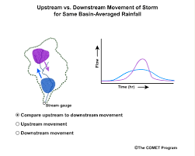
DIRECTION OF STORM MOVEMENT EFFECT

Slide 8
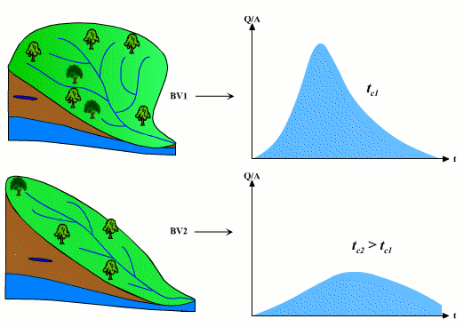
SHAPE OF CATCHEMENT EFFECT

Slide 9
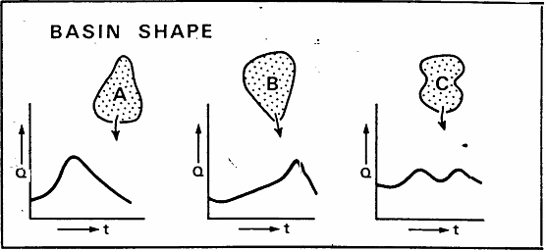
SHAPE OF CATCHEMENT EFFECT

Slide 10


DRAINAGE OF WATERSHED

Slide 11
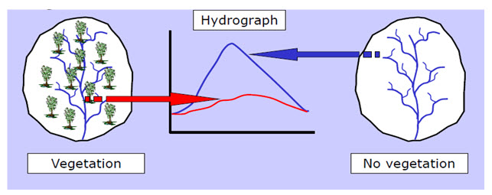
LAND COVER

Slide 12
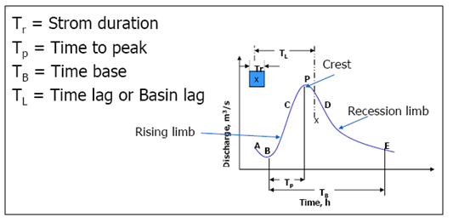
HYDROGRAPH AND TIME RELATIONS
Time base: Time from which the concentration curve begins (point of rise) until the direct runoff ceases.

Slide 13
HYDROGRAPH AND TIME RELATIONS
Lag time or Basin Lag: difference in time between center of mass of effective rainfall and center of mass of runoff produced. Or
Time interval from the maximum effective rainfall to peak rate of runoff.

Slide 14
HYDROGRAPH AND TIME RELATIONS
Time of concentration: the concentration time is the time required, with uniform rain for 100% of a tract of land to contribute to the direct runoff at the outlet. Or the time for runoff to arrive at the outlet from the remote most point after the rain ceased .

Slide 15
HYDROGRAPH SEPARATION
Hydrograph separation means to separate base flow and DRO in a hydrograph as a basis for further analysis techniques
Several methods of base flow separation are used when exact amount of base flow is unknown. Such as
  Constant Discharge method/ Horizontal line method
  Constant slope method
  Fixed base time method
  Concave method

Slide 16
UNIT HYDROGRAPHS
Unit hydrograph is a direct runoff hydrograph resulting from one unit (one inch or one cm) of constant intensity uniform rainfall occurring over the entire watershed.
The concept of unit hydrograph is based on linear systems theory and follows the principles of superposition and proportionality.
It is incorrect to describe a unit hydrograph without specifying the duration, of the storm that produced it
An x hours unit hydrograph means a direct runoff hydrograph having 1.0 inch volume resulting from an x hours storm having a steady intensity 1/x in per hour

Slide 17
APPLICATION OF UNIT HYDROGRAPH
A unit hydrograph is used for the prediction of flood peak and time to peak in the stream at a particular section due to any amount of effective precipitation
Application of an x-hour unit hydrograph to rainfall excess amounts more than 1 unit is accomplished just by multiplying the excess amount by the unit hydrograph ordinates
For example, a 3 hours rain event producing 2.0” effective precipitation would have runoff rates 2 times of a 3-hours unit hydrograph. Similarly a 3- hours storm having 0.5” net precipitation would produce runoff rates half of the 3 hours unit hydrograph.
This assumption of proportional flows applies only to equal duration storms

Slide 18
ASSUMPTIONS OF UNIT HYDROGRAPH
Following are the assumptions while deriving the unit hydrograph:
  Precipitation amount and intensity is uniform over the entire watershed
  Precipitation intensity remains uniform throughout the storm
  Base length of the hydrograph DRO for a particular catchment resulting from a storm of given duration is approximately the constant
  Entire watershed is treated as a single unit

Slide 19
DERIVATION OF UHG
Data Collection
To develop a unit hydrograph it is desirable to acquire as many rain fall records as possible
These can be obtained from the published data by meteorological department
Preliminary selection
Storms occurring individually , simple storm structure
Storms having uniform distribution of rainfall throughout the rainfall excess period
Further shortlisting
Duration of rain event should be approximately 10-30% of lag time of the basin
DRO volume should be 0.5-1.75 units
Storms having uniform spatial distribution of rainfall
Suitable number of storms should be analyzed to obtain average ordinates
Conversion of DRO to UHG
Direct runoff ordinates of each storm should be reduced so that each event represents 1 unit of DRO
Final UHG of a specific duration can be obtained by averaging ordinates of selected ordinates
Separation of the components of hydrograph i.e., DRO and Base flow

Slide 20
NUMERICAL PROBLEM
Determine UHG ordinates if effective precipitation is 1.4 in for this storm. And each time unit is 1.5 hours.
Time (units) | Total Runoff (cfs) | Baseflow (cfs) | Time (units) | Total Runoff (cfs) | Baseflow (cfs)
1 | 110 | 110 | 7 | 293 | 113
2 | 122 | 122 | 8 | 202 | 112
3 | 230 | 120 | 9 | 160 | 110
4 | 578 | 118 | 10 | 117 | 105
4.7 | 666 | 116 | 10.5 | 105 | 105
5 | 645 | 115 | 11 | 90 | 90
6 | 434 | 114 | 12 | 80 | 80

Slide 21
NUMERICAL PROBLEM
Using the hydrograph developed in last problems derive a DRO hydrograph of a storm event as given below.
1.7”
1.2”
0.7”
Each time unit is 1.5 hours

Slide 22
CONVERSION OF UHG DURATION
Unit hydrograph developed by procedure outlined earlier is applicable only for a specified duration of storm
The application to storms of larger or smaller duration might be required sometimes
Instead of making hydrograph for the new duration there are two more methods
  Lagging method
  S-curve Method

Slide 23
LAGGING METHOD
The method of “lagging” is based on the assumption that linear response of the watershed is not influenced by previous storms
one can superimpose hydrograph offset in time and flows are directly additive
if a hydrograph of 1 hour is given, hydrograph for 2 hours duration can be obtained by plotting two 1 hour UHG with second UHG 1 hour lagged, adding ordinates and dividing by two
Lagging procedure is restricted to the multiples of the original duration according to the expression
D₁=nD
D₁ : possible durations of UHG by lagging method
D : Original duration of UHG
n : 1,2,3,….

Slide 24
S-CURVE METHOD
Construction of any duration of unit hydrograph
Lagging system is the same as described in last method
A unit hydrograph is assumed to repeat indefinitely
Continuous lagging of UHG is comparable to a continuously applied rainfall at a certain intensity
The cumulative addition of the initial UHG ordinates at time intervals equal to unit storm duration results in a S-hydrograph
Maximum discharge of S-hydrograph occurs at time D hours that is less than time base of the storm

Slide 25
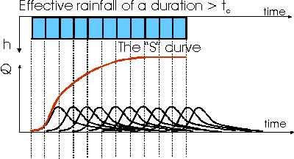
S-CURVE METHOD

Slide 26
S-CURVE METHOD
Any duration t UHG may be obtained if we have a D hours UHG
Simply lag the first S-hydrograph of D hours UHG by a second S-hydrograph a time interval equal to t hours
Subtract the ordinates of second S-hydrograph by the first one
And multiply these ordinate with a factor D/t

Slide 27
NUMERICAL PROBLEM
Give the following 2-hr UHG, use S-curve procedures to construct a 3-hr UHG.
Time (hours) | Q (cfs)
0 | 0
1 | 100
2 | 250
3 | 200
4 | 100
5 | 50
6 | 0

