Slide 1
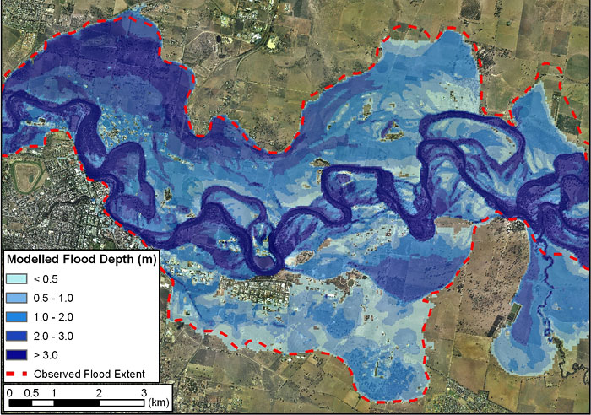
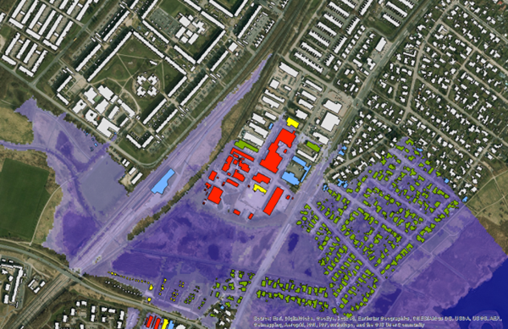
FLOODS AND THEIR Estimation
Post event comparison of flood extent modelled (predicted) by a floodplain hydraulic model (blue) and actual flood event (redline) in NSW, Australia
Simulation of maximum flood extent plotted against Buildings/structures in an area © DHI, Denmark
LECTURE 12

Slide 2
FLOODs
  “Flood is a high stage in river which causes overbank flow and inundates the adjoining areas ( Flood Plains)”

Slide 3
FLOODs
Significance of flood study
  For the assessment of the design flood
  For the design of flood protection structures
Causes of flood
  Causes may be individual or a combination of the following
  Excessive rainfall-runoff
  Excessive snowmelt
  Dam failure
  Landslide outburst
  Glacier lake outburst

Slide 4
CAUSES OF FLOODS
1. Excessive Rainfall-Runoff
  High intensity rainfall for longer duration
  Large run-off generated can cause flood
  Generally in tropical region
2. Excessive Snowmelt Runoff
  In summers when increase in temperature causes snowmelt
  Slope of rising limb of a snowmelt hydrograph is less steeper than rainfall-runoff hydrograph

Slide 5
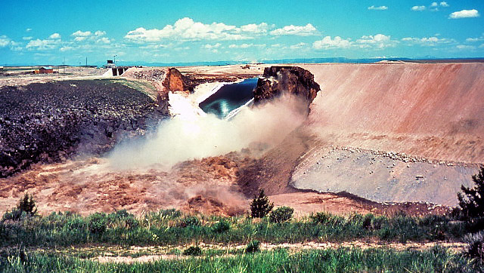
CAUSES OF FLOODS
3. Dam failure
  Almost 2000 dams have failed
  A large quantity of water rushes towards the downstream
  Causes huge damage
Teton Dam Failure, Idaho, USA. (June 5,1976)

Slide 6
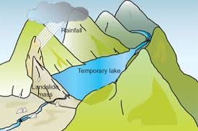
CAUSES OF FLOODS
4. Land Slide outburst
  Due to landslides natural earthen dams form in the river and they block the flow
  Natural lake is formed upstream of such dam
  Which inundates the adjoining land due to damming
  When water overtops this earthen embankment it fails and large quantity of water rushes downstream

Slide 7
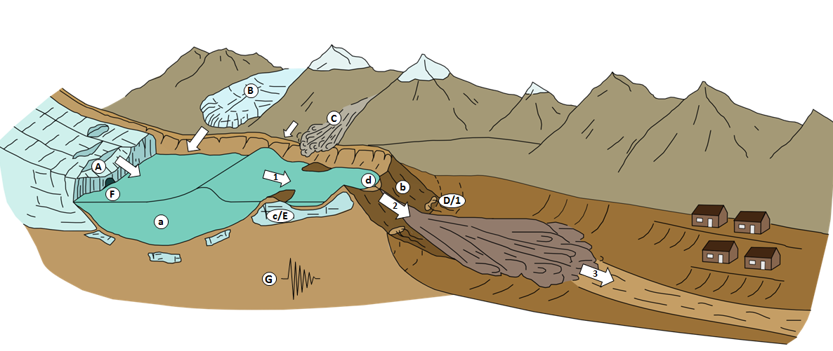
CAUSES OF FLOODS
5.Glacier Lake outburst
  When glacier fragments are detached from the glacier and fall down in river they make an ice dam
  Water keeps on accumulating upstream of the dam and causes flooding
  And when it fails causes flooding downstream

Slide 8
METHODS/ APPROACHES FOR ESTIMATION OF FLOODS
Following are very common approaches to estimate flood
From past flood marks
Using rational formula
Using empirical flood formulae
Using unit hydrograph method
By using flood frequency analysis

Slide 9

1.FROM PAST FLOOD MARKS
Site is physically visited and maximum flood marks are estimated in the last 30-35 years
These marks may be identified by asking the local residents
Reduced level of highest flood is determined
Sometimes these marks are also traced on some building or trees
The cross section is obtained at site by differential levelling and draw a horizontal line on highest flood mark
Determine flow area on the section from drawing sheet and wetted perimeter determine hydraulic radius R
$R=\frac{Area}{Perimeter}$

Slide 10
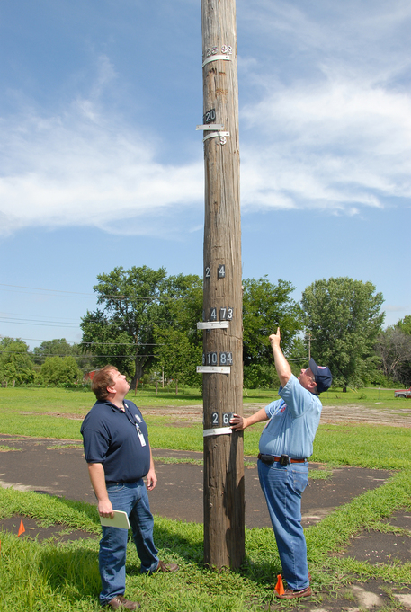
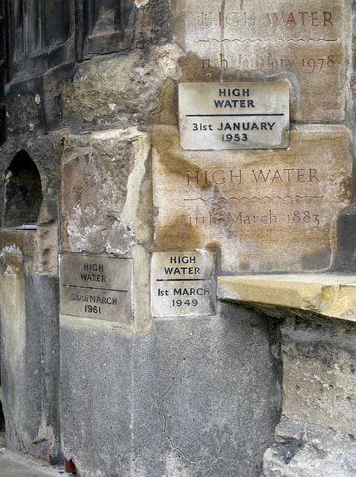
Missouri, USA.
Entrance to church of ST. Margaret, England

Slide 11

1.FROM PAST FLOOD MARKS
Carry out differential levelling along the profile of the channel and determine bed slope
$S=\frac{∆h}{L}$
Assess an appropriate value of manning’s coefficient “n” for channel surface
$V_{p}=\frac{1}{n} .R^{2/3}.S^{1/2}$
$V_{p}$ is peak velocity
Peak discharge/ Flood=$V_{p}$ x A
This method gives highest flood in the history

Slide 12

2.USING RATIONAL FORMULA
This method is most suitable for small urbanized water sheds $≤50km$²
$Q_{p}=C.I.A$
This formula is widely used for assessment of design flood for storm sewers and other drainage structures. If the area consists of different surface conditions which means different values of C then a weighted average with respect to area is used in place of C in above formula
Where
Q_{p} : Peak discharge
C : Runoff Coefficient(depends upon surface conditions
ranges from (0.05-0.95)
I : Intensity of rainfall a certain duration and return period
A : Watershed area

Slide 13
2.USING RATIONAL FORMULA
For a culvert design determine peak flood using rational method. The drainage basin area is 800 hectares and is 90% treed(C=0.4) and 10% exposed rock (0.8). Intensity of precipitation is 30mm/hr

Slide 14
3.USING EMPIRICAL APPROACH
Empirical formulae are generally applicable for the regions where they are developed
If these are to be applied to some other region hydro-meteorological conditions should be same.
Following are some important empirical relations
  Dickens Formula
  Ryve’s formula
  Inglis Formula
  Nawab Jang Bahadur Formula
  Usman Naeem Formula
  Hafiz Asif Arshad Formula

Slide 15

3.USING EMPIRICAL APPROACH
Dickens Formula: (for central and northern part of India)
$Q_{p}=C .A^{3/4}$
$A:Watershed area$
C : Dickens Constant (6-30)
Ryve’s Formula: (for central part of India)
$Q_{p}=C .A^{2/3}$
C : Ryve’s Constant (6.8-10.2)

Slide 16

3.USING EMPIRICAL APPROACH
Inglis Formula: (for western part of India)
$Q_{p}=\frac{123}{\sqrt{A+10.4}}$
Nawab Jang Bahadur Formula: (for northern part of India)
$Q_{p}=C.A (0.92−log⁡(\frac{A}{14})$)
Hafiz Asif Arshad Formula: (For Upper Jhelum River)
$Q_{p}= A^{0.72}$. $S^{0.32}$ ( S is watershed slope in %)
Usman Naeem Formula: (For Upper Chenab River)
$Q_{p}=1.005. A^{2.46}$. $S^{4.22}$ ( S is watershed slope in %)

Slide 17
4.BY APPLYING UNIT HYDROGRAPH METHOD
Hydrograph is a DRO hydrograph resulting due to unit effective precipitation (1cm/ 1”) over the watershed
Area under unit hydrograph is always 1cm or 1” . It means volume of the precipitation volume normalized with watershed area
Unit hydrograph gives the time distribution of surface runoff due to unit effective precipitation over the watershed
For any value of effective precipitation over the watershed time distribution of the surface runoff can be obtained by using ordinates of unit hydrograph

Slide 18
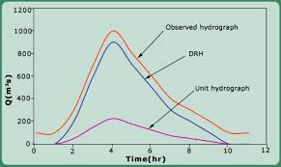
4.BY APPLYING UNIT hydrograph method

Slide 19
4.BY APPLYING UNIT hydrograph method
Procedure:
For the rainstorm compute effective precipitation
Peff= Pt – (E+I+T)
Compute time of concentration tc
Select duration of unit hydrograph
Pick the value of Qp from the unit hydrograph
Compute the Qp for given x(cm) precipitation
  (Qp)x = x . (Qp)UHG
Time of concentration: (t_{c}) it is the time required by a drop of water to reach at the outlet from the farthest location of watershed

Slide 20
4.BY APPLYING UNIT HYDROGRAPH METHOD
Limitation:
  Amount of rainfall is uniform over the whole watershed
  Intensity of precipitation is uniform throughout the area
  Applicable for smaller area ≤ 500 km²
  Method is applicable for tropical watersheds

