Slide 1
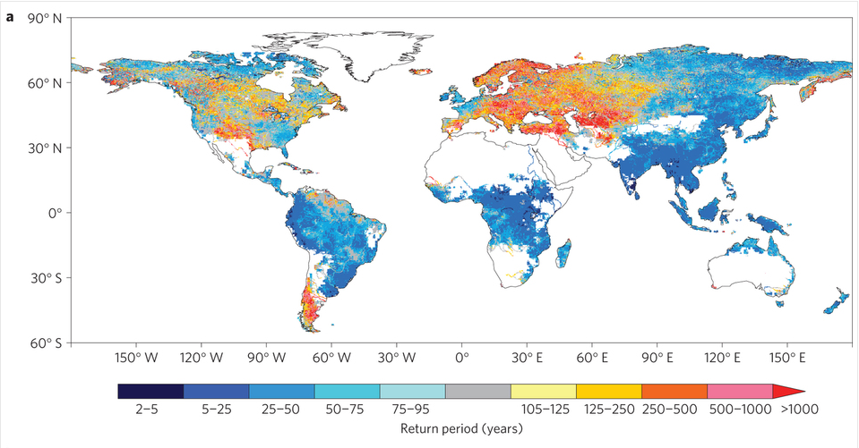
FLOOD FREQUENCY ANALYSIS
Global Flood risk under climate change, 2013
LECTURE 13

Slide 2
FLOOD FREQUENCY ANALYSIS
It is a statistical probabilistic method
Flood magnitudes are determined corresponding to different return periods
Past flood data is used
Accuracy of this method depends on the length of past data record
Recommended length of data record required for this method is 30 years
If it is less than 10 years flood frequency analysis should not be carried out on this data

Slide 3
INTRODUCTION
“The frequency is the number of time that a given magnitude flood may occur in a given period.”
Knowledge of the magnitude and probable frequency of recurrence of flood is necessary for
Economical and safe design of bridges, dams, levees, culverts and other structures
Effective management of flood plains, flood defense schemes
To predict possible flood magnitude over a certain time period
To estimate the frequency with which floods of a certain magnitude may occur

Slide 4
METHODS OF COMPILING FLOOD DATA
There are two methods of treating data for studying frequency analysis
1. annual flood series
2. partial duration analysis

Slide 5
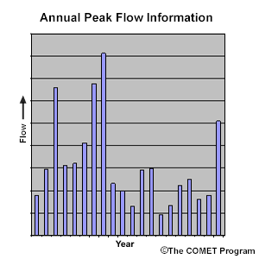
ANNUAL FLOOD SERIES
An annual flood is defined as the highest momentary peak discharge in a water year.
The use of only one flood in each year is the most frequent objection to the use of annual floods.
Infrequently, the second highest flood in a given year, which is omitted in the above definition, may outrank many annual floods.
Q
1990
1991
1992
1993
time

Slide 6
PARTIAL DURATION FLOOD SERIES
The objection noted under annual floods is resolved by listing all floods that are greater than a selected base without regard to number within any given time period.
The base is generally selected as equal to the lowest annual flood so that at least one flood in each year is included, however, in a long record, the base is generally raised so that on the average only 3 or 4 floods a year are included.
But sometimes there may be no flood in a year and may be three or four peaks occur in the same year if base flood selected is not the minimum
Q
Q_{Sel}
1990
1991
1992
1993
time

Slide 7

RETURN PERIOD/RECURRING INTERVAL (T)
“ return period is the average number of years during which a flood of a given magnitude will be equaled or exceeded once.” or
“it is time interval after which a similar flood can be expected.”
$T=\frac{1}{P}$ where P is probability of occurence

Slide 8
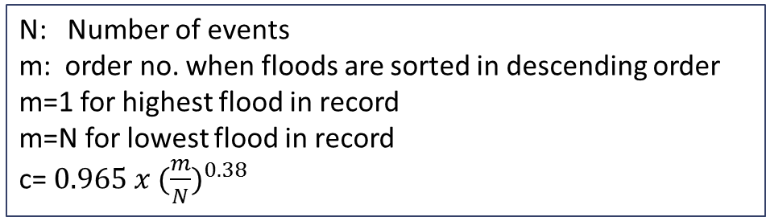

METHODS TO DETERMINE THE RETURN PERIOD
Empirical methods are most commonly used
1. California method $\text{(}T=\frac{N}{m})$
2. Allen Hazen method $\text{(}T=\frac{2N}{(2m−1)})$
3. Weibull method $\text{(}T=\frac{N+1}{m})$
4. Gumbel’s method $\text{(}T=\frac{N}{(m+c−1)})$
N: Number of events
m: order no. when floods are sorted in descending order
m=1 for highest flood in record
m=N for lowest flood in record
c= $0.965 x {(\frac{m}{N})}^{0.38}$

Slide 9
NUMERICAL PROBLEM
For the data record find out the return periods using
California Method 2. Allen Hazen Method
Weibull Method 4. Gumbel Method
Also compute the frequency.
Year | Flood (m³/s)
1981 | 4800
1982 | 4400
1983 | 4600
1984 | 5000
1985 | 4600
1986 | 3800
Year | Flood (m³/s)
1987 | 3600
1988 | 3700
1989 | 2410
1990 | 2500
1991 | 3500
1992 | 3500

