Slide 1
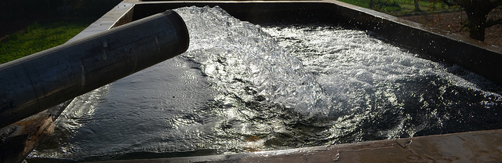
GROUND WATER HYDROLOGY
LECTURE 15

Slide 2
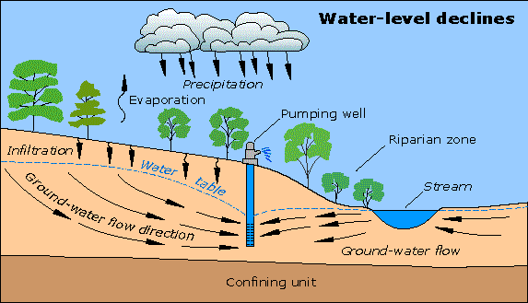
GROUND WATER HYDROLOGY
“Science of occurrence, distribution and movement of water below the surface of earth”

Slide 3
IMPORTANCE OF GROUND WATER
About 30% of earths fresh water resources exist as ground water
This is a pollution free resource of water and is specially useful for domestic use
After rainfall and surface water, ground water is the next most important water source for irrigation
Aside from direct use ground water is an important phase of hydrological cycle
Most of flow in perennial streams originates from subsurface water while a large part of ephemeral streams may percolate beneath the surface

Slide 4
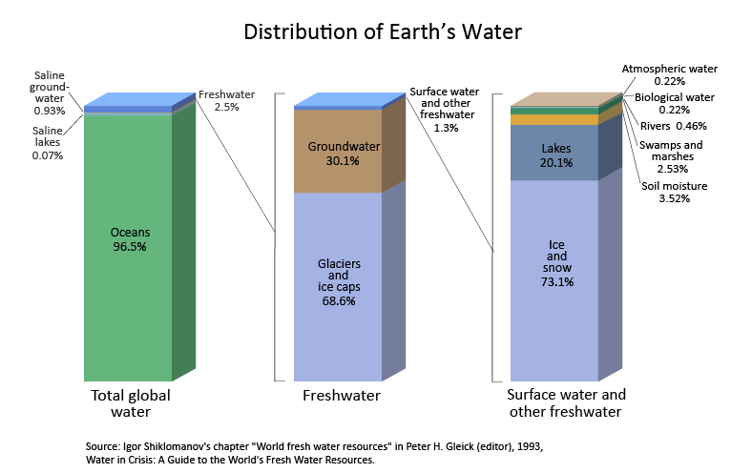
DISTRIBUTION OF EARTH’S WATER

Slide 5
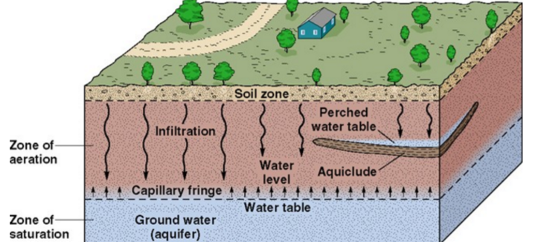
OCCURRENCE OF SUBSURFACE WATER
Ground water occurs as pore water in the soil
Going into the ground one passes through zone of aeration to the zone of saturation
Zone of aeration : the region in which pores in the soil may contain air or water also called “vadose zone”
Zone of saturation: the region below the water table where interstices are filled with water also known as “phreatic zone”

Slide 6

VERTICLE DISTRIBUTION OF SUBSURFACE WATER
Vadose/ Unsaturated/ Aeration Zone
Root Zone (10m) / Soil water ( water retained by roots of vegetation)
Intermediate zone (for deep WT, water in this zone flows under gravity)
Lithosphere $≈1$Km
Capillary zone ( water retained by Capillary force)
WT
Saturated/ Phreatic Zone
Aquifer (All interstices filled with water)

Slide 7
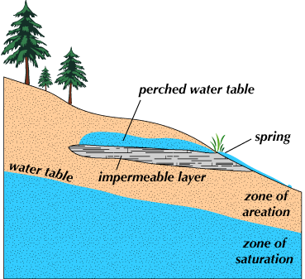
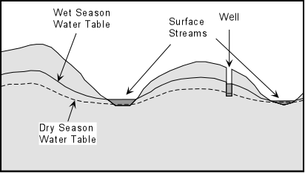
WATERTABLE
Both zones in the soil are divided by an irregular surface known as water table
Above water table occurs vadose zone and below it occurs saturated zone
Water table is a locus of points (in an unconfined aquifer) where hydrostatic pressure equals atmospheric pressure
Water table does not remain fixed
  It fluctuates with precipitation events
  It follows the topography
  It flows

Slide 8
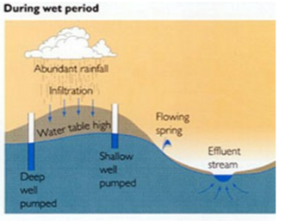
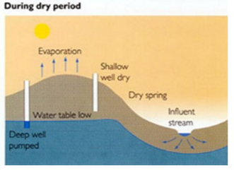
WATERTABLE
Water table is not stagnant it rises and falls in elevation depending on the rain fall.
It rains different at different patches in the land. Difference in the levels of WT in two adjacent lands creates slope.
That slope also causes the ground water to flow towards lower level.

Slide 9
IMPORTANT TERMINOLOGY
Aquifer: a geological formation that contains water and also allows to transmit water from one point to another under ordinary field conditions (for depths more than 3Km a little water is found due to smaller pores and high pressure)
Aquiclude: A geological formation that contains water but does not allow water to transmit sufficiently
Aquifuge/Aquitard: A geological formation which neither contain any water nor allow any transmission of water through them. Rock formation are an example of such formations

Slide 10
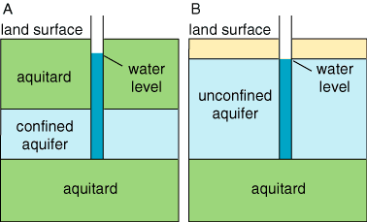
TYPES OF AQUIFERS
  There are two types of aquifers
    Unconfined aquifers
    Confined aquifers

Slide 11
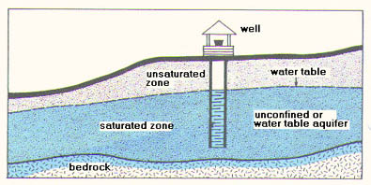
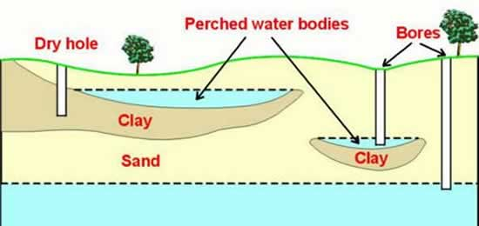
TYPES OF AQUIFERS
Unconfined Aquifers:
  These are the aquifers into which water seeps directly from the ground above them
  Also known as non-artesian or water table aquifers
  A special case of unconfined aquifers is perched water bodies. This occurs whenever a ground water body is separated from main water table by a relatively impermeable strata.

Slide 12
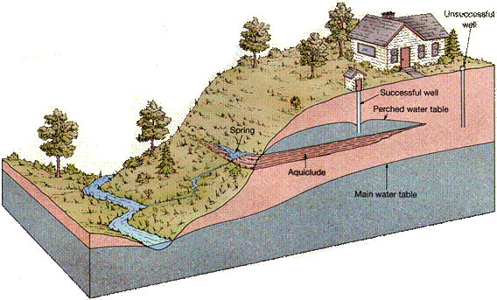
TYPES OF AQUIFERS
Perched water body

Slide 13
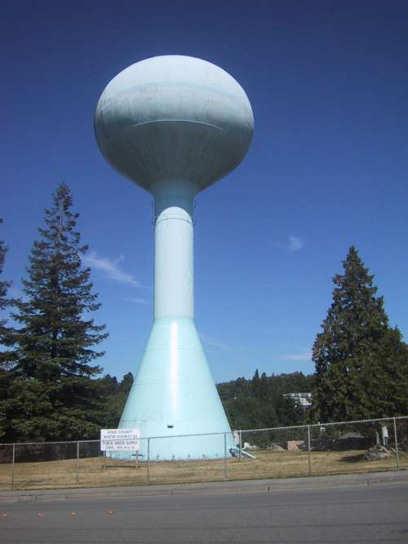
TYPES OF AQUIFERS
Water Tower
confined Aquifers:
  Such an aquifer which remains overladen by an impermeable strata Aquiclude/Aquifuge/aquitard.
  In this type of aquifer water can not seep directly from the ground above. Instead there are certain recharge points wherever this strata is exposed to ground surface.
  Water is under pressure in this aquifer
  Also known as artesian aquifer

Slide 14
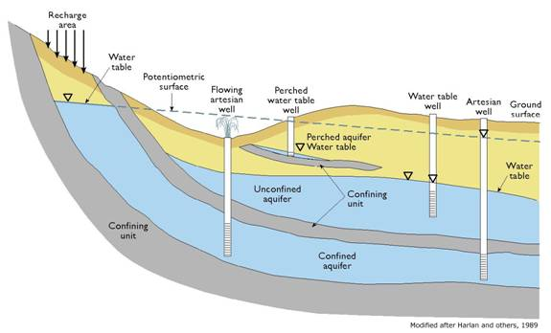
TYPES OF AQUIFERS
Confined Vs Unconfined Aquifers

Slide 15
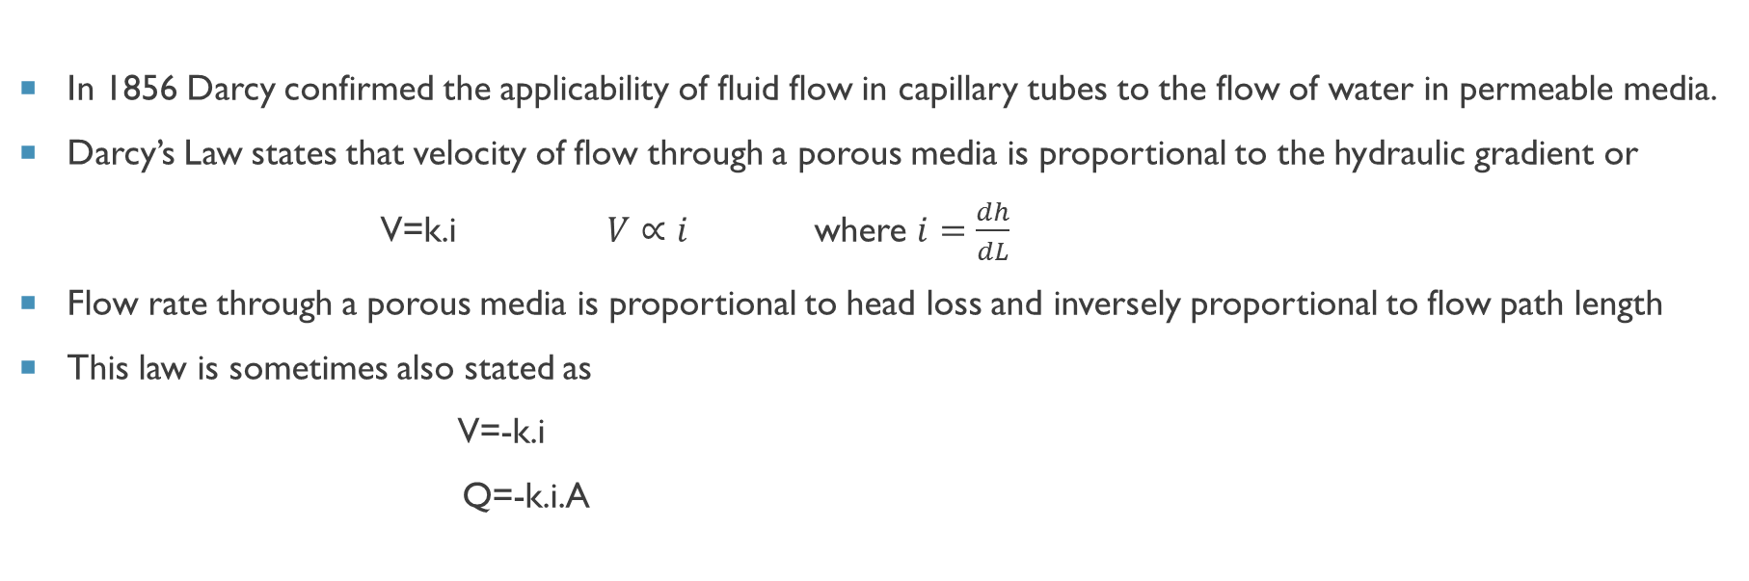
DARCY’S LAW
In 1856 Darcy confirmed the applicability of fluid flow in capillary tubes to the flow of water in permeable media.
Darcy’s Law states that velocity of flow through a porous media is proportional to the hydraulic gradient or
V=k.i $V∝i$ where $i=\frac{dh}{dL}$
Flow rate through a porous media is proportional to head loss and inversely proportional to flow path length
This law is sometimes also stated as
V=-k.i
Q=-k.i.A
Negative sign indicates that flow is in direction of decreasing head

Slide 16





DARCY’S LAW
Q
Darcy’s law is applicable for laminar flow (R_{N} $≤1$)
$R_{N}=\frac{ρvD}{μ}=\frac{vD}{θ}$ where D is grain diameter
$i=\frac{dh}{dL}=\frac{h_{2−}h_{1}}{L}$
A= x-sectional area of specimen =$δ$_{x}$.δ$_{y}
$Q=\frac{−K(h_{2−}h_{1})}{L}.A$
$V_{a}=\frac{Q}{A_{p}}$ $A_{p}=n. A=n.δ\text{x}.δ\text{y}$
V_{a} is actual seepage velocity
n is porosity (n$=\frac{Vol. of voids}{Total volume of soil}$)=(0.25-0.75)
Q
$∆$h
h₁
h₂
L
Porous Medium
$δ$_{y}
$δ$_{x}
Cross Section of Porous Medium

Slide 17
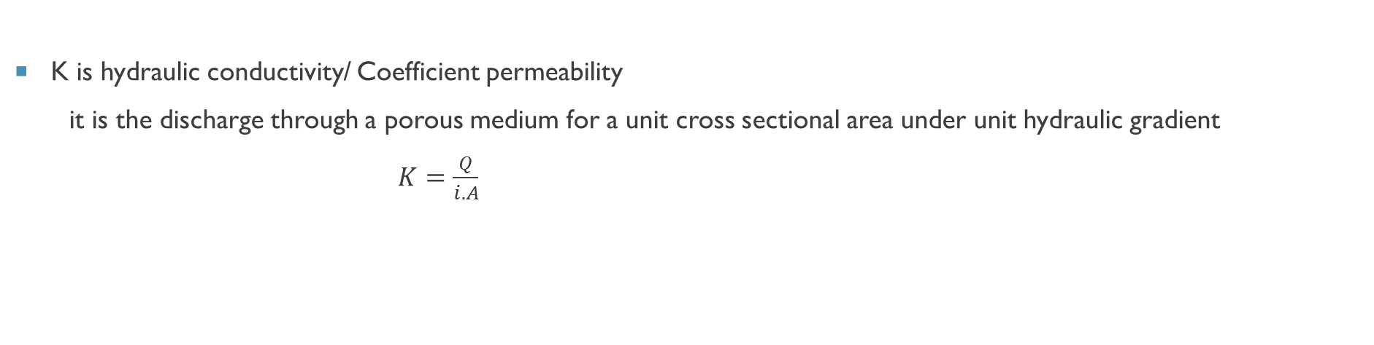
DARCY’S LAW
K is hydraulic conductivity/ Coefficient permeability
it is the discharge through a porous medium for a unit cross sectional area under unit hydraulic gradient
$K=\frac{Q}{i.A}$

Slide 18
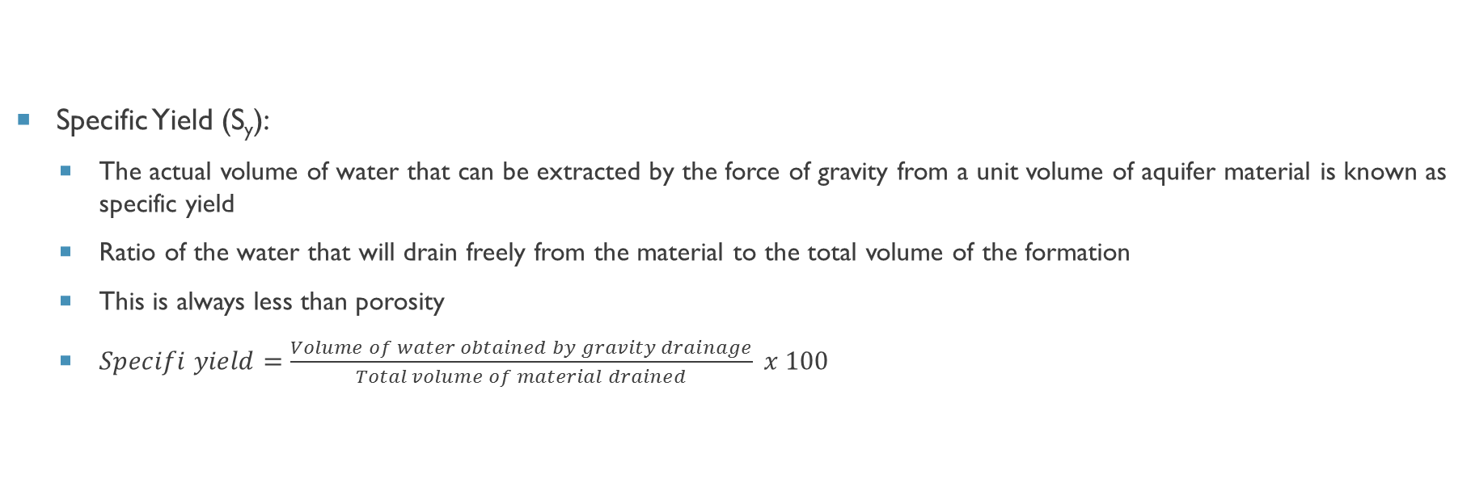
SPECIFIC YIELD
Specific Yield (S_{y}):
  The actual volume of water that can be extracted by the force of gravity from a unit volume of aquifer material is known as specific yield
  Ratio of the water that will drain freely from the material to the total volume of the formation
  This is always less than porosity
  $Specifi yield=\frac{Volume of water obtained by gravity drainage}{Total volume of material drained} x 100$

Slide 19
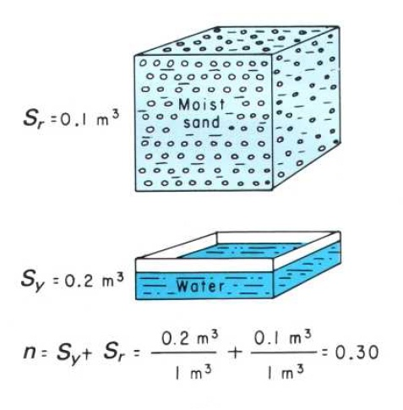
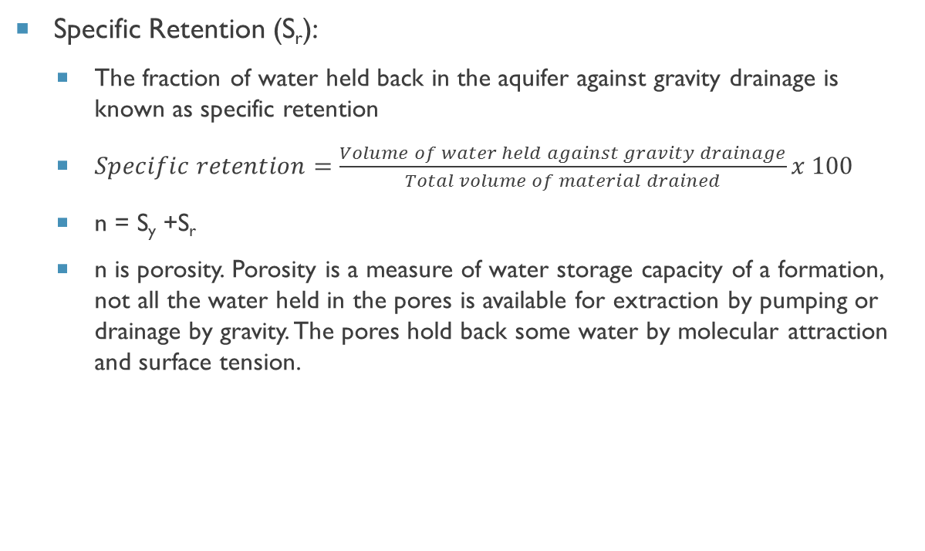
SPECIFIC RETENTION
Specific Retention (S_{r}):
  The fraction of water held back in the aquifer against gravity drainage is known as specific retention
  $Specific retention=\frac{Volume of water held against gravity drainage}{Total volume of material drained}x 100$
  n = S_{y} +S_{r}
  n is porosity. Porosity is a measure of water storage capacity of a formation, not all the water held in the pores is available for extraction by pumping or drainage by gravity. The pores hold back some water by molecular attraction and surface tension.

Slide 20
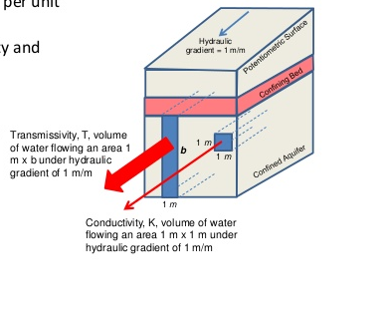
TRANSMISSIVITY
Rate at which water of the prevailing kinematic viscosity is transmitted through a unit width of an aquifer under a unit hydraulic gradient
It is a product of hydraulic conductivity and aquifer layer thickness
T=k.b

Slide 21
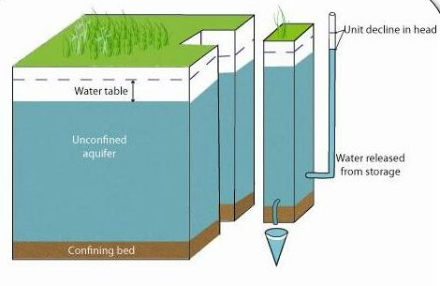
STORATIVITY/ STORAGE COEFFICIENT
It is defined as the volume of water that an aquifer releases from or takes into storage per unit surface area of the aquifer per unit change in head normal to the surface.
It is the product of specific storage and thickness of aquifer layer
S= S_{s} .b

Slide 22
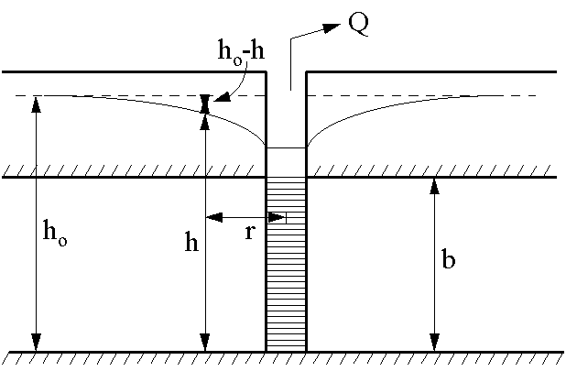
HYDRAULICS OF WELL
Steady state condition:
  When a well is pumped, water is removed from aquifer surrounding the well and water table lowers
  This lowering takes place in well as well as soil surrounding the well
  This depression is called as “Draw down”
  A drawdown curve gives the variations in the drawdown with distance from the well
  In 3d called as cone of depression
  Outer limit of cone of depression defines the area of influence of
  the well

Slide 23
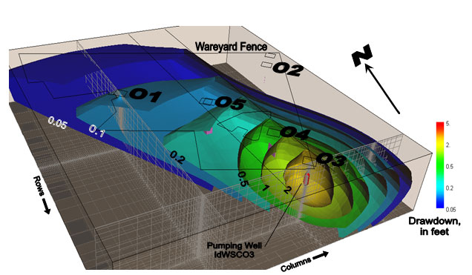
CONE OF DEPRESSION
Multiple well test, Idaho Water Science Center, USGS

Slide 24
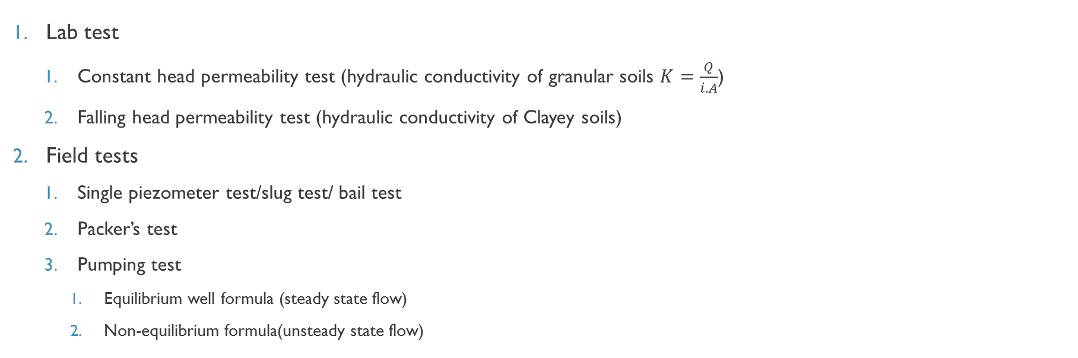
MEASUREMENT OF HYDRAULIC Parameters of Aquifer
Lab test
  Constant head permeability test (hydraulic conductivity of granular soils $K=\frac{Q}{i.A}$)
  Falling head permeability test (hydraulic conductivity of Clayey soils)
Field tests
  Single piezometer test/slug test/ bail test
  Packer’s test
  Pumping test
    Equilibrium well formula (steady state flow)
    Non-equilibrium formula(unsteady state flow)

Slide 25
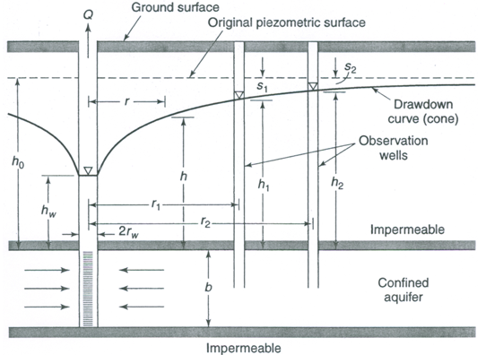
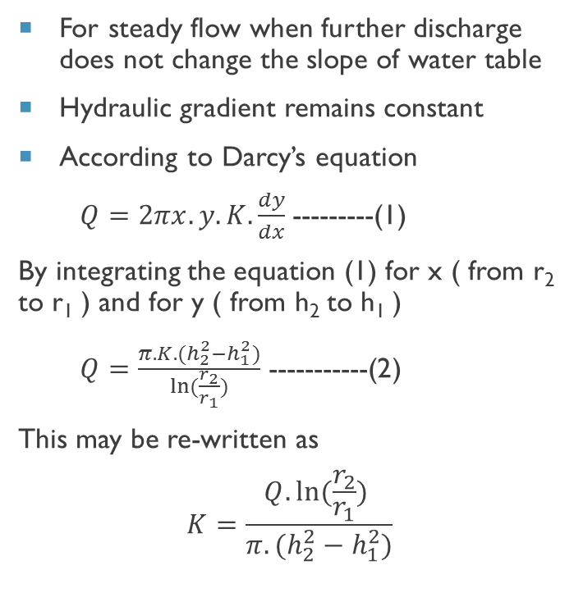
Equilibrium well formula (thiEm formula)
For steady flow when further discharge does not change the slope of water table
Hydraulic gradient remains constant
According to Darcy’s equation
$Q=2πx.y.K.\frac{dy}{dx}$---------(1)
By integrating the equation (1) for x ( from r₂ to r₁ ) and for y ( from h₂ to h₁ )
$Q=\frac{π.K.(h_{2}^{2}−h_{1}^{2})}{ln⁡(\frac{r_{2}}{r_{1}})}$ -----------(2)
This may be re-written as
$$K=\frac{Q.ln⁡(\frac{r_{2}}{r_{1}}) }{π.(h_{2}^{2}−h_{1}^{2})}$$

Slide 26
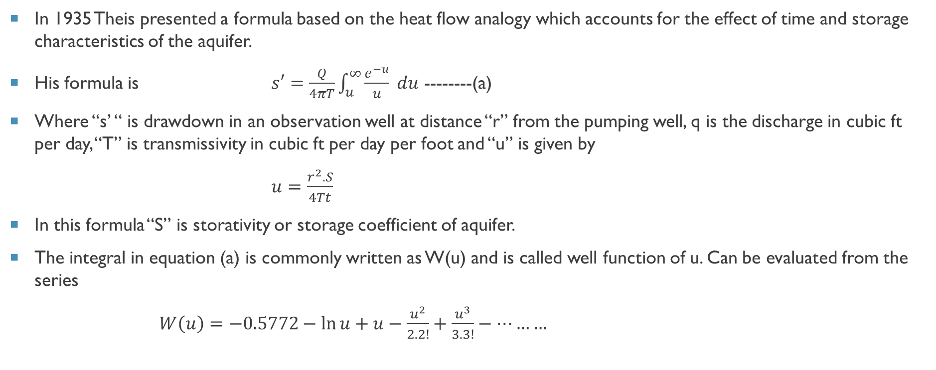
Non-Equilibrium well formula (theis formula)
In 1935 Theis presented a formula based on the heat flow analogy which accounts for the effect of time and storage characteristics of the aquifer.
His formula is $s′=\frac{Q}{4πT}\int_{u}^{∞}{\frac{e^{−u}}{u} du}$ --------(a)
Where “s’ “ is drawdown in an observation well at distance “r” from the pumping well, q is the discharge in cubic ft per day, “T” is transmissivity in cubic ft per day per foot and “u” is given by
$u=\frac{r^{2}.S}{4Tt}$
In this formula “S” is storativity or storage coefficient of aquifer.
The integral in equation (a) is commonly written as W(u) and is called well function of u. Can be evaluated from the series
$W\left(u\right)=−0.5772−\ln{u}+u−\frac{u^{2}}{2.2!}+\frac{u^{3}}{3.3!}−………$

Slide 27
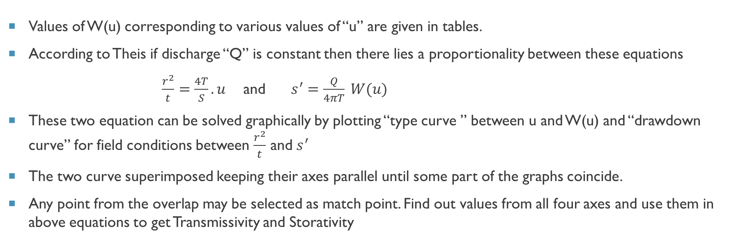
Non-Equilibrium well formula (theis formula)
Values of W(u) corresponding to various values of “u” are given in tables.
According to Theis if discharge “Q” is constant then there lies a proportionality between these equations
$\frac{r^{2}}{t}=\frac{4T}{S}.u$ and $s^{′}=\frac{Q}{4πT} W(u)$
These two equation can be solved graphically by plotting “type curve ” between u and W(u) and “drawdown curve” for field conditions between $\frac{r^{2}}{t}$ and $s^{′}$
The two curve superimposed keeping their axes parallel until some part of the graphs coincide.
Any point from the overlap may be selected as match point. Find out values from all four axes and use them in above equations to get Transmissivity and Storativity

Slide 28
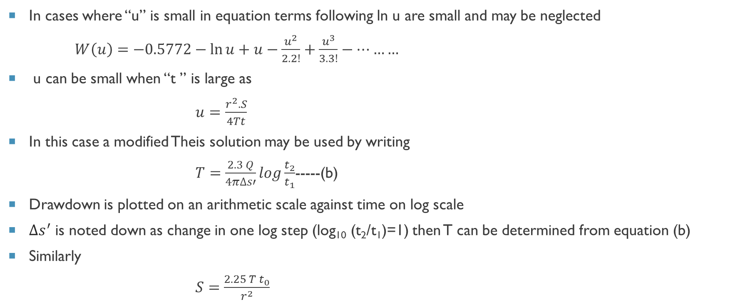
MODIFIED theis formula
In cases where “u” is small in equation terms following ln u are small and may be neglected
$W\left(u\right)=−0.5772−\ln{u}+u−\frac{u^{2}}{2.2!}+\frac{u^{3}}{3.3!}−………$
u can be small when “t ” is large as
$u=\frac{r^{2}.S}{4Tt}$
In this case a modified Theis solution may be used by writing
$T=\frac{2.3 Q}{4π∆s′}log\frac{t_{2}}{t_{1}}$-----(b)
Drawdown is plotted on an arithmetic scale against time on log scale
$∆s^{′}$ is noted down as change in one log step (log₁₀ (t₂/t₁)=1) then T can be determined from equation (b)
Similarly
$S=\frac{2.25 T t_{0}}{r^{2}}$
Where $∆s^{′}$ is change in drawdown between t₁ and t₂
Where t_{o} intercept in days when straight line graph is extended to Z=0

Slide 29
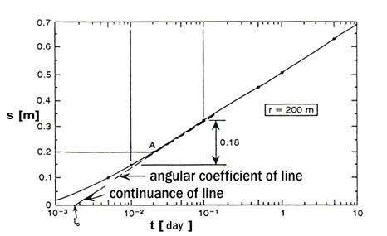
Modified theis method

Slide 30
Merits of theis method
A value of S can be determined
Only one observation well is required
A shorter period of pumping is required
No assumption of steady state flow condition

Slide 31
Assumptions of theis method
Aquifer is homogenous, isotropic, of uniform thickness and of infinite areal extent
Before pumping the peizometric surface is horizontal
Well is pumped at constant rate “Q”
Flow everywhere is horizontal
Storage within well can be neglected as diameter is small

Slide 32
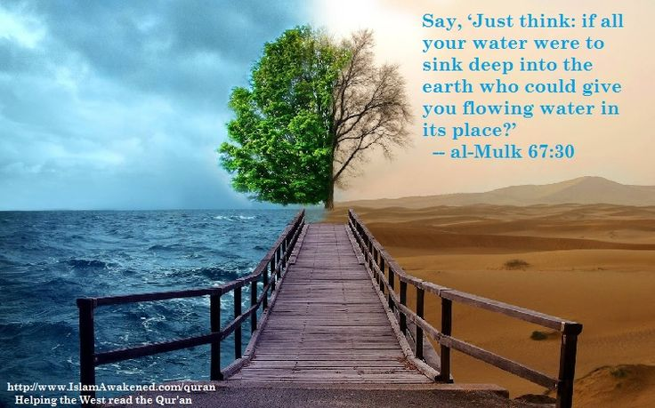
Thank You
Any Questions??

