Slide 1
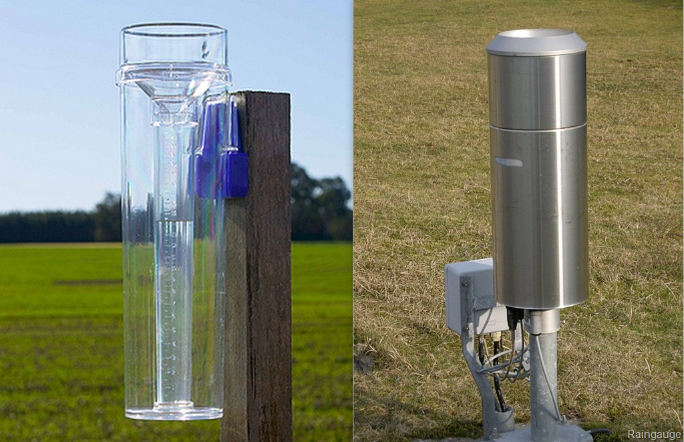
MEASUREMENTS OF PRECIPITATION
LECTURE 4

Slide 2
MEASUREMENTS OF PRECIPITATION
It includes
Amount of precipitation
Duration of precipitation
Intensity of precipitation
Areal extent of precipitation

Slide 3
MEASUREMENTS OF PRECIPITATION
1. AMOUNT OF PRECIPITATION
Total depth of rain water (or Snow) assuming that there is no evaporation, transpiration, surface water losses or infiltration
Units of measurements : mm or in
2. DURATION OF PRECIPITATION
Difference between start time and ending time of the rain storm
Units of measurements: hours or minutes

Slide 4
MEASUREMENTS OF PRECIPITATION
3. INTENSITY OF PRECIPITATION
Amount of precipitation per unit time at a place, also known as “Rain Rate”
Intensity depicts how fast or slow the rain storm is
Units of measurements: mm/hour
4. AREAL EXTENT OF PRECIPITATION
The area over which rainfall occurs
Units of Measurements: miles² or km²

Slide 5
MAIN APPROACHES TO MEASURE RAINFALL
Rain gauges Ground Measurements
Using radars Atmospheric Measurements
Satellite measurements Remote sensing
Ground measurements being the accurate most as it is closest to actual rain that falls on the adjacent ground
That is why is the reliable most method of measurement

Slide 6
RAIN GAUGES
Types of rain gauges
  Non-recording type rain gauges
  Recording type rain gauges
Non-Recording Gauges
  Gives total amount of precipitation in the interval e.g., 24 hors for daily observation
  Doesn’t provide continuous record
  Observer visits at prescribed time and measures rain e.g., 8 O’clock in the morning for daily observation
  Examples : Standard Rain Gauge or US national weather bureau Rain gauge

Slide 7
RAIN GAUGES
Recording type Rain gauges:
  They give continuous record of amount of precipitation for interval on a graph paper attached called “Rain Chart”
  Examples: Tipping Bucket type Rain Gauge, Weighing type rain gauge, float type rain gauge ,etc.

Slide 8
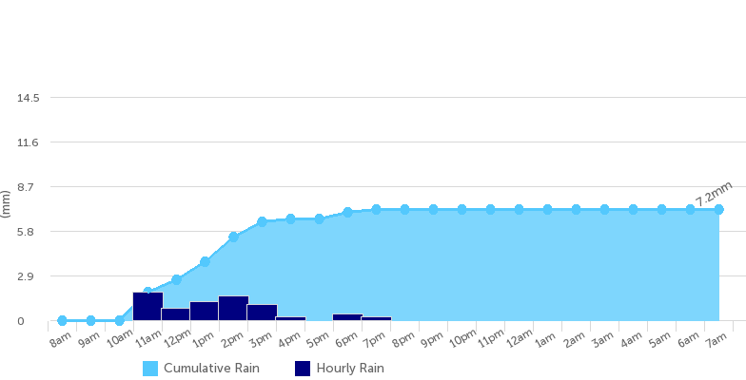
RAIN GAUGES

Slide 9
RAIN GAUGES
What information is obtained from rain chart?
  No. of Rain storms
  Amount of precipitation in each rain storm
  Duration of precipitation in each rain storm
  Intensity of precipitation
  Total daily amounts
Observer visits the recording rain gauge after fixed intervals and removes the older rain chart and replaces with a new one

Slide 10
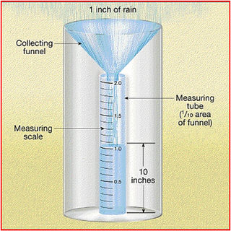
STANDARD RAIN GAUGE/ US NATIONAL WEATHER BUREAU RAIN GAUGE
This is a non-recording type rain gauge
Main Components:
  Receiver/collector
  Funnel
  Measuring Cylinder
  Outer/overflowing Cylinder
  Measuring stick ( 24” long black laminated graduated stick)
  Frame/ support

Slide 11
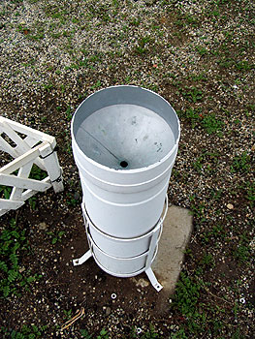
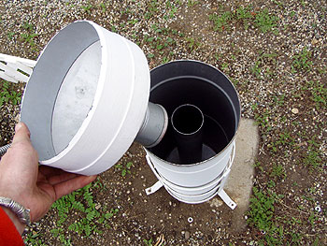
STANDARD RAIN GAUGE/ US NATIONAL WEATHER BUREAU RAIN GAUGE

Slide 12
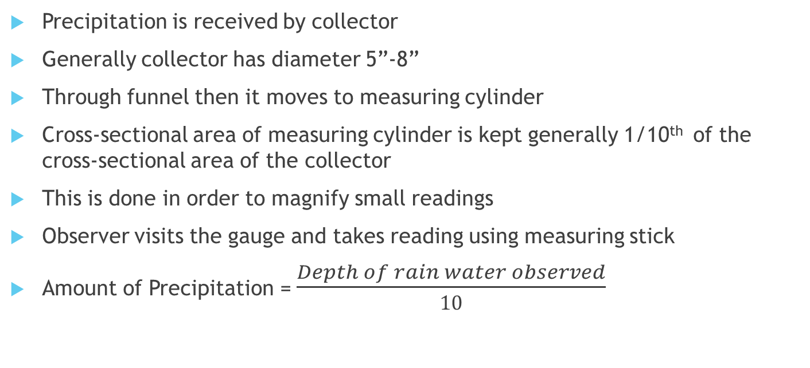
STANDARD RAIN GAUGE/ US NATIONAL WEATHER BUREAU RAIN GAUGE
Precipitation is received by collector
Generally collector has diameter 5”-8”
Through funnel then it moves to measuring cylinder
Cross-sectional area of measuring cylinder is kept generally 1/10th of the cross-sectional area of the collector
This is done in order to magnify small readings
Observer visits the gauge and takes reading using measuring stick
Amount of Precipitation = $\frac{Depth of rain water observed}{10}$

Slide 13
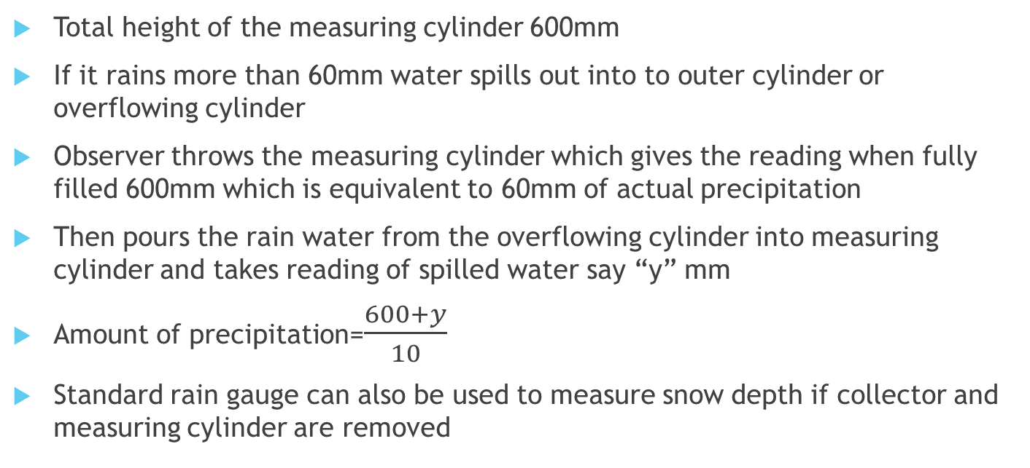
STANDARD RAIN GAUGE/ US NATIONAL WEATHER BUREAU RAIN GAUGE
Total height of the measuring cylinder 600mm
If it rains more than 60mm water spills out into to outer cylinder or overflowing cylinder
Observer throws the measuring cylinder which gives the reading when fully filled 600mm which is equivalent to 60mm of actual precipitation
Then pours the rain water from the overflowing cylinder into measuring cylinder and takes reading of spilled water say “y” mm
Amount of precipitation=$\frac{600+y}{10}$
Standard rain gauge can also be used to measure snow depth if collector and measuring cylinder are removed

Slide 14
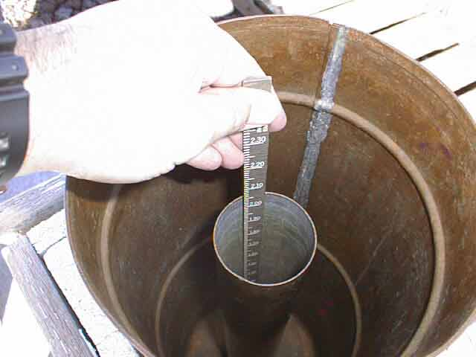
STANDARD RAIN GAUGE/ US NATIONAL WEATHER BUREAU RAIN GAUGE

Slide 15
STANDARD RAIN GAUGE/ US NATIONAL WEATHER BUREAU RAIN GAUGE
Insertion of the measuring stick is a source of error in precipitation reading
d₁
d₂
Before insertion of stick
After insertion of stick

Slide 16
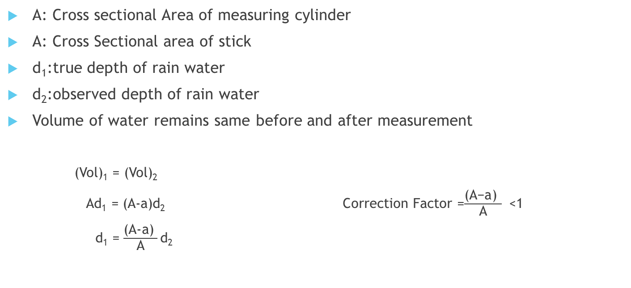
STANDARD RAIN GAUGE/ US NATIONAL WEATHER BUREAU RAIN GAUGE
A: Cross sectional Area of measuring cylinder
A: Cross Sectional area of stick
d₁:true depth of rain water
d₂:observed depth of rain water
Volume of water remains same before and after measurement
  (Vol)₁ = (Vol)₂
  Ad₁ = (A-a)d₂ Correction Factor =$\frac{\text{(}\text{A}\text{−}\text{a}\text{) }}{\text{A}}$ <1
  d₁ = $\frac{\text{(}\text{A}\text{−}\text{a}\text{) }}{\text{A}}$d₂

Slide 17
RECORDING TYPE RAIN GAUGES
  They give continuous record of amount of precipitation for interval on a graph paper attached called “Rain Chart”
Following are the examples of recording rain gauges:
  Tipping Bucket Rain Gauge
  Weighing Bucket type Rain Gauge
  Float Type Rain Gauge

Slide 18
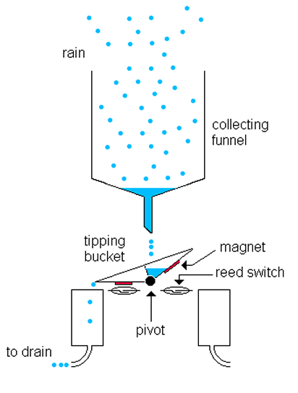
TIPPING BUCKET TYPE RAIN GAUGE
Consists of two small buckets
Placed below the funnel
Funnel is fitted into a receiver
Buckets are pivoted in an unbalance condition such that only one bucket is remains below funnel
One bucket is always higher than other
Rain is received by the receiver or collector
After a certain small amount of rain water (0.25mm) is received by the bucket below funnel
It becomes unstable and tips to empty itself into measuring tube
At the same time lifts the other bucket under the funnel

Slide 19
TIPPING BUCKET TYPE RAIN GAUGE
At the same time lifts the other bucket under the funnel and starts collecting water in it
Tipping of the bucket actuates an electric circuits
This current signal causes the pen to make a mark on chart wrapped around a rotating drum revolved by clock driven mechanism
Each mark on the chart corresponds to 0.25mm
By counting number of marks and noting the time amount and intensity of rain can be determined
Verification may be done by water gathered in the measuring tube

Slide 20
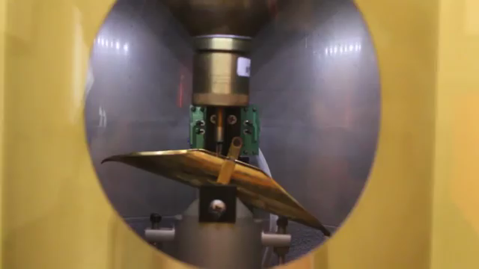
TIPPING BUCKET TYPE RAIN GAUGE

Slide 21
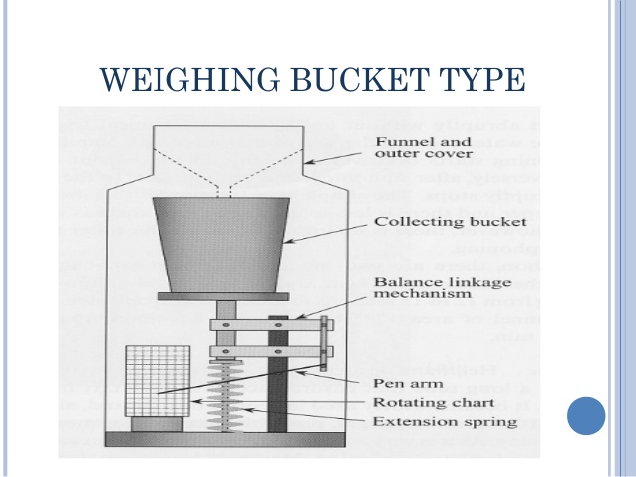
WEIGHING BUCKET TYPE RAIN GAUGE
Rain is collected by receiver and transferred to a weighing bucket through a funnel
Bucket rests on a weighing platform
As bucket starts filling with water its weight increases and platform moves downwards
The movement of the platform is transmitted to a pen
Pen makes a trace of accumulated rainfall on a chart attached to a barrel revolved by clock driven mechanism
The record is continuous in form of conventional mass curve

Slide 22
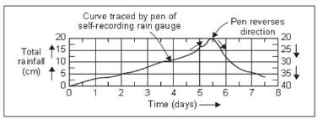
WEIGHING BUCKET TYPE RAIN GAUGE

Slide 23
WEIGHING BUCKET TYPE RAIN GAUGE
The gauge must be serviced about once a week
Clock is re-wound and the chart is replaced
For high rainfall in a few gauges recording mechanism is reverses the direction of record immediately on reaching the upper edge of the recording chart

Slide 24
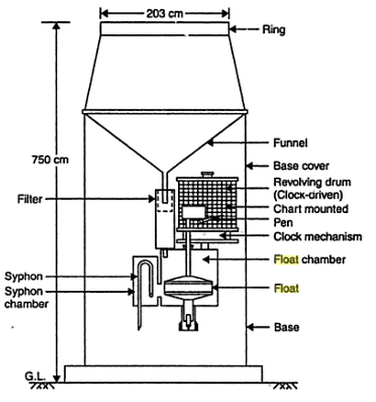
FLOAT TYPE RAIN GAUGE
Rain is received by a collector or receiver and sent into a float chamber through a funnel
Float chamber contains a float with a vertical stem fixed in position
A pen is mounted on the vertical stem and the pen moves on a chart attached to a drum revolving by clock driven mechanism
The pen marks a trace of cumulative depth of rainfall
Record is in the form of a rain chart
When the float chamber fills to the design level a syphon activates and empties the float chamber
This is also known as siphon gauge

Slide 25
SNOWFALL MEASUREMENTS
It may be measured in two ways:
Amount of snowfall
Equivalent amount of water
Equipment used:
Standard rain gauge without measuring cylinder
Weighing bucket type rain gauge
Snow gauge
By scratching snow pack

Slide 26
MEASURING EQUIVALENT AMOUNT OF WATER
This can be done in three ways:
By heating the cylinder
By weighing the cylinder
By adding known amount of hot water
By Heating the cylinder:
  This approach is objectionable because some amount may evaporate
  Measured equivalent amount of water will be less
By Weighing the cylinder:
  W₁= weight of cylinder + Weight of snow
  W₂= weight of cylinder
  W= W₁ – W₂

Slide 27
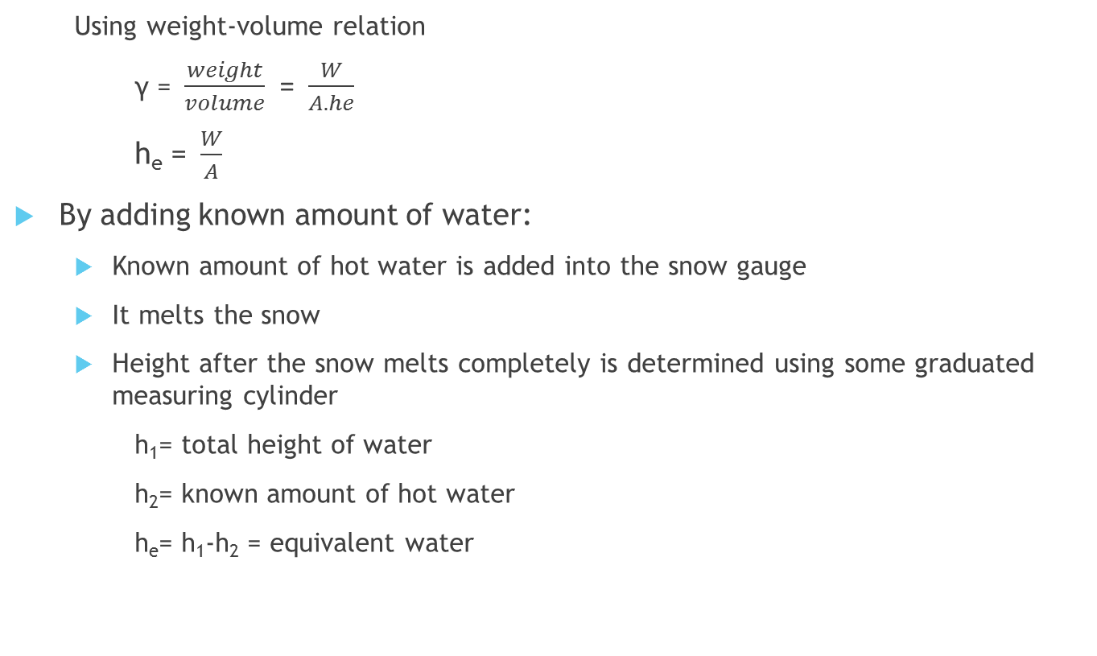
MEASURING EQUIVALENT AMOUNT OF WATER
  Using weight-volume relation
  γ =$\frac{weight}{volume}$ =$\frac{W}{A.he}$
  h_{e} =$\frac{W}{A}$
By adding known amount of water:
  Known amount of hot water is added into the snow gauge
  It melts the snow
  Height after the snow melts completely is determined using some graduated measuring cylinder
  h₁= total height of water
  h₂= known amount of hot water
  h_{e}= h₁-h₂ = equivalent water

Slide 28
SITE SELECTION FOR A RAIN GAUGE
Following points should be considered for installation of a rain gauge at any site:
There should ne a level ground of 50-100m diameter around the gauge
Sharp sloping sides of hills should be avoided
There should be no obstruction in all directions for 1:4 slope. Buildings and trees within the range act as wind shelter.
There should be proper wind shelter to avoid disturbances of rain showers. For hilly areas a valley having slope less than or equal to 1:4 slope is recommended. As this topography provides natural wind shelter.
Adjoining ground should be covered with short grass to avoid addition of splashes
Height of the rain gauge should also be sufficient enough to avoid splashing

Slide 29
ERRORS IN PRECIPITATION MEASUREMENT BY RAIN GAUGES
Insertion of measuring stick: measured amount will be more than actual. Error is roughly 1%.
Dents in collector or receiver: measuring area reduces and measures less than actual
Dents in Measuring Cylinder: measured amount is more than actual
Initial wetting: about 0.25mm of rain water is utilized to initially wet the surfaces of rain gauges
Rain drop splashes:
  Rain drop splashes strike ground surface and enter into the collector. Grass can damp this effect. Measured amount is more than actual
  Splash may occur from rain gauge to the ground. A collar may be placed on the collector to reduce this. Measured amount is lesser than actual

Slide 30
ERRORS IN PRECIPITATION MEASUREMENT BY RAIN GAUGES
Vertical updraft of wind: reduces catch due to upward currents and acceleration of the precipitation drops. This deficiency is significant for small rain drops than the larger drops. That is why it affects the measurements of lighter rain more than for heavy rain.
Non-Verticality of rain gauge: catch area varies
Frictional effect: this is for recording gauges. For example if there is friction on pivot of tipping bucket will disrupt the movement of buckets and hence will cause errors in measurements
Leakage of cylinders: loss in amount of water gathered results in lesser than actual measurements.
By evaporation: in some cases evaporation may reduce the amount of gathered water. This might be overcome by putting a thin layer of some oil in gauge which will reduce evaporation.

Slide 31
THANK YOU ANY QUESTIONS??

