Slide 1
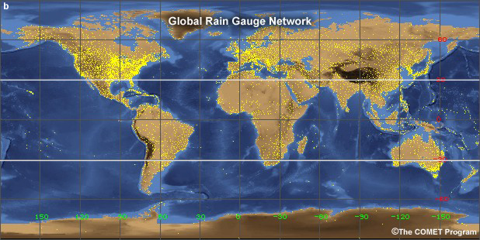
PRECIPITATION GAUGE NETWORK
LECTURE 5

Slide 2
PRECIPITATION GAUGE NETWORK
To have an idea of areal distribution of precipitation there should be adequately planned rain gauge network
There are two reasons to plan a network:
  Catch area of a precipitation gauge is very small
  Amount of precipitation varies from place to place

Slide 3
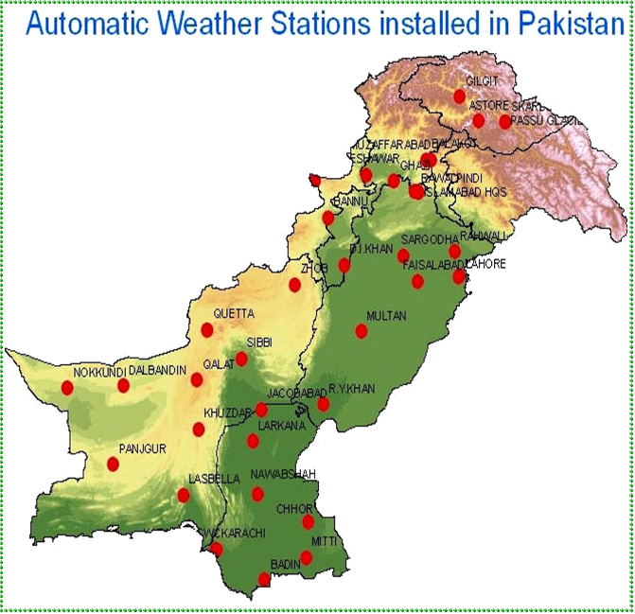
PRECIPITATION GAUGE NETWORK IN PAKISTAN

Slide 4
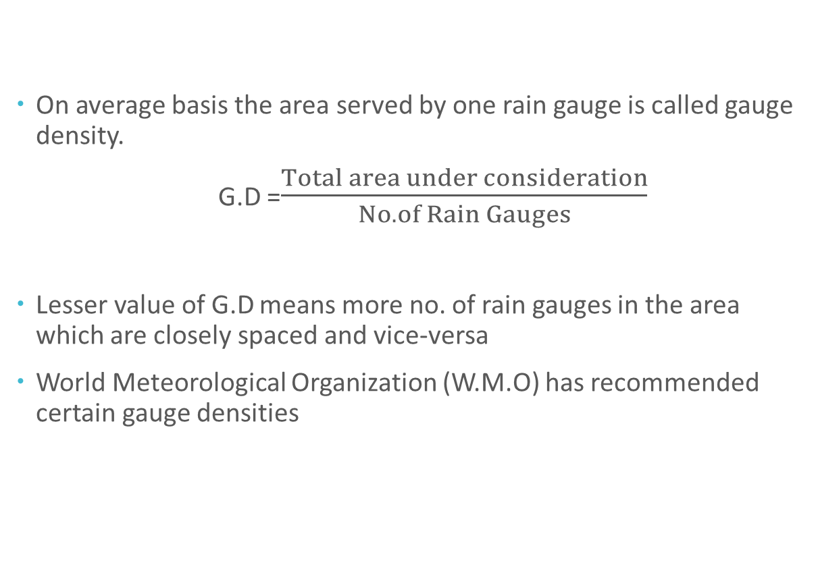
GAUGE DENSITY (G.D)
On average basis the area served by one rain gauge is called gauge density.
G.D =$\frac{Total area under consideration}{No. of Rain Gauges}$
Lesser value of G.D means more no. of rain gauges in the area which are closely spaced and vice-versa
World Meteorological Organization (W.M.O) has recommended certain gauge densities

Slide 5
W.M.O RECOMMENDED GAUGE DENSITIES
For Flat regions 600-900 Km² /station
For mountainous regions 100-250 Km² /station
For small mountainous islands 25 Km² /station
For arid and polar zones 1500-10,000 Km² /station

Slide 6
FACTORS AFFECTING GAUGE DENSITY
Topography
  For hilly terrains G.D should be lesser because generally more rains and more variations
Hydro-meteorology
  Areas with more precipitation should have less G.D
Stream network
  Denser stream network lesser will be G.D
Population density
  More population lesser should be G.D
Economy
  Lesser G.D.P more G.D
Interest
  Climatological station is must on airports and water control reservoirs
Research
  Lesser G.D results in better output

Slide 7
INTERPRETATION OF PRECIPITATION DATA FROM A GAUGE NETWORK
Interpretation of rain data coming from a rain gauge network includes
  Estimation of missing precipitation data
  Checking consistency in precipitation data record
  Determination of average areal precipitation

Slide 8
1.ESTIMATION OF MISSING PRECIPITATION DATA
According to US environmental data services, for estimation of missing precipitation record, there should be atleast three surrounding stations (Index Stations)
Index stations should be having more or less same effective radii as station “X” (station for which precipitation data is missing)
And these stations should be more or less equally spaced around station “X”
C
A
X
B

Slide 9
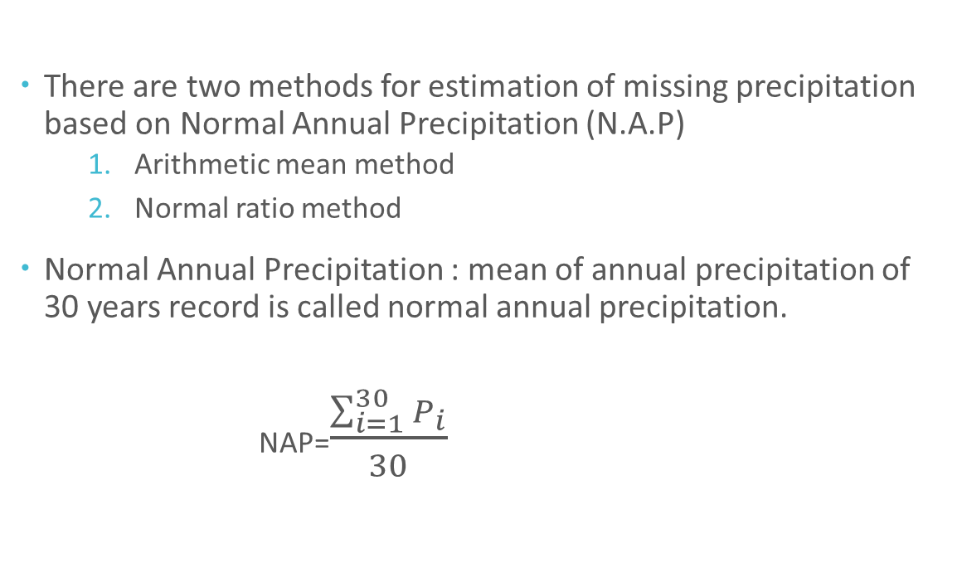
1.ESTIMATION OF MISSING PRECIPITATION DATA
There are two methods for estimation of missing precipitation based on Normal Annual Precipitation (N.A.P)
  Arithmetic mean method
  Normal ratio method
Normal Annual Precipitation : mean of annual precipitation of 30 years record is called normal annual precipitation.
  NAP=$\frac{\sum_{i=1}^{30}{P_{i}}}{30}$
C
A
X
B

Slide 10
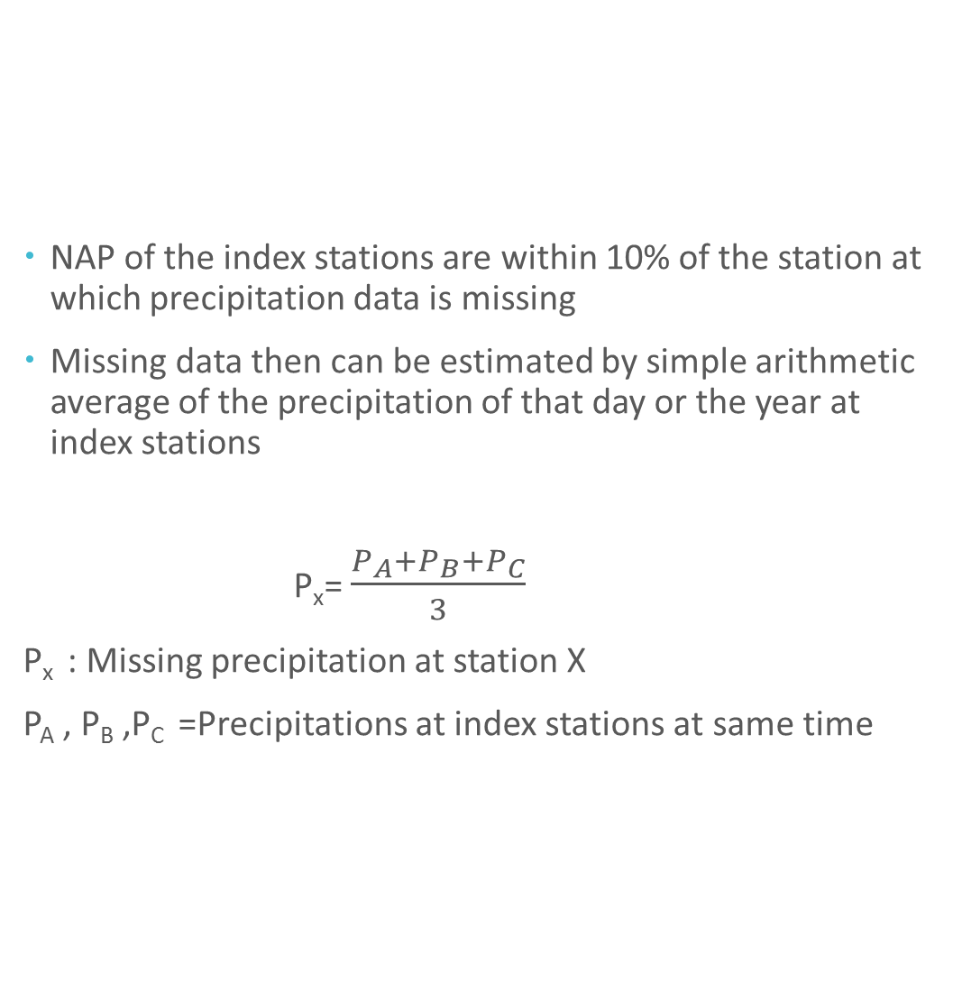
a)ARITHMETIC MEAN METHOD
NAP of the index stations are within 10% of the station at which precipitation data is missing
Missing data then can be estimated by simple arithmetic average of the precipitation of that day or the year at index stations
P_{x}= $\frac{P_{A}+P_{B}+P_{C}}{3}$
P_{x} : Missing precipitation at station X
P_{A} , P_{B} ,P_{C} =Precipitations at index stations at same time
C
A
X
B

Slide 11
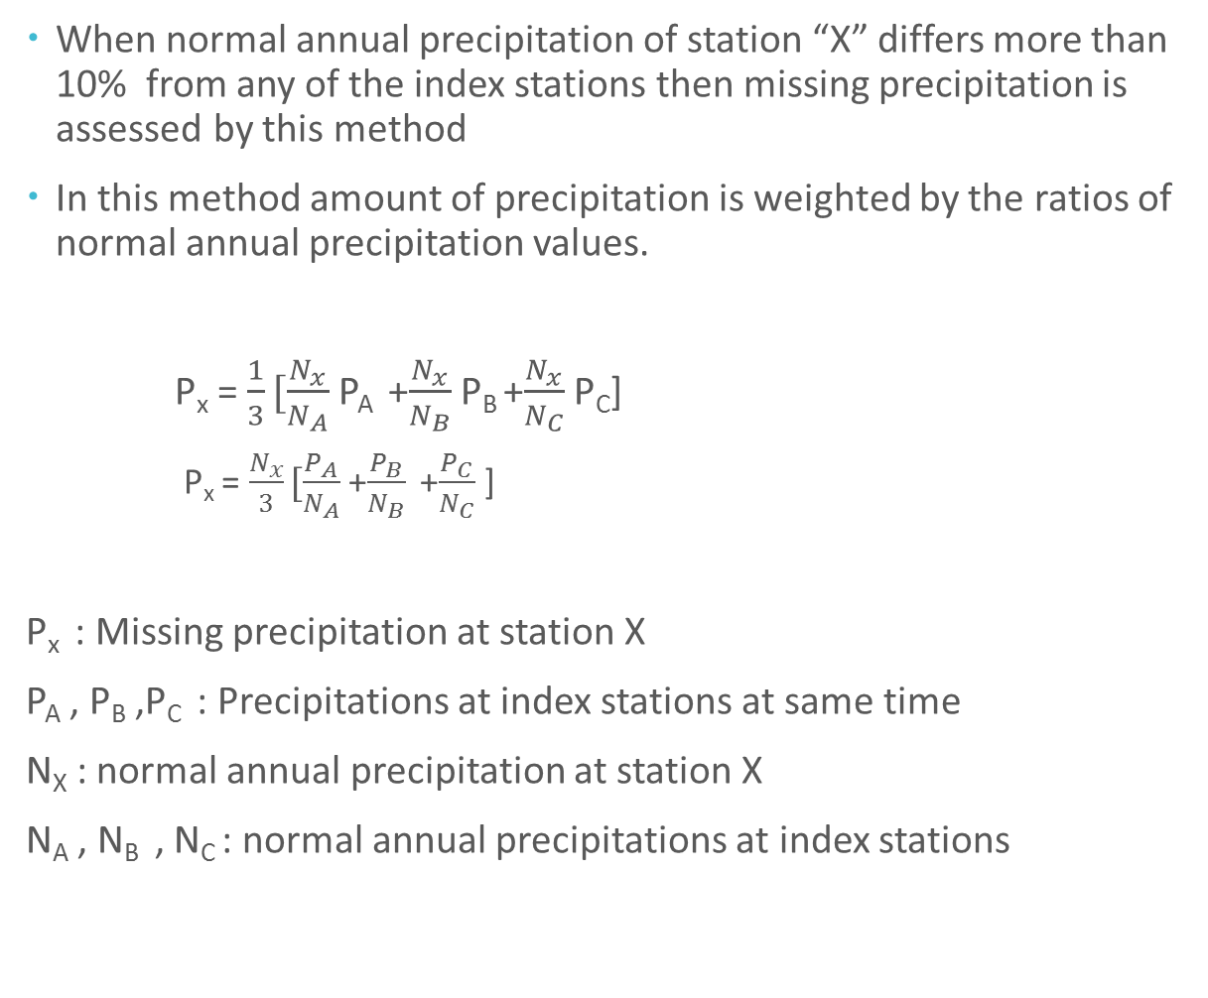
b)NORMAL RATIO METHOD
When normal annual precipitation of station “X” differs more than 10% from any of the index stations then missing precipitation is assessed by this method
In this method amount of precipitation is weighted by the ratios of normal annual precipitation values.
P_{x} = $\frac{1}{3}[\frac{N_{x}}{N_{A}}$ P_{A} +$\frac{N_{x}}{N_{B}}$ P_{B} +$\frac{N_{x}}{N_{C}}$ P_{C}]
  P_{x} = $\frac{N_{x}}{3}[\frac{P_{A}}{N_{A}}$ +$\frac{P_{B}}{N_{B}}$ +$\frac{P_{C}}{N_{C}}$ ]
P_{x} : Missing precipitation at station X
P_{A} , P_{B} ,P_{C} : Precipitations at index stations at same time
N_{X} : normal annual precipitation at station X
N_{A} , N_{B} , N_{C} : normal annual precipitations at index stations
C
A
X
B

Slide 12
NUMERICAL PROBLEM
Precipitation station X was inoperative on 24 august, 2010. The precipitation records for the same date at three surrounding stations A,B and C were 82,87 and 97mm respectively. Normal Annual Precipitations at station X, A,B and C are 920,800,810 and 950mm respectively

Slide 13
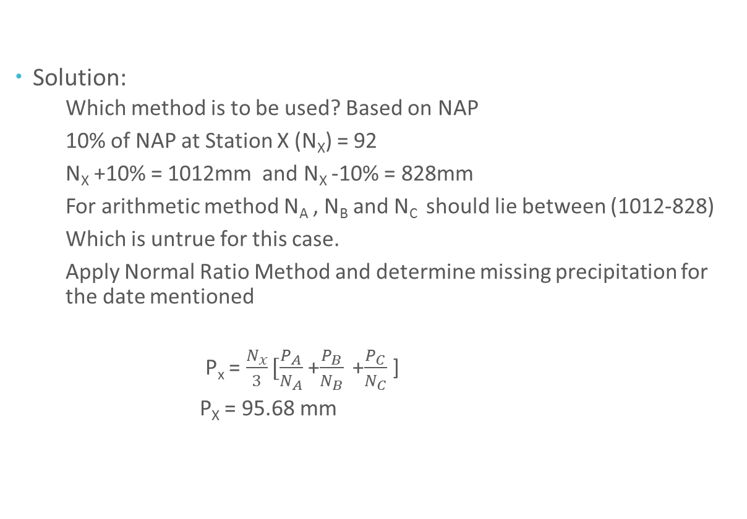
NUMERICAL PROBLEM
Solution:
  Which method is to be used? Based on NAP
  10% of NAP at Station X (N_{X}) = 92
  N_{X} +10% = 1012mm and N_{X} -10% = 828mm
  For arithmetic method N_{A} , N_{B} and N_{C} should lie between (1012-828)
  Which is untrue for this case.
  Apply Normal Ratio Method and determine missing precipitation for the date mentioned
  P_{x} = $\frac{N_{x}}{3}[\frac{P_{A}}{N_{A}}$ +$\frac{P_{B}}{N_{B}}$ +$\frac{P_{C}}{N_{C}}$ ]
  P_{X} = 95.68 mm

Slide 14
2. CONSISTENCY OF PRECIPITATION RECORD
Double mass analysis tests the consistency of the record at a station by comparing its accumulated annual or seasonal precipitation with concurrent accumulated values of mean precipitation for a group of surrounding stations
A change in the slope indicates a change in precipitation regime at station.
Any change due to meteorological reasons will not cause change in slope because all the base stations and the station whose consistency is in question will be affected equally

Slide 15
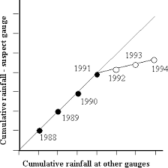
DOUBLE MASS CURVE

Slide 16
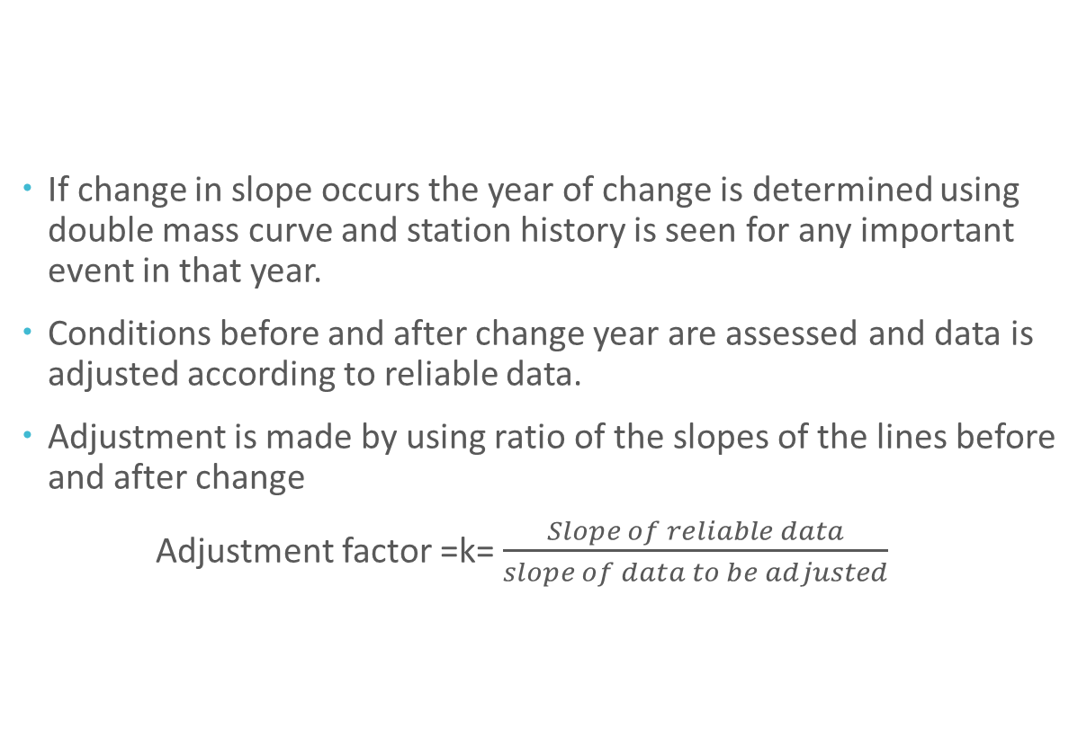
DOUBLE MASS CURVE
If change in slope occurs the year of change is determined using double mass curve and station history is seen for any important event in that year.
Conditions before and after change year are assessed and data is adjusted according to reliable data.
Adjustment is made by using ratio of the slopes of the lines before and after change
Adjustment factor =k= $\frac{Slope of reliable data}{slope of data to be adjusted}$

Slide 17
DOUBLE MASS CURVE
Number of surrounding stations should be atleast 10
Considerable caution must be exercised in applying this technique. Because the plotted points deviate about a mean line and changes in slope should be only accepted if there is a marked difference substantiated by other evidences too.
If the slope change remains for a period less than 5 years this change is ignored. Data is considered consistent
Depending upon conditions any of the data before or after the change year may be reliable but generally latest data is taken as reliable.

Slide 18
CAUSES OF INCONSISTENCY
Change in the location e.g., gauge near a river site
Change in the instrument e.g., modern, better performance
Change in observational procedures

Slide 19
3. AVERAGING PRECIPITATION OVER AN AREA
Average depth of precipitation over a specific area on a storm, seasonal or annual basis is required in many types of hydrologic problems.
This average depth when multiplied with the area under consideration provides total volume of water generated in a storm, or seasonally or annually.
There are mainly three methods to compute average depth
Arithmetic average
Thissen’s method
Isohyetal method

Slide 20
a) ARITHMETIC AVERAGE METHOD
Simplest method of obtaining average depth over an area is arithmetic mean of the gauges present in the area
This technique yields good estimated in flat countries where the gauges are more or less uniformly spaced
And individual gauge catches do not vary much from the mean value
These limitations can be partially overcome if topographical influences and areal representation are considered while installing gauges

Slide 21
a) ARITHMETIC AVERAGE METHOD
Applicability:
  Uniform precipitation almost at all stations
  Stations are equally spaced in the area
  For very small and plane areas results may be satisfactory
Merits:
  This is a quick and simple method
Demerits:
  When there is variation in precipitation almost 10% from the mean value outcome is not very true. Also not applicable to areas with unequal spacing between stations. These are generally most encountered conditions

Slide 22
b) THE THISSEN’S METHOD
This method attempts to allow for non-uniform distribution of gauges by providing a weighing factor for each gauge
Stations are plotted on a map and connecting lines are drawn
Perpendicular bisectors are marked and by their intersection polygons are made. Each polygon is effective area for that gauge.
Area of each gauge is determined then by planimetry and is presented as percentage of total area
Weighted average rainfall for the total area is computed by multiplying the precipitation over each gauge and its effective area
by summing the product of areas and precipitations and dividing by total area average rainfall can be estimated

Slide 23
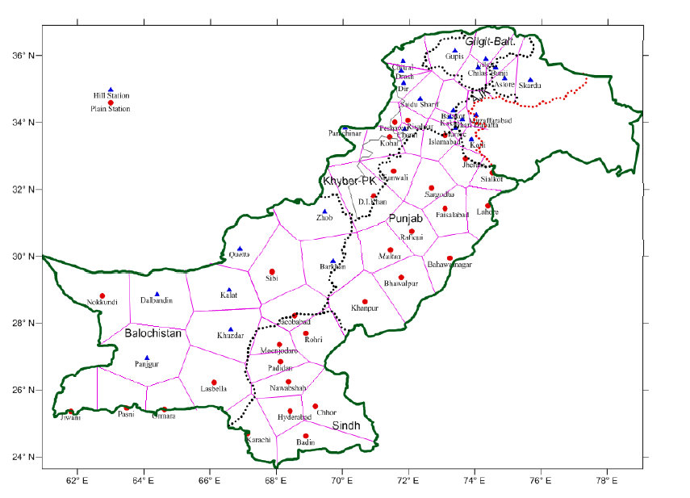
b) THE THISSEN’S METHOD

Slide 24
b) THE THISSEN’S METHOD
Applicability:
  Applicable for large and variable precipitation areas. Effective areas are computed to reduce variations which was a hindrance in calculations of simple arithmetic method.
Merits:
  Applicable to large and variable areas
  Better results as compared to arithmetic mean method
Demerits:
  This is a time taking and hectic technique
  Assumptions are rigid and abrupt in precipitation values for any polygon which is un-natural
  And there is a requirement for replotting the map and do all the work again if there is a change in the location of a gauge or there is a new instrument installed

Slide 25
c) THE ISOHYETAL METHOD
This is the most accurate method when used by experienced analyst
Station locations and amounts of precipitations are plotted on the map
Contours of equal precipitation (isohyets) are drawn
Average is computed by weighing the average precipitation between successive isohyets (usually taken as average of the two Isohyetal values)
And as done in Thissen's methods the sum of these products is divided by total area

Slide 26
c) THE ISOHYETAL METHOD
Applicability:
  Applicable to large areas with non uniform precipitation patterns
Merits
  Applicable to areas with non-uniform precipitation behavior and unequal spacing between stations which is closer to natural conditions.
  Most accurate method if analyst is expert because this may involve the personal judgment of the analyst
Demerits
  This is a hectic and time consuming method
  It require a total change in the map and plotting if there is any change in the gauges in that area

