Slide 1
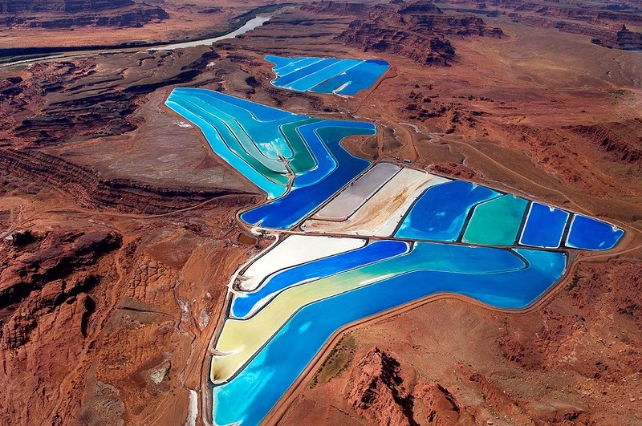
EVAPORATION
LECTURE 7

Slide 2
EVAPORATION
“Net rate of vapor transport to the atmosphere”
Reverse process of precipitation
Evaporation considered to be a problem for reservoirs storage on one hand may prove very valuable on the other hand
In the cover picture displayed are the potash evaporation ponds managed by Intrepid potash. Inc , Utah, United States of America.
These are salt evaporation ponds that extend over 1.5km² area along the Colorado River

Slide 3
EVAPORATION
Water converts from liquid to vapor state
This change of state requires exchange of energy
Almost 600 calories/ gram of water
If the temperature of water bodies is to be maintained an equal amount of the radiation must be supplied from an external source i.e., radiation and conduction from the overlying air or the energy stored below the surface

Slide 4
EVAPORATION
Precipitation reaching surface of earth goes back to atmosphere
Portion of this precipitation evaporates before reaching the surface of earth
Since precipitation is measured by rain gauge networks which are on ground so estimation of this evaporation is not of the concern
But this evaporated part of precipitation does have an impact on radar estimation as discussed
Similarly the evaporation from the surface of oceans is of extreme importance but is out of the scope of a hydrologist, mainly studied in oceanography

Slide 5
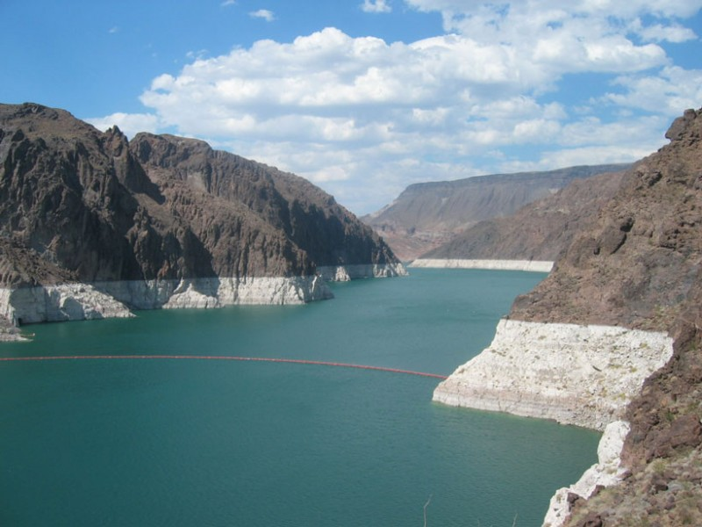
EVAPORATION
Anticipated evaporation is a decisive element in the design of reservoirs to be constructed in arid regions
Low water levels at Lake Mead, in Nevada, highlight the importance of quantifying reservoir evaporation.

Slide 6
FACTORS CONTROLLING EVAPORATION
Rates of evaporation vary, depending on
Meteorological factors
Nature of evaporating surface
Quality of the water itself.

Slide 7
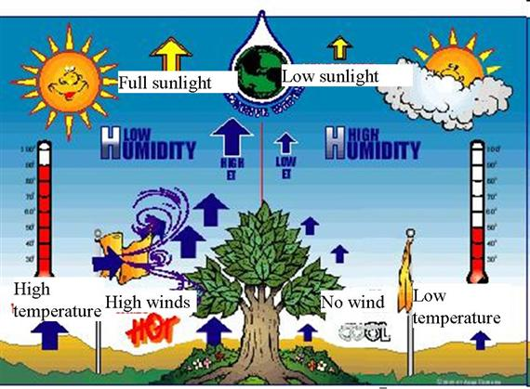
METEOROLOGICAL FACTORS

Slide 8
METEOROLOGICAL FACTORS
Radiation
Wind speed
Vapor pressure of overlying air
Water temperature
relative effect of these meteorological factors is difficult to evaluate at its best

Slide 9
NATURE OF EVAPORATING SURFACE
All surfaces exposed to precipitation such as vegetation, building and paved streets are potentially evaporating surfaces
1. Soil
Rate of evaporation from a saturated soil surface is approximately the same as that from an adjacent water surface of same temperature
As the soil begins to dry, evaporation decreases and its temperature rises to maintain the energy balance
Eventually evaporation ceases if there is no more water available near surface for evaporation and there is no mechanism to transport water from appreciable depths
It means evaporation from the land surface is bound by the available amount of water

Slide 10
NATURE OF EVAPORATING SURFACE
2. Snow or Ice:
Evaporation can occur only when the vapor pressure of air is less than the surface of snow or only when the dew point temperature is lower than the temperature of the snow
The vapor pressure on the surface air film over the melting ice is 6.11mbars and this is the maximum possible air-to-snow vapor pressure difference
The maximum rate of evaporation from the snow is only about one fourth of the evaporation from a water surface at 30º C when dew point temperature is 15º C under the same wind conditions
Reasonable assumptions yield an upper limit of 5mm water equivalent per day for evaporation from a snow surface

Slide 11
EFFECTS OF WATER QUAITY
Effect of salinity or dissolved salts is to reduce the vapor pressure of the solution
Vapor pressure of sea water (35,000 ppm dissolved salts) is about 2% less than that of pure water at same temperature
The reduction in evaporation is less than that indicated by the change in the vapor pressure as with reduced evaporation there is an increase in temperature of the water, which partially offsets the vapor pressure reduction
Even for sea water the reduction in evaporation is never more than a few percent over an extended period of time so that salinity effects can be neglected in the estimation of reservoir evaporation
Any foreign material which tends to seal the water surface or change its vapor pressure or albedo will effect its evaporation.

Slide 12
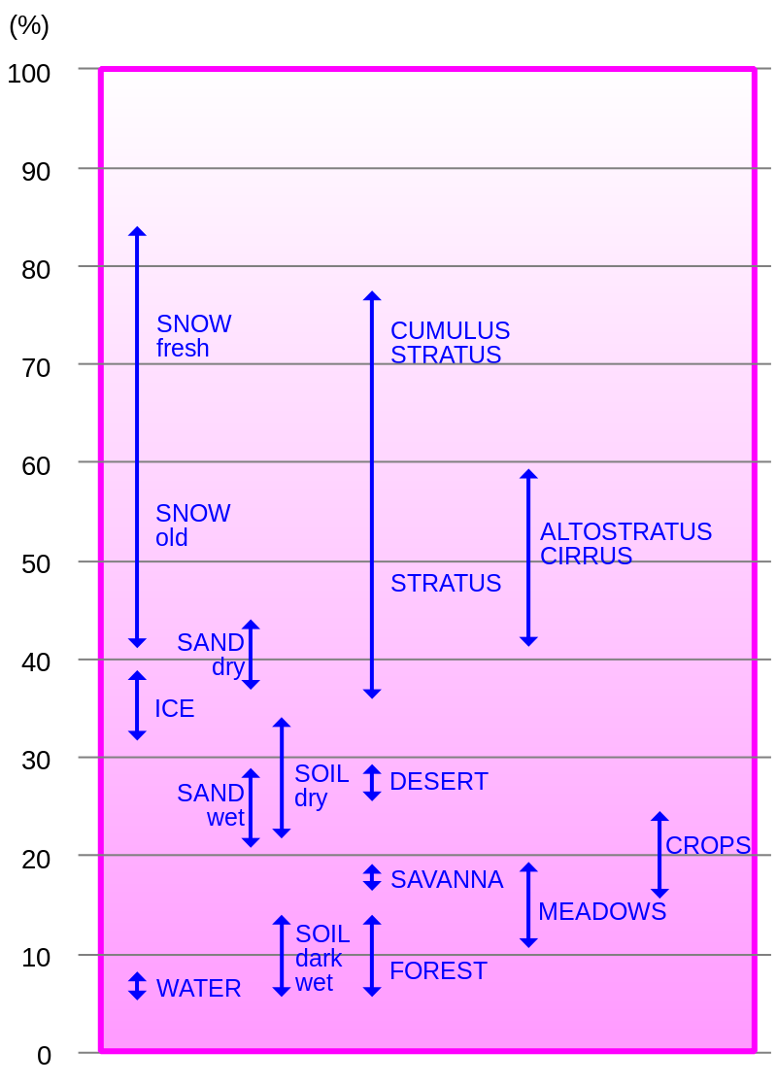

Slide 13
STANDARD EVAPORATION RATES
1.Potential Evaporation Rate E_{p} (mm/Day):
  The quantity of water evaporated per unit area, per unit time from an idealized, extensive free water surface under existing atmospheric conditions
  2.Reference Crop Evaporation Rate, E_{o} (mm/day)
  Rate of evaporation from an idealized grass crop with a fixed crop height of 12 cm and an albedo of 0.23, completely shading the ground and not short of water.

Slide 14
ESTIMATION OF RESERVOIR EVAPORATION
The direct measurements of evaporation under field conditions is not feasible, atleast in the sense we can measure rain fall or stream gauge
As consequence variety of methods have been derived for determining or estimating vapor transport from water surfaces.
(A) Analytical Approaches
Water Budget Approach
Energy Budget Method
Mass Transfer Method
(B) Using Evaporation Pans

Slide 15
ESTIMATION OF RESERVOIR EVAPORATION FROM PAN EVAPORATION
The pan is undoubtedly the most widely used evaporation instrument today, and its application in hydrologic design and operation is of long standing.
Pan evaporation is the combined effect of all atmospheric factors

Slide 16
USWB CLASS A PAN
It is the most widely used evaporimeter for finding evaporation from the free water surface.
The Class A Evaporation pan is circular, 120.7 cm in diameter and 25 cm deep. It is made of galvanized iron (22 gauge) with a stilling well.
The pan is mounted on a wooden open frame platform which is 15 cm above ground level to facilitate the circulation of air beneath the pan.
It is filled to a depth of 20cm.
Daily evaporation rate is given by the fall in water level measured in the stilling well by hook gauge.
Adjustments are made to the evaporation values if rainfall occurs during a period of measurement.
After measuring the drop in water level each time, water is added to the pan to bring back the water level to original position of pointer tip level.

Slide 17
USWB CLASS A PAN

Slide 18
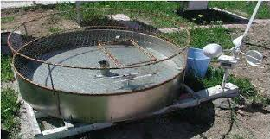
USWB CLASS A PAN
Sometimes a screen is placed over the pan to avoid losses from the animal or bird drinking.
It also avoids trash getting into the pan with the wind

Slide 19

LAKE/RESERVOIR EVAPORATION
    E_{L} = K_{p} . E_{p}
    E_{L} = Lake Evaporation (mm/Day)
    E_{p} = Pan evaporation (mm/Day)
    K_{p} =Pan Coefficient
    K_{p} = $\frac{Average annual lake evaporation}{Average annual pan evaporation}$
Pan Type | Pan Coefficient
Class A | 0.7
BPI | 0.94
Colorado | 0.9
Young | 0.94

Slide 20
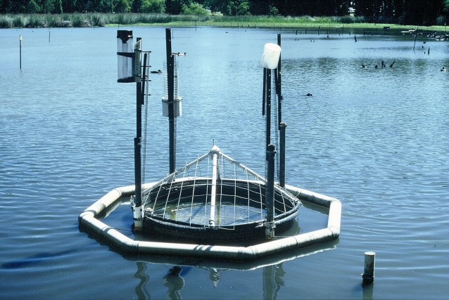
ESTIMATION OF RESERVOIR EVAPORATION FROM PAN EVAPORATION
For some types of pans the ratio of annual lake-to-pan evaporation (Pan Coefficient) is quiet consistent ,year by year and does not vary excessively
There are three types of exposures employed for pan installation
1. Sunken
2. Floating
3.Surface

Slide 21
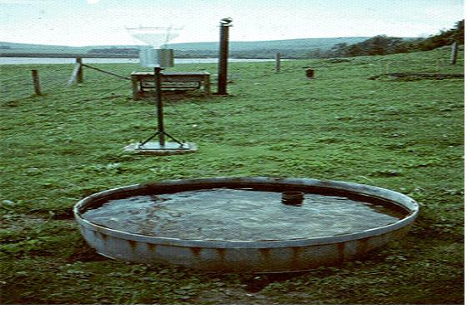
ESTIMATION OF RESERVOIR EVAPORATION FROM PAN EVAPORATION
1. Sunken Pans
Burying the pan tends to eliminate objectionable boundary effects such as radiation on the side walls and heat exchange between the pan and atmosphere but it creates observational problem
Sunken pans collect more trash
They are difficult to install, clean, repair
Leaks are not easily detected
Height of vegetation adjacent to pan is quiet crucial
Appreciable heat exchange does take place between pan and the soil depending on such factors as soil type, moisture content and vegetative cover
This results in large climatic variations in the pan coefficients of small, sunken, uninsulated pans.

Slide 22
ESTIMATION OF RESERVOIR EVAPORATION FROM PAN EVAPORATION
6 ‘
1. Sunken Pans
2’
G.L.
2”
G.L.
2”
Bureau of Plant Industry (BPI) Pan
34”
3’
G.L.
2”
16”
Young’s pan
Colorado Pan

Slide 23
ESTIMATION OF RESERVOIR EVAPORATION FROM PAN EVAPORATION
2. Floating Pans
This type of pans most nearly approximate evaporation from the lake than that from an on-shore pan
Boundary effects are appreciable
Observational difficulties are prevalent with floating pans
Often splashing affects measurements
Installation, operation and maintenance expense is excessive
Relatively very low number of such pans exist

Slide 24

ESTIMATION OF RESERVOIR EVAPORATION FROM PAN EVAPORATION
2. Floating Pans
3 ‘
2”
18”
Wooden raft

Slide 25
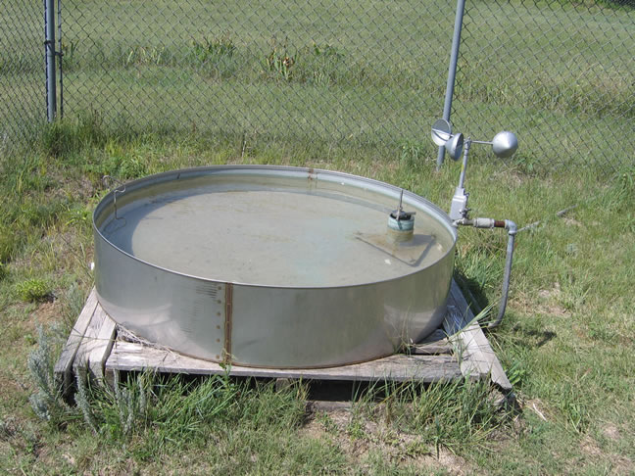
ESTIMATION OF RESERVOIR EVAPORATION FROM PAN EVAPORATION
3. Surface Pans
Pans exposed above the ground surface experience greater evaporation than the sunken pans, primarily because of radiation intercepted by the side walls
Heat exchange through the pan produces unrealistic effects which must be taken into account
This can be minimized by insulating the pan
Principal advantages of surface pans are economy and ease of installation, operation and maintenance

Slide 26
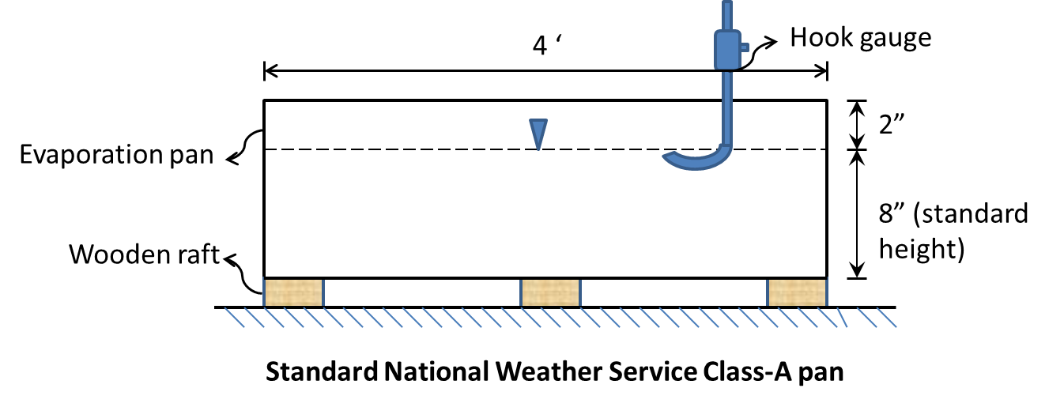
ESTIMATION OF RESERVOIR EVAPORATION FROM PAN EVAPORATION
3.Surface Pan

Slide 27

TRANSPIRATION
Evaporation of water through the plants is called transpiration
It occurs chiefly at the leaves of the plants when they open up their stomata for the exchange of CO₂ and Oxygen during the photosynthesis.
The volume of water lost in transpiration can be very high.
It has been estimated that over the growing season, one acre of corn plants may transpire 400,000 gallons of water.
As liquid water, this would cover the field with a lake 15 inches deep.

Slide 28
FACTORS AFFECTING TRANSPIRATION
Light
Temperature
Humidity
Wind
Soil Moisture

Slide 29
THANK YOU
QUESTIONS??

