Slide 1
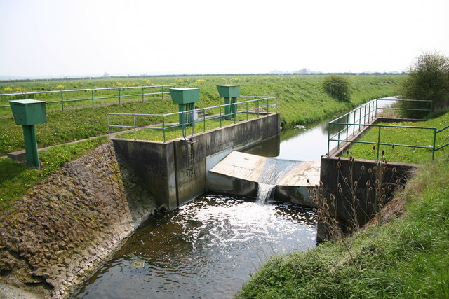
STREAM GAUGING
LECTURE 8

Slide 2
STREAM GAUGING
Stream flow data is primarily gathered by hydrologists for hydrologic studies
To an engineering hydrologist stream flow data is dependent variable in most studies
Generally it is difficult to make direct and continuous measurement of discharge but relatively simple to obtain a continuous record of stage
Adequate co-relation is developed in this regard at a certain stream section

Slide 3
IMPORTANCE OF STREAM GAUGING
Streams provide
  water supply for human settlements and animals
  Irrigation water for plants
  Energy for power production
  Floods cause extensive hardship and damage
  For design of bridges, culverts, spillways, reservoirs, food plain delineation and flood warning systems

Slide 4
SELECTION OF STATION SITE
The control is a section or a reach of a stream which controls the relationship between the stage and discharge
The stage gauge is therefore installed within the area of influence of control
Control should be permanent
Artificial controls are built in a stream channel to stabilize relation between stage and discharge, they may be low dams, broad crested weirs or partial flumes

Slide 5
SELECTION OF STATION SITE
The stream course is straight for about 300 feet upstream and downstream of the gage site.
The streambed in the vicinity of the site is not subject to scour and fill. It is also free of aquatic plants.
The banks of the stream channel are permanent. They are free of brush and high enough to contain floods.
Opportunity to install an artificial control
Possibility of no backwater effect from d/s tributaries
Good metering section
Minimum debris and floating matter
The site is accessible for installation and operation and maintenance of the gaging site. The selection of a gaging site is again a compromise between these criteria.
Power and telephone line facility

Slide 6
STREAM GAUGING
Data gathered at a stream gauging station comprises of
  Stage
  Discharge
  Sediment (to develop sedigarphs)
Uses of this data are
  Use and control of water in a stream (drinking, municipal purposes, irrigation, industries, power generation)
  Control over hazardous situations e.g., Floods

Slide 7
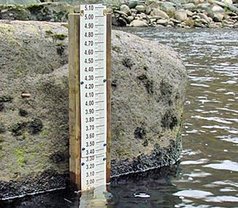
STAGE
Elevation of surface of water above an arbitrary datum
River stage is an important concept when analyzing how much water is moving in a stream at any given moment
A record of stream stage is useful in itself for designing bridges, embankments, levees, and other structures affected by stream elevations, or in planning for the use of flood plains

Slide 8
STAGE
Datum of the gauge might be a recognized datum such as North American Vertical Datum of 1988 (NAVD 88) or an arbitrary datum.
Sometimes datum is taken as Mean Sea Level (MSL)
Select the arbitrary datum plane for a stream gauging site to avoid negative values of gage height. This requires the arbitrary datum plane to be below the lowest expected gage height, which will be at, or below, the elevation of zero flow on the control for all conditions.
For each gauging station, maintain a permanent datum that has at least three permanent reference marks that are independent of the gage structure
The gauge datum may need to be changed if there is excessive channel scour or a manmade channel change

Slide 9
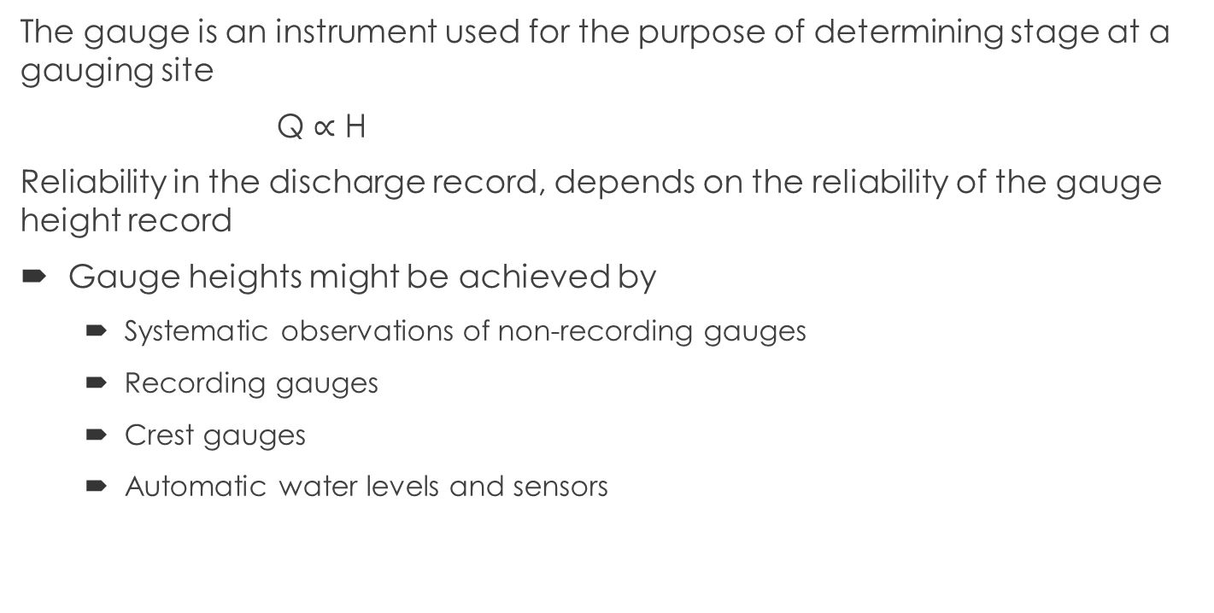
STAGE MEASUREMENTS
The gauge is an instrument used for the purpose of determining stage at a gauging site
Q $∝$ H
Reliability in the discharge record, depends on the reliability of the gauge height record
Gauge heights might be achieved by
  Systematic observations of non-recording gauges
  Recording gauges
  Crest gauges
  Automatic water levels and sensors

Slide 10
NON-RECORDING/MANUAL GAUGES
A few non-recording gauges are as follows:
Staff Gauge
Wire-weight Gauge
Float type gauge
Electronic Tape Gauge

Slide 11
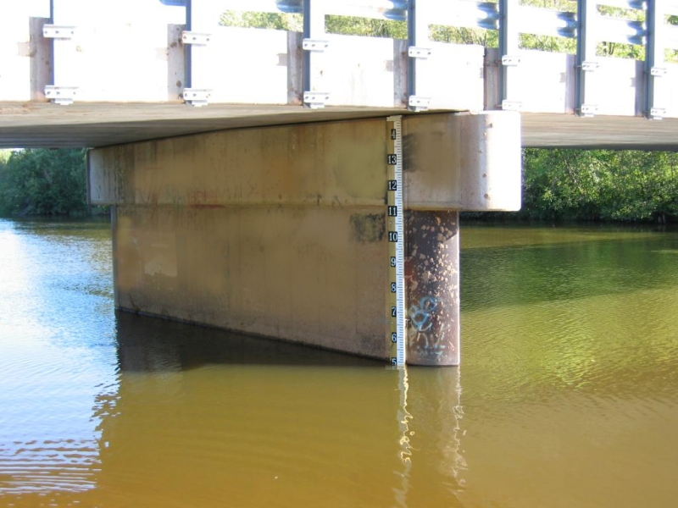
MANUAL/NON-RECORDING STAGE GAUGES
Staff Gauge:
  Simplest method to measure stage
  This is a scale set so as a portion of it is always immersed in the water
  The staff gage is either vertical or inclined. The standard USGS vertical-staff gage consists of porcelain-enameled iron sections 4 in. wide and 3.4 ft long and graduated every 0.02 ft
  Gauge may consist of a vertical scale attached to a bridge pier or piling

Slide 12
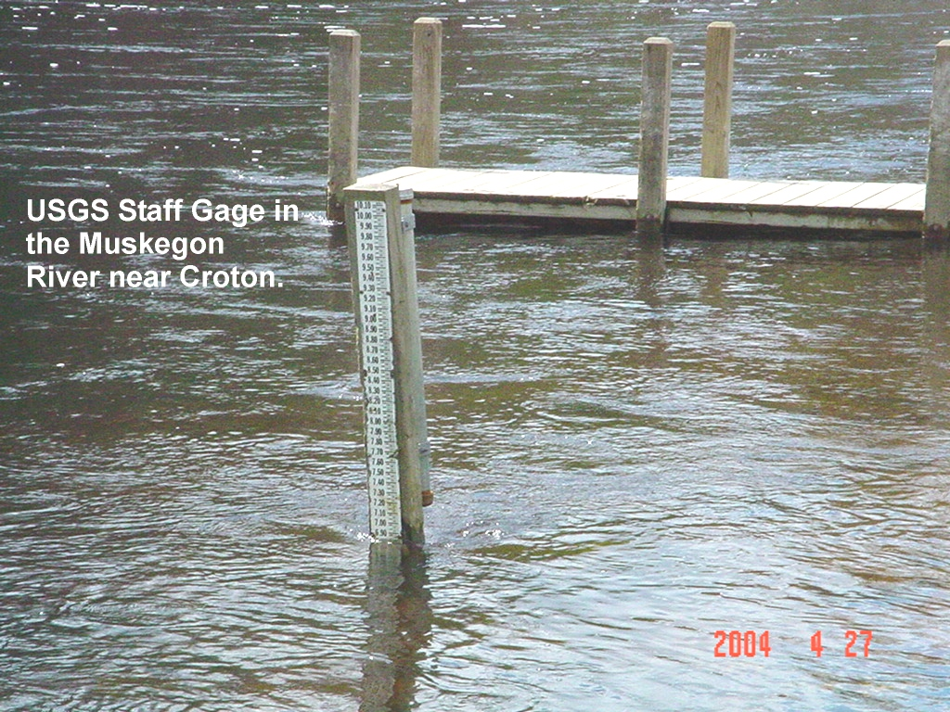

Slide 13
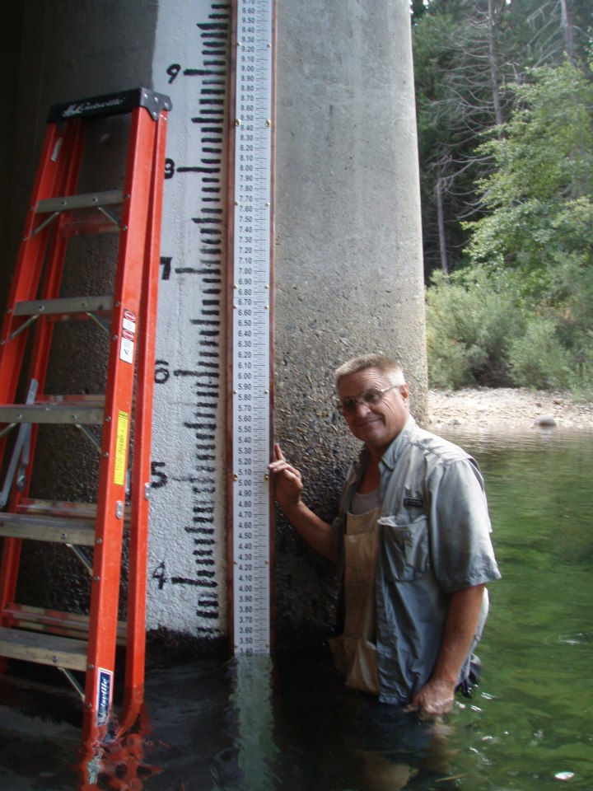
MANUAL/NON-RECORDING STAGE GAUGES
Gauge scale may be printed on the existing structure or on special gauge boards

Slide 14
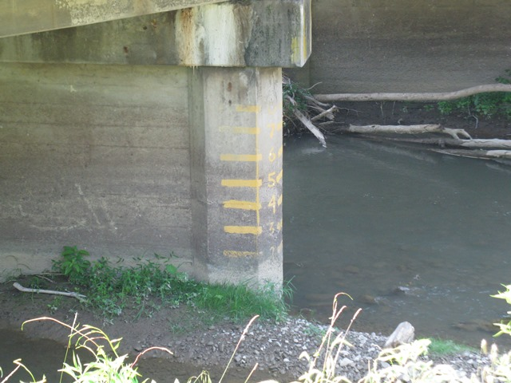
MANUAL/NON-RECORDING STAGE GAUGES
Gauge scale may be printed on the existing structure or on special gauge boards

Slide 15
MANUAL/NON-RECORDING STAGE GAUGES
An inclined staff gage is used for an outside gage and usually consists of a graduated heavy timber securely attached to a permanent foundation

Slide 16
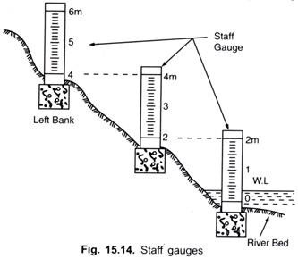
MANUAL/NON-RECORDING STAGE GAUGES
If no suitable Structure is present on site then sectional gauging may be used

Slide 17
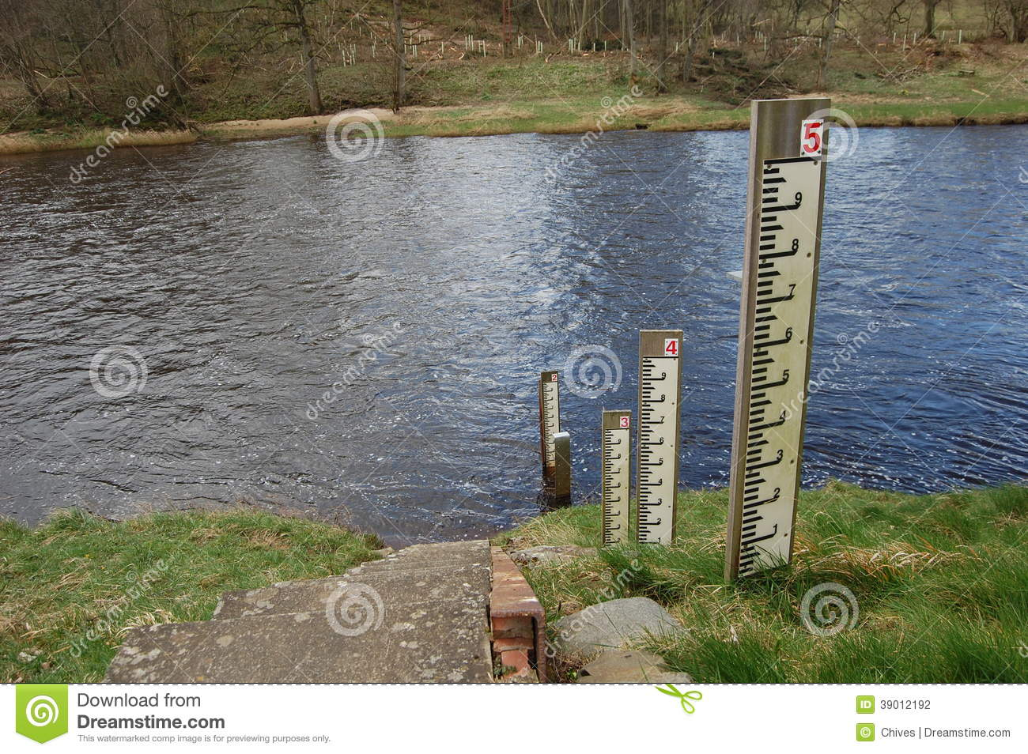

Slide 18
MANUAL/NON-RECORDING STAGE GAUGES
When there is possibility of silt or mud, staff with raised graduations is preferred
During normal flow season, the gauge is read from 06:00 to 16:00 daily
In flood continuous record is obtained

Slide 19
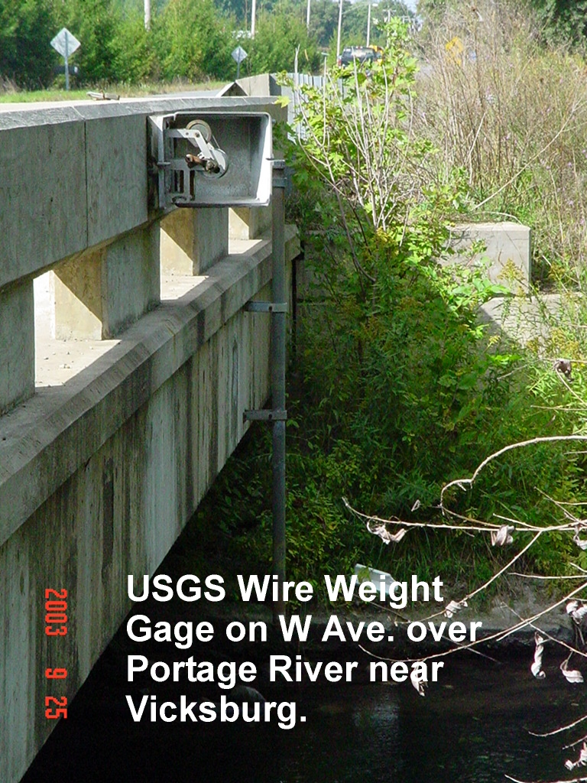
MANUAL/NON-RECORDING STAGE GAUGES
Wire Weight Gauge:
Canfield wire weight gauge
Type- A wire weight Gauge
  The type A wire-weight gage is usually attached to a bridge handrail and is generally used as an outside auxiliary gage.
  At some sites it is used as a reference gage.

Slide 20
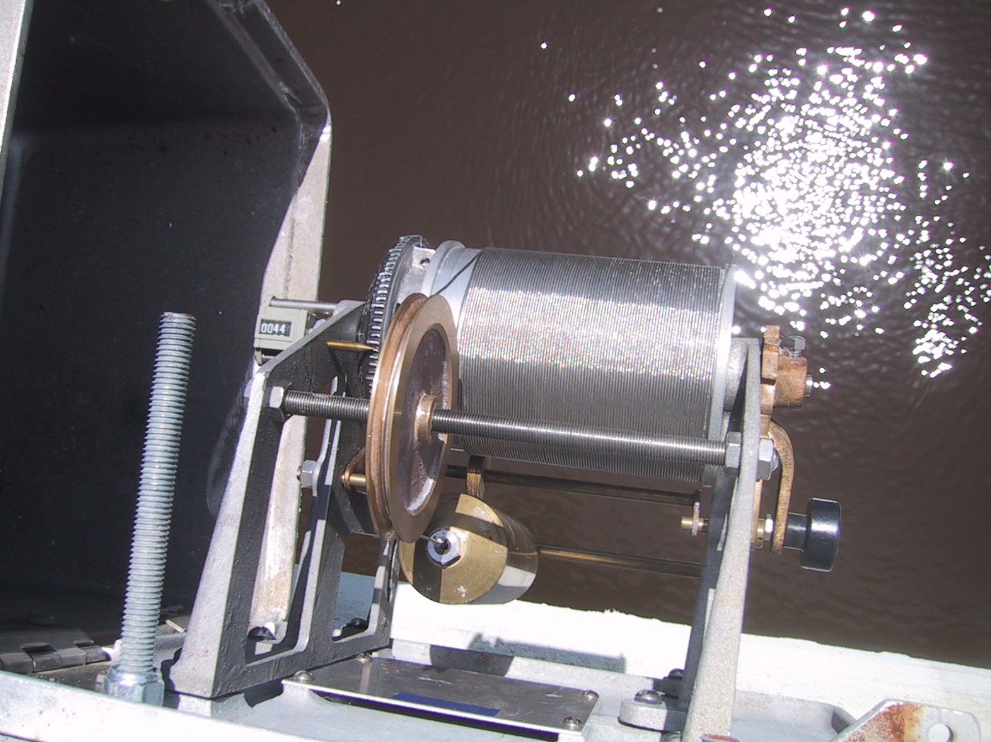

Slide 21
MANUAL/NON-RECORDING STAGE GAUGES
Wire Weight Gauge:
  A type A wire-weight gage consists of a drum wound with a single layer of stainless steel 0.045 inch cable, a bronze weight attached to the end of the cable, a graduated disc, and a counter, all within a cast-aluminum box
  Disc is graduated in tenths & hundreds of a foot
  Circumference of the reel is adjusted so that one revolution covers 1ft of wire length
  No. of revolutions are counted using the counter

Slide 22
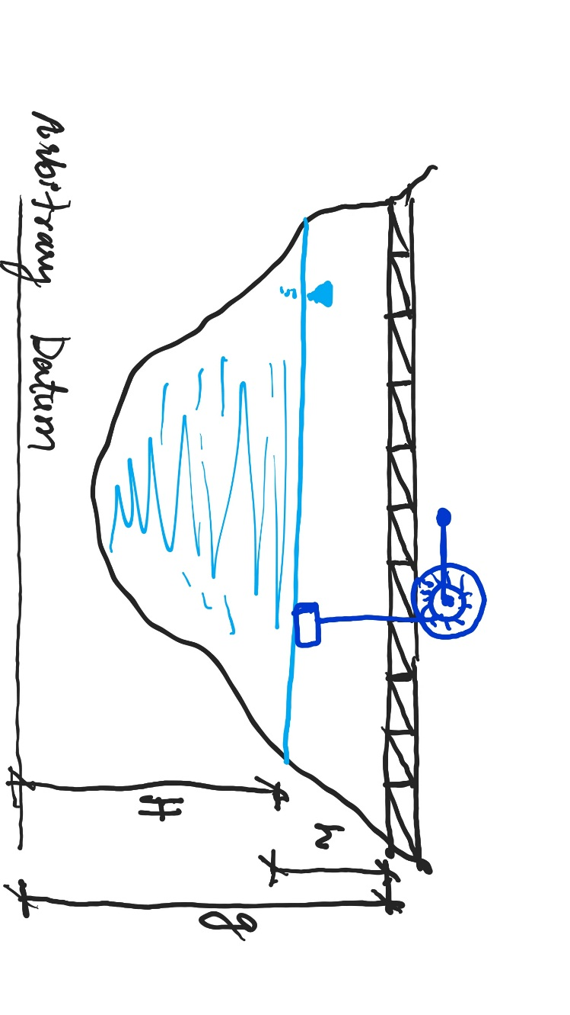
MANUAL/NON-RECORDING STAGE GAUGES
Wire Weight Gauge:
  Disk is permanently connected to the counter
  Weight is lowered from a bridge or other overhead structure until it reaches water surface
  Reading is taken when the bronze weight touches the surface of water
  Gauge is usually fixed on some girder or bridge
  By subtracting the length of the line paid out from the elevation of a fixed reference point on the structure water surface elevation can be determined
  H = g-h

Slide 23
MANUAL/NON-RECORDING STAGE GAUGES
Wire Weight Gauge:
  A cantilevered wire-weight gage is sometimes used where outside staff gages are hard to maintain and where a bridge, dock, or other structure over the water is not available for the location of a wire-weight gage.

Slide 24
MANUAL/NON-RECORDING STAGE GAUGES
Float Type Gauge:
  Installed in stilling well to avoid waves effects
  The gauge consists of a graduated steel tape, counter weight and pulley
  As the water level rises, float rises and needle moves on the counter
Dial
Pulley
Stream/Channel
Counterweight
Float
Intake Pipe
Stilling Well

Slide 25
MANUAL/NON-RECORDING STAGE GAUGES
Float Type Gauge:

Slide 26
MANUAL/NON-RECORDING STAGE GAUGES
V
V
Electronic Tape Gauge:
  It consists of a steel tape graduated in feet , a cylindrical weight, a reel for the tape, a battery, a voltmeter
  One terminal of the battery is attached to the ground connection and the other terminal to voltmeter
  Other terminal of the voltmeter is connected through the frame reel to tape and weight
  The weight is lowered until it contacts the water surface, this contact completes the electric circuit and produces a signal on voltmeter
  The tape reading is then taken
Tape
Ground
Circuit Diagram
Weight
Volt Meter
Reel
Tape
Counterweight
Weight
Schematic Sketch

Slide 27
MANUAL/NON-RECORDING STAGE GAUGES
Electronic Tape Gauge:

Slide 28
RECORDING GAUGES
Float type Gauge:
  Manual gauges are simple and inexpensive but must be read frequently to define rating curve accurately when stage is changing
  This gauge produces a continuous graphic record
  A float generally housed in a stilling well with a shelter over it
  Float rises with rise of water surface in the well which is actually the stage in the stream or channel
  With this float is attached a pointer which moves on a barrel
  Barrel revolves with clock driven mechanism and has a chart pasted on it

Slide 29
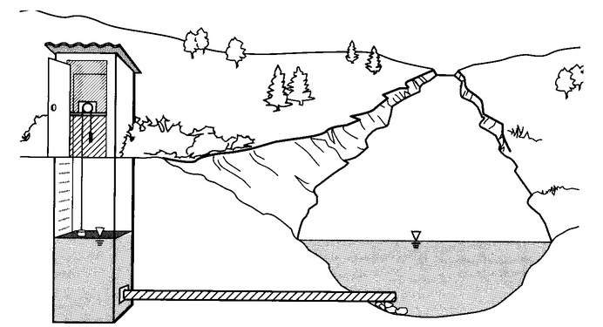
RECORDING GAUGES

Slide 30
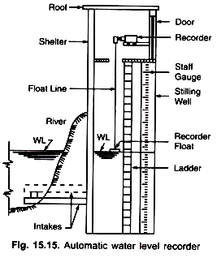
RECORDING GAUGES
Stream and reservoir gages require some type of instrument shelter, and in the case of gages that use float sensors, they also require a stilling well
The stilling well protects the float and dampens the fluctuations in the stream caused by wind and turbulence,
Stilling wells also protect the gauges from floating debris
Stilling wells are made of concrete, reinforced concrete, concrete block, concrete pipe, corrugated-galvanized-steel pipe, aluminum pipe, PVC pipe and occasionally wood

Slide 31
RECORDING GAUGES
The stilling well should be deep enough for its bottom to be at least a foot below the minimum stage anticipated
Its height should be enough to accommodate a flood of frequency 1 in 50 years
The open bottom type stilling well has the advantage of being less likely to fill with sediments

Slide 32
RECORDING GAUGES
Reinforced concrete stilling well

Slide 33
RECORDING GAUGES
Generally two or more intake pipes are places from stilling well into the stream
Intake should be 0.5’ lower than the lowest expected stage and 5’ above the bottom of stilling well to prevent silt buildup
It is customary to install gauges inside and outside the well to check the performance of recorder

Slide 34
CREST STAGE GAUGES
Crest stage gauge is simple, economical ,reliable and easily installed device for obtaining the elevation of the flood crest of streams
This gage is low cost solution for supplementary record keeping or in situations where recorders are not justified economically or where manual gauges are inadequate
Many different types of crest-stage gages have been tested, the most functional one is a vertical piece of 2 inches galvanized pipe containing a wood or aluminum staff held in a fixed position with relation to a datum reference.

Slide 35
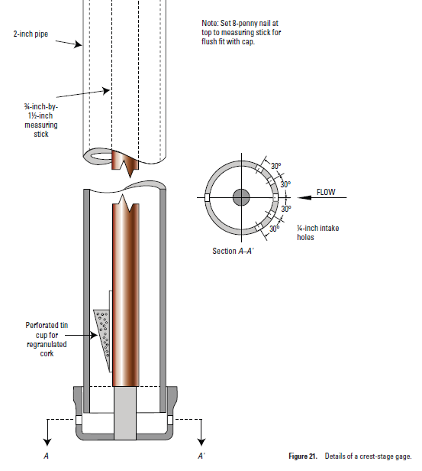
CREST STAGE GAUGES
Small amount of ground cork is placed in perforated cup
As the water level rises in the pipe cork floats with the water and adheres to the staff at the highest level
The staff can be removed and the crest reading is recorded
Cork is then wiped off and staff is ready to be replaced in the pipe

Slide 36
CREST STAGE GAUGES
Pipe Cap
Brackets
Graduated Staff that fits inside the pipe
Culvert Wall
Holes to admit water
Pipe Cap
Crest-stage Gauge Assembly

