Slide 1
Wedge Failure
It is concerned with slopes containing discontinuities striking obliquely to the slope face where sliding of a wedge of rock takes place along the line of intersection of two such planes.
Wedge failures can occur over a much wider range of geologic and geometric conditions than plane failures.
Figure 1 shows a typical wedge failure involving sliding on two persistent joints with line of intersection of joints day lighting at toe of rock face, and an upper plane that formed a tension crack.

Slide 2
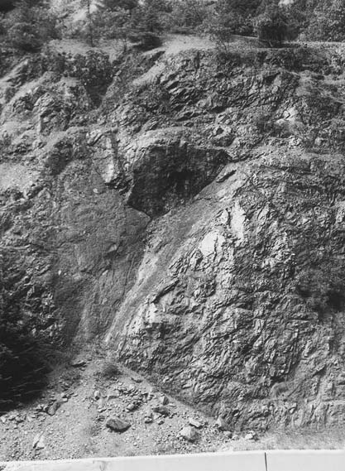

Slide 3
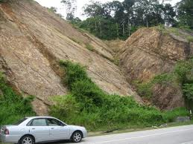
Wedge Failure

Slide 4
Conditions
There are three conditions of Wedge Failure:
Two planes will always intersect in a line.
The dip (plunge) of the line of intersection must be ﬂatter than the dip of the face, and steeper than the average friction angle of the two slide planes, that is ψ_{fi} >ψ_{i} >φ .
The line of intersection must dip in a direction out of the face for sliding to be feasible.

Slide 5
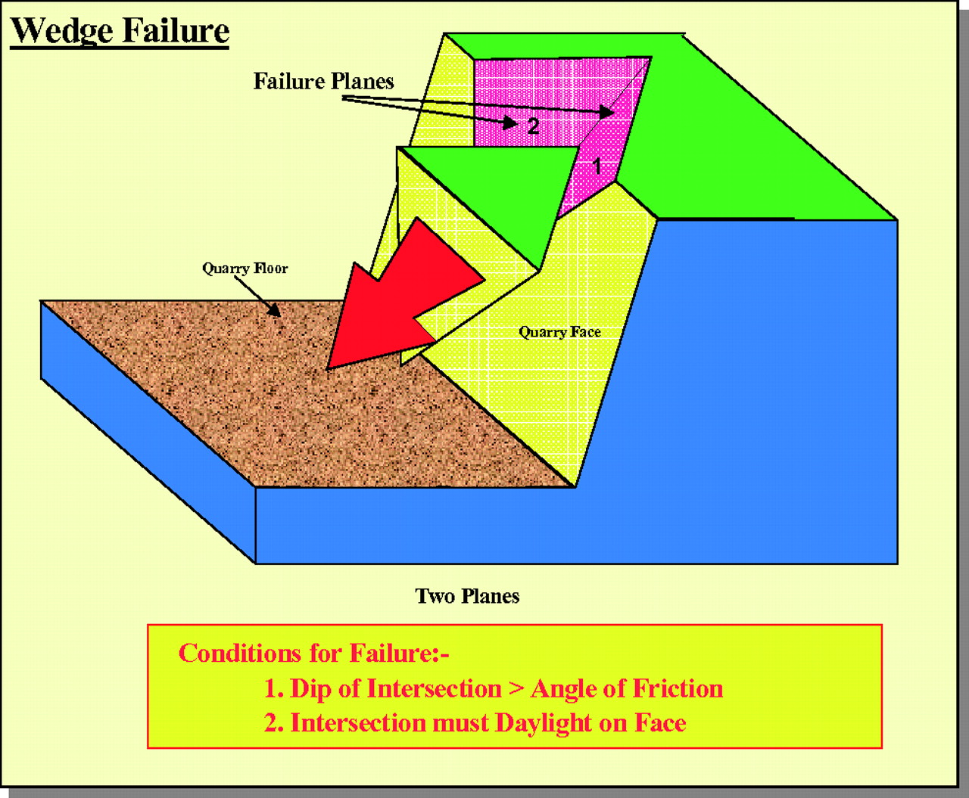

Slide 6
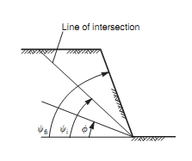
View of slope at right angles to the line of intersection

Slide 7

The dip direction (trend) α_{i} and dip (plunge) ψ_{i} of the line of intersection of planes A and B can be determined by using the following equations
where α_{A} and α_{B} are the dip directions, and ψ_{A} and ψ_{B} are the dips of the two planes. First equation gives two solutions 180◦ apart; the correct value lies between α_{A} and α_{B}.

Slide 8
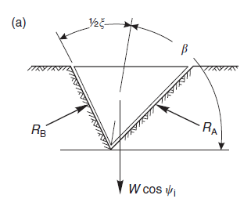

Analysis of wedge failure
View of wedge looking at face showing deﬁnition of Angle of tilt(β) and Included angle of wedge(ξ), and reactions on sliding planes R_{A} and R_{B.}

Slide 9
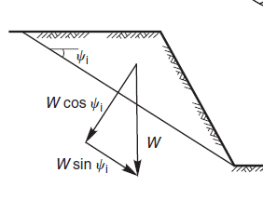
Cross-section of wedge showing resolution of wedge weight W.

Slide 10

The factor of safety of the wedge deﬁned in Figures,
assuming that sliding is resisted only by friction and
that the friction angle φ is the same for both planes
is given by,
where R_{A} and R_{B} are the normal reactions provided by planes A and B and the component of the weight acting down the line of intersection is (W sin ψ_{i}). The forces R_{A} and R_{B} are found by resolving them into components normal and parallel to the direction along the line of intersection.

Slide 11
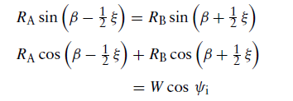
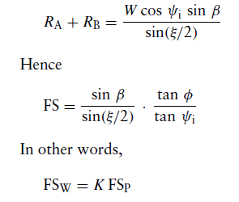

In order to meet the conditions for equilibrium, the normal
components of the reactions are equal and the sum of the
parallel components equals the component of the weight acting into the line of intersection.
By solving and adding, we get

Slide 12
Where FS_{W} is the factor of safety of a wedge supported by friction only, and FS_{P} is the factor of safety of a plane failure in which the slide plane, with friction angle φ, dips at the same angle as the line of intersection ψ_{i}.
K is the wedge factor that depends upon the included angle of the wedge ξ and the angle of tilt β of the wedge. Values for the wedge factor K, for a range of values of ξ and β are plotted in next Figure.

Slide 13
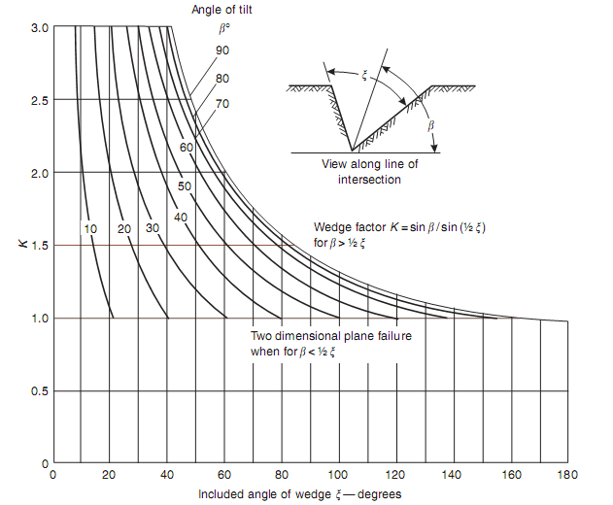
Wedge factor K as a function of wedge geometry.

