Slide 1
M.Sc Structural Engineering
Subject: Reinforced Concrete Structures
Teacher Incharge: Prof. Dr. Asad Ullah Qazi
email: asad.qazi@uet.edu.pk
asadullahqazi@gmail.com
Cell # 0332-4267664

Slide 2
Reinforced Concrete Structures
Text Books
  Design of Concrete Structures (13th Edition)
  by Arthur H. Nilson, David Darwin & Charles W. Dolan
  Concrete Structures Part I & II by Prof. Dr. Zahid Ahmed Siddiqui
References
  Reinforced Concrete Mechanics and Design (6th Edition) by James G. Macgregor
  Reinforced Concrete (5th Edition) by Edward G. Nawy
  Reinforced Concrete Design by Ferguson, SI Edition
  Wind and Earthquake Resistant Buildings by Bungale S. Taranath
  Building Code Requirements for Structural Concrete (ACI 318-14)
  UBC 1997 or ASCE-7
  Notes on ACI, Portland Cement Association, Latest

Slide 3
Reinforced Concrete Structures
Topics to be covered
Basic Concepts of Flexural Design
Codes, Standards and Specifications
Gravity and Lateral Loads
Preliminary Analysis and Proportioning of Frame Structures
Load Combinations
Pattern Loading
Moment and Shear Envelops

Slide 4
Reinforced Concrete Structures
Bond, Development Lengths and Bar Cutoffs
Uniaxial and Biaxial Bending of Columns
Slender Columns, Moment Magnification for Sway and Braced Columns
Torsion, Equilibrium and Compatibility Torsion
Yield Line Theory for Analysis of Slabs
Direct Design Method and Equivalent Frame Method for Two Way Slab Design

Slide 5
Reinforced Concrete Structures
Strip Method for Slab Design
Moment Curvature Relationships
Load Displacement Relationships
Moment Redistribution
Introduction to Section, Member and Structure Ductility
Design of Reinforcements at Joints
Detailing of Seismic Resistance
Design of Raft Foundation

Slide 6
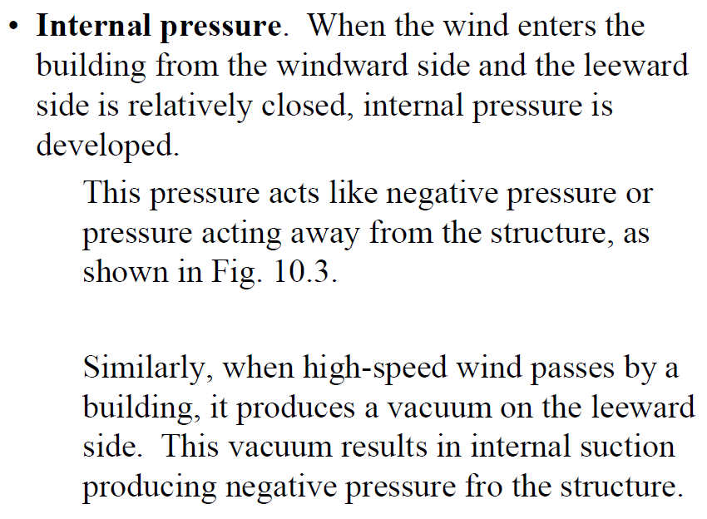
or

Slide 7
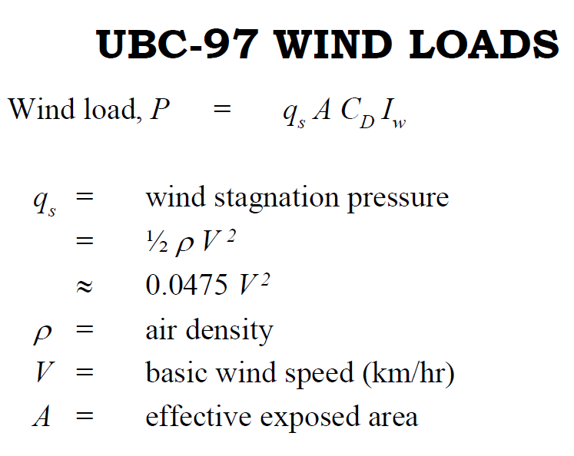
q_{s} = Dynamic pressure is kinetic energy per unit volume
of a fluid
Kinetic Energy per unit volume
½ mv² /volume = kg (m/sec)²/m³ = kg/(m.sec²) = kg/(m.sec²).(m/m) = (kg.m/sec²)/m² = N/m²
At sea level and at 15 °C air has a density of
approximately 1.225 kg/m³

Slide 8
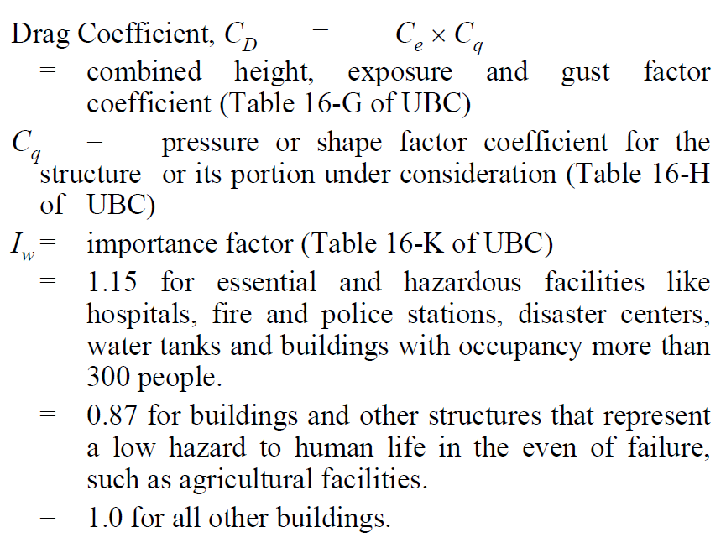
C_{e}
t

