Slide 1

TERMS TO KNOW
SECTIONAL DETAILS

Slide 2
PLAIN CEMENT CONCRETE
The intimate mixture of cement, sand, coarse aggregate (jelly) and water is known as plain cement concrete.
A small quantities of admixtures like air entraining agents, water proofing agents, workability agents may also be added to impart special properties to the plain cement concrete.

Slide 3
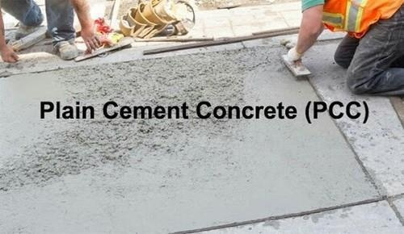
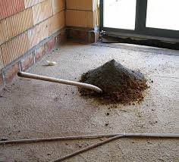

Slide 4
USES OF P.C.C
1. As bed concrete below the wall footings, column footings and on walls below beams.
2. As sill concrete to get a hard and even surface at window and ventilator sills.
3. As coping concrete over the parapet and compound walls.
4. For flagging the area around the buildings.
5. For making pavements.
6. For making tennis courts, basket ball courts etc.

Slide 5
REINFORCED CEMENT CONCRETE
Concrete is good in resisting compressive stress but is very weak in resisting tensile stresses.
Hence reinforcement is provided in the concrete wherever tensile stress is expected.
The best reinforcing material is steel, since its tensile strength is high and bond between steel and concrete is good.
Since elastic modulus of steel is quite high compared to concrete, the force developed in steel is high.
A cage of reinforcements is prepared as per the design requirements, kept in the form work and then green concrete is poured.
After the concrete hardens, the form work is removed. The composite material of steel and concrete, now called R.C.C. acts as a structural member and can resist tensile as well as compressive forces efficiently.

Slide 6
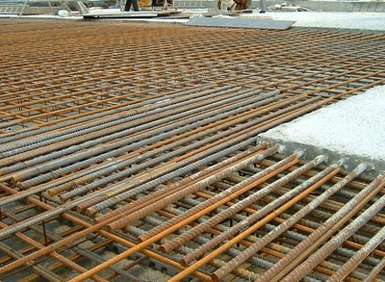
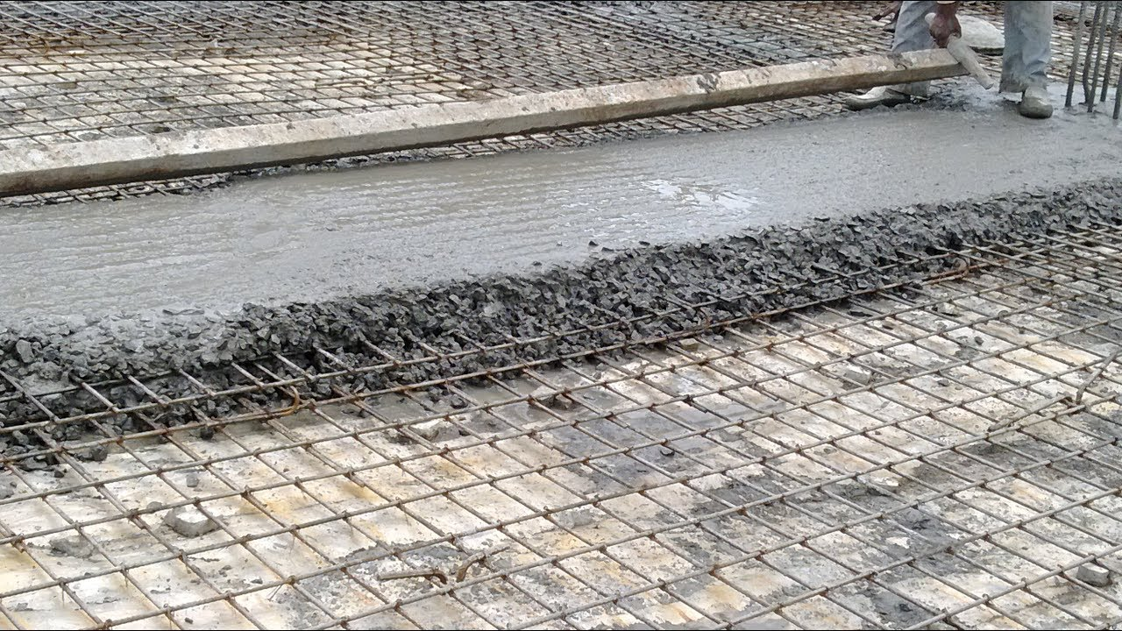

Slide 7
USES OF R.C.C
1. R.C.C. is used as a structural member wherever bending of the member is expected. The common structural elements in a building where R.C.C. is used are:
(a) Footing
(b) Columns
(c) Beams, lintels
(d) Chejjas, roof slabs
(e) Stairs.
2. R.C.C. is used for the construction of storage structures like:
(a) Water tanks
(b) Dams
(c) Silos, bunkers

Slide 8
They are used for the construction of
(a) Bridges
(b) Retaining walls
(c) Docks and harbours
(d) Under water structures
4. R.C.C. is used for building tall structures like
(a) Multistorey buildings
(b) Chimneys
(c) Towers.
5. R.C.C. is used for paving
(a) High ways
(b) City roads
(c) Airports.
6.R.C.C. is used in atomic plants to prevent radiation. For this purpose R.C.C. walls built
are as thick as 1.5 m to 2.0 m.

Slide 9
Plinth Level
The level at which Substructure ends and superstructure starts is called Plinth level.
It is the part of the superstructure between natural ground level and Finished floor level. the plinth is provided to restrict the seepage of storm water and rainwater into the building.

Slide 10
Damp proof course (DPC) is laid on Plinth level. The purpose of applying DPC is to restrict the movement of moisture through walls and floors.

Slide 11
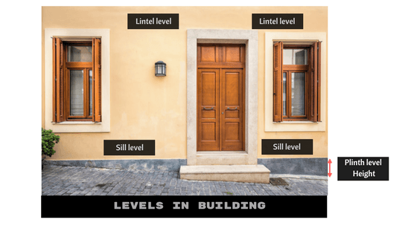

Slide 12
Sill level or Window Sill level
The level between the base portion of the window and portion of the floor above ground level (upwards) is called Sill level.
Mortar bed or concrete bed is laid at the base of the window.
It is recommended that the minimum sill level height of 44 inches

Slide 13
Lintel level
The level between the top portion of the window and top slab is called Lintel level.
The potion above the Door lintel or Window lintel is called Lintel level.
Lintel is provided above the door and window to transfer the upward wall load to the surrounding wall.
Lintel is generally made up of Reinforced concrete or cement mortar.

Slide 14
Natural ground level (N.G.L)
Natural ground level is termed as Level of the ground.
The height of Natural ground level (NGL) is generally measured with Mean-sea level.

Slide 15
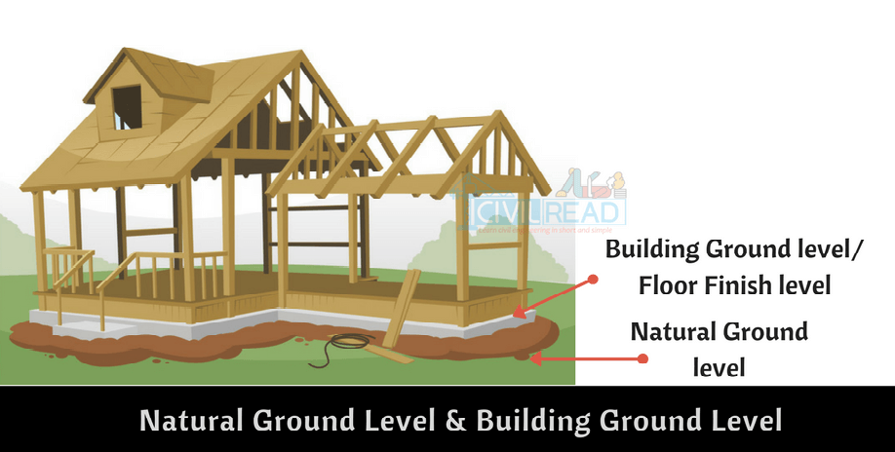

Slide 16
Building ground level (B.G.L) / Finish floor level (F.F.L)
The ground level inside building is called Building Ground level or Floor Finish level.
This level is at the height of minimum 150mm – 450mm from the Natural ground level (N.G.L).
The reason for raising building height is to restrict the entry of water during storms and rainfall.
The height may go upto meters if the building located in slope and heavy rainfall areas.

Slide 17
