Slide 1

Building Plans

Slide 2
Contents
Plan
Floor Plan
Basic Components of floor plan
Architectural Symbols
Factors must be Considered in Zoning
Standard Dimensions of plots in Lahore
Recommended Sizes of Floor Plan Components
Steps involved in creating plans

Slide 3
Plan
Plan of building represents a horizontal section of building at given height seen from top.
It is a general convention to imagine that the building has been cut down by a horizontal plan at the sill level of the window and is seen from the top after removal of the so cut part.
The plan shows that arrangement of rooms, verandah, or corridor, position of door, and window and other opening along with their respective sizes.

Slide 4
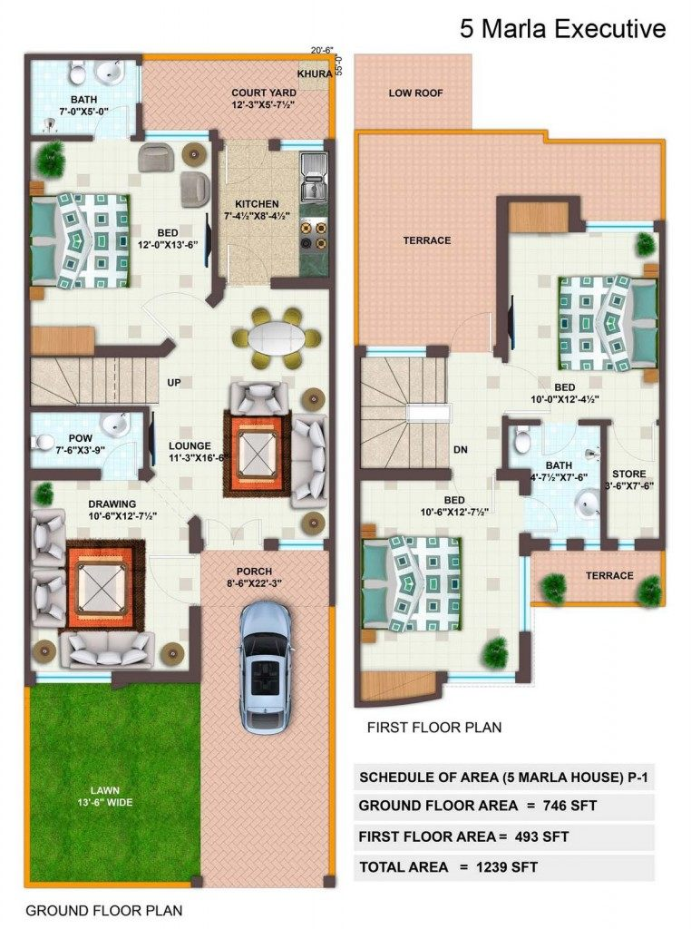
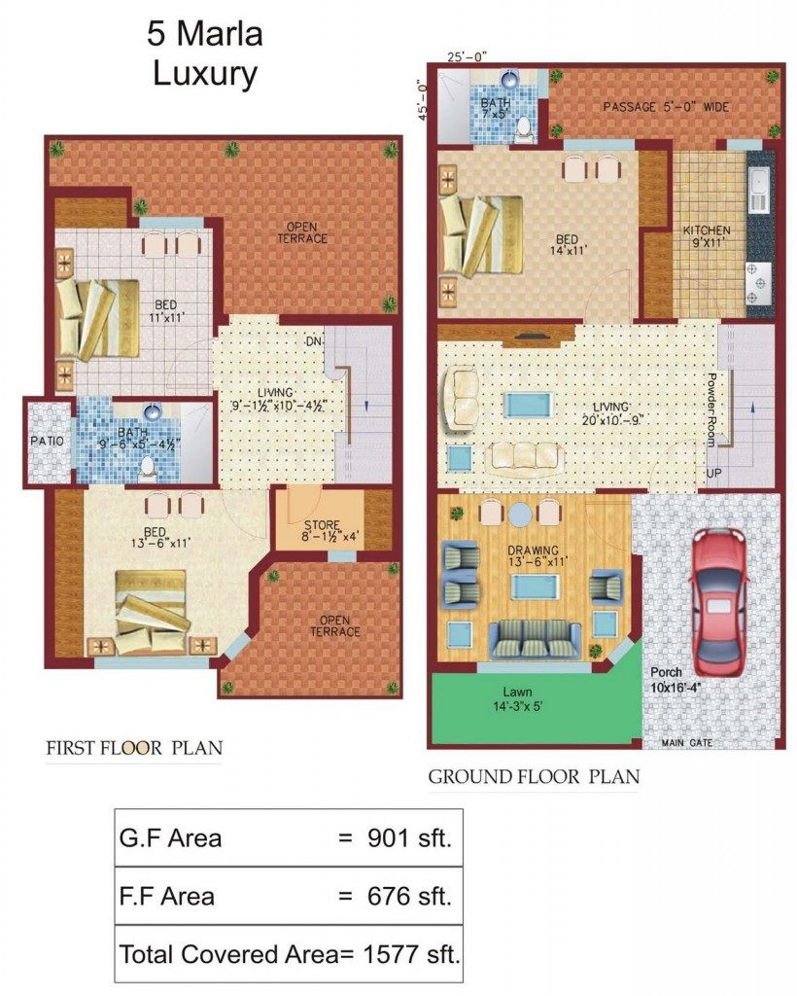

Slide 5

How do you know what to build?
All construction begins with plans:
Floor Plan
Elevation Plan
Plot Plan
Cross Section

Slide 6
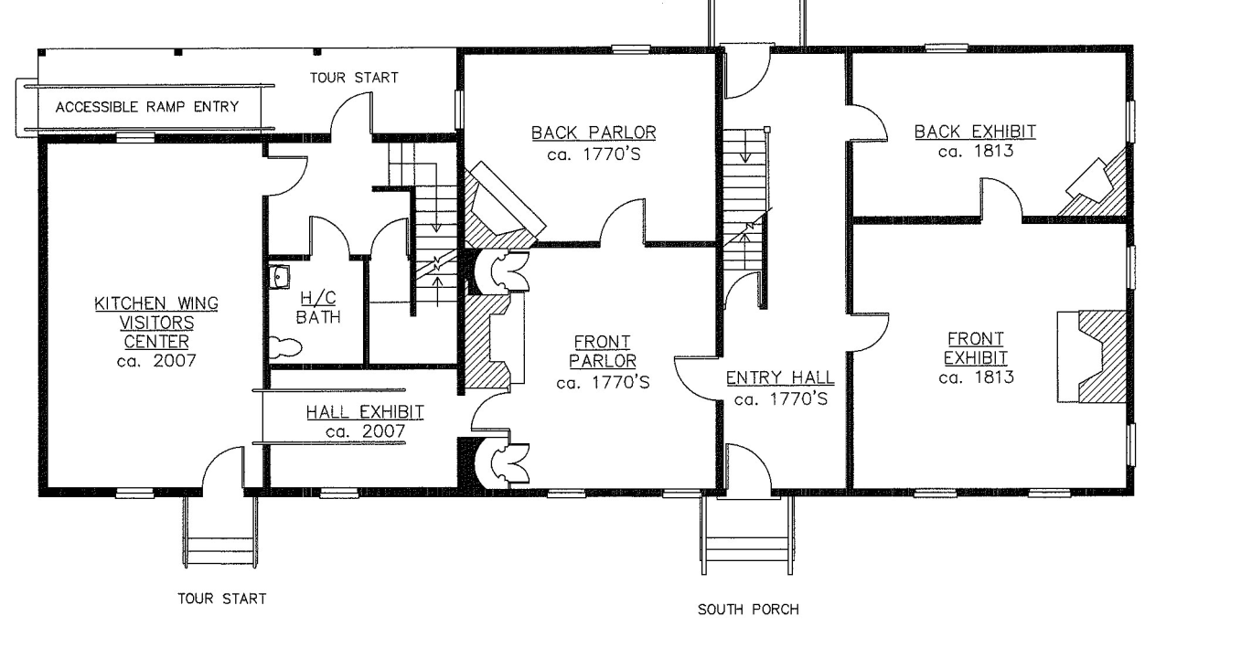
What is a Floor Plan?
Shows the layout of the house from above
Floor plans can show:
Rooms & sizes
Doors & Windows
Staircase
Electrical
Plumbing
Mechanical

Slide 7
Basic Components of Floor Plan
Bedrooms with attach bath
Kitchen
Drawing Room
Living Room
Car Porch
Staircase
Store Room

Slide 8

ORIENTATION OF BUILDINGS
Building orientation refers to the way a building is situated on a site and the positioning of windows, rooflines, and other features, it depends upon
Surrounding of site
Proximity of a road or street
Sun’s path
Direction of wind
Character and intensity of rain

Slide 9




N
NW
NE
LESS SUN
W
SUN SET
SUN RISE
KITCHENS
E
VERANDAHS
SUN ALL AROUND THE YEAR
BED ROOMS
DINING ROOMS
SW
DRAWING AND
LIVING ROOMS
SE
S

Slide 10
Architectural Symbols

Slide 11
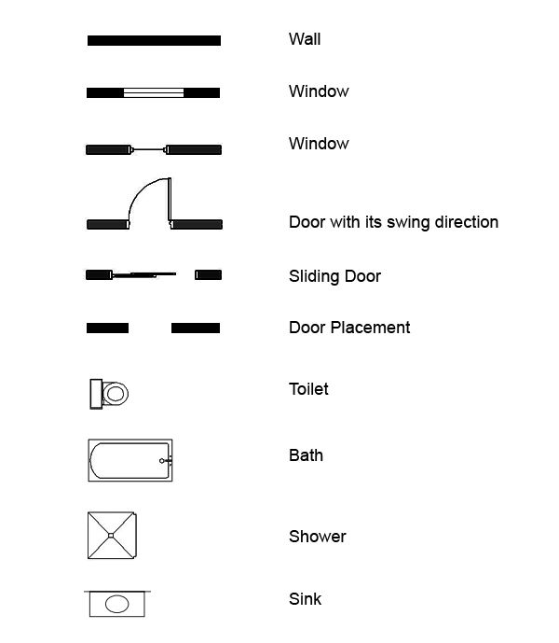

Slide 12
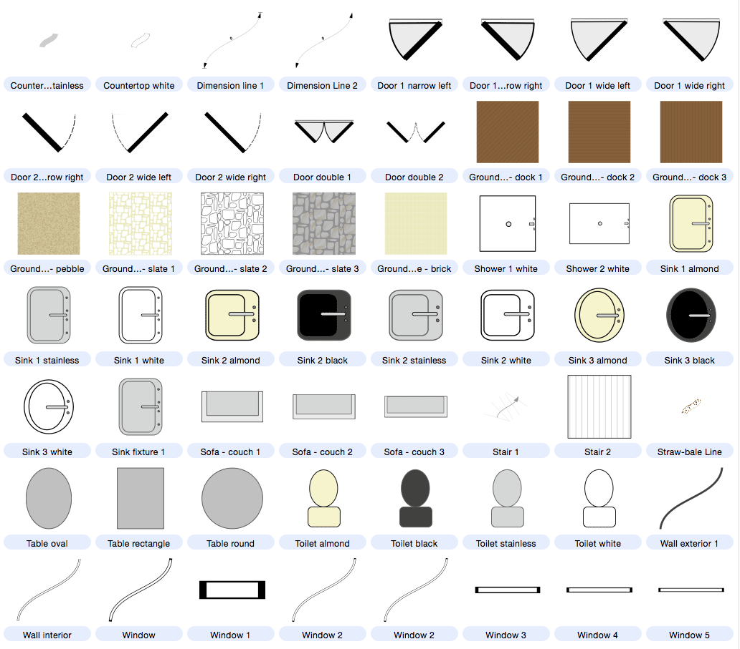

Slide 13
Factors must be Considered in Zoning
The drawing must have attach bathroom for the guests.
The privacy of bed rooms must be ensured.
The ventilation must be ensured by placing windows and patios.
The kitchen can not be placed with bath room.
The placement of kitchen must be carefully placed to ensure the proper ventilation.
The doors must not be parallel to each other because the opening of one door can disturb the privacy of house.

