Slide 1
Khasra Plan

Slide 2
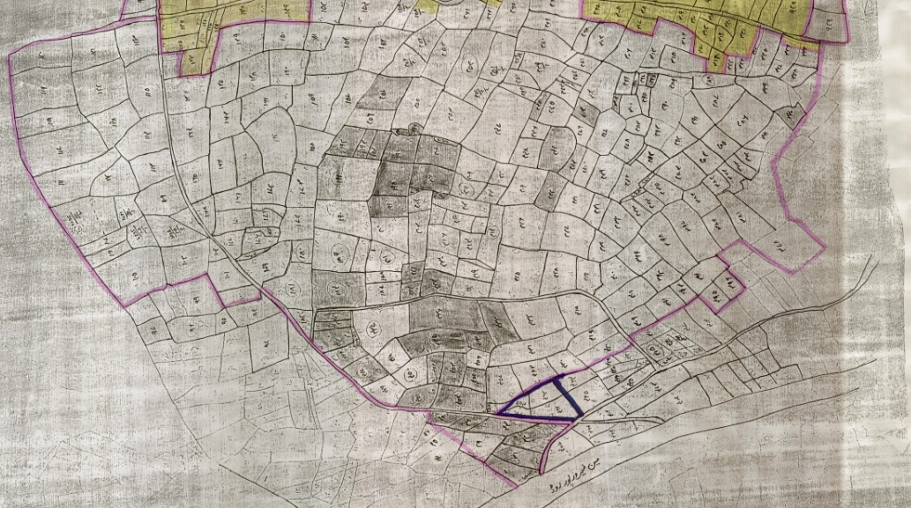
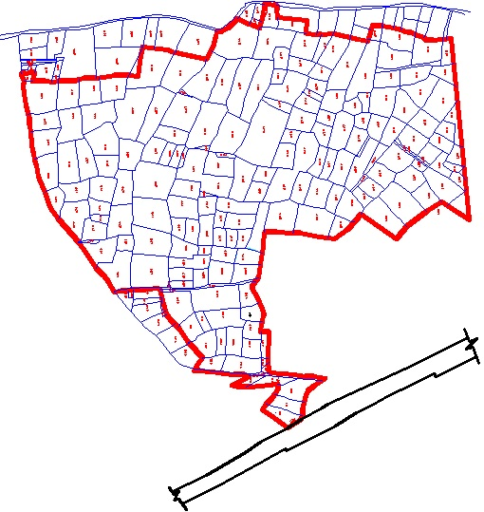
ACQUIREING KHASRA PLAN
Draw a boundary on khasra plan and include all the land you want to acquire for project.
Digitize khasra plan in order to calculate tentative area.

Slide 3
TYPES OF KHASRA PLAN
Istemal Shuda
  No fix size of individual khasra
  Digitization gives an idea of area

Slide 4
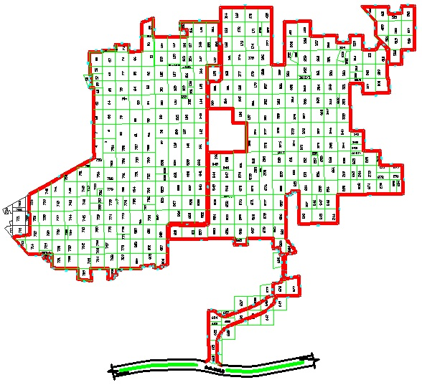
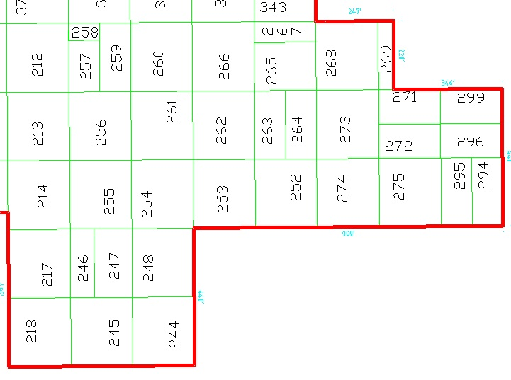
TYPES OF KHASRA PLAN (Cont…)
2. Kishtwar
  Proper Muraba Bandi
  Regular Size Khasra (one acre)

