Slide 1
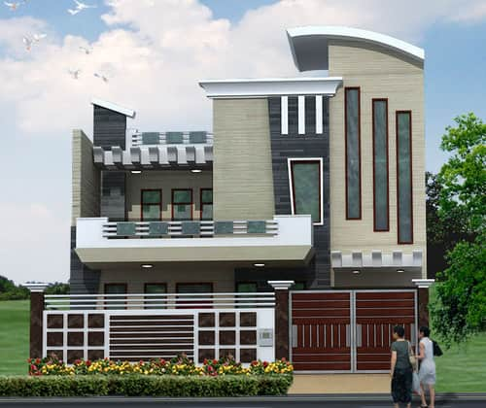
RESIDENTIAL ARCHITECTURE
Instructor:
Syed Arif Hussain

Slide 2
What are Cross Sections?
Cross section drawings show views of the home as though you had sliced down through the house from the top with a saw and looked in from the resulting opening.
The more complex the home design, the more cross sections you should provide.
Cross sections also show window details such as dimensions, exact locations with respect to interior walls and their heights relative to the ceiling or floor.

Slide 3
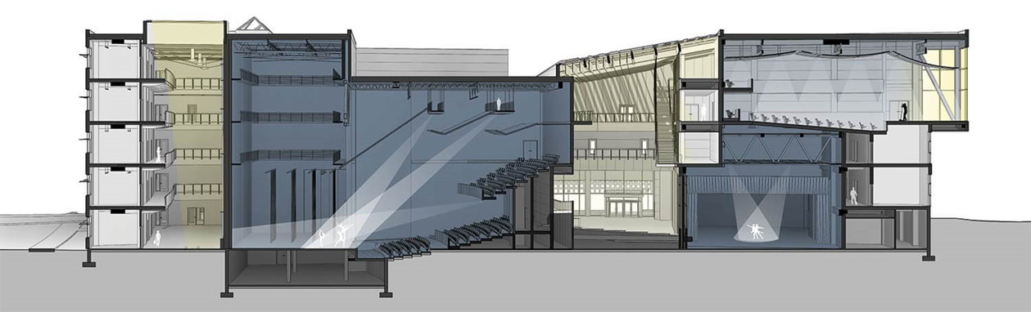
SECTIONS

Slide 4
How Many Cross Sections are Required?
The number of cross sections needed completely depends on the complexity of the design, your planning department requirements and who is building the house.
In general, you should create cross sections for the following:
Structural walls, posts or beams
Stair framing details
Floor and ceiling heights and variances
Cabinetry or custom built furniture
Any other details that will help the builder understand the home design

Slide 5


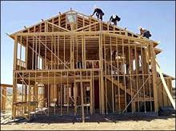
Who needs Sections?
Inspector/Plan check
Contractor
Buyer/Owner
Others???
Sub-Contractors
Truss manufacturer
Engineer

Slide 6
Steps to Drawing a Cross Section
SECTIONS
1. Choose a Cross Section Line
2. Draw the House Envelope
3. Draw Floors and Ceilings
4. Side Wall Windows, Doors and Framing
5. Interior Walls and Structural Elements
6. Facing Wall Windows and Doors
7. Variances in Ceiling or Floor Heights
8. Labeling
9. Add a Title Block

Slide 7
Purpose of Building Sections
SECTIONS
Illustrate type of construction such as foundation types, walls, and roof construction
Give vertical dimensions and provide information about size of structural components
Provide important information about materials and material sizes
Inform contractor or builder of special or unconventional construction methods or techniques
Show specific materials to be used

Slide 8
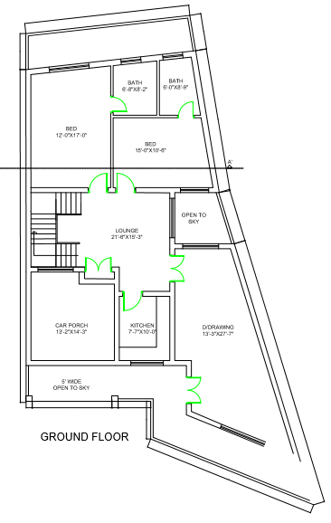

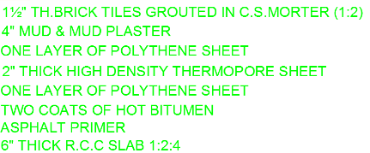
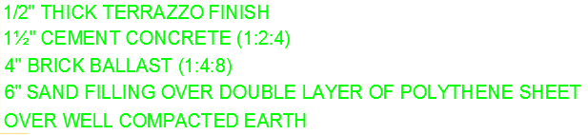
SECTIONS
Draw House Plan
Draw all the visible walls and windows
Draw the Section line
Describe the Roofing Details
Describe the Foundation Details

